Slide 1
Transition cable for TPOT
Takao

Slide 2
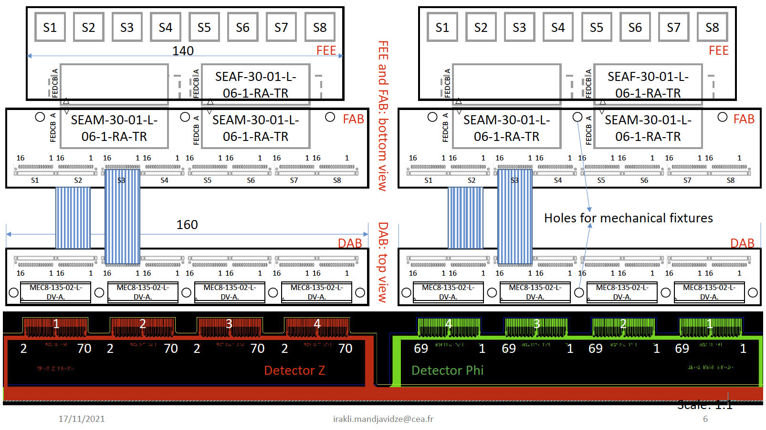
Whole set drawing

Slide 3
FAB (FEE adapter board) side
40mm
(50mm is max)
160mm (170mm is max)

Slide 4
DAB (Detector adapter board) side
13mm
(max)
~5mm

Slide 6
Status and Issues
The design is conceptual. In order to proceed for real design, we need to send a PO to SAMTEC. The quote will be sent to me before the end of this week.
We have to decide today
The size of PCB will be finalized after PCB design is completed. Current concept is a little bigger than I requested.
Irakli pointed out that we should consider the possible detachment of the DAB (detector adaptrr board) due to cable strain. (4 ribbon cable per DAB). Placing a screw to fix the PCB to detector is a good idea, but we need to engineer a bit.
Cable length can be anything. I think ~6cm is enough, since the FAB (FEE adapter board) has 40mm length already.

Slide 7
Backup

