Slide 1
Analysis of Metrology Data
Stephen Pate

Slide 2
Metrology Data Quality Analysis
Compare measured positions of reference marks to design positions: two steps
  Global translation & rotation to best match design positions (“global fit”)
  Local translation & rotation of each wedge, to take into consideration small misplacements (“local fit”)
  The size of local misplacements should be consistent with the mechanical tolerances of holes, screws, etc.
  The residuals remaining after the local misplacements are taken into account should reflect the measurement errors in the CMM.
Compare distances between reference marks to known values; could measure non-flatness of the sensor (i.e., is each sensor parallel to the plane determined by the three survey pins?).

Slide 3
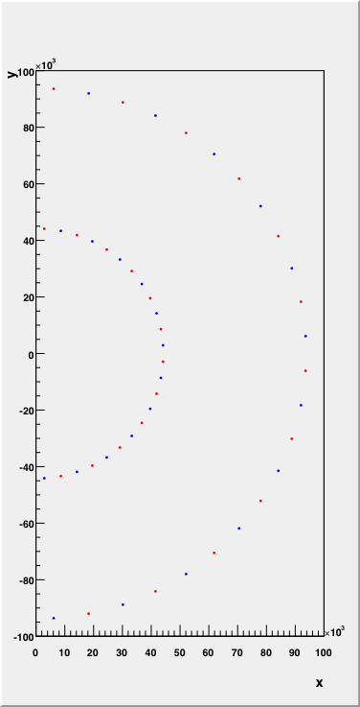
Design Locations
For small disks can only use the two center reference marks
The inner one is located 44000+200=44200 microns from the center
The outer one is located 44000+49785=93785 microns from the center
There are 24 wedges, spaced by 7.5 degrees
Red is upstream
Blue is downstream

Slide 5
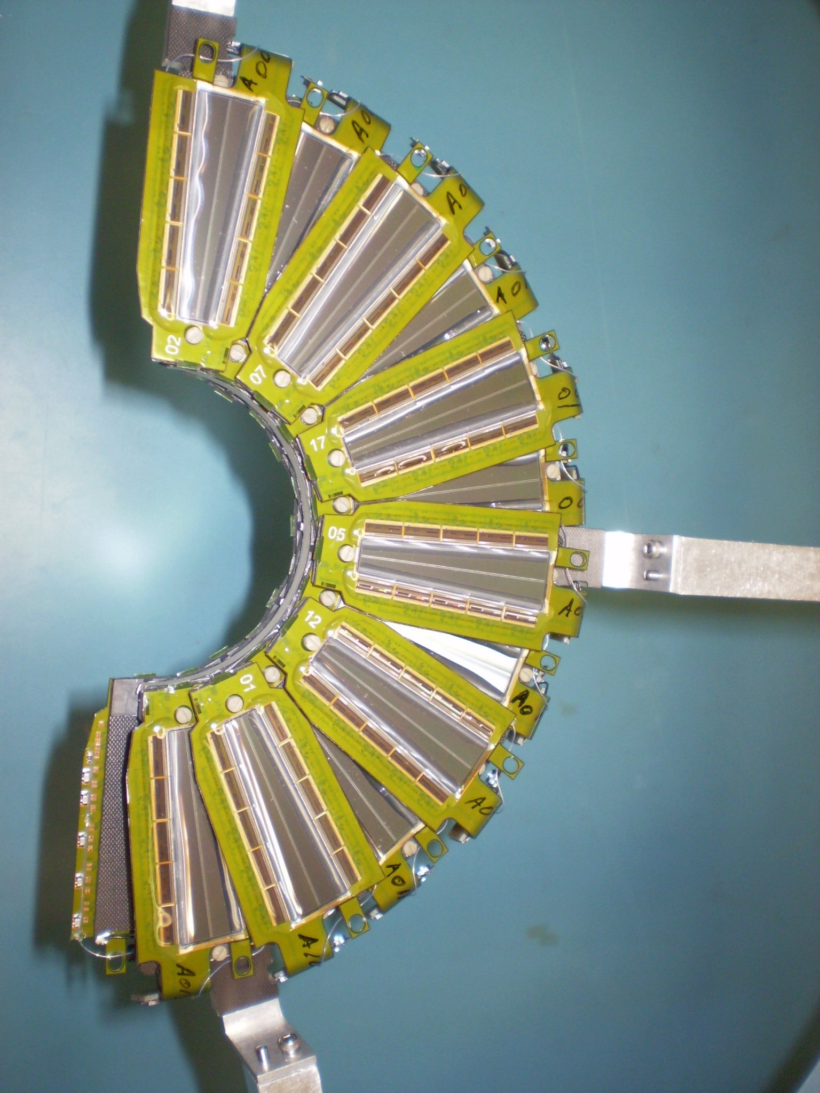

Slide 6
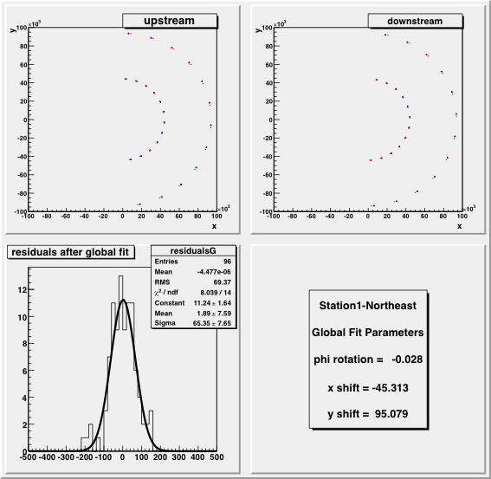
St1NE Global Fit
All of the measured points are rotated and translated together to best fit the design locations.
Blue=design
Red=measurements
Using un-weighted chi-square; I do not assume I know what the CMM errors are yet.

Slide 7
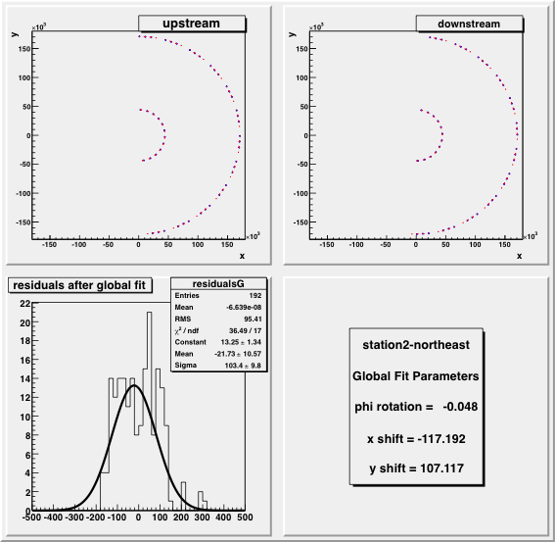
St2NE Global Fit
All of the measured points are rotated and translated together to best fit the design locations.
Blue=design
Red=measurements
Using un-weighted chi-square; I do not assume I know what the CMM errors are yet.

Slide 8
Local Fits
Each measured wedge is now allowed to rotate/translate individually to better fit the design locations. This step directly measures the sizes of “misplacements” that occurred during assembly, as allowed by mechanical tolerances.
Homework: need to analyze all the sources of “misplacements” to determine which ones dominate the observations.
  Placement of sensor on HDI
  Placement of pedestals on HDI
  Tolerance of pinholes on pedestals
  Location of pins on disk

Slide 9
Local Fits for Small Wedges
We are fitting two measured (x,y) locations to two design (x,y) locations, using three parameters; this means the fit has one degree of freedom.
The fit will center the measured reference marks with respect to the design reference marks; that’s the only degree of freedom.
Δx, Δy, φ
24 fits like this are performed.

Slide 10
Local Fits for Large Wedges
We are fitting four measured (x,y) locations to four design (x,y) locations, using three parameters; this means the fit has five degree of freedom.
Δx, Δy, φ
24 fits like this are performed.

Slide 11
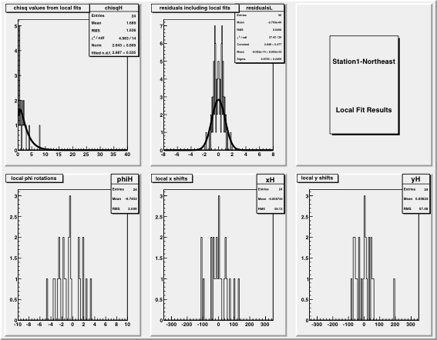
St1NE Local Fits
Residuals are consistent with a measurement error of about 5 µ.
The distribution of the rotations shows a full range of ~9 milliradians.
The distribution of the translations shows a full range of about 250 µ.

Slide 12
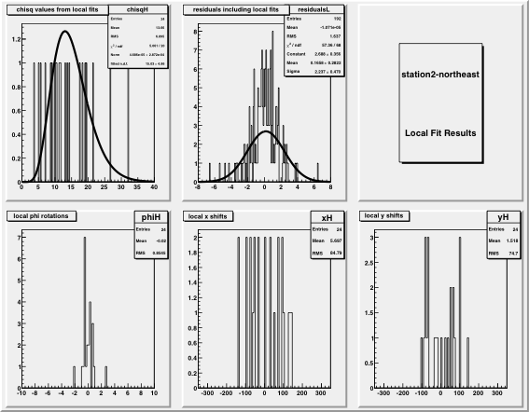
St2NE Local Fits
Residuals are consistent with a measurement error of about 5 µ.
The distribution of the rotations shows a full range of ~5 milliradians.
The distribution of the translations shows a full range of about 250 µ.
Chi-square distribution is wider: more degrees of freedom.

Slide 13
Sensor Length and Flatness
Are the sensors parallel to the plane formed by the three survey pins?
Look at the measured distance s’ between the two reference marks on each sensor, and compare this to the known distance s.
For the small sensors, s = 49585 µ.
Sensor length s
d
θ
Measured projection of sensor s’
Examine the distribution of differences s’ – s. This should be a distribution near 0, perhaps with a tail on the negative side.

Slide 14
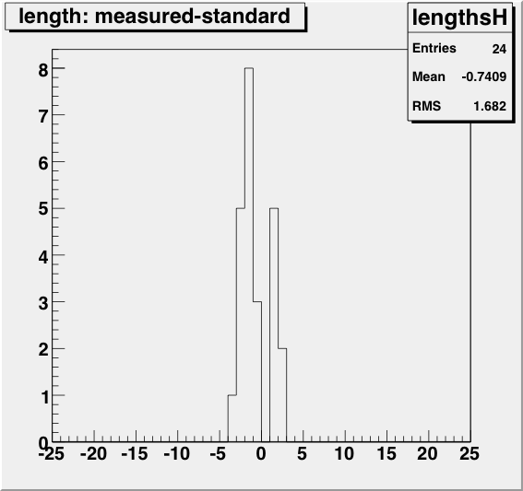
St1NE Sensor Lengths
The largest observed deviation is -4 µ.
That is a non-flatness of 12.7 milliradians, and a lift of d = 0.63 mm.

Slide 15
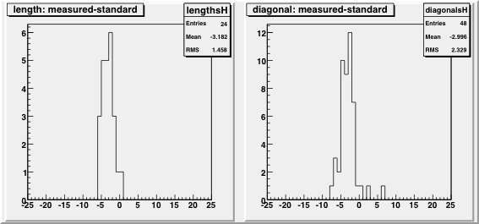
St2NE Sensor Lengths
In the case of large wedges, we can also look at the “diagonal” distance between the bottom center reference mark and the top side reference marks.

Slide 16
Data Quality Analysis Complete
I have posted 4 files with all the analysis histograms in the CDS agenda for this meeting
Data files from Hexagon and the ROOT macro are in CVS offline/analysis/fvtx/metrology/.
Homework: Study gravitational loading by comparing data for Station4 SouthWest in two orientations.
Homework: Discuss how to parametrize sensor locations in a way that is best suited to track-finding optimization.

