Slide 1
VTX Detector Half Assembly
Walter Sondheim,
For the VTX Collaboration

Slide 2
Overview:
Presentation depicts all of the major steps necessary to integrate the four VTX Barrel Detector Layers with the BNL support structure.
Primary function is to cover assembly process flow and incorporate references to drawings and hardware as needed for this assembly.
A copy of HYTEC and BNL drawings should be made available for reference.

Slide 3
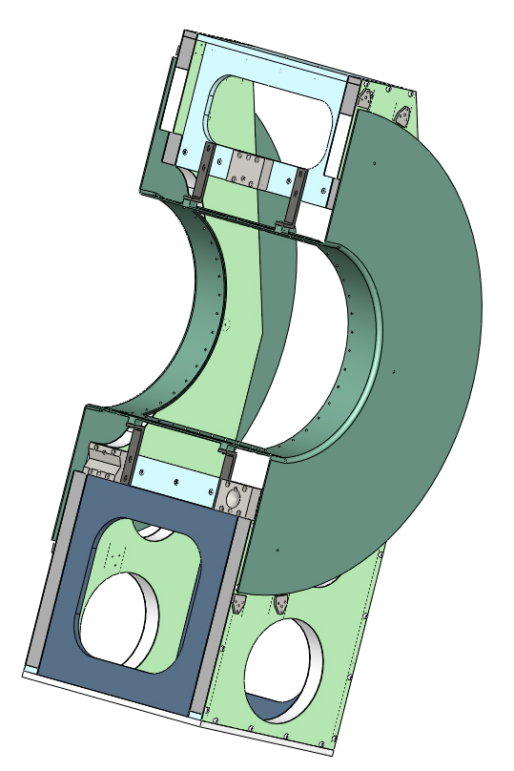
Attach gas enclosure to BNL support structure
Gas enclosure attaches to BNL assembly fixture at four points, 2 each at top and bottom of window frame via angle brackets 111-PHX-02-2211
Spacer blocks need to be added to the BNL assembly fixture sides to fill gap between it and the gas enclosure spool piece ½ disks, make use of cross-rod attachment hole (used for shipping only)

Slide 4
Attach space-frame assembly with layer 4 barrel mounts to BNL support structure using flexures
The next step is to place the space-frame assembly, with the layer 4 barrel mounts attached (or the substitute layer 1 and 3 barrel mount - bars) into the BNL support structure
The space-frame interfaces to the support structure using the three flexure mounts, 111-PHX-02-2065 and 2066, these are mounted to the space-frame with 1 extractable pin 111-PHX-02-2011 and 2 M3x.5 X 12 mm screws
The addition of the flexure elastic seal 111-PHX-02-2034 and the seal retainer 111-PHX-02-2036 should be made
The flexures interface to the BNL support structure with 2 extractable pins and 2 #10 screws
The reason to keep the layer 4 barrel mount as a part of the space frame assembly at this point is to guarantee the spacing of the flexures is correct – top to bottom
Next step is with the substitute layer 1 and 3 barrel mounts in place remove the layer 4 barrel mounts

Slide 5
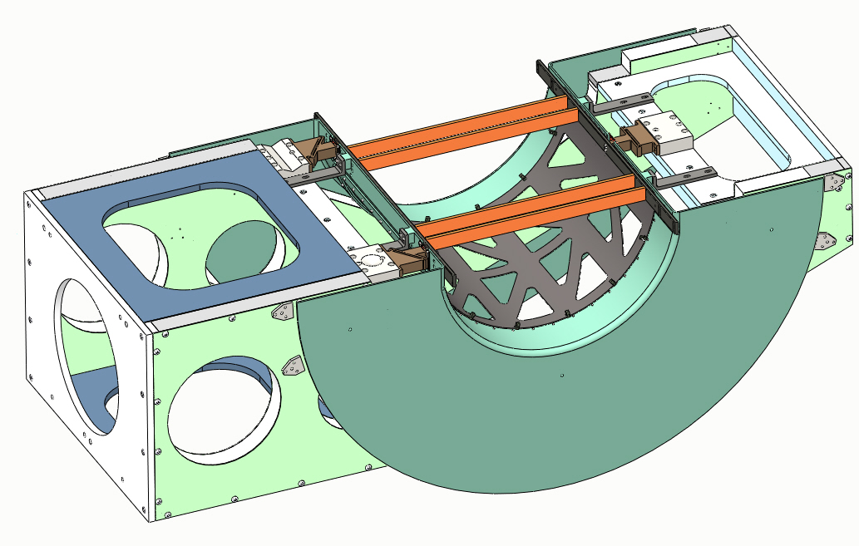
Attach space-frame to BNL support structure
A stand will need to be fabricated to support the backside of the BNL support structure to allow for the larger diameter of the gas-enclosure and the Big-Wheels
After the space-frame is interfaced to the BNL support structure remove the layer 4 barrel mounts
Attach 8 Big-wheel plate mount spacers to the BNL support structure 111-PHX-02-2212
Barrel mount substitutes
Big-wheel spacers

Slide 6
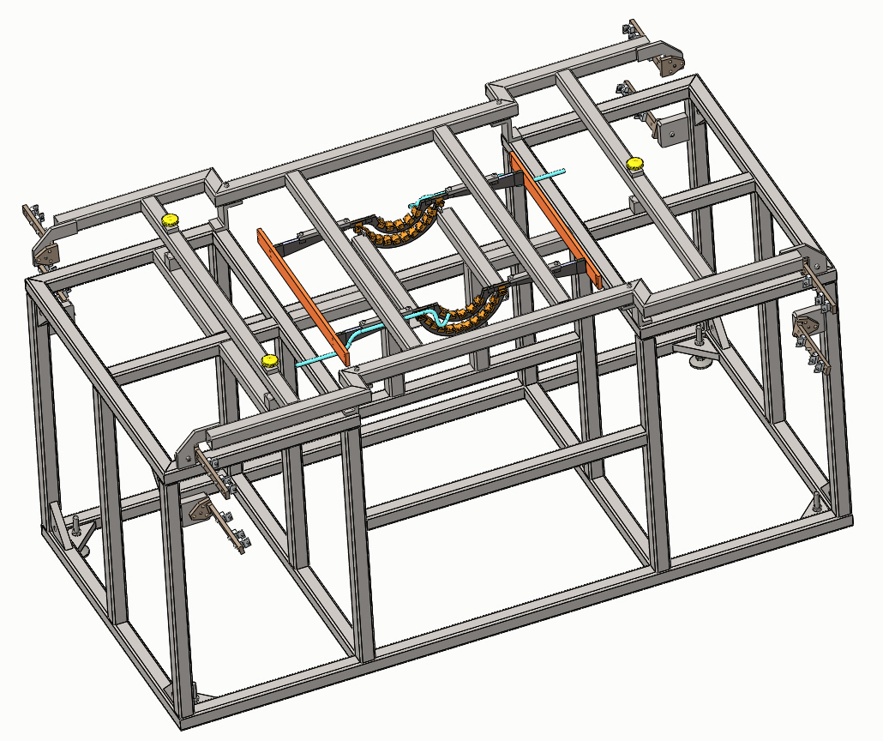
Locating barrel mounts for layers 1 & 2
Attach layer 2 barrel mount tot back of layer 1 barrel mount
Attach main-beam tooling bars to ends of layer 1 barrel mounts, this will set the correct spacing between them, use pin 111-PHX-02-2011 and M3 x 13 mm long screws
Attach layer 2 barrel mounts to BNL layer 2 assembly stand, drawings 105-0222-168 & 105-0222-176
Detach layer 1 transfer frame and layer 1 barrel mount from layer 2 barrel mounts
Pay attention to assembly drawing 111-PHX-02-2004 for orientation of barrel mounts to +Y axis or UP
Main-beam tool
VTX, Y +axis

Slide 7
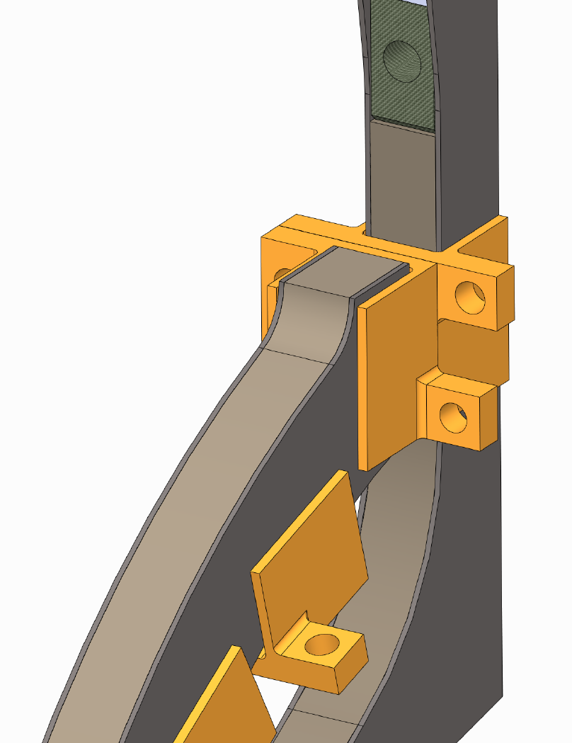
Barrel 2 to barrel 1 attachment points
Screw attachment points between layer 1 and 2 barrel mounts, 2-56 screw with nut
2 locations at each end
Attachment point to layer 2 assembly fixture, using a 2-56 screw and nut to layer 2 barrel mount

Slide 8
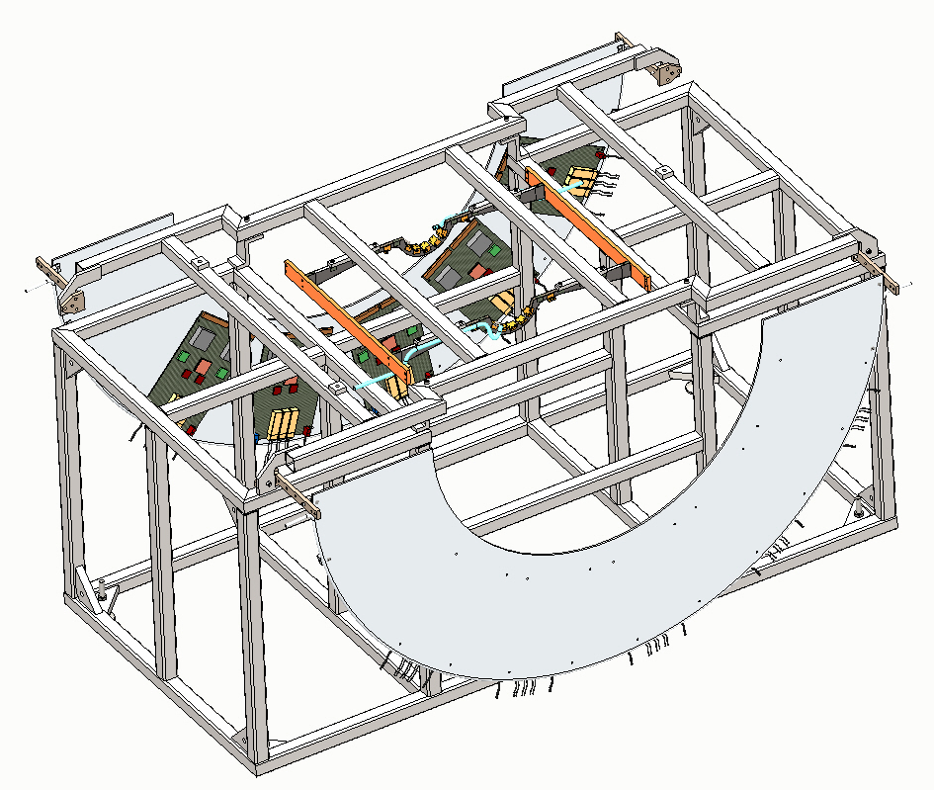
Locating layer 1 barrel mount in assembly stand
After the layer 2 barrel mount has been set in its assembly stand, take the layer 1 barrel mount, with the main-beam tooling bars and transfer frame and set in the BNL layer 1 assembly fixture, BNL drawings 105-0222-165 & 105-0222-180 (station 1 transfer fixture)
The main-beam tooling can remain with the barrel mounts
The layer 1 Big-wheels, with SPIRO boards attached can be mounted to the assembly fixture using the four brackets on the transfer fixture
111-PHX-02-2204, plate 1, note orientation
111-PHX-02-2201, qty 4

Slide 9
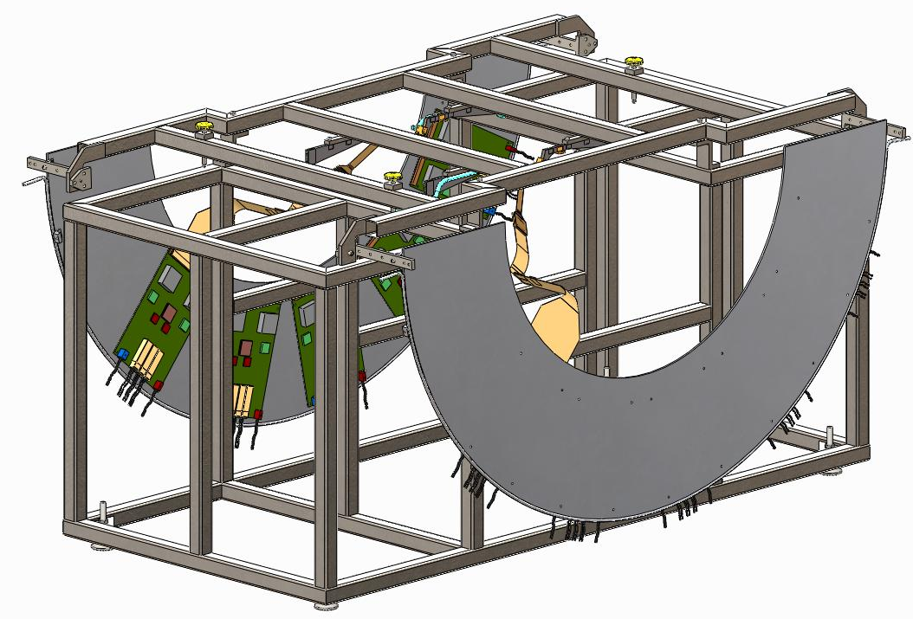
Barrel 1 Assembly ( Pixel Stave Installation)
5 Pixel Staves (without extension cables) are installed on Barrel 1 Mount, using 2 2-56 X 3/16 PEEK screws at each end of stave (20 total for layer 1) staves are located to barrel mount via pins in barrel mounts
SPIRO III boards are attached to Big-wheel using 4, 4-40 X 3/8” screws, 20 per plate
Station 1 Big-wheel is located at second to last mounting point on support brackets
Extension Cable 111-PHX-02-2039 connections are made to the Spiro Cards
The extension cables are mated to the ladder bus
2nd to last mounting point
+Y

Slide 10
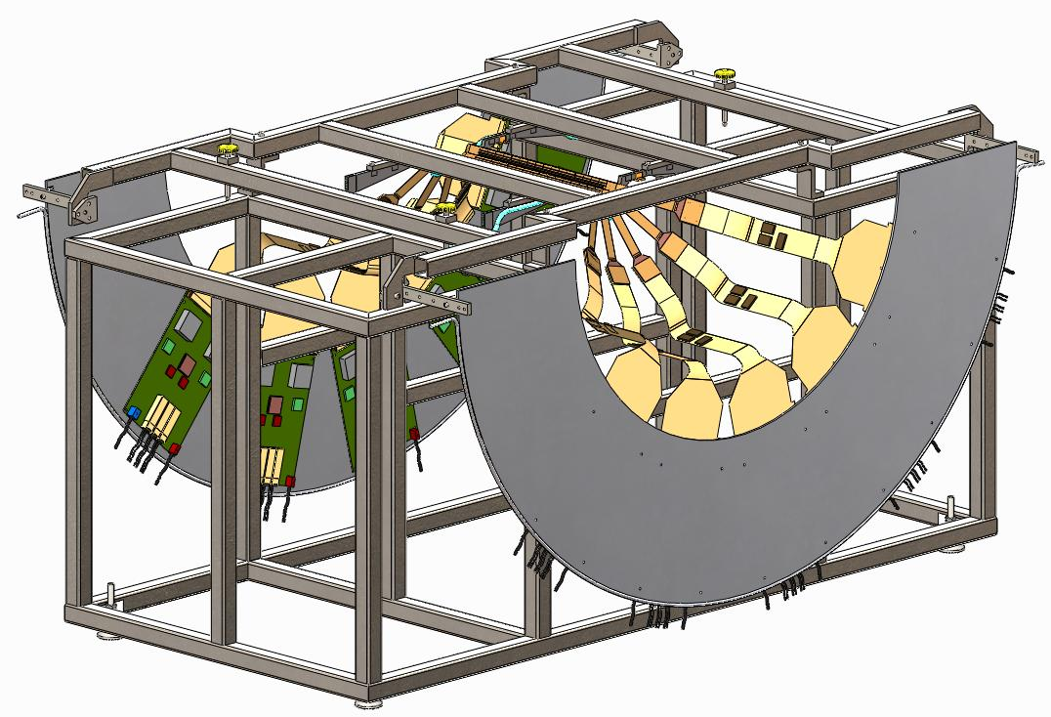
Barrel 1 Assembly (Cooling Tube Installation)
After all Staves are installed, 1/8” ID Tygon Cooling Tubes are connected as per Don Lynch’s cooling diagram (see next slide) the bottom ladder is the inlet and should have two ladder in parallel - then tied in series to the upper three ladders tied in parallel to an outlet

Slide 11
Don Lynch’s VTX cooling circuits
New internal loop designs which meet design requirements
Layers 3 and 4 Strip-Pixel Stave Cooling Loop
F_{V}= 17.3 ml/sec
Tin= -8 ºC
Pin = 138 KpA
(20 PSIG)
Layers 1 and 2 Pixel Stave Cooling Loop
F_{V}= 27.6 ml/sec
Tin= -8 ºC
Pin = 138 KpA
(20 PSIG)
Tout= -4ºC
Pout = 69 KpA
(10 psig)
2 loops in layer 3, 3 loops in layer 4 per ½ detector
Tout= -6ºC
Pout = 69 KpA
(10 psig)
1 loop in layer 1, 2 loops in layer 2 per ½ detector,
5 staves each loop

Slide 12
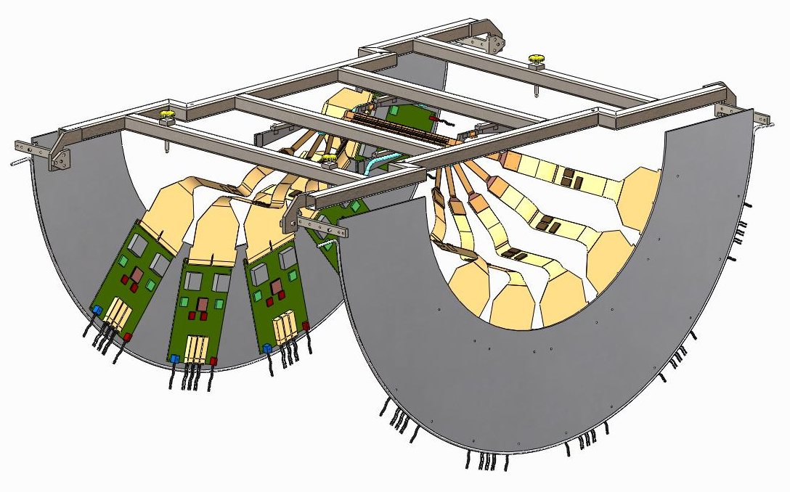
Main Assembly Sequence (Barrel 1 Transport)
Barrel 1 Assembly can remain in the Assembly transport frame until it is removed to connect with the layer 2 assembly
The upper portion of the Barrel 1 Assembly Fixture serves as the Barrel 1 & 2 Assembly Transport Frame
*In this view the main-beam tooling has been removed
Big-wheels located in 4th position going out in Z

Slide 13
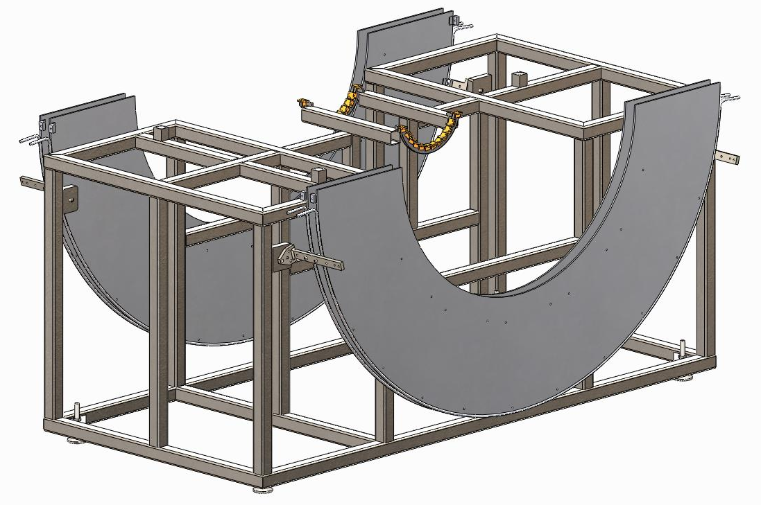
Barrel 2 Assembly (Barrel Mounts)
Barrel 2 Big-wheels with SPIRO cards attached (not pictured) are installed in the Barrel 2 Assembly Fixture, again using 4-40 X 3/8 inch screws
Barrel 2 Mounts are installed in the Barrel 2 Assembly fixture, BNL drawings 105-0222-168 & 105-0222-176, reference drawing 111-PHX-02-2005, 111-PHX-02-2012 – performed in slide 3
This assembly will mount off the backside of the layer 1 barrel mount assembly
Big-wheels – with SPIRO boards attached, are mounted to assembly stand ( see slide 12)
111-PHX-02-2205, plate 2A inner plate, note orientation
111-PHX-02-2206, plate 2B outer plate, note orientation
111-PHX-02-2201,
qty 4
+Y

Slide 14
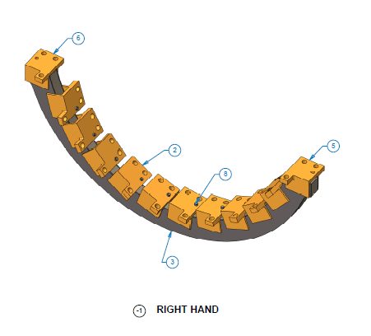
Locating Barrel Mount to Assembly Stand
4 screw hole locations are attachment points to layer 1 barrel mounts.
Mounting location to assembly stand using 2 2-56 X ½ inch with nut. **
NOTE: it is possible that the three 2.18mm diameter holes in the two mounting blocks should be opened up to 3/32 inch diameter. These mounting points face towards the inside.

Slide 15
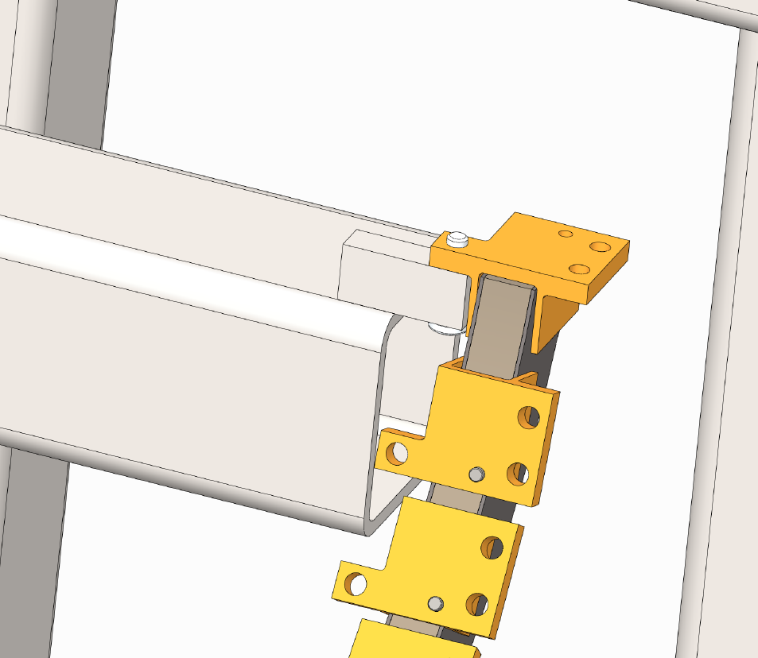
Locating Barrel Mount to Assembly Stand
2-56 nut here
View of layer 2 barrel mount attached to HYTEC assembly stand, NOTE the #2-56 screw needs to be at least ½ inch in length in order to secure with a nut. The three holes in this block, should also be opened up to 3/32” diameter, as previously mentioned.

Slide 16
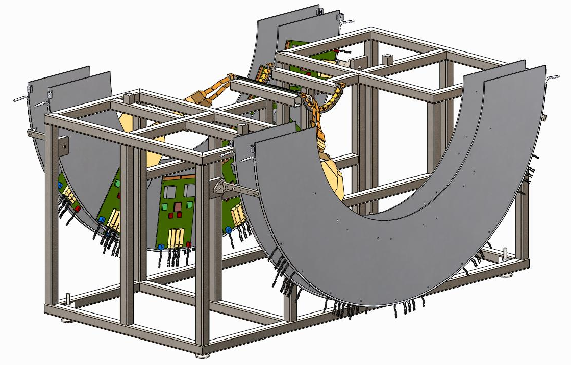
Barrel 2 Assembly (Stave Installation)
Pixel Stave are installed in Barrel 2 Mounts, using pins in barrel mounts and 2 2-56 X 3/16 inch screws, 40 screws total, McMaster-Carr part# 91772A076
Extension Cables are attached between the Spiro Cards and the pixel bus, extension cables from every other stave goes to the same Big-wheel, the two Big Wheels should be kept apart as much as possible using their support brackets (1st and last position)
The Big-wheels are mounted further apart to facilitate extension cable connection to the SPIRO III cards, cables 111-PHX-02-2040 and 111-PHX-02-2041
1st cable 111-PHX-02-2040, longer of 2
Plate 2B
Plate 2A
2nd set of Big Wheel support brackets, plates are spaced as far a part as possible
+Y

Slide 17
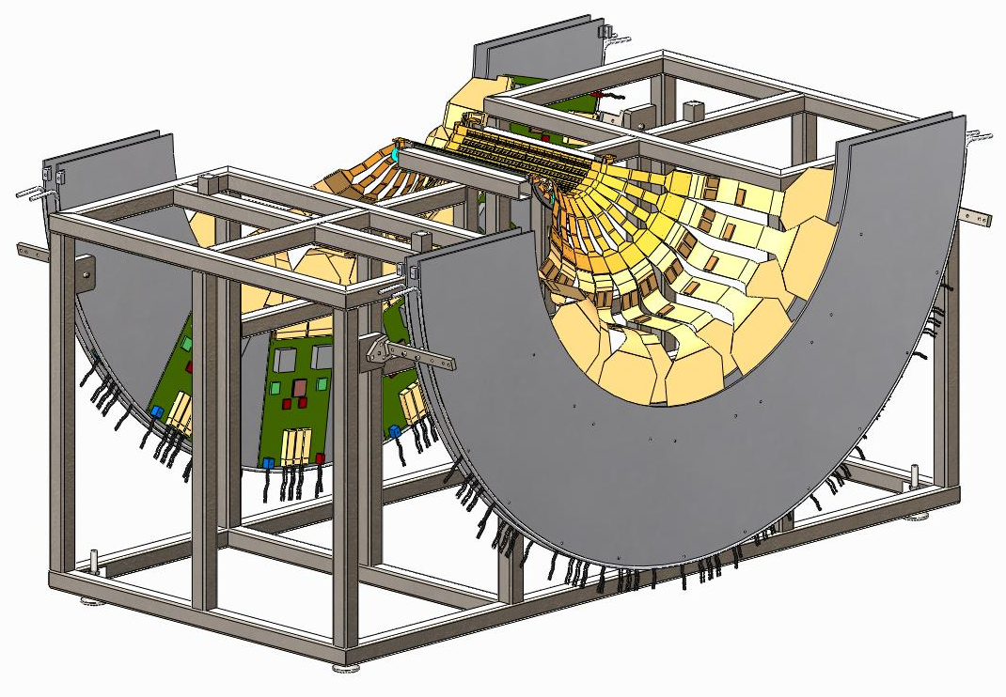
Barrel 2 Assembly (Cooling Tube Installation)
Using a foam cylinder may aid the bending of extension cables
The Big-wheels are moved to their final positions on brackets
After all Staves are installed, Cooling Tubes are connected, D. Lynch circuit description
Big-wheels are moved closed together on brackets, 2nd and 3rd location going out in Z
+Y

Slide 18
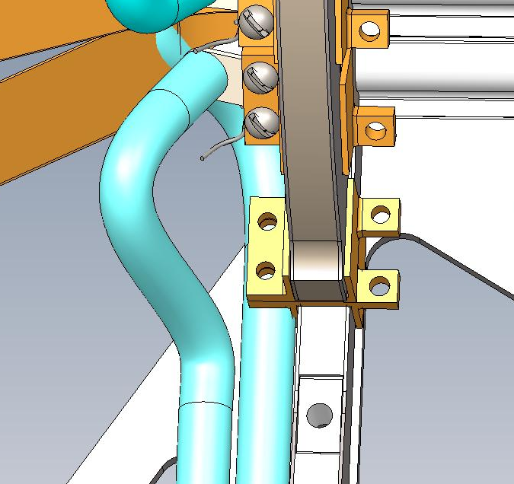
Detail view of ladder attachment, layer 2
Detailed view of ladder attachment to layer 2 barrel mount:
  2-56 screws attaching ladder to barrel mount
  Location for 2-56 screws (2) attaching layer 2 barrel mount tot layer 1 barrel mount

Slide 19
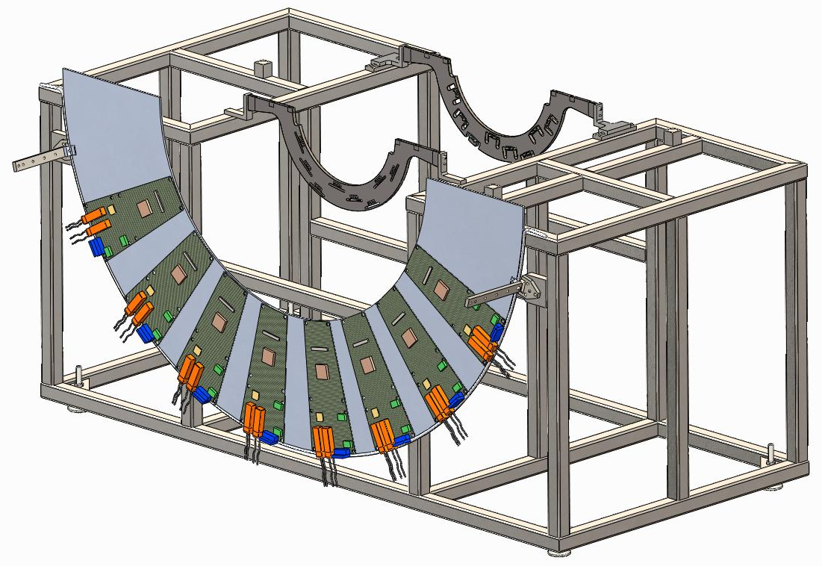
Barrel 3 Assembly (Barrel Mounts)
Barrel 3 Big-wheel with electronic LDTB cards attached is installed in the Barrel 3 Assembly Fixture, attached to closest position to assembly fixture. Screw. LTDB board is attached to the Big-Wheel by 8, 8-32 X 3/8 inch screw
Barrel 3 Mounts are installed in the Barrel 3 Assembly fixture, 105-0222-167, using 1 M3x.5 X 13 mm length and 2 111-PHX-02-2011 extractable pins at each end with a M3x.5 X 13mm long screw
The Barrel Mount opposite of the Big-wheel is initially mounted out far enough to allow the hose barbs to clear during Stave installation (reference dimensions);
  Stave = 331.5 mm
  Tube & hose barb = 12.75 mm
  Initial spacing between mounts
  344. 5 mm minimum
+Y
3rd set of 2 Big Wheel support brackets, 111-PHX-02-2201, BW #3 111-PHX-02-2207

Slide 20
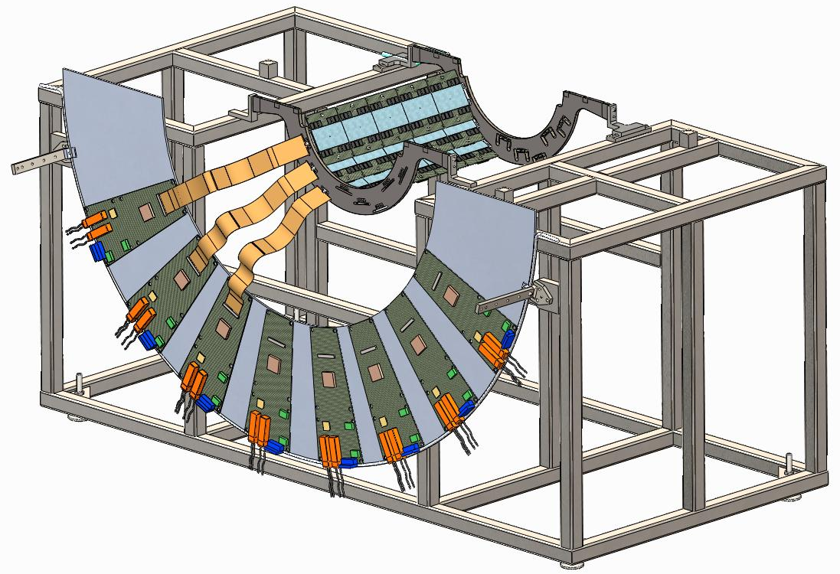
Barrel Assembly (Stave Installation)
Strip Staves are installed in Barrel 3 Mounts in a circular pattern
Extension Cables are attached to the LDTB electronics cards by sliding them through slots in the Barrel 3 Mount
2 Pins 111-PHX-02-2011 and one M3x.5 X 16 mm screw, hold the Stave in alignment with the Barrel Mount on the Big-wheel side
Opposite end of stave is supported with one long M3x.5 threaded rod with nut

Slide 21
Barrel 3 Assembly (Cooling Tube Installation)
Once all the Staves are installed the Barrel Mount on the cooling tube side is moved in and attached to the Staves
  This will be done using the screws that are long enough to reach the Stave through the Barrel Mount
    Slowly move the barrel mount towards the ends of the stave
  When the barrel mount is brought in contact with the end of the stave, 2 111-PHX-02-2011 pins are added to keep this end of the stave in alignment with the barrel mount, the long M3x.5 threaded rod is replaced with 2 pins and a M3x.5 X 12. mm screw
After the Barrel Mount is secure the cooling hoses are attached between the Staves, as per Don Lynch’s cooling circuit on slide 6. Remember the inlet is at the bottom
Verify the correct barrel mount to barrel mount spacing using the main-beam tooling bars, initially laying them on the face that the mid-plane lateral stiffeners would attach to 111-PHX-02-2019

Slide 22
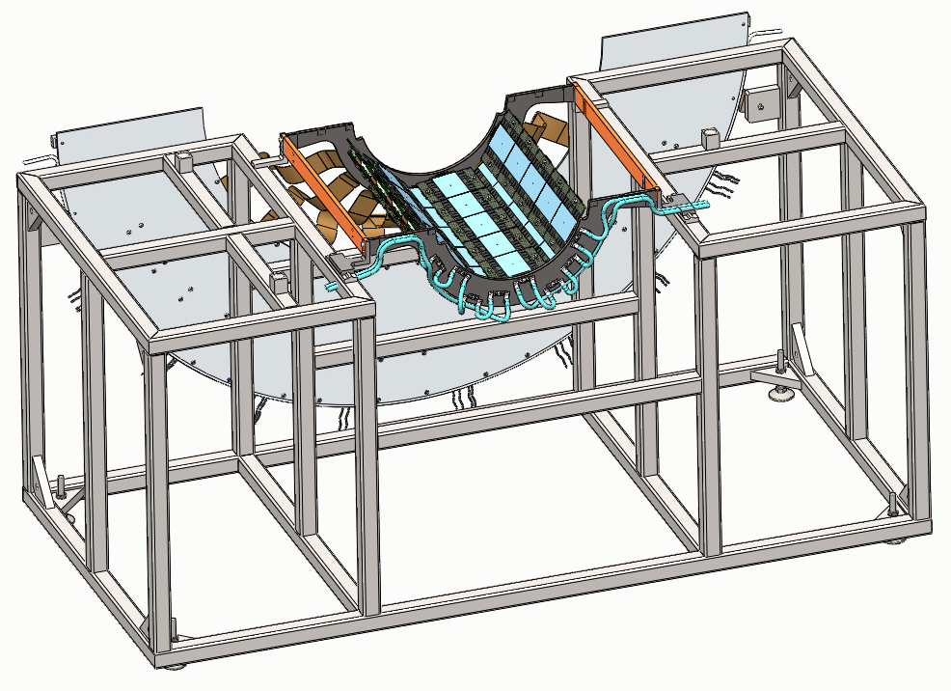
Barrel 3 assembly
It is possible to pin the main-beam tooling bars through the assembly stand bracket to check barrel mount to barrel mount spacing
+Y

Slide 23
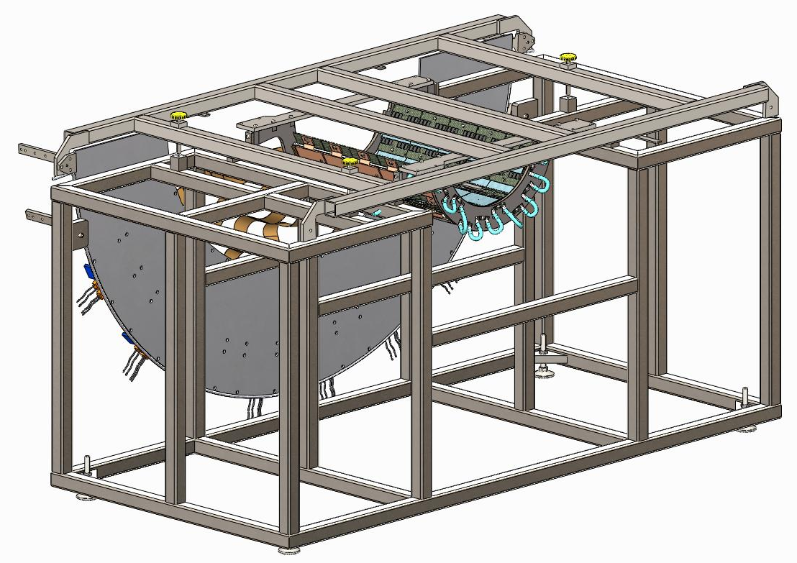
Barrel 3 Assembly (transport frame added)
Addition of BNL Barrel 3-4 transport frame, BNL-105-0222-185, 3 ¼-20 thumb screws are needed to set the height of the transport frame above the assembly stand
Remove main-beam tooling if still in use
Big-wheel should be mounted to inner most position on brackets

Slide 24
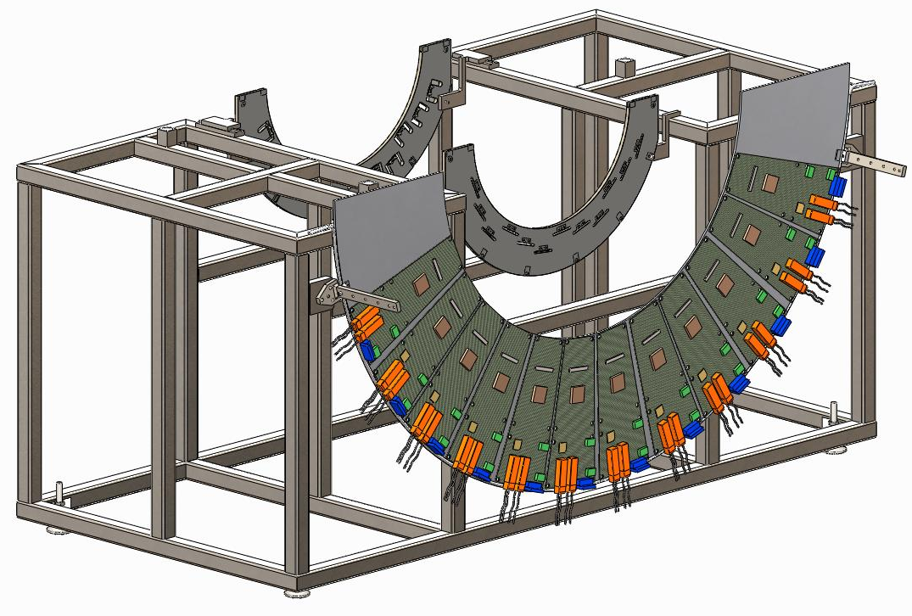
Barrel 4 Assembly (Barrel Mounts)
Barrel 4 Big-wheel with electronics cards attached is installed in the Barrel 4 Assembly Fixture
Barrel 4 Mounts are installed in the Barrel 4 Assembly fixture
The Barrel Mount opposite of the Big-wheel is initially mounted out as far as possible on slider blocks, to allow the hose barbs to clear during Stave installation
Big wheel plate #4 111-PHX-02-2208
4th set of 2 Big Wheel mounts 111-PHX-02-2201
+Y

Slide 25
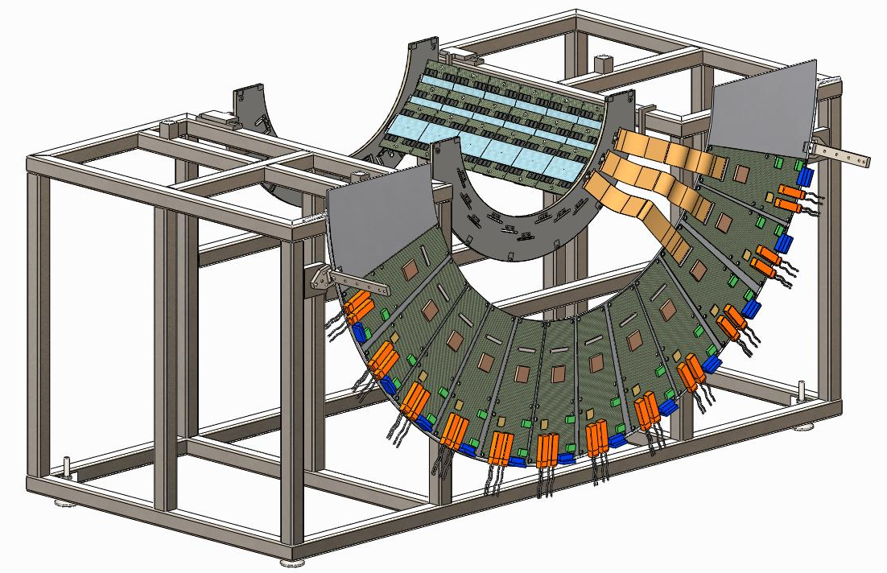
Barrel 4 Assembly (Stave Installation)
Strip Staves are installed in Barrel 4 Mounts
Extension Cables are attached to the electronics cards by sliding them through slots in the Barrel 3 Mount
2 Pins 111-PHX-02-2011 and one M3x.5 X 12 mm screw, hold the Stave in alignment with the Barrel Mount on the Big-wheel side
Opposite end of stave is supported with one long M3x.5 threaded rod with a nut
Big-wheel mounted to inner most position on bracket

Slide 26
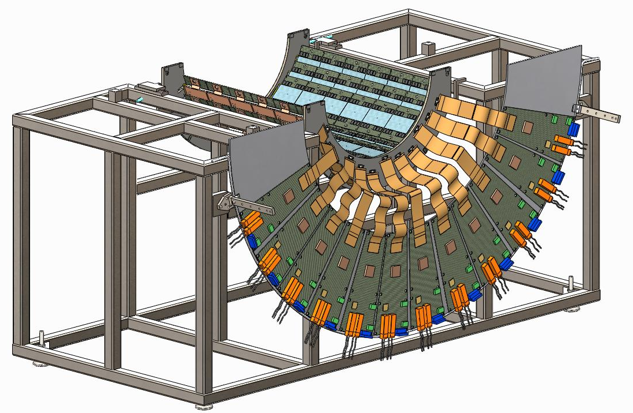
Barrel 4 Assembly (Cooling Tube Installation)
Once all the Staves are installed, the Barrel Mount on the cooling tube side is moved in and attached to the Staves
  This will be done using threaded rod with nuts that are long enough to reach the Stave through the Barrel Mount
    Slowly move the barrel mount towards the ends of the stave
  When the barrel mount is brought in contact with the end of the stave, 2 111-PHX-02-2011 pins are added to keep this end of the stave in alignment with the barrel mount, the long M3x.5 threaded rod is replaced with a M3x.5 X 12 mm screw
After the Barrel Mount is secure the cooling hoses are attached between the Staves, as per Don Lynch’s cooling circuit on slide 6.

Slide 27
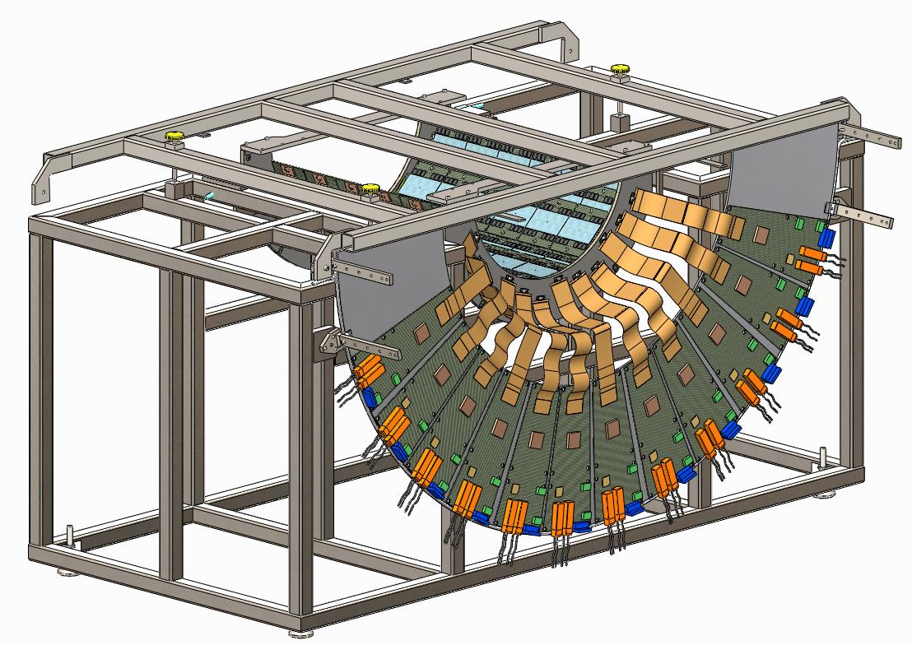
Barrel 4 Assembly (Transport Frame)
Addition of the 2nd BNL Barrel 3-4 transport frame, BNL-105-0222-185, 3 ¼-20 thumb screws are needed to set the height of the transport frame above the assembly stand

Slide 28
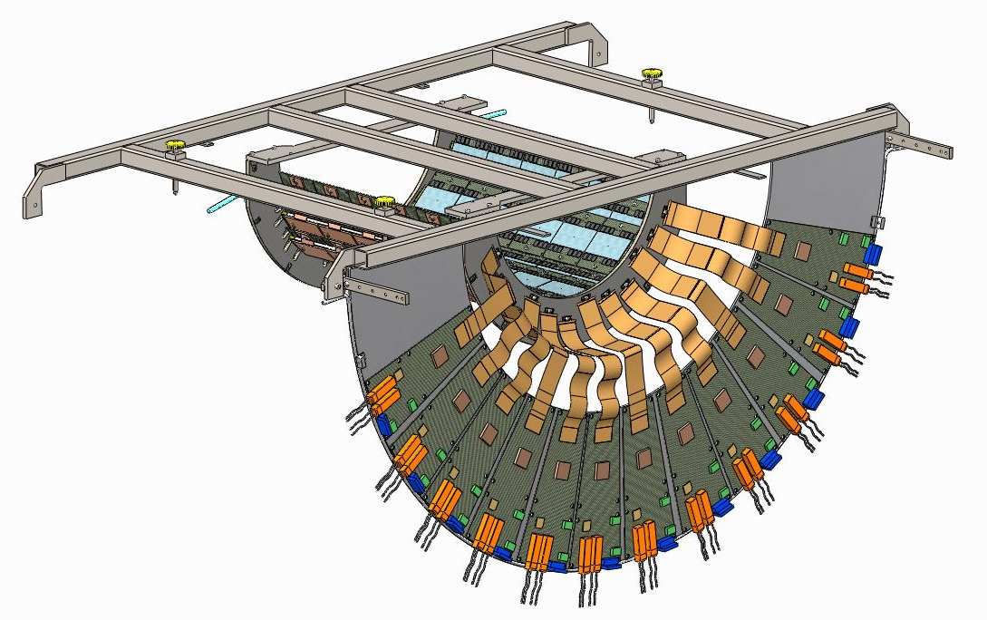
Main assembly sequence layer 4
Barrel 4 in transport frame ready to install in BNL support structure
Same transport frame will be used to install layer 3 in the BNL support structure

Slide 29
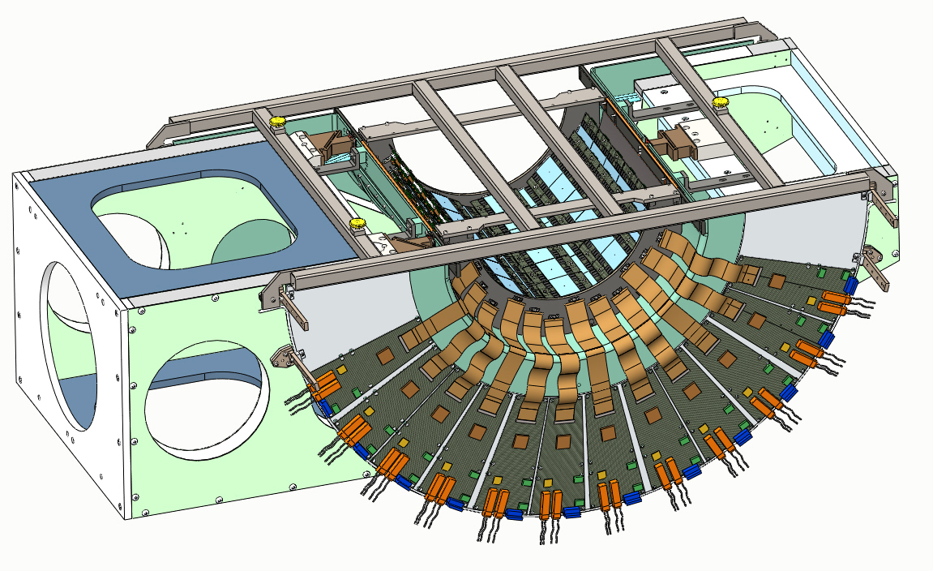
Main assembly sequence layer 4
Barrel 4 is placed into the BNL support structure and attached to the space-frame
Adjustment screws interface with the support structure’s kinematic interface to provide accurate placement (height)
Transfer attachment of Big-wheel to assembly structure

Slide 30
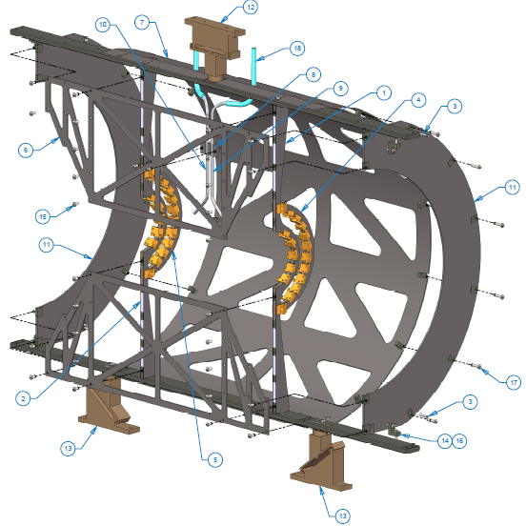
Attachment points layer 4 to space frame
Each layer 4 barrel mount attaches as shown in drawing 111-PHX-02-2004 -
2 - right angle brackets # 14 to main-beam
4 - M3x.5 X 10 mm screws #17
2 - extractable pins #3
6 - M3x.5 X 12 mm screws #16
NOTE it may be necessary to disconnect some of the LTDB cables from the Big-wheel in order to install some of the 13 mm long screws

Slide 31
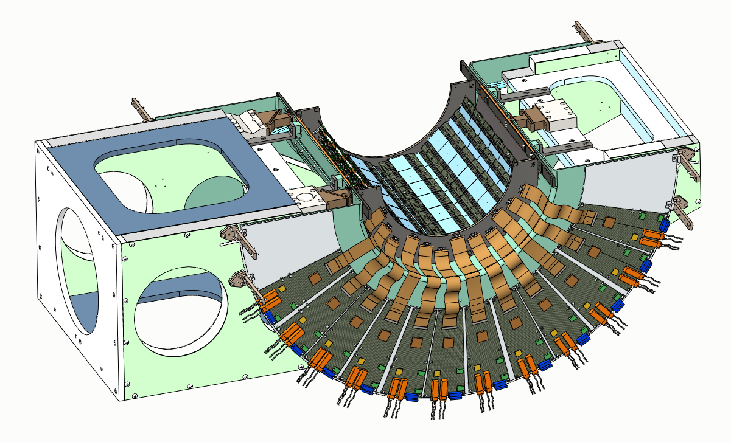
Barrel 4 transport frame removed
Transport Frame is removed from the Barrel 4 Assembly
Cooling Tube connections through the Gas Enclosure are made, according to Don Lynch’s cooling circuit plan, see slide #12
BW brackets not installed yet

Slide 32
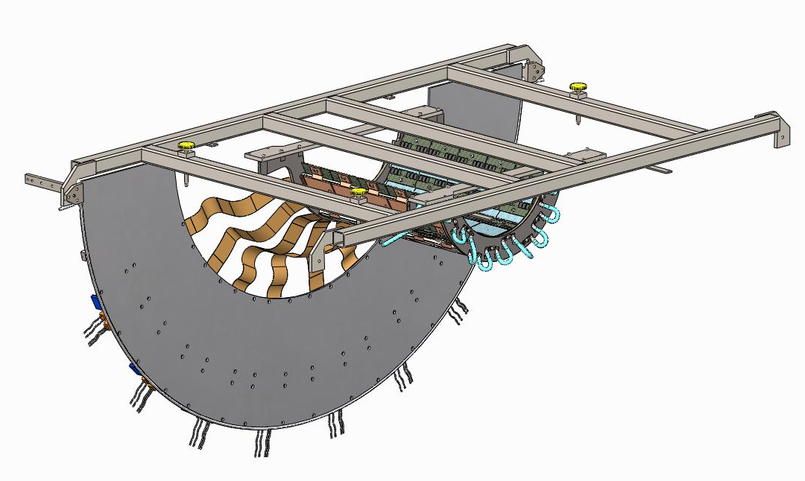
Main assembly sequence layer 3
Transportation Frame is used to move the Barrel 3 Assembly from its Assembly Fixture to the BNL support structure, after removal from layer 4
Transport frame attached to layer 3 barrel mount using 12 M3x.5 X 6 mm

Slide 33
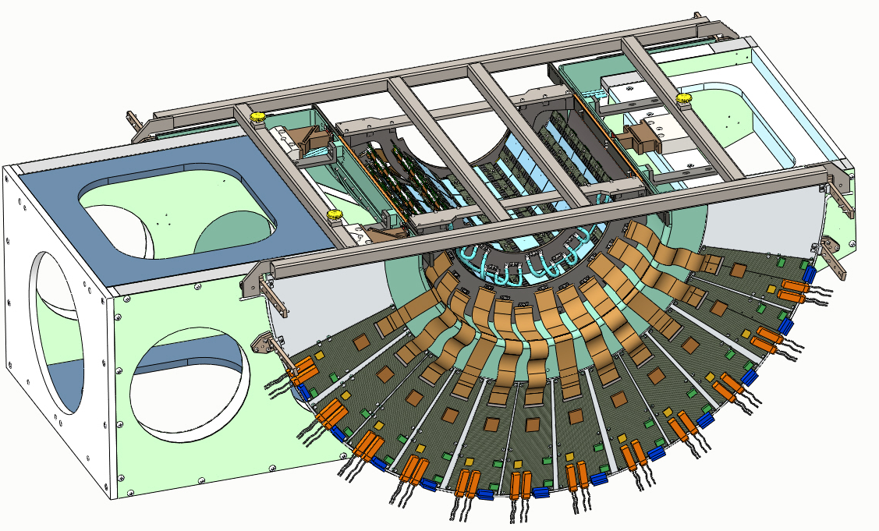
Main assembly layer 3
Barrel 3 is placed into the BNL support structure
Barrel 3 attaches to the main-beams using 4 extractable pins and 4 M3x.5 X 12 mm long screws
Connect Big-wheel to support structure

Slide 34
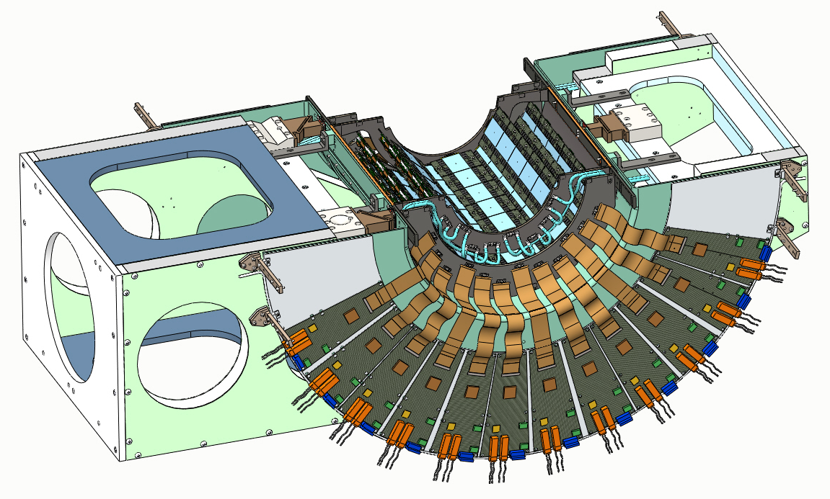
Barrel 3 transport frame removed
Transport frame is removed from the barrel 3 assembly
Cooling lines are connected according to Don Lynch’ cooling circuit diagram
Again upper Big-wheel brackets (4) are not present

Slide 35
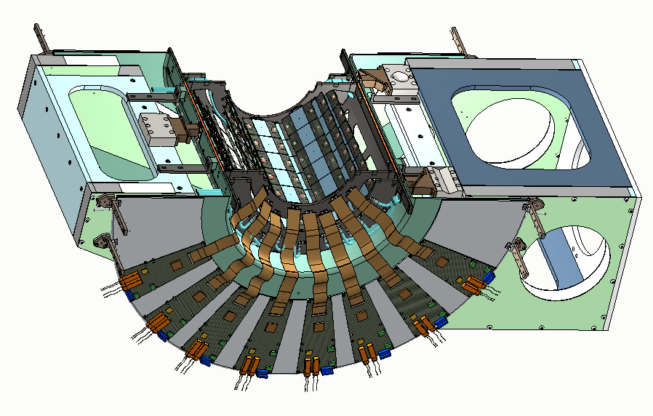
Layer 3 view showing Big-wheel
This view of layer 3 for the layer 3 Big-wheel side
NOTE you will only have the lower two Big-wheel support brackets in place

Slide 36
Main assembly, barrel 1 placed on barrel 2
The barrel 1 assembly is taken in its transport stand to the layer 2 assembly fixture
This fixture will serve as the transport fixture for both layer 1 and 2 into the BNL assembly support structure

Slide 37
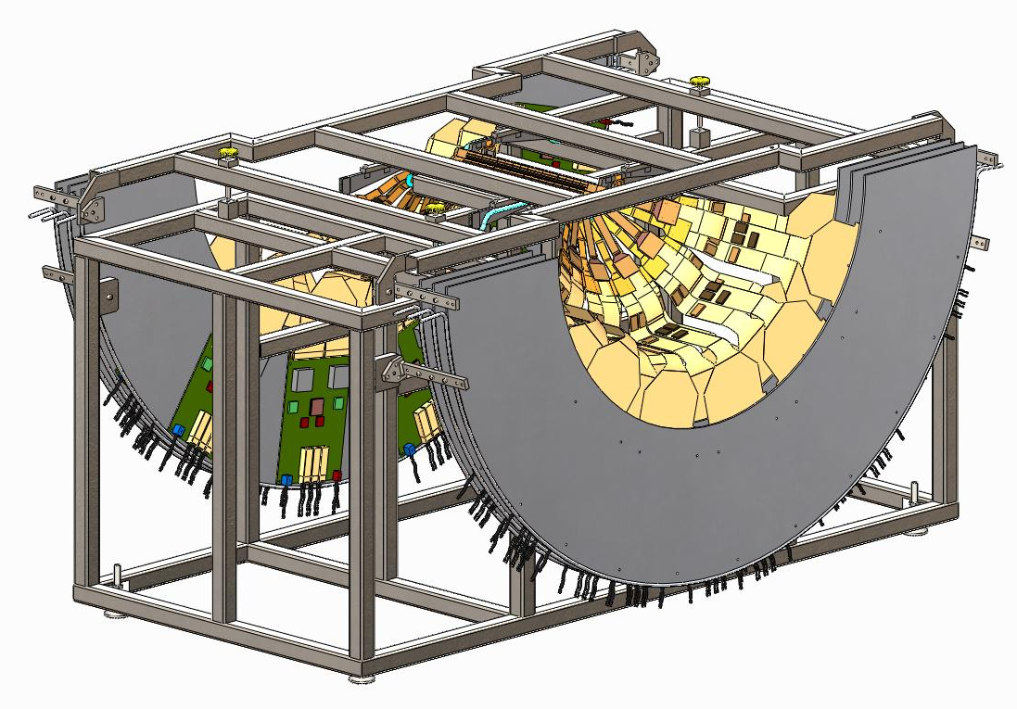
Barrel 1 mated to barrel 2
Barrel 1 Assembly is attached to the Barrel 2 Assembly
Layer 2 barrel mount is reattached to the backside of the layer 1 barrel mounts using 2-56 screws and nuts (8)
Barrel 2 Big Wheels are transferred from the Barrel 2 Assembly Fixture to the Barrel 1 & 2 Transport Frame

Slide 38
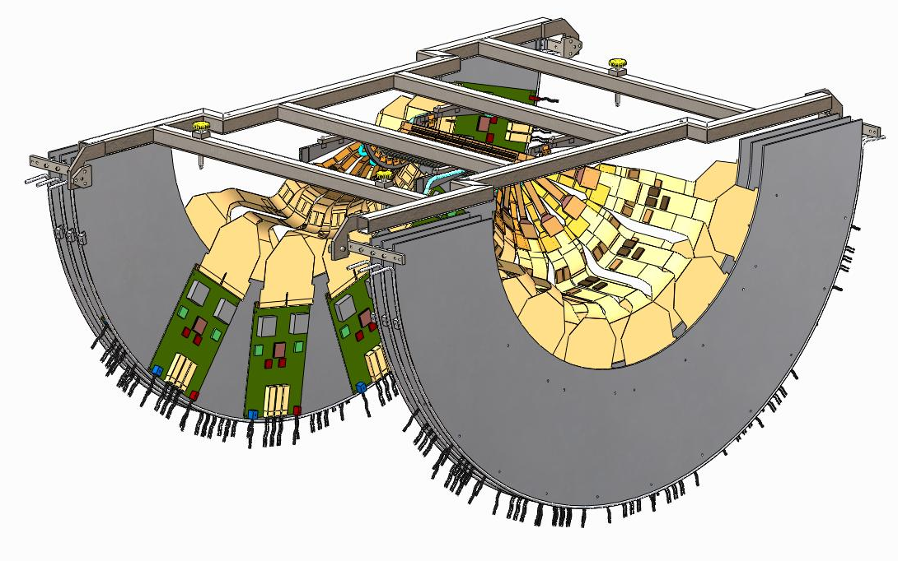
Barrels 1 and 2 transported
Barrel 1 & 2 Transportation Frame is used to move the Barrel 1 & 2 Assembly from the Barrel 2 Assembly Fixture to the Main Assembly
NOTE: This transfer includes all six Big Wheels associated with the Pixel layers 1 & 2, their X position is limited by the cable lengths

Slide 39
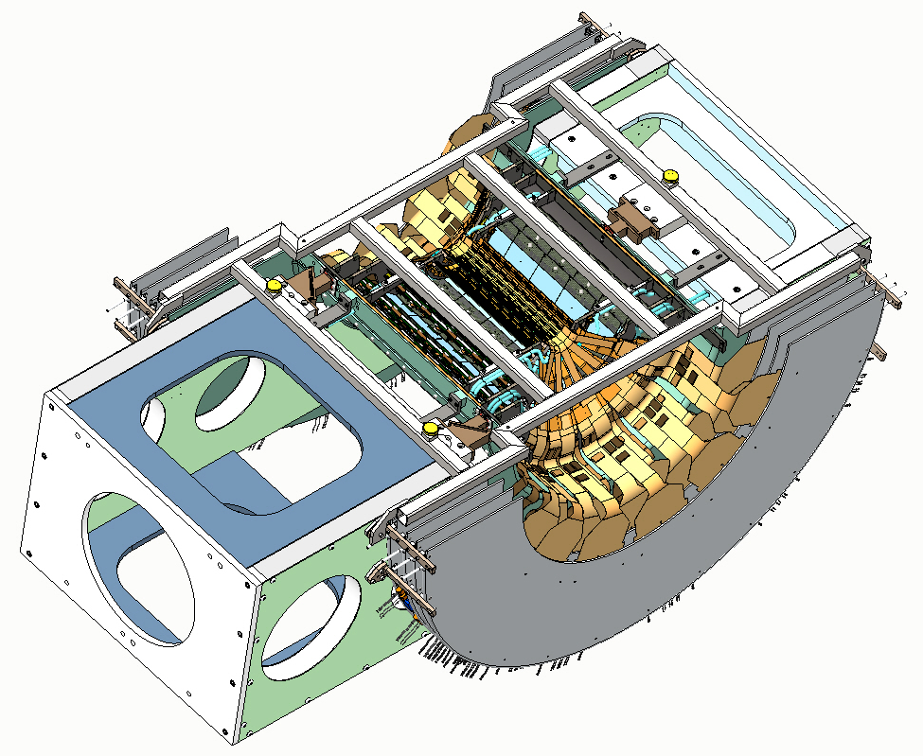
Main assembly, layers 1 and 2 added
Barrels 1 and 2 placed in BNL support structure
Verify position of Big-wheels in support structure
Barrel mounts for layer 1 attach to main-beam using extractable pins (4) and M3x.5 X 12 mm screws (4)

Slide 40
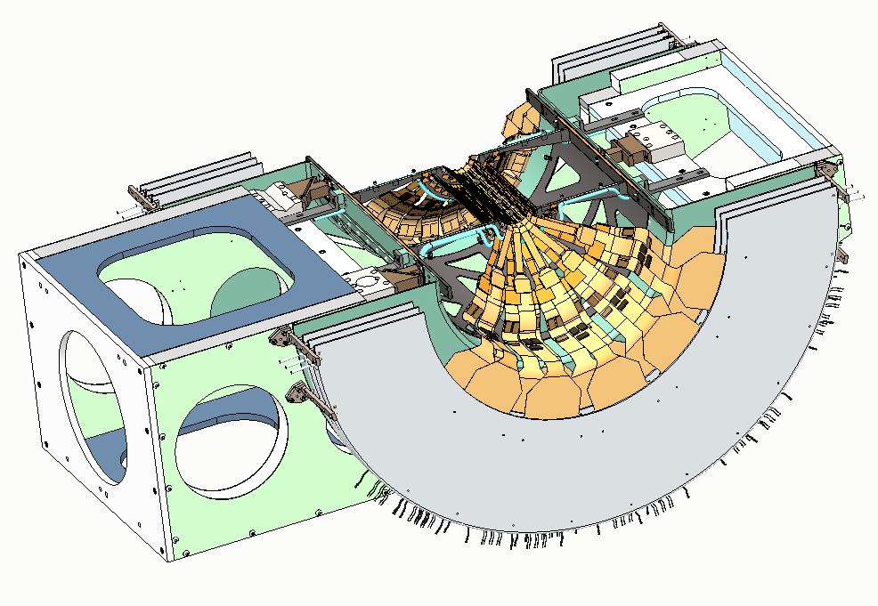
Barrels 1 and 2 transport frame removed
Barrel 1 & 2 Transport Frame is removed from the BNL support structure
Cooling Tube connections through the Gas Enclosure are made
Upper Big-wheel support brackets are added to support structure

Slide 41
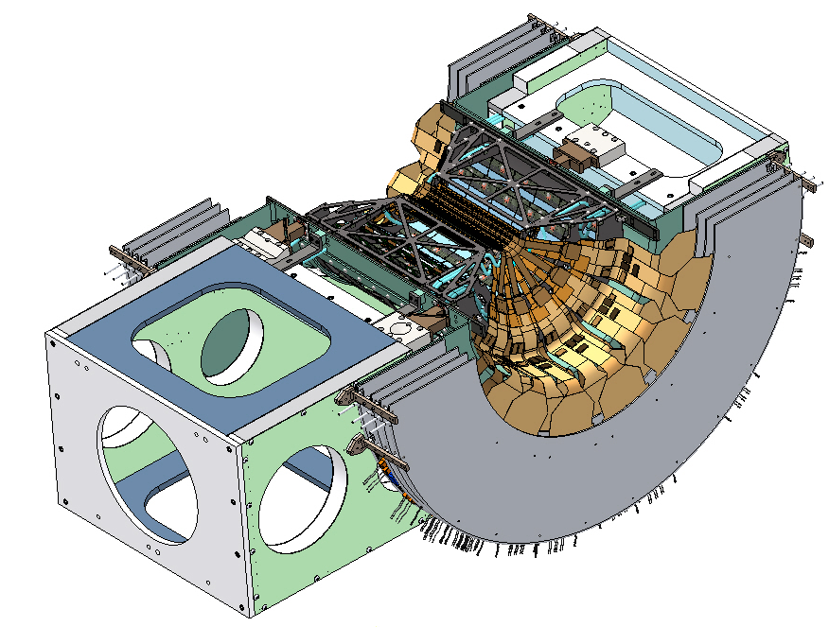
Add the mid-plane lateral stiffners
Install 2 111-PHX-02-2019 VTX lateral stiffeners, attachment is made to the 1, 3 and 4 barrel mounts using 20 M3x.5 X 6.0 mm long screws

Slide 42
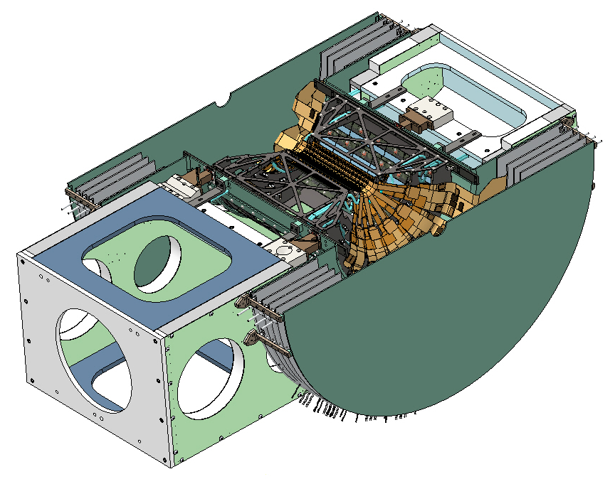
Gas enclosure end plates added
The FR-4 gas enclosure end plates are added (location of FVTX readout plate)
Silicone gas seal material as well as readout circuit board Gap-pad material added as required
A taller gas seal needed layer 1 plated and end plate
Use of U-clips around perimeter of Big-wheels may be necessary to make seal

Slide 43
Final assembly
Install the dry Nitrogen gas lines and their mounting block

