Slide 1
Guide to FVTX Disk and Cage Assembly
Stephen Pate
with lots of help from others…

Slide 2
Overview of Tasks
Receive wedges from SiDet – perform calibration and source tests
Assign each wedge to a specific destination in the FVTX
Bend HDIs
Attach pedestals
Remove HDI tabs
Add grounding and “inject1” wires
Cut Notches in Mounting Tabs On Small Disks
Attach Thermocouples to Disks
Assemble wedges on disk
Perform metrology of sensors on disks
Attach HDI extension cables, cooling lines, and bias cables to wedges
Transfer disk to cage; route cooling lines and cables
Test disk in cage using ROC card with cooling
Repeat until cage is filled

Slide 3
Receive wedges from SiDet
All wedges arriving from SiDet will be identical (except for the “large” and “small” sizes)
Power up wedges, run calibrations, do source tests – check to make sure the wedge survived shipping
Store wedges in dryboxes as much as possible

Slide 4
Assign each wedge to a specific destination in the FVTX
The sameness of the wedges will end as soon as the first steps in the disk assembly process are completed.
To avoid confusion, each wedge should have a unique identity and we should give it a final destination before we do anything to it
A big display in the assembly room can help to summarize these assignments
This information should be entered into the FVTX database and recorded on appropriate travelers

Slide 5
Wedges, Disks, Cages
All large/small wedges delivered from SiDet are the same. They become different when we decide where they will be placed; this determines the bend in the HDI, and the pedestals.
All large/small disks are assembled in the same way, except for the alternation of short/tall pedestals (more on that later)
Large disks (stations 1-3) have different phi-offsets (staggering), but these are determined by mounting blocks built into the cage, not by any detail on the disk.
All cages are assembled in the same way. These four cages are SouthEast (SE), SouthWest (SW), NorthEast (NE) and NorthWest (NW).

Slide 6
Order of Construction
For no particular reason, we’ll build the cages in this order: SE, SW, NE, NW (if you have a better ordering in mind, let me know).
The first wedges we receive will be distributed among locations in the SE cage, and so on.
Cage destination determines vertical orientation, need to know that before metrology.

Slide 7
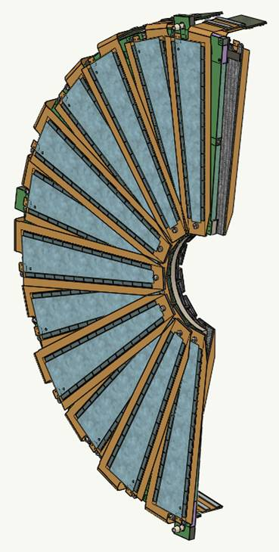
Construction Naming and Numbering
Large disk
Shown in SE or NW orientation;
SW or NE would be rotated 180º about the beam axis.
Small wedges are on disk (station) 0
Large wedges are on disks (stations) 1, 2, 3
For purposes of assembly of a single disk, wedges are numbered 0-11 going clockwise on each side
There’s an “upstream” side (faces towards the vertex) and a “downstream” side (faces away from the vertex).
Wedge 0 is special; it sticks out beyond the disk edge and has a special truncated pedestal (see later slides).
On small disks this is a tall pedestal
On large disks this is a short pedestal (as shown here)
11
0
Downstream side
11
Upstream side
0

Slide 8
PHENIX Naming and Numbering
Small wedges are on disk (station) 0
Large wedges are on disks (stations) 1, 2, 3
In PHENIX coordinate system, wedges are numbered 0-47 – see next slide.
In a single disk, these numbers would be 12-35, or 36-47 + 0-11.);
Need to make sure this does not become a point of confusion…
South cage is “arm 0”, north is “arm 1”

Slide 9
PHENIX Naming and Numbering
Wedge Numbering in PHENIX Coordinate System

Slide 10
Bend HDI
The location and direction of the bend in the HDI depends on the station number and the side the disk.
Bends in Station 1 and 2 are the same (for a given side); the bends in the extension cables take care of interferences…
Station 3 has the (bonus) double bend.
Station 1 Station 2 Station 3

Slide 11
Bend HDI
But the bend does not depend on the layer on a given side; top and bottom layers on a given side are bent the same because there is no overlap between HDIs coming from top and bottom wedges on the same side.
Same side
Same bend

Slide 12
Bend HDI
UNM designed and built fixtures for performing these various bends. Location of heaters conflicts with locations of pedestals, so the pedestals are attached after the bending is done.

Slide 13
Attach pedestals
Backplanes are attached to thermal pedestals using Arclad strips and an air pump with vacuum fixture.
Template is used to cut Arclad strips into appropriate shapes with holes.
Air pump of same type used by VTX.

Slide 14
Attach pedestals – Small Wedges
Small wedges
SMALL WEDGES:
Even-numbered wedges all have the tall pedestals (are on the top layer of a side)
Odd-numbered wedges all have the short pedestals (are on the bottom layer of a side)
Large and Small wedges have the opposite tall/short <-> even/odd association. See next slide.
Three kinds of pedestals:
Tall: For top-layer wedges but not on the disk edge
Short: For bottom-layer wedges
Tall and Truncated: For top-layer wedges on the disk edge; the pedestals on wedges at the disk edge are truncated to not extend beyond the disk edge (this is always wedge-0 in the construction numbering)
NOTE: HDIs will still have alignment tabs at this stage.

Slide 15
Attach pedestals – Large Wedges
Large wedges
LARGE WEDGES:
Odd-numbered wedges all have the tall pedestals (are on the top layer of a side)
Even-numbered wedges all have the short pedestals (are on the bottom layer of a side)
Large and Small wedges have the opposite tall/short <-> even/odd association. See previous slide.
Three kinds of pedestals:
Tall: For top-layer wedges
Short: For bottom-layer wedges but not on the disk edge
Short and Truncated: For bottom-layer wedges on the disk edge; the pedestals on wedges at the disk edge are truncated to not extend beyond the disk edge (this is always wedge-0 in the construction numbering)
NOTE: HDIs will still have alignment tabs at this stage.

Slide 16
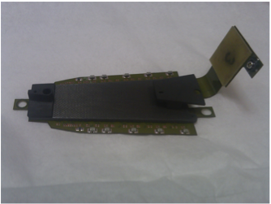
Remove HDI tab on narrow end of wedge
Use sharp scissors or a razor blade or a scalpel.

Slide 17
Connect Backplane to Wedge Ground
Bulk material of backplane is conductive carbon fiber; needs to be in common ground with analog and digital grounds of wedge.
Solder wire to bias ground tab.
Connect wire into pre-made hole in backplane with conductive epoxy.

Slide 18
Attach wire to prevent “inject1” fault

Slide 19
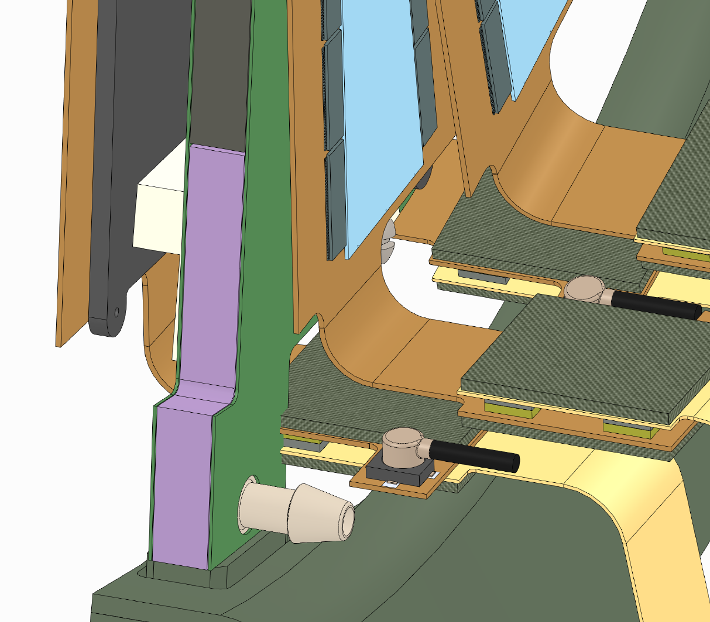
Cut Notches in Mounting Tabs On Small Disks
Backward bent HDI is in reality ~4.0 mm shorter then what was in the CAD model, then the connection tab with the extension cable runs into the “mounting tab” on the disk to the cage in all three locations
Backward bent HDI
Solution; cut notch in mounting tab
Drawings coming from LANL…

Slide 20
Attach Thermocouples to Disks
Simple to attach and test thermocouples at this point; harder to do either of those things after the wedges are mounted on the disks.
The thermocouples will be attached near the cooling inlets and outlets.
Same thermocouples as used on the VTX.
(Need pictorial info here…)

Slide 21
Dry Run: Assemble wedges on disk; put disks in cages
Using blank backplanes (with pedestals) as dummy wedges, or using a small number of real wedges, practice placing wedges on disks. Then practice carrying disk to cages.
How to attach cooling lines?
How delicate is the process of placing a disk in a cage? How many hands/tools/supervisors are needed?
Can disk survey monuments been seen properly once in the cage?

Slide 22
Assemble wedges on disk
Specific assembly ordering -- questions
Bottom layer before top layer – that’s clear!
φ-ordering important? Probably not
Complete one side before the other? Or do both bottom layers before doing the top layers? Perhaps unimportant as well
Where to support cooling lines? Thermocouple wires?

Slide 23
Assemble wedges on disk
Careful attention needs to be paid to the method for inserting and tightening the tiny #2 screws that hold the wedges onto the cooling plates; scratching the surface of the sensor is to be avoided...
Definitely want to use torque-limiting screwdriver with proper driver on it.
May need to customize driver head to safely hold screws.
Use PEEK material for screws.

Slide 24
Grounding Configuration
Concern: digital cross-talk and noise due to interactions between neighboring wedges
Method: send clocks to as many wedges on a disk as possible, and read out selected wedges; look for changes as a function of turning on/off other wedges; can test validity of grounding assumptions

Slide 25
Perform metrology of sensors on disks
Using external vendor, Hexagon Metrology (RI) – transportation issues? Check with Ed O’Brien on paperwork for taking equipment offsite. Also need proper packing for transportation.
Touch-probe (“stylus”) will locate the three circular survey points on a disk
Optical viewer will locate the 2 visible reference marks on each sensor; sensors have 6 reference marks, but in general 4 of them will be obscured by encapsulant;
Both sides of disk optically surveyed in single operation; establishes relation between coordinates on either side

Slide 26
Attach HDI extension cables, cooling lines, and bias cables to wedges
For the extension cables, an exact correlation between length, bending, and wedge location exists
Extension cables are fastened to a hoop to keep them in place during this process, and for upcoming transfer to the cage
Probably want to do extension cables at same φ together, attach them to the hoop, then move on to the next φ location
Cooling lines and bias cables must also be attached; thermocouple wire as well

Slide 27
Transfer disk to cage; route cooling lines and cables
Station is hand-carried a short distance from disk assembly fixture to cage fixture using special carrier designed for each station
Cooling lines may need to be routed through cage walls during this procedure (is this dodgy?)
Carrier rests on cage while station is fastened to the cage; cables are unfastened from the hoop; carrier is then taken away
Cables are then attached to the ROC board

Slide 28
Test disk in cage using ROC card with cooling in operation
It is very important to test a disk in a cage as much as possible BEFORE putting in the next disk (for repairs, disks must be removed in the opposite order they were put in…)
This includes operating the disk through the ROC card, applying bias, running cooling through the lines – everything possible
Grounding options can be explored at this time as well…

Slide 29
Metrology of Disks in Cages
It is proposed to measure the relative positions of disks inside a cage using the touch-probe of the brand-new 5-axis CMM in the main shop at BNL.
The CMM in the main shop cannot be outfitted with a camera, and they seem to lack the expertise to import a design model into the measuring program, but the number of measurement points is not very large so these do not seem like major obstacles

