Slide 1
RIM6125
B3L12 stave
The upper side in this picture is the side where the leak position was first found
The lower side in this picture is the side where we see strange object inside the tube
The lower side was cut by Bill Lenz at the middle so that we can see inside of the tube
The strange objects are at the corner of the tube.
A half of the tube stayed in the stave. The other half was cut out and was placed next to the stave. The Kapton tape is to protect the cut area. It was placed after Bill Lenz cut the tube. Then he cut/removed the carbon sheet of the upper part to reveal the tube.

Slide 2
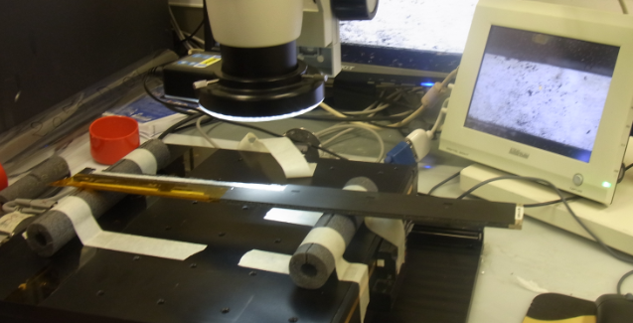
The tube is really dirty. A lot of reactions. A lot of dirty stuff.
Start scanning the upper part: Aluminum tube surface. RIM6134. 13:18=12:03 EST

Slide 3
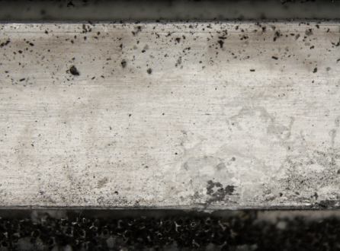
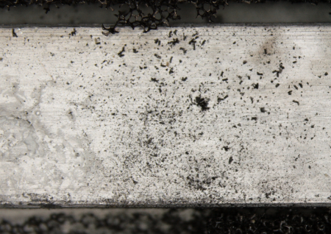
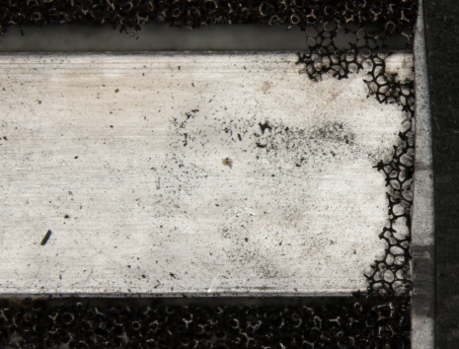
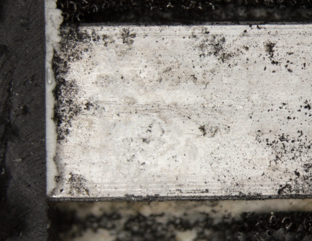
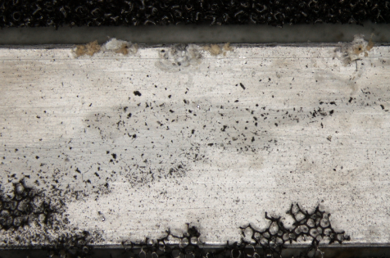
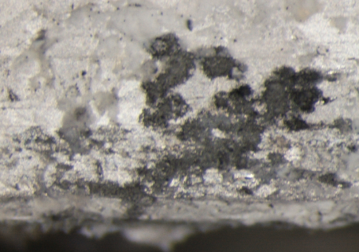
19132346 13:23 (11:48 EST)
start of upper surface scan
19133424 End 13:34 (11:59 EST)

Slide 4
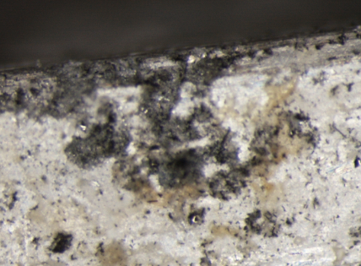
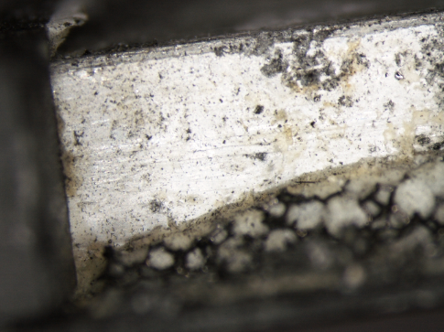
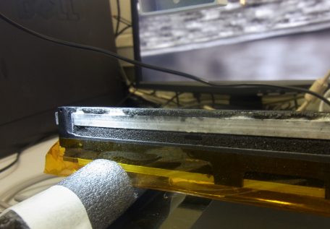
19134254
Looks like a leak point
19134126 13:41 (12:01EST)
RIM6138 13:18(camera)
12:03 EST
After top surface scan, see the side wall
We found a large corrosion near the end.

Slide 5
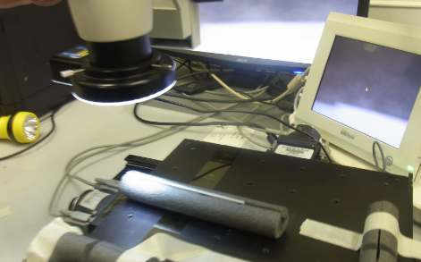
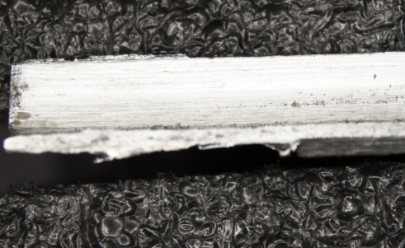
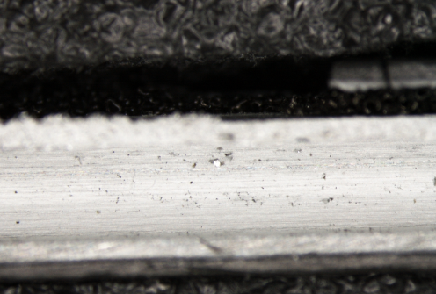
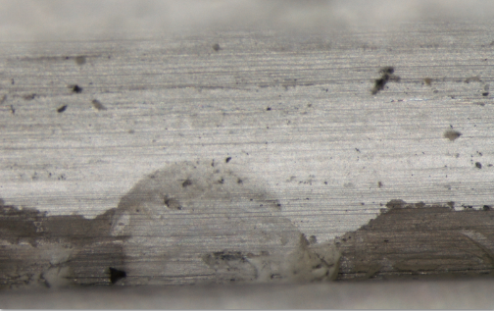
19135219 13:52=12:17 EST
RIM6146 scan of the small cut-away piece
13:30(camera) = 12:15 EST
19140956 14:09=12:29 EST
End of Scan. Lunch break.
19140319. This is the “strange object”

Slide 6
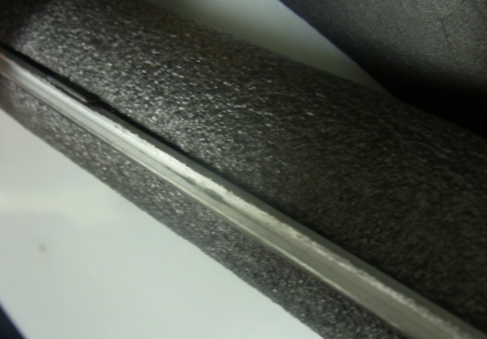
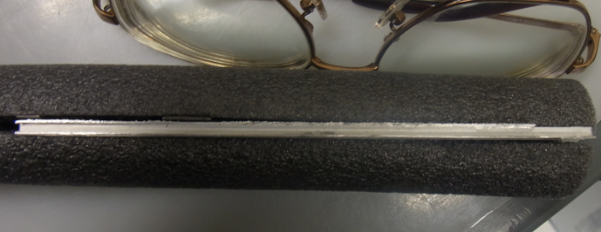
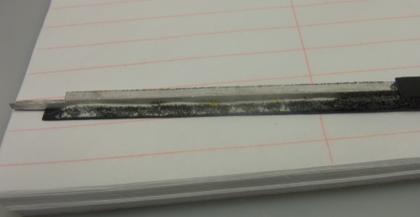
RIM6149
This is the one seen in the video scope
RIM6158 14:35=13:20 EST
RIM6159 the other side of the piece
You can see several yellowish spots

Slide 7
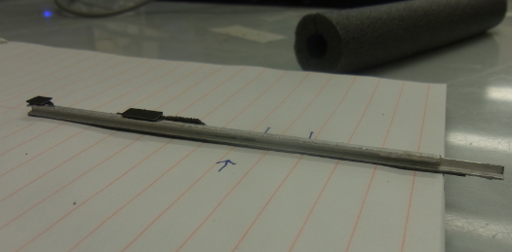
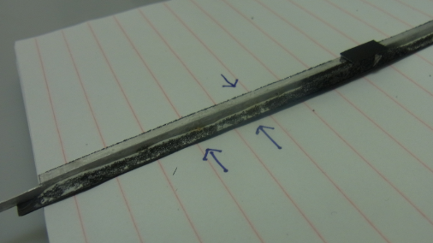
RIM6167 position of the strange feature
inside of the tube
The backside. The arrows points to yellowish spots
The left spot is quite large

Slide 8
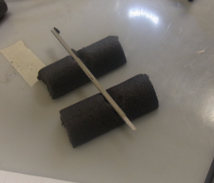
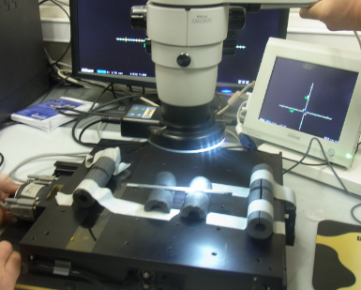
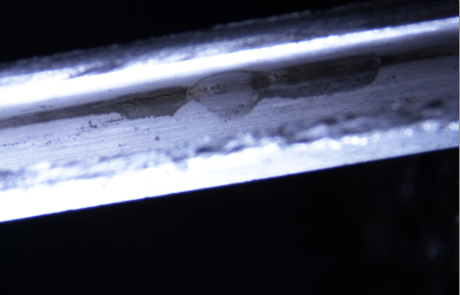
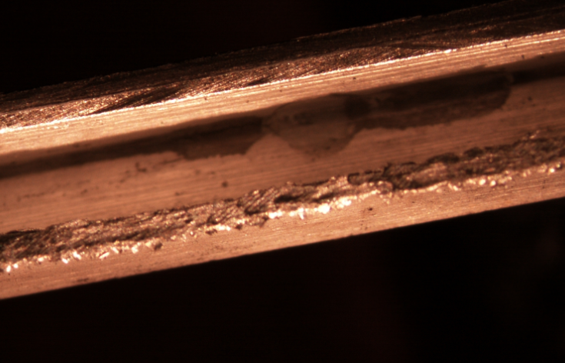
RIM6172. To see the strange object at the corner,
Hubert made a nice support
RIM6174 View the corner. ~45 deg rotated.
14:49(camera) = 13:34 EST
19151414 trying to get a better lighting
You see the strange feature at the corner
19151215 15:12=13:37EST
19151215 15:12=13:37EST

Slide 9
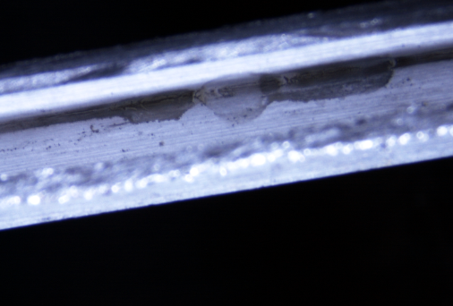
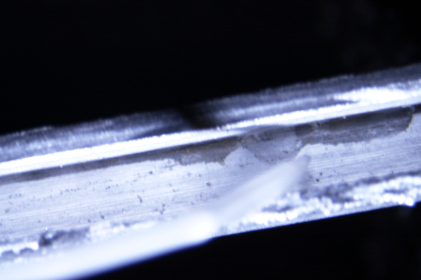
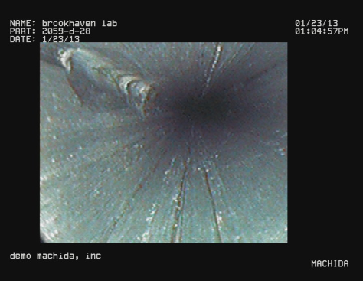
19151627 Rachid touched the place. Actually this is just after he touched.
He said the surface was smooth. But color is changed. No large deformation of the shape.
19151459 I think this is before Rachid touched the place (15:49=14:14EST)
I think this spot is the strange object seen at the corner by the video scope.
In the video scope, there are a few more places with similar features.
I believe the spot in the small piece is exactly the same place seen in the video picture on the left.

Slide 10
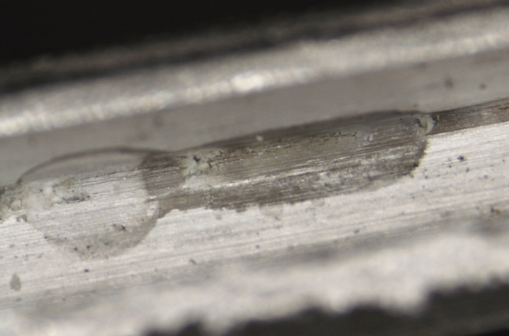
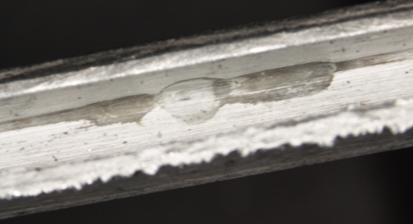
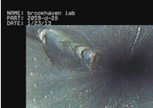
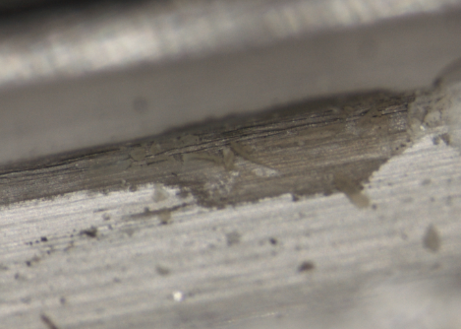
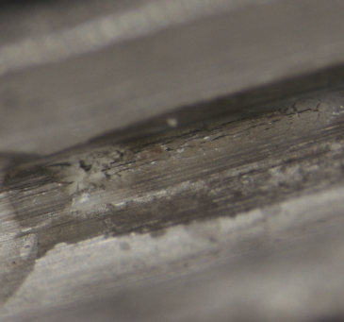
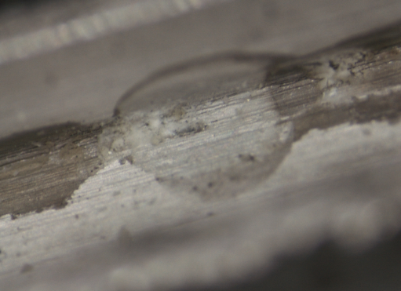
19152107 We found a proper lightning
Looks like a think film-like layer. It is possible that Rachid scratched off some of them

