Slide 1
Summery of Cooling System Teflon Leaks* *This is independent of the internal problems
Rob Pisani

Slide 2
Timeline
April 1st, 2013
3/8” per day drop was observed in the high temp chiller. Leak rate before this was 3/8” per week.
April 3, 2013,
Small hole in FVTX big wheel Return line was found and fixed. Hole was 2 feed down past the FVTX BIG wheel return.
A one foot section of tubing around the leak points was removed and couplings installed.
High temp chiller leak rate returned to ~1/16” a day.
April 12-15, 2013
a larger than normal leak in the low temp loop observed. (3/8” day)
April 17th , 2013
On April 17th Leak rate was ½” a day
Shunts were installed at the Low temp manifold to provide enough flow to the cooling system
A one foot section of tubing around the leak points were removed and couplings installed.
Flow to the VTX-Strip bypass lines was stopped and lines drained.
After April 17th’s repair, leak rate dropped from 1/2” a day to ¼-3/16” a day.

Slide 3
Timeline Continued
No new leaks seem to have developed after April 17th’s.
May 8th,
investigated the continuing slow leak in low temp chiller since April 17th
Found leak in the FVTX return line 2 feet from the supply manifold.
After May 8th Repair, leak rate down to 1/16 a day.
Both chillers have an average leak rate of 1/16” a day
Leak rates of both chillers at start of run were 3/8” a week
Note: 1” fluid drop =1 gallon of Novec in chiller
Diagrams on Slides 5-8

Slide 4
Damage was found in only FVTX returns (4) lines and one FVTX supply line that are run in the same bundle as the VTX strip lines running in bypass.
2 to 3 VTX tubes per bundle depending on side in bypass
These lines are in ½” thick foam rubber insulation
All tubes were wet from water/ice INSIDE the insulation near spark point.
There were no ground points near the damaged areas.
These are the same lines that were used last year.
This year, short bypass lines at the detector were installed since Strips are not running
This year, grounding was added to the Stainless barbs at the detector
Pressure of return lines are under 10 psi
Flows are the same as last year ~20 gph
Low temp (0C) leaks look to have started around April 12-14
Similar damage found in FVTX Big Wheel return line on North East during the April 3 access. Only difference is fluid temp is 10C

Slide 5
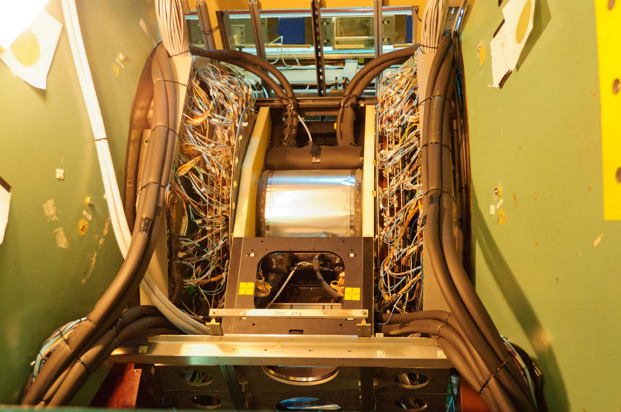
Bypass Lines for missing parts of the VTX
Areas where SS hose barbs are grounded
Bypass lines added to maintain proper flow for cooling system
Grounding was added in 2013
To stop large static discharging from the tubing

Slide 6
Work April 3rd and 17th
Leak Found
Low Temp FVTX Line 4/17
Leak Found
Low Temp FVTX Line 4/17
Leak Found High Temp FVTX on 4/3
Similar leaks found in FVTX returns lines on West

Slide 7
May 8th Repair
Leak Found Low Temp FVTX on 5/8 2 feet from manifold on return line only 1 line.

Slide 8
Modifications for Run 14
All long runs of Teflon were replaces with 5/16” Stainless steel.
3 to 4 foot Teflon jumpers were used at both ends to connect to manifold and detector.
Barbs between Teflon and Tygon were grounded (both loops)

Slide 9
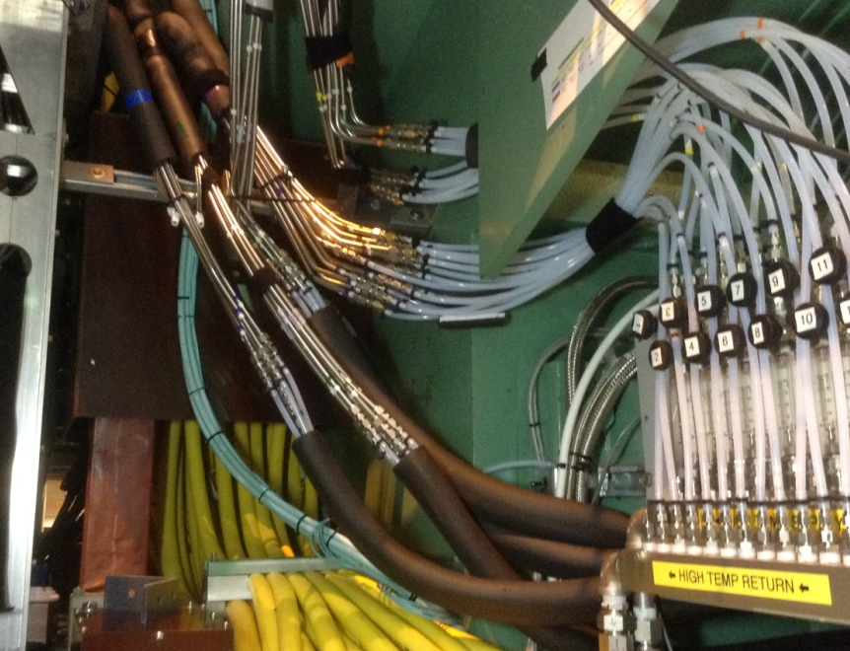
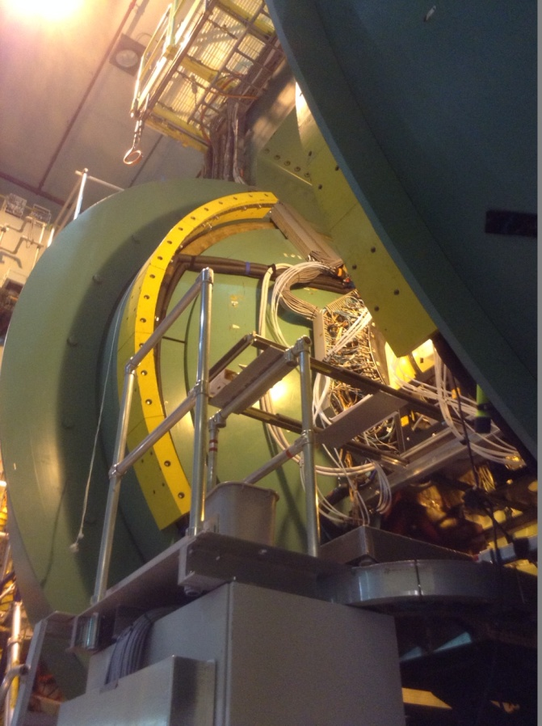
Stainless lines being installed

Slide 10
Timeline for Run 14
Feb 19th 2014—High Temp chiller Loop
Damaged lines were on the output of the big wheels (all 4 locations, 6 to 9 inches from the Tygon connection point)
Sparking at damaged areas was audible and visible (and recorded) .
Static charge could be felt easily on the outside of those lines at all 4 locations.
We had 7 damaged lines during that access (feb 19). All lines were on the big wheel return lines (SE 1,2,4 NE 2,3 SW 4 and NW 1)
No charging or damage was found in any other locations.
In addition, the lines exiting the big wheels were covered with aluminum and grounded to help dissipate the charge before it does damage. (bad Idea)
Re-inspect on Feb 24th because of fluid drop
Many damaged Big Wheels lines again
Also found damage to Pixel Return lines
The FAQ for Novec has also changed from last year. It now includes information about static charging and dissolved plasticizers.
http://detector-cooling.web.cern.ch/detector-cooling/data/3M_FAQ_Fluorinert.pdf

Slide 11
Another interesting Video
This is a 18” section of Teflon that was removed from the detector. It was sitting on the table for about 20 minutes before we cut it.
Seems the whole length of tube collects charge
It does not drain across the surface.

Slide 12
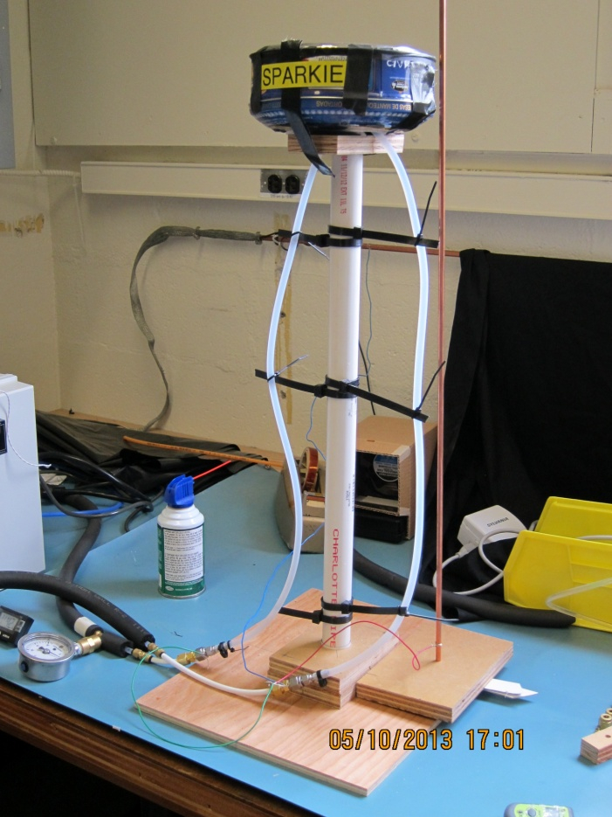
Work to Reproduce damage in lab
Hubert Tried to generate charge in teflon
Different temperatures were tested.
Not able to generate charge
This year I tried to repeat the test by making a mock up of the big wheel.
(6 feet 3/16” al tube, tygon, teflon to stainless very similar to the setup in the IR
Ran at different temps and flow
Nothing generated.

Slide 13
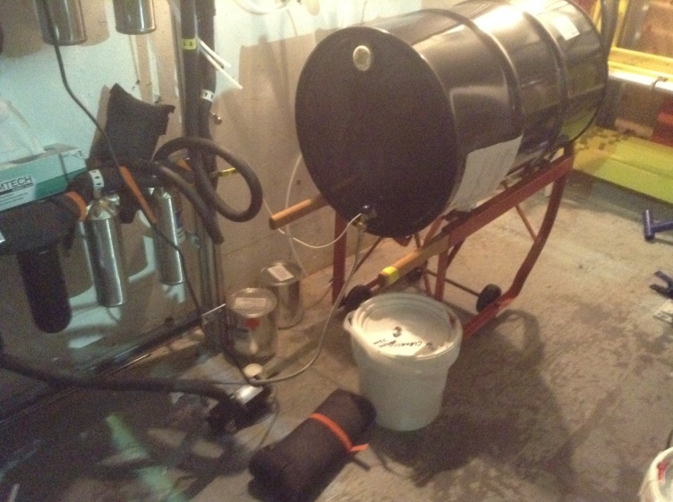
Spark!!
One place we have been able to generate charge is at the Drum of Novec
Drum and flex line are isolated
Drum is porcelain lines
Flex line is stainless steel
The pump housing and impeller are plastic.

