Slide 1
Physics Impact of
MPC-EX on other Subsystems
Oleg Eyser
UCR/BNL
MPC-EX Internal Review
December 9, 2011

Slide 2
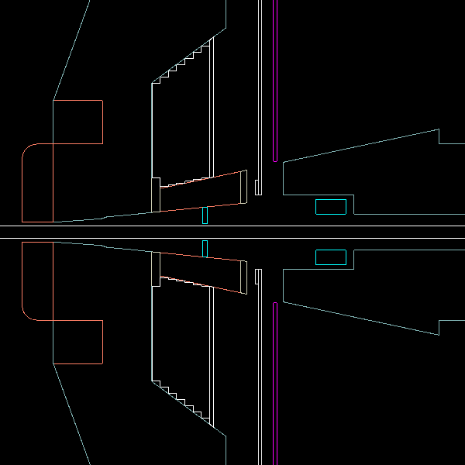
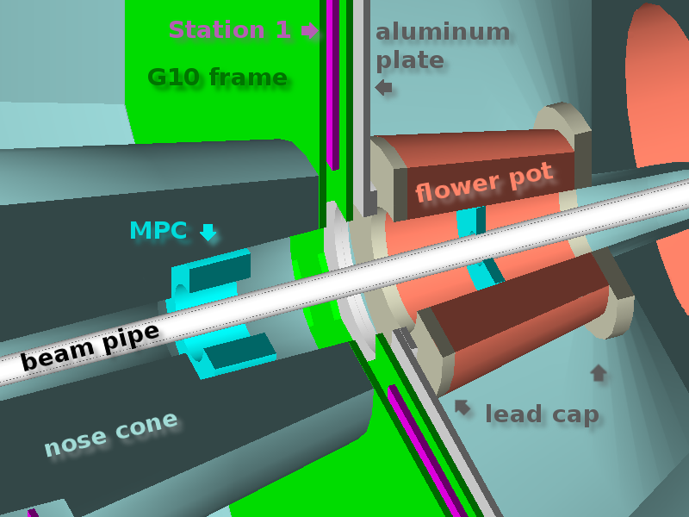
Geometry & Physics
GEANT4
  complete south muon arm + central magnet
QGSP_BERT_HP interactions
  process modeling for neutron thermalization
  complete isotope mix for materials
PYTHIA input → neutron flux or photons

Slide 3
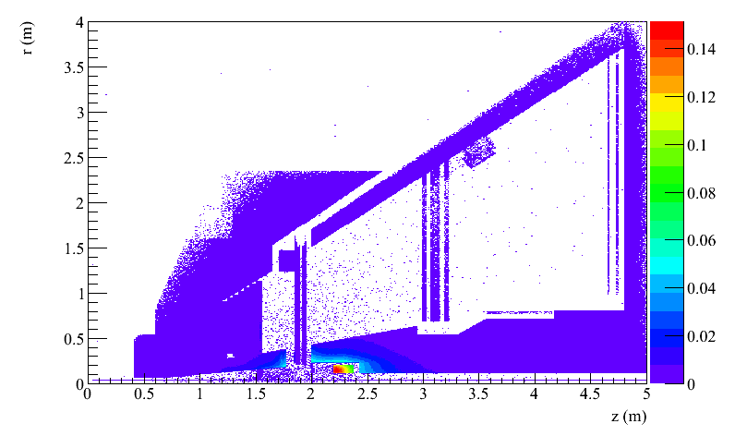
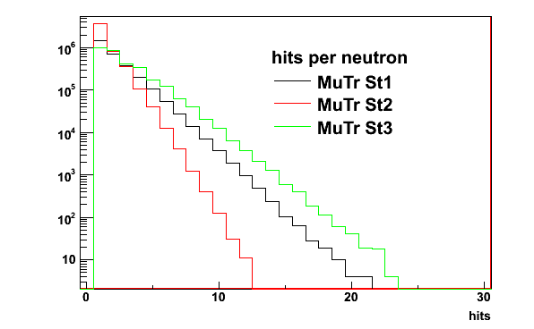
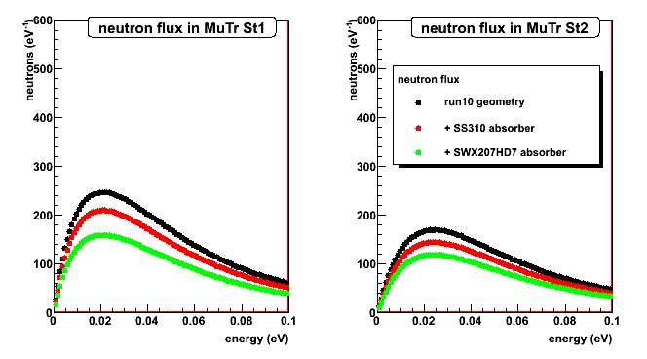
Thermal Neutrons
Origins of neutrons in MuTr St1
Thermal neutrons behave gas-like
Thermalization happens primarily on hydrogen (water, plastic, G10)

Slide 4
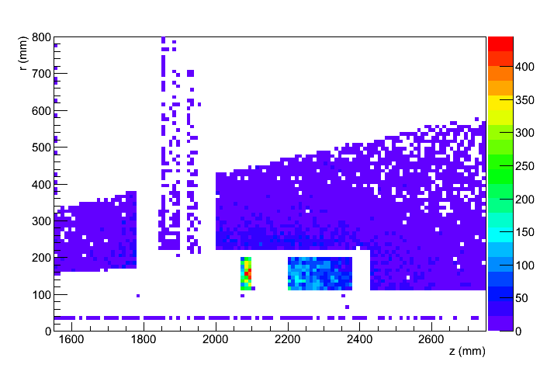
Inclusion of Pre-Shower
MuTr St1
MPC read-out
Neutron origins are shifted into the pre-shower
Spallation products are directed (dep. on material)

Slide 5
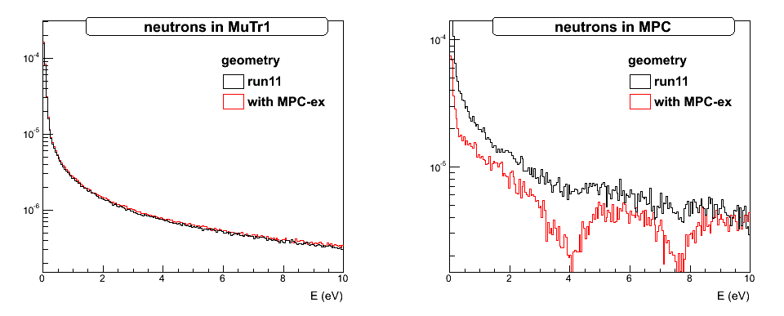
Slow Neutrons with MPC-EX
per event per cm²
(absorption resonance in W)
Comparison with dedicated Li absorber shows that neutrons leave piston hole before thermalization
It is not important where the neutrons are produced (for a thin component in front of piston hole)

Slide 6
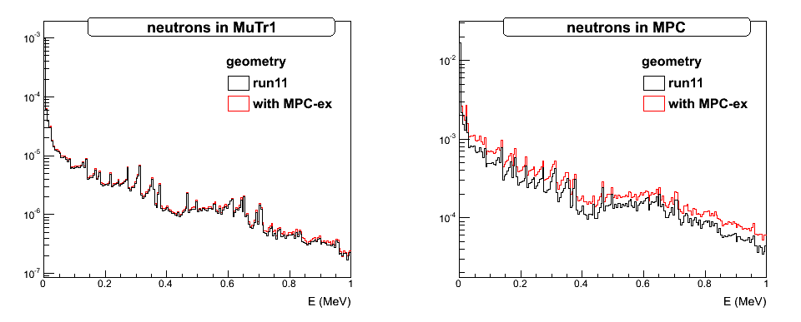
Fast Neutrons with MPC-EX
Impact on MuTr is comparable to slow neutrons
Increased impact on MPC (read-out and crystals)
Total spectrum falls exponentially

Slide 7
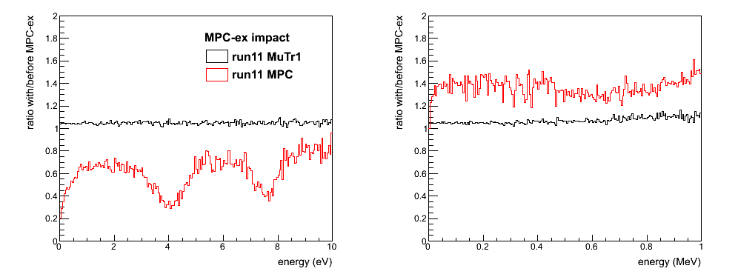
Summary
Tungsten itself is a pretty good neutron absorber
The directed spallation process leads to an increased neutron flux on the MPC read-out

Slide 8
Conclusions
Muon Trackers
  High energy gamma emission from thermal neutron capture
  Increased by about 5%
MPC
  Fast neutron background in read-out
  Total neutron flux in PbWO₄ crystals
  Increased by about 40%
  Comparable to increased c.o.m. energy
  200 → 500 GeV

Slide 9
backup

Slide 10
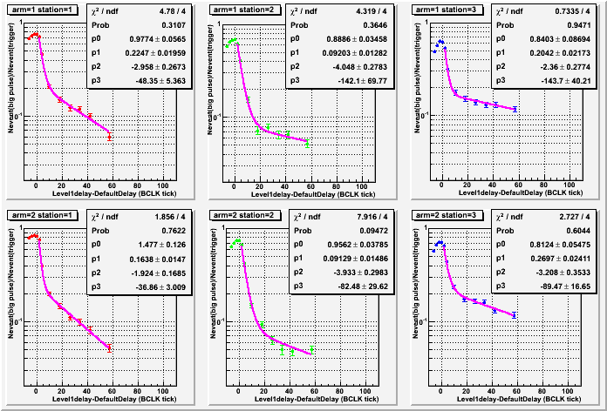
Single Bunch Analysis Run10
Collision bunch
Tsutomu Mibe
S.St1
S.St2
S.St3
5μs
15μs
15μs
N.St1
N.St2
N.St3
4μs
9μs
9μs

Slide 11
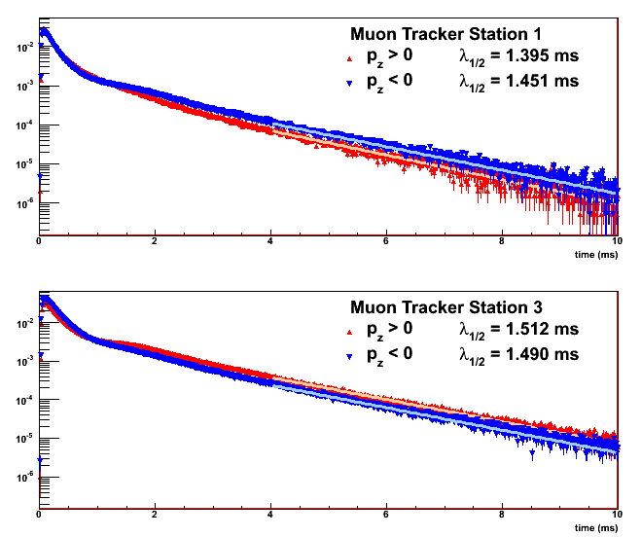
Thermal Neutron Times
Different regions with changing behavior
Thermalization
Carbon: 110 collisions
Iron: 500 collisions
Lead: 1800 collisions
Effective thermalization
takes ≈30 µs
Travel times between
stations > 0.5 ms
Very consistent between
St1 and St3
thermalization
in G10 @ St3
thermalization
in G10 @ St1

Slide 12
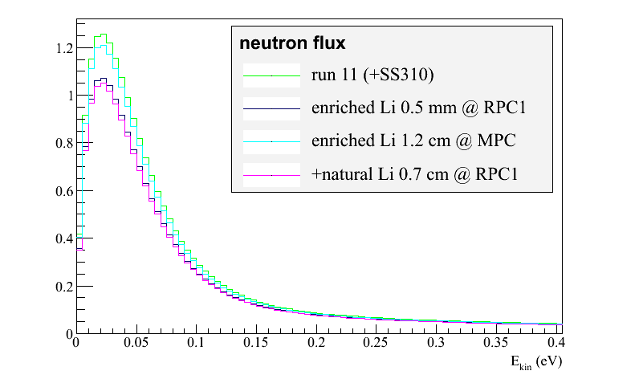
Li Absorber in Piston Hole
Additional Li₂CO₃ absorber at the opening of the piston hole
Using all UIUC Li₂CO₃
22.0 cm radius
1.2 cm thickness
Absorber in piston hole only has small effect

Slide 13
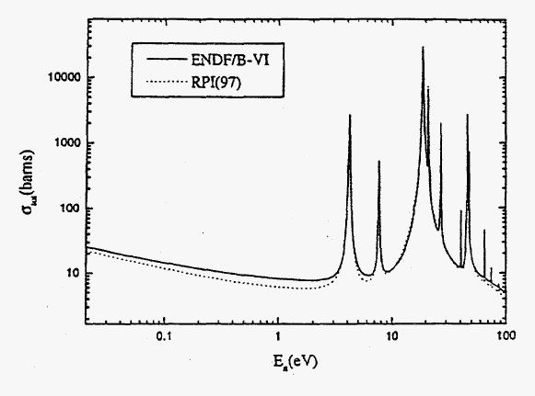
Neutron Capture in Tungsten

