Slide 1
FVTX half-station-disk assembly orientation and bias cable layout
Walter Sondheim - LANL
Mechanical Project Engineer; VTX & FVTX

Slide 2
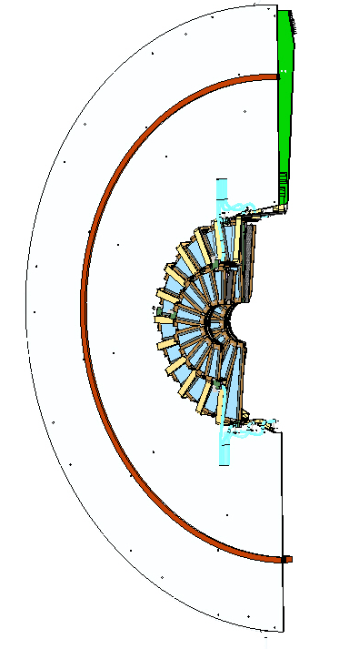
Northwest and Southeast Assembly
An assembled Half-FVTX detector, location in the PHENIX experimental hall: the Northwest or Southeast position.
All station disk are numbered from the IP side of the detector, stations 1, 2, 3 & 4, from a mechanical perspective.

Slide 3
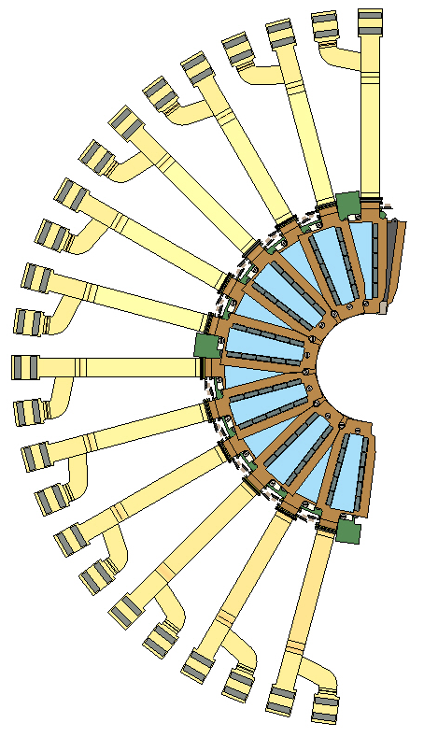
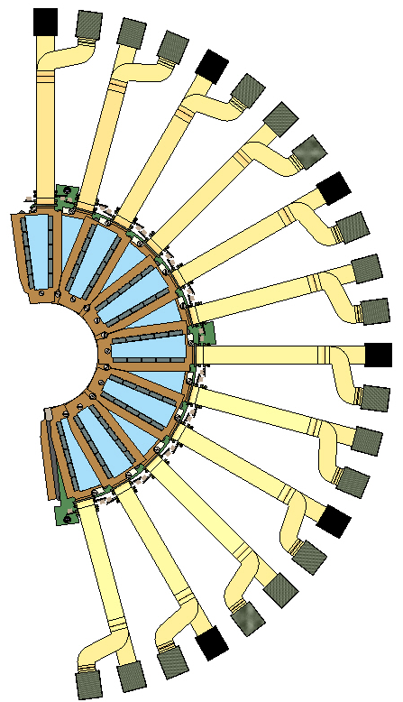
NW and SE station 1:
Upstream first top wedge #1, going counterclockwise to 12.
Downstream first top wedge #1A, going clockwise to 12A.
#12
#12A
IP facing side
Looking towards IP backside

Slide 4
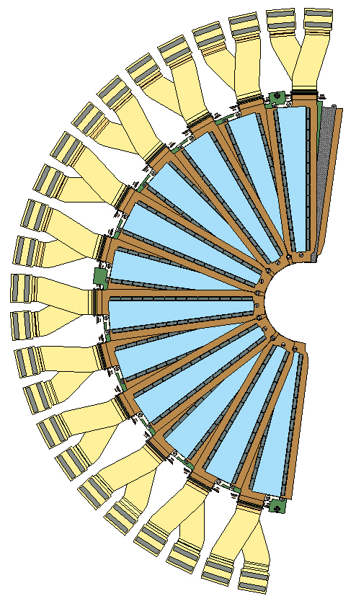
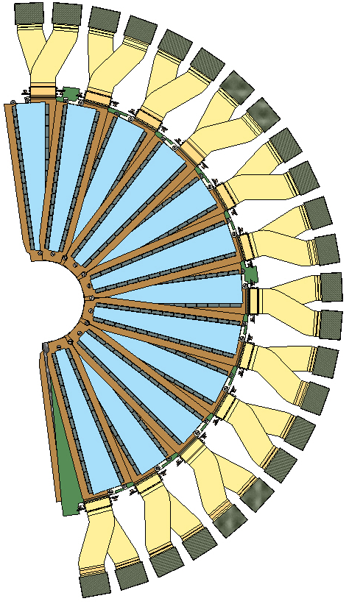
NW and SE station 2:
Upstream first top wedge #1, going counterclockwise to 12.
Downstream first top wedge #1A, going clockwise to 12A.
#12
#12A

Slide 5
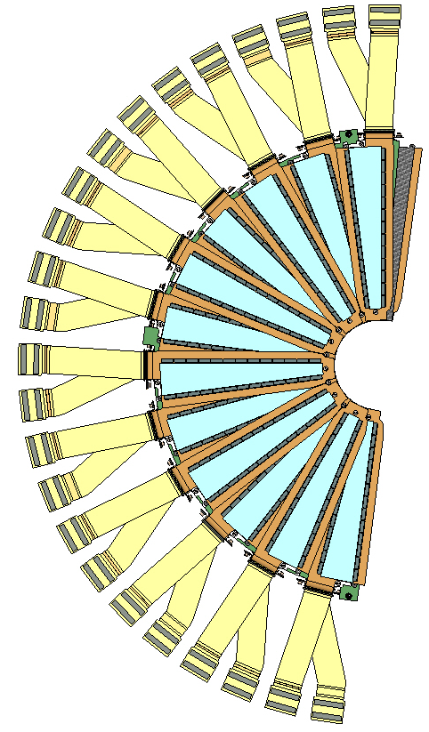
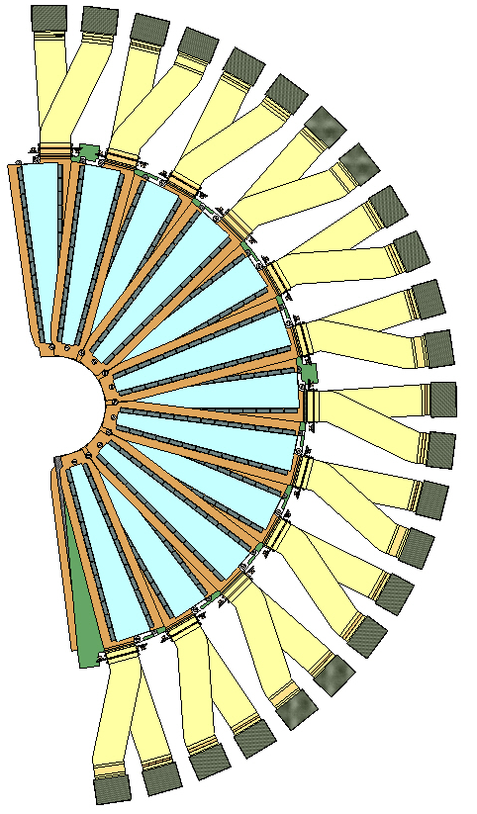
NW and SE station 3:
Upstream first top wedge #1, going counterclockwise to 12.
Downstream first top wedge #1A, going clockwise to 12A.
#12
#12A

Slide 6
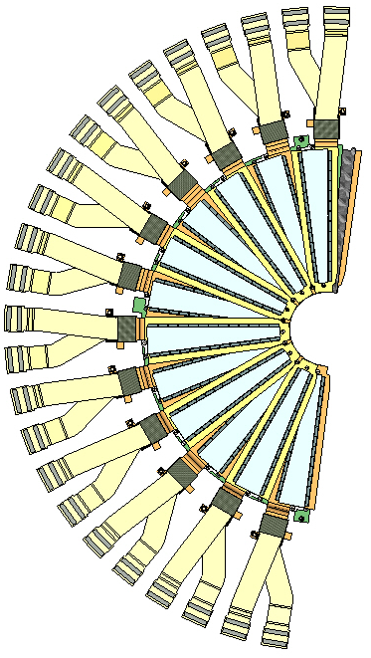
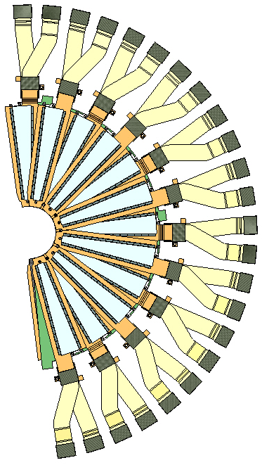
NW and SE station 4:
Upstream first top wedge #1, going counterclockwise to 12.
Downstream first top wedge #1A, going clockwise to 12A.
#12
#12A

Slide 7
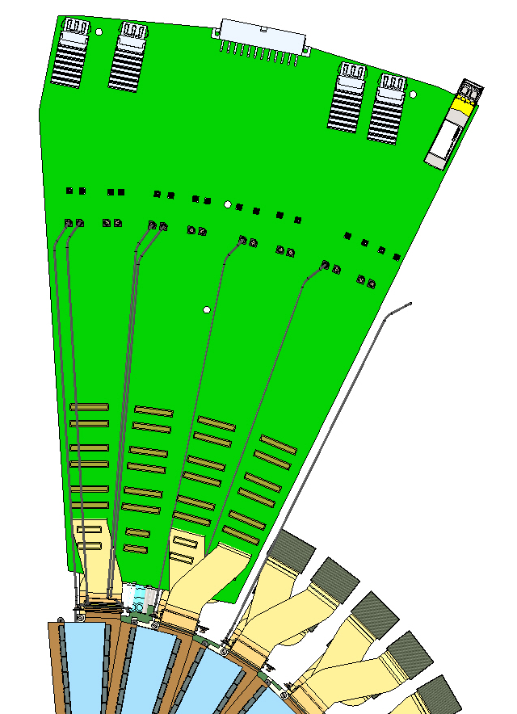
FVTX ROC card:
Bias cable connector or ROC card; 1 – 16, left to right
  #1 station1 wedge 1A, downstream tall pedestal
  #2 station 2 wedge 1A, downstream short pedestal
  #3 station 3 wedge 1A, downstream short pedestal
  #4 station 4 wedge 1A, downstream short pedestal
  #5 station 1 wedge 1, upstream short pedestal
  #6 station 2 wedge 1, upstream tall pedestal
  #7 station 3 wedge 1, upstream tall pedestal
  #8 station 4 wedge 1, upstream tall pedestal
  #9 station 1 wedge 2A, downstream short pedestal
  #10 station 2 wedge 2A, downstream tall pedestal
  #11 station 3 wedge 2A, downstream tall pedestal
  #12 station 4 wedge 2A, downstream tall pedestal
  #13 station 1 wedge 2, upstream tall pedestal
  #14 station 2 wedge 2, upstream short pedestal
  #15 station 3 wedge 2, upstream short pedestal
  #16 station 4 wedge 2, upstream short pedestal
In Roger’s model the station 1 half disk has different wedge layout
Bias connections on ROC board, left to right 1 - 16
1
16

Slide 8
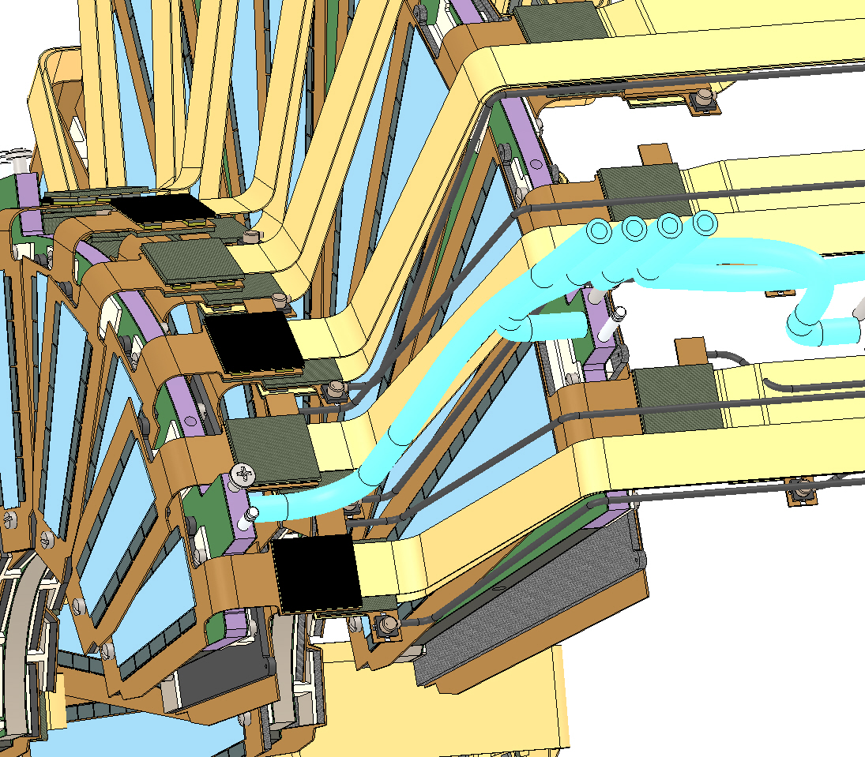
FVTX Bias connection on wedge:
Station 1 wedge 1A

Slide 9
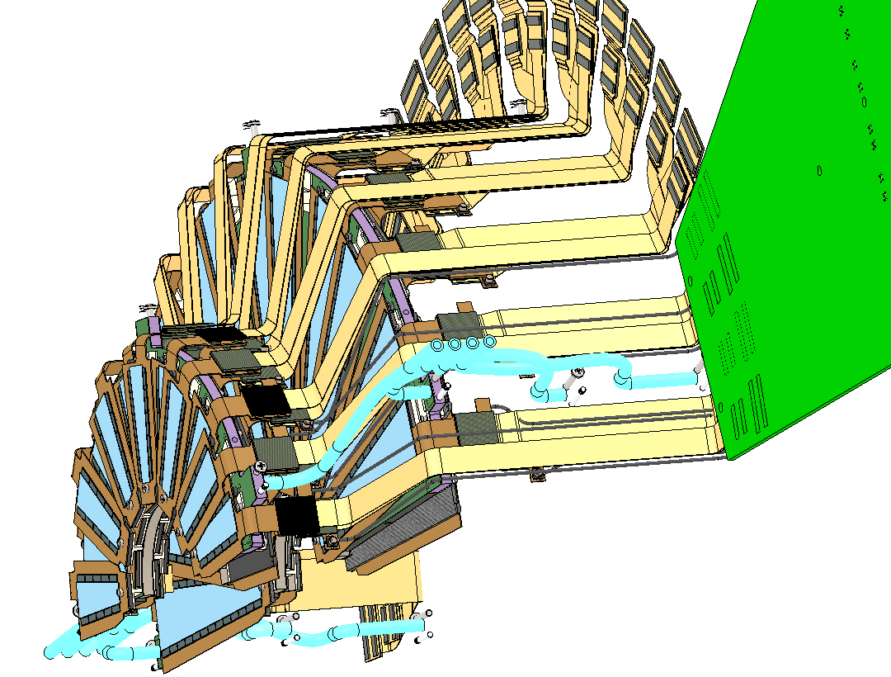
FVTX bias cables:
In final iteration of bias cable layout they will be color coded.

