Slide 1
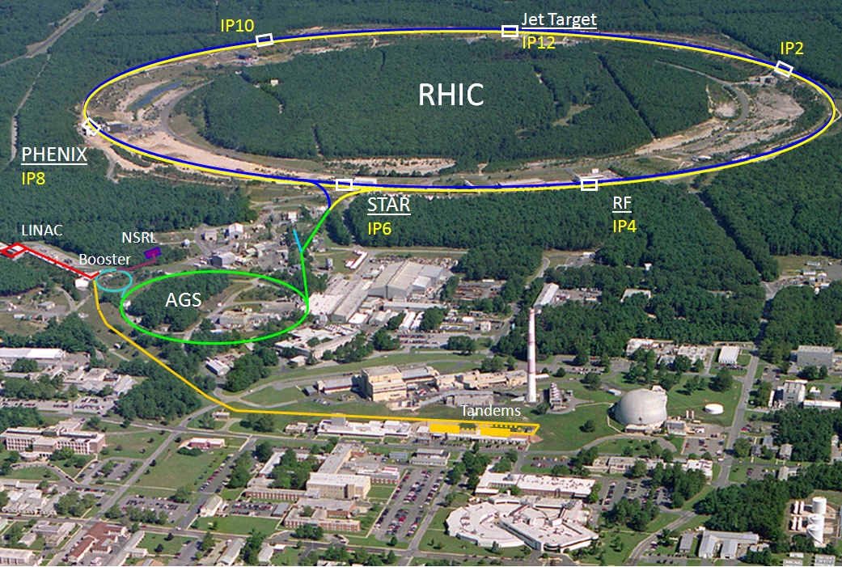

Internal target option for RHIC Drell-Yan experiment
Wolfram Fischer and Dejan Trbojevic
★
31 October 2010
Santa Fe Polarized Drell-Yan
Physics Workshop
Notes:
25+10 min total

Slide 2
Content
Layout of internal target experiment
β* considerations, orbit correction
Low density target option– 10¹⁵ atoms/cm²
low density = operation in parallel to STAR and PHENIX
High density target option – 10¹⁷atoms/cm²
high density = dedicate operation after store for STAR and PHENIX

Slide 3
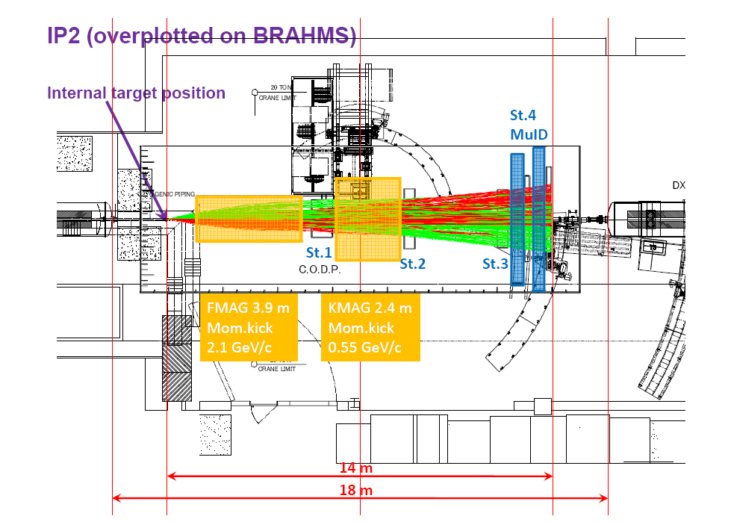
Drell-Yan experiment proposal with internal target
Notes:
Apparatus from E906 (Fermilab)

Slide 4
Orbit effects
2 dipoles (11, 3 mrad bend) with same polarity
(RHIC arc dipoles bends 38 mrad)
Beams largely shielded (see next slide)
For comparison:
RHIC orbit corrector has 0.3 mrad
(at locations with larger β-functions)

Slide 5
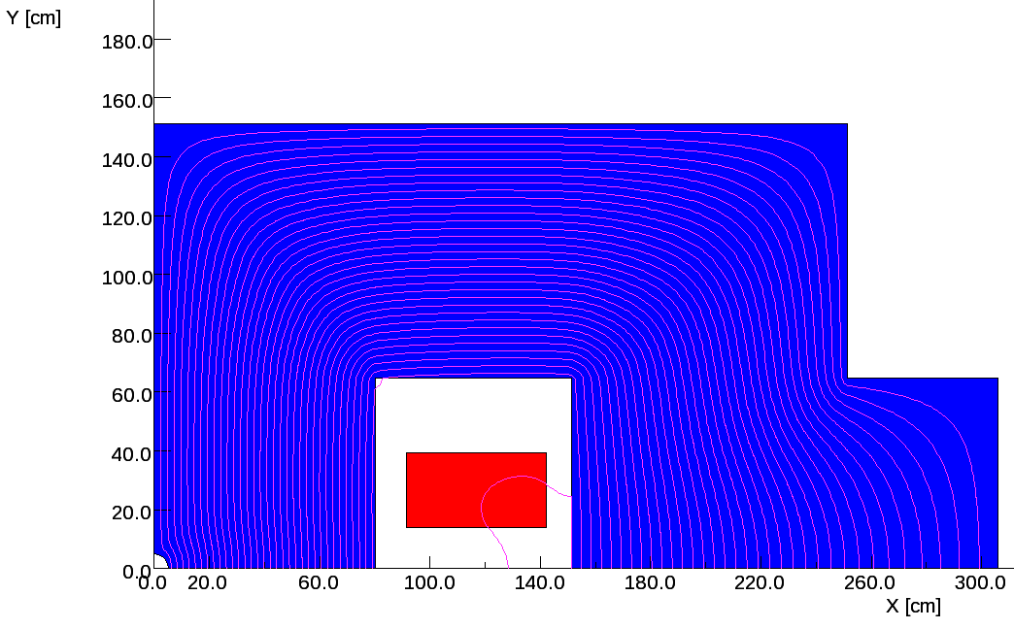
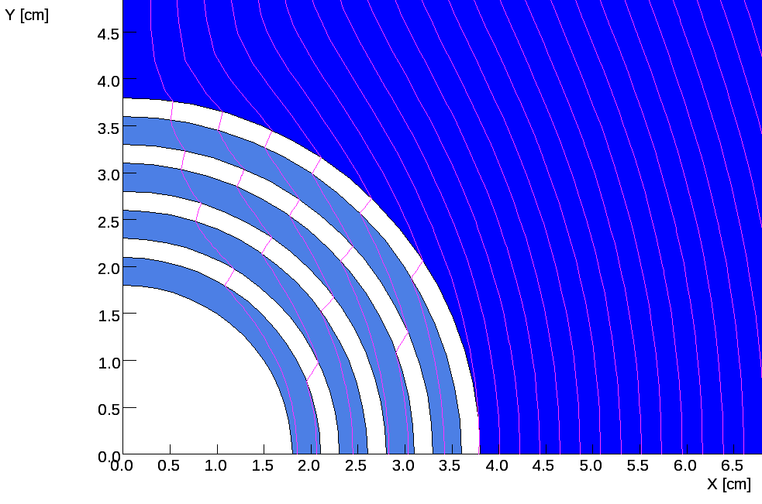
Orbit effects
If we drill a R=5 cm through hole, then field drops to 0.336 T
(magnetic length will increased by 10 cm)
By = 0.1662 T
R = 5cm: 1.3 Tm
R = 2cm: 0.6 Tm
+ ~20% from 2nd magnet
[RHIC arc dipole corrector: ~0.3 Tm )
Needs further work, likely not a showstopper for small radius.

Slide 6
β* considerations
Have operated BRAHMS mostly with β* = 3.0 m
(until Run-6)
Have also used
  β* = 2.0 m (d-Au at 100 GeV/nucleon, Run-3, lifetime/background problems)
  β* = 2.5 m (Cu²⁹⁺ at 100 GeV/nucleon, Run-5, lifetime/background problems)
  β* = 3.0 m (Cu²⁹⁺ at 11.2 GeV/nucleon, Run-5)
  β* = 3.0 m (31.2 GeV p, Run-6)
β* = 2.0 m possible (perhaps even β* = 1.0 m)
[not critical for internal target, see next slide]
May need power supplies for local correctors
can be studied with dynamic aperture simulations (Y. Luo)

Slide 7
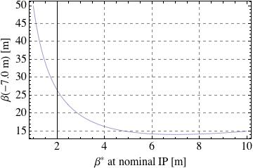
β* considerations
So far all consideration were for β* at nominal IP
Internal target is at s = -7.0 m where β should be as small as possible
(to both maximize luminosity and minimize emittance growth of proton beam)
With β* at nominal IP:
β_{min} = 14m at s = -7m
(reached for β* = 7 m)
RMS beam size for
- β_{min} = 14m
- ε_{n} = 20 mm.mrad
- 250 GeV protons
is 1 mm
=> need ~4 mm target
width for full overlap

Slide 8
Beam lifetime with internal target D. Trbojevic
τ lifetime
N particle number
t time
n target density
l interaction length (= circumference)
f revolution frequency
σ_{N} cross section for nuclear interactions leading to loss
σ_{C} cross section for Coulomb interactions leading to loss
[D. Trbojevic, “Beam lifetime and emittance growth in RHIC under normal operating conditions,
with the hydrogen gas jet, the cluster jet and pellet targets”, BNL C-AD/AP/403 (2010)]

Slide 9
Emittance growth with internal target D. Trbojevic
ε_{Ν} normalize emittance
β_{TWISS} twiss function
Θ scattering angle
m_{p} target density
c speed of light
γ Lorentz factor
Z_{P}, A_{P} particle Z and A
c speed of light
L_{RAD} radiation length
α fine structure constant
N_{m} gas density (molecules/g)
Z_{T}, A_{T} target Z and A
n_{m} gas density (g/cm³)
r_{e} classical electron radius
R_{T} Thomas-Fermi screening radius
R_{N} effective radius of target nucleus
[D. Trbojevic, “Beam lifetime and emittance growth in RHIC under normal operating conditions,
with the hydrogen gas jet, the cluster jet and pellet targets”, BNL C-AD/AP/403 (2010)]

Slide 10
Low density internal target – 10¹⁵ atoms/cm²
Low density H target (storage cell, cluster)
for continuous operation in parallel to PHENIX and STAR
With 10¹⁵ atoms/cm²
  beam lifetime: τ_{Ν} = 15 h
  initial loss rate of 4x10⁸ p/s + secondary particles
  luminosity lifetime: τ_{Ν} < 7.5 h
  emittance growth: dε_{N}/dt ~ 10⁻² mm mrad/h
  luminosity loss to PHENIX and STAR (10 h store): ~% range
Need to reduce target density by about factor 3-5
τ_{Ν} ~ 50 h without target under current conditions

Slide 11
Beam lifetime in Run-8 pp (100 GeV)
Intensity fitted to N(t) = A*exp(-t/t1) + (1-A)*exp(-t/t2) [first 3h]
slow part, A = 10%
50 h
slow part, 1-A = 90%
Expect proton beam lifetimes at 250 GeV to approach these values in the future.

Slide 12
Luminosity lifetime in Run-8 pp (100 GeV)
Luminosity fitted to L(t) = A*exp(-t/t1) + (1-A)*exp(-t/t2) [first 3h]
slow part, A = 12%
14 h
slow part, 1-A = 88%
Expect proton beam lifetimes at 250 GeV to approach these values in the future.

Slide 13
High density internal target – 10¹⁷ atoms/cm²
High density target (pellet, solid)
for end-of-store operation after PHENIX and STAR
With 10¹⁷ atoms/cm²
  beam lifetime: τ_{Ν} = 0.15 h
  initial loss rate of 4x10¹⁰ p/s + secondary particles
  emittance growth: dε_{N}/dt ~ 1 mm mrad/h
  can cause beam losses in other parts of ring
  luminosity loss to PHENIX and STAR (10 h store): ~2-3%
  due to lost time in overall cycle
  DY experiment becomes the beam dump

Slide 14
Luminosity loss to STAR and PHENIX for end-of-store operation
operation ok right of line
Assumptions:
12 h from beginning of store to next (without DY experiment)
end-of-store run with length of 1.5x beam lifetime (N_{b,final} = 0.22 x N_{b,initial})

Slide 15
High density internal target – 10¹⁷ atoms/cm²
With high density target beam loss at internal target
is similar to beam dump
Internal target will become
effectively the beam dump
Will need shielding and
radiation control like at dump
In particular need shielding
for superconducting magnets
in area (especially DX)
Electronics in experimental
hall needs to be radiation hard

Slide 16
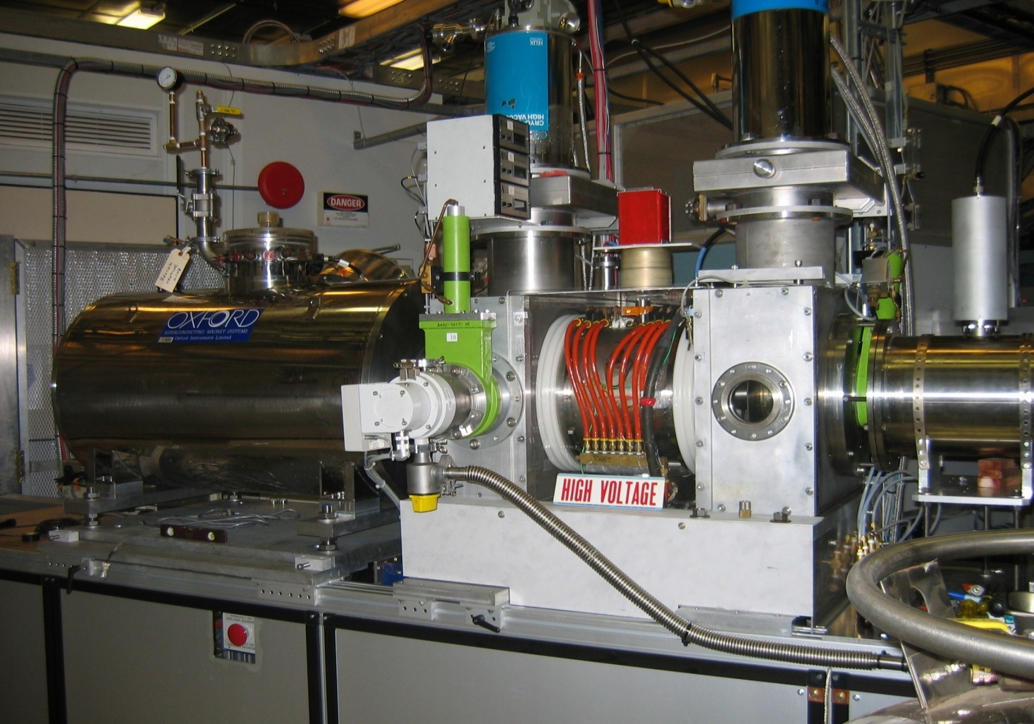
Polarized proton intensity upgrades
Bunch intensity
Polarized source upgrade under way
10x intensity, ~5% more polarization (2013)
could translate in about 3x10¹¹ p/bunch
new SAD/ASE (under way)
Number of bunches (>111) requires
new SAD/ASE (under way)
new RHIC injection system
likely in-situ coating of beam pipe
(R&D under way)
possibly another dump upgrade
(just finished one – beam pipe inserts)
improved machine protection system
(loss control on ramp, during store)
existing OPPIS
In-situ pipe coating SEY
and ρ reduction (start >2013)

Slide 17
Other ideas – target surrounding beam (E. Stephenson)
Plan experiment to measure polarization at large amplitudes (M. Bai).

Slide 18
Summary
Internal target is an option for beam operation
Layout of internal target experiment
orbit distortion with shielded fields probably ok
β_{min} = 7.5 m at s = -7 m, need ~4 mm target width for full overlap
Low density target option – 0.3x10¹⁵ atoms/cm²
parasitic operation to STAR and PHENIX, (%-range luminosity loss)
High density target option – 3x10¹⁶ to 10¹⁷atoms/cm²
end-of-store operation, few % luminosity loss to STAR and PHENIX
target becomes beam dump
Higher bunch intensity upgrade under way

Slide 19
Additional material

Slide 20
β* considerations
Field quality of triples in IR2 not as good as IR6 and IR8
Local IR correctors installed in IR2 (like IR6 and IR8)
but have currently no power supplies connected
have used full complement in IR6/IR8 in operation:
6-poles, skew 6-poles, 8-poles, 10-poles, 12-poles
Small β* implies large β_{max} in triplets (β*β_{max} = const ~ 1.5 km) and therefore larger exposure of beam to triplet field errors
These cause emittance growth and beam lifetime reduction through the enhancement of chaotic particle motion (the reason for all beam loss)

Slide 21
β* considerations
RHIC interaction region with nonlinear correctors
[F. Pilat et al., “Non-linear effects in the RHIC interaction regions, …”, PAC 2003.]
Full corrector set (like IR6/IR8): 14 ps per beam
Reduced set (6-pole, skew 6-pole): 4 ps per beam
About $12k per 50A ps (+infrastructure, controls, and installation: ~$100k)

