Slide 1
PHENIX Upgrades and Drell Yan Capabilities
K. Oleg Eyser
UC Riverside
for the PHENIX collaboration
Santa Fe Polarized Drell Yan Workshop
October 31, 2010

Slide 2
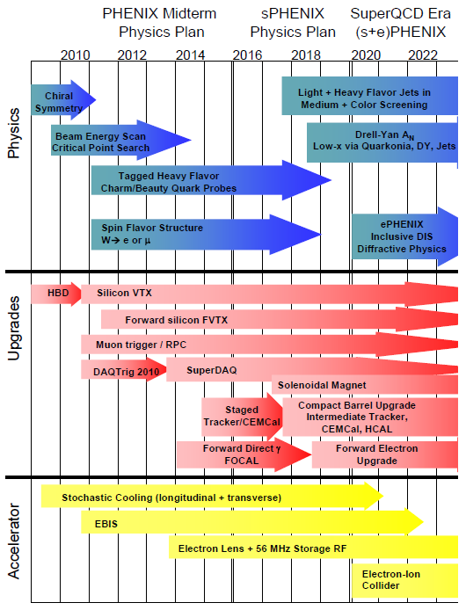
PHENIX Decadal Plan
Midterm upgrades until 2015
Long term evolution after 2015
Dynamical origins of spin-dependent interactions
New probes of longitudinal spin effects
Measurement with polarized He³ and increased energies
www.phenix.bnl.gov/plans.html

Slide 3
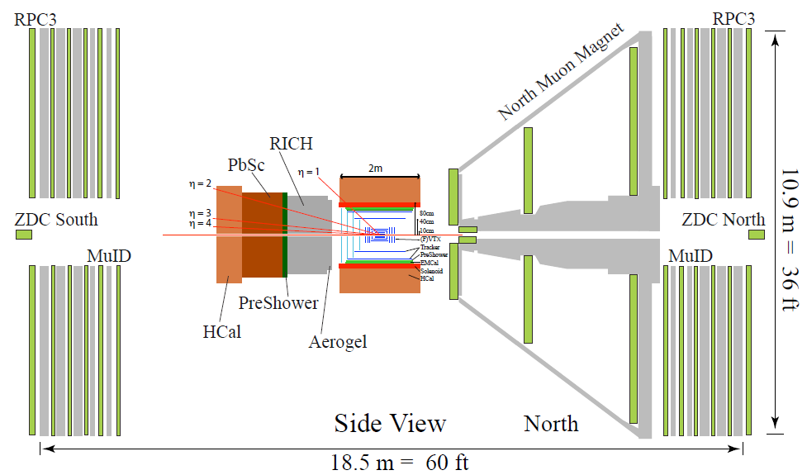
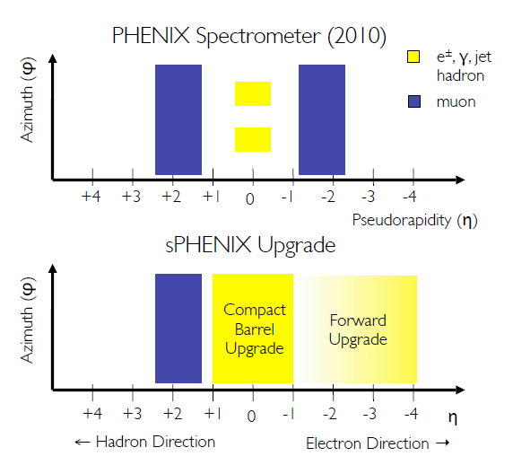
sPHENIX detector acceptance
Data Acquisition System
Trigger capabilities

Slide 4
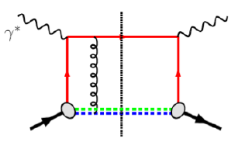
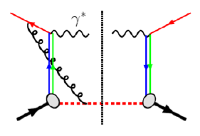
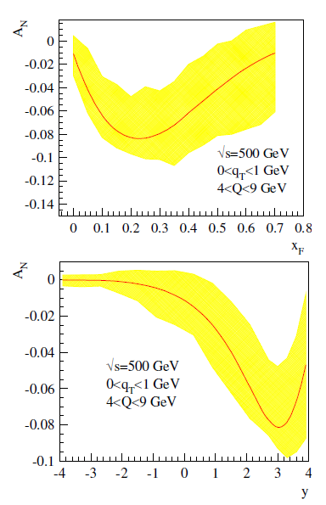
Polarized Drell Yan
Solid factorization
No fragmentation
Direct correlation of intrinsic transverse quark momentum to the proton spin
Fundamental QCD test
Sign of asymmetry compared to SIDIS
current Muon arm acceptance
Z. Kang and J. Qiu. Phys. Rev., D81:054020, (2010)

Slide 5
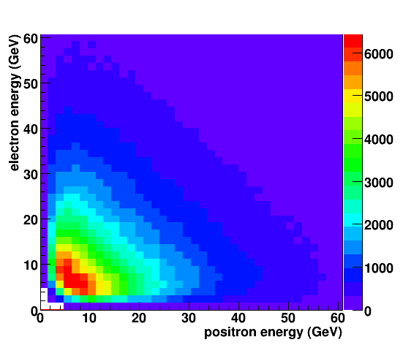
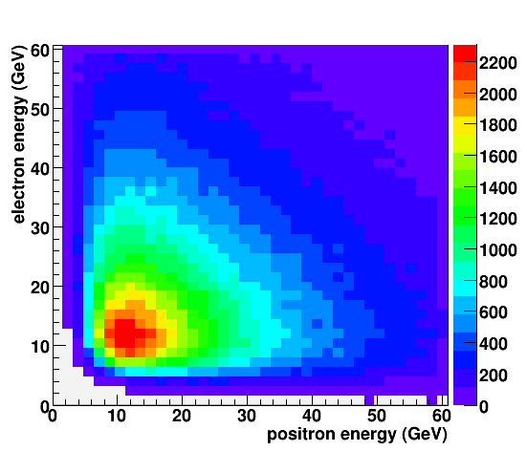
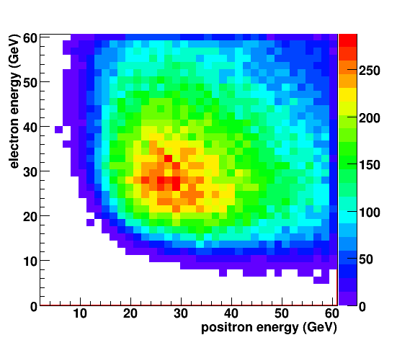
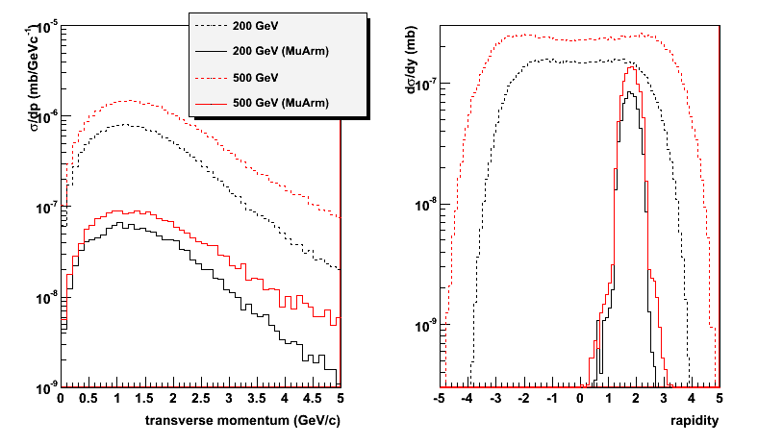
Kinematics
Leptons have large energies
Larger cross section with increased collision energy
Large A_{N} for y > 2
More forward favorable over PHENIX Muon arm detectors ($1.2<η<2.4$)
DY: electron-positron pairs
m_{inv} > 3 GeV/c²
$$η_{lepton}>3.0$$
$$η_{lepton}>1.0$$
$$η_{lepton}>2.0$$
√s = 200 GeV
√s = 500 GeV
muon arm acc.
$$e^{±} vs. μ^{±}$$

Slide 6
Proposed PHENIX Upgrades

Slide 7
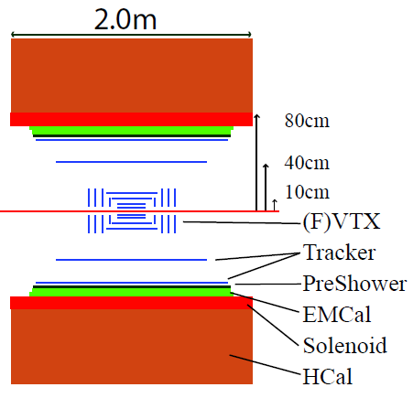
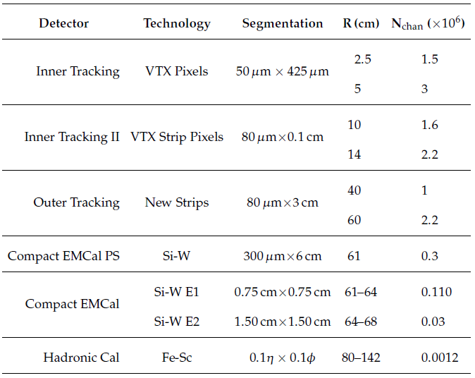
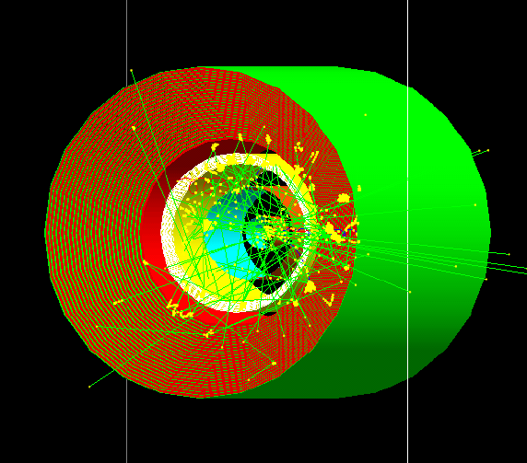
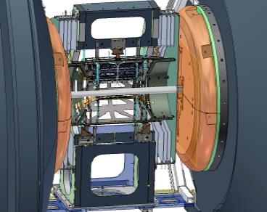
Central Arm Detectors

Slide 8
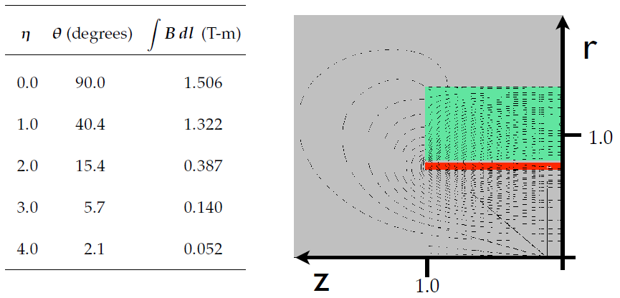
Magnet
Solenoid similar to D0
Magnetic field: B = 2 T
Magnet dimensions: d = 1 m, l = 2 m
Field return with small forward impact

Slide 9
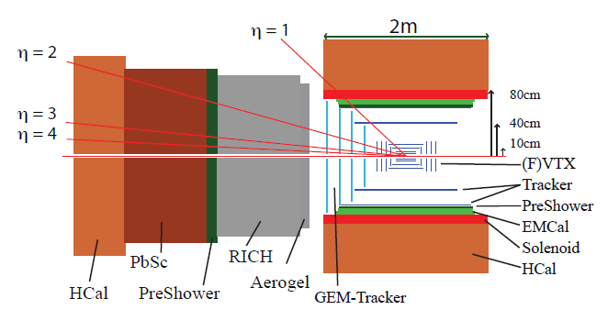
Forward Detectors
Forward direction: 1.0 < |$η$| < 4.0
Momentum / charge identification
Optimized for electron / photon identification
Hadron rejection (identification)
Tracking
Good resolution with small radiation length
Displaced vertex from heavy flavor <100 µm
VTX & FTVX in use before 2013
R&D for CMOS MAPS
Severe material constraints for e+p / e+A

Slide 10
Calorimetry & Particle ID
Combine electro-magnetic and hadronic calorimetry with a preshower detector
EMCal: PbGl / PbSc / PbWO₄
Large longitudinal momenta require small Moliere radius
π⁰ reconstruction up to 80 GeV desirable for A_{N} at high x_{F}
Radiation hardness at large pseudo-rapidities
HaCal: FeSc (same as central HaCal)
Typical energy resolution needed
If muon ID is beneficial: CALICE concept
PreShower
Based on FOCAL proposal
2∙X₀ with two layers of Si strips (500 µm pitch)
Full GEANT4 modeling not done yet

Slide 11
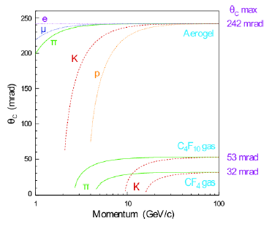
Ring Imaging Cerenkov Detector
Dual-radiator RICH
Combine aerogel and gas radiator
n_{aerogel} > 1.03
n_{C4F10} = 1.00137
Particle ID up to p = 60 GeV/c
Light-weight mirrors
Glass coated beryllium or carbon fiber
Photon detectors: $λ_{radiator}$
PMT, APD, HPD, GEM…
R&D needed to determine the best solution for the requirements
LHCb multi-radiator RICH

Slide 12
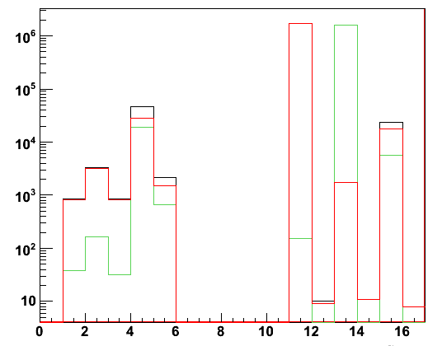
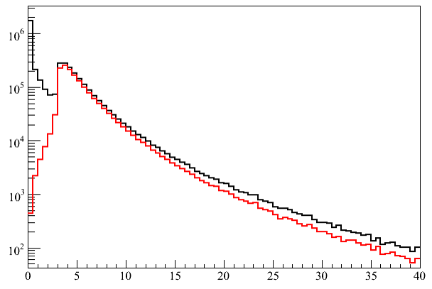
Simulation settings
10M events for Drell Yan
100M+ event for QCD background
PYTHIA 6.4
Tune A
Drell Yan: ISUB 1
QCD jets: ISUBs 11, 12, 13, 28, 53, 68
Elastic, diffraction, and low-p_{T}: ISUBs 91, 92, 93, 94, 95
ISUB 1: $γ^{∗}$ decay modes
m_{inv} > 3 GeV/c²
electrons
muons
electron pairs from Drell Yan
electron pairs in ISUB 1
m_{inv} < 3.0 GeV/c² is not physical
Virtual photon decay
m_{inv} (GeV/c²)

Slide 13
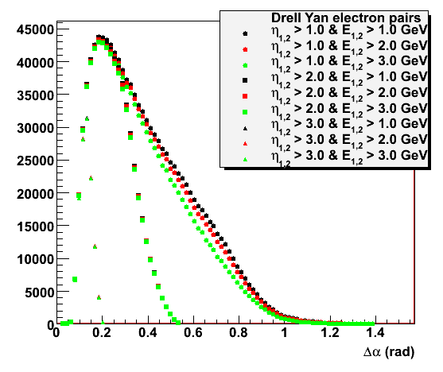
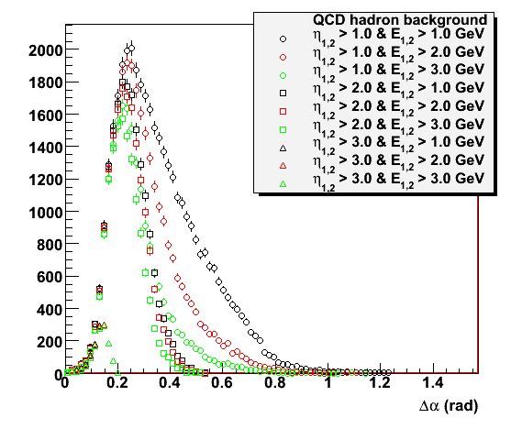
Electron pair kinematics
Drell Yan leptons have large energies
Forward direction has desired asymmetry
Background from QCD
Decreases with lepton energy
Decreases with lepton rapidity
Opening angle of electron-positron pairs
lepton energy cut
E > 1.0 GeV
E > 2.0 GeV
E > 3.0 GeV
lepton pseudo-rapidity cut
$η>1.0$
$η>2.0$
$η>3.0$
Drell Yan
QCD bg

Slide 14
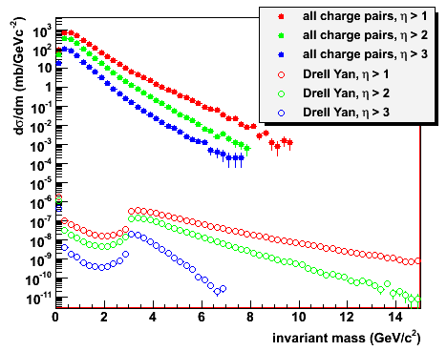
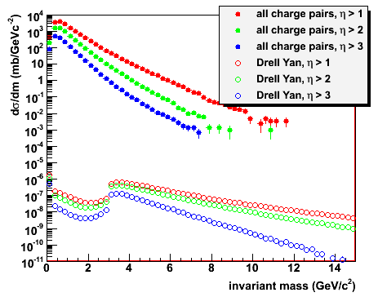
Hadron rejection
All charged particle pairs between J/Ψ and ϒ
Hadron suppression 10³-10⁴ needed at 500 GeV
Drell Yan signal reduced in 200 GeV forward
√s = 200 GeV
√s = 500 GeV

Slide 15
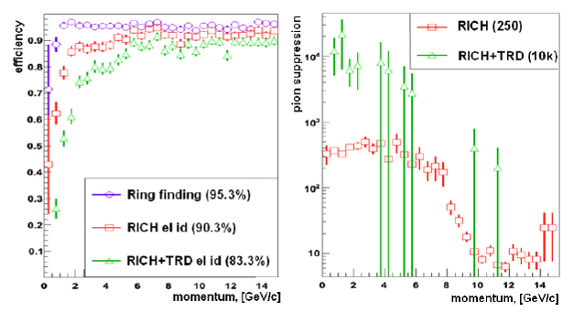
Fast detector modeling: RICH
Lose electrons due to detector efficiency
Mis-identify mesons as electrons
Ring Recognition and Electron Identification in the RICH detector of the CBM experiment at FAIR Journal of Physics: Conference Series 219 (2010) 032015
http://iopscience.iop.org/1742-6596/219/3/032015/pdf/1742-6596_219_3_032015.pdf

Slide 16
Detector smearing
Track resolution
Momentum smearing $\frac{Δp}{p}≈2\%$
Energy resolution
Electromagnetic shower $\frac{ΔE}{E}≈5.95\%/\sqrt{E}⨁0.76\%$
Hadronic interaction in the EMCal
$l≈1∙λ_{I}$
$\frac{E_{dep}}{E}=35\%±14\%$
Hadronic interaction in the HaCal $\frac{ΔE}{E}≈50\%/\sqrt{E}⨁5\%$
Electron efficiency 94% (p>10 GeV/c)
preShower is not included yet
additional hadron rejection ≈10
All rapidity cuts are on the leptons’ pseudo-rapidity (detector acceptance)

Slide 17
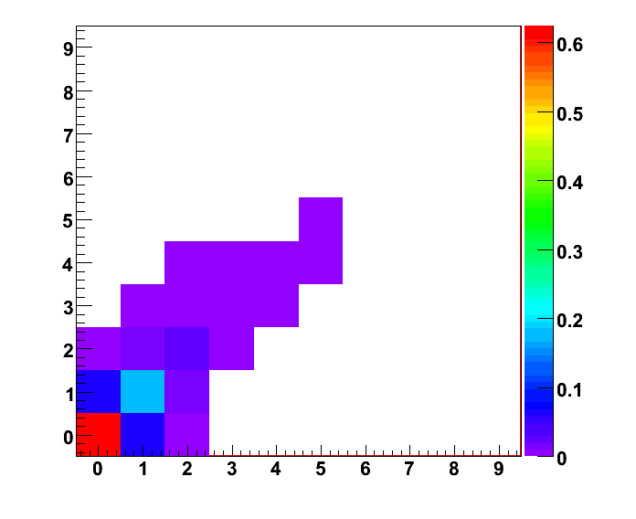
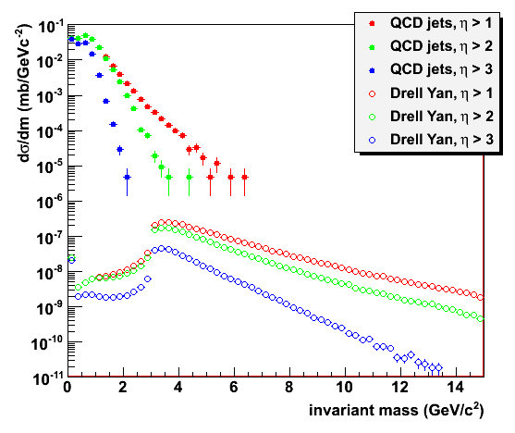
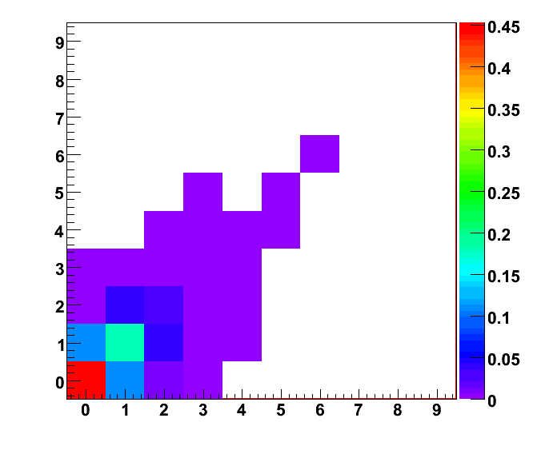
Charge identification
Lepton multiplicities are small in the detector acceptance
≈50% increase at small m_{inv}
Negligible effect for m_{inv} > 2 GeV/c²
w/ charm
electron multiplicity
w/ bottom
positron multiplicity

Slide 18
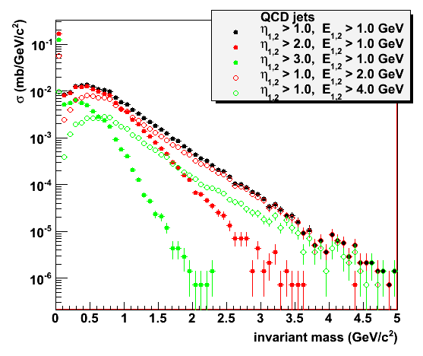
Background kinematics
Electrons and positrons from hard QCD processes are uncorrelated
Opening angles are comparable to Drell Yan: detector acceptance
Lepton energies of Drell Yan decays are large
Energy cut removes QCD background at small m_{inv}
Large energies in QCD background favor mid-rapidity
Energy asymmetry has not been instrumented yet

Slide 19
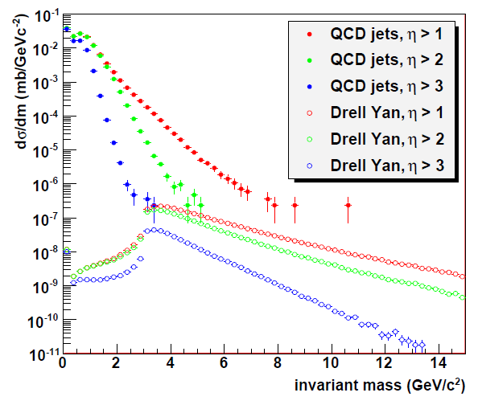
QCD jet background
2G PYTHIA events for hard QCD and diffractive processes
Drell Yan signal
3 – 10 GeV/c²
Energy cut
E_{1,2} > 2 GeV
Forward rapidities
Effectively no background left
Statistically limited
Drell Yan for m_{inv} < 3 GeV/c² not physical (PYTHIA settings)

Slide 20
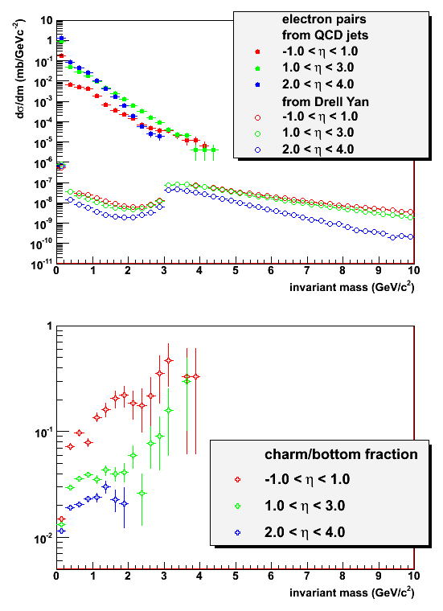
Heavy flavor contributions
More low mass heavy flavor in central directions
Charm & bottom contributions increase with m_{inv}
Need designated heavy flavor simulation
Comparison at m_{inv} < 3 GeV/c² needs more studies
See previous slide
Smaller energy cut

Slide 21
Summary
PHENIX has prepared a new decadal plan for 2011-2020
New detectors have been proposed to replace the central and parts of the forward detectors
Drell Yan transverse single spin asymmetries are expected to be largest at 2 < y < 4
A possible measurement is most promising at 3.0 GeV/c² < m_{inv} < 10 GeV/c²
Fast detector smearing has been included in PYTHIA stuides
Di-lepton background from hard QCD and diffractive processes is effectively removed in forward directions
Detailed detector simulations needed

