Slide 1
Overview of Fermilab Accelerator Complex and Beam Lines
T. Kobilarcik
FNAL

Slide 2
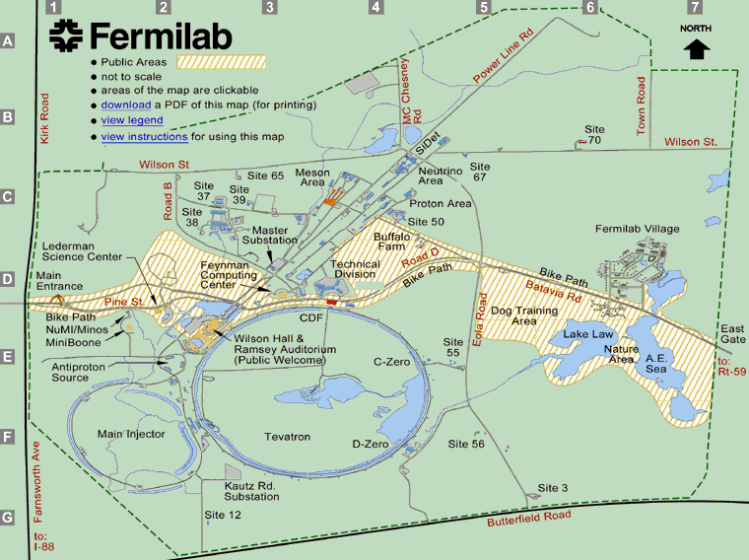
Fermilab Accelerators
Linac
Booster
Main Injector
Tevatron

Slide 3
Linac
400 MeV protons.
15 – 50 μs spill at 15 Hz.
35 mA.
Currently transports beam to MTA hall.
Hall is 40’ long, 21’ wide, and 16’ tall.
Probably need new facility.

Slide 4
Booster
8 GeV protons
1.6 μs spill at 15 Hz; 53 MHz structure.
5 x 10^12 protons per spill.
Currently transports beam toward MiniBooNE experiment via Booster Neutrino Beamline.

Slide 5
Tevatron
Presently unable to deliver beam to fixed target experiments.
Historically:
800 GeV protons
20 second slow spill at 60 seconds; 53 MHz structure.
1 x 10^13 protons per spill.
Single turn extraction possible

Slide 6
Main Injector
120 GeV protons.
10 μs single turn extraction.
1 to 4 second slow spill.
53 MHz structure.
60 second repetition rate.
Delivers beam to fixed target area.

Slide 7
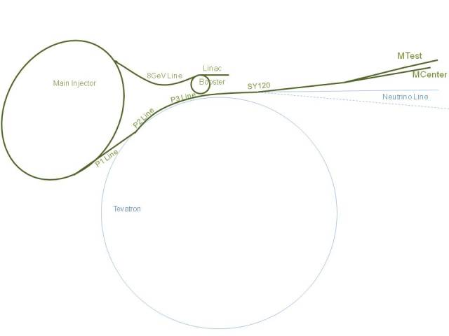
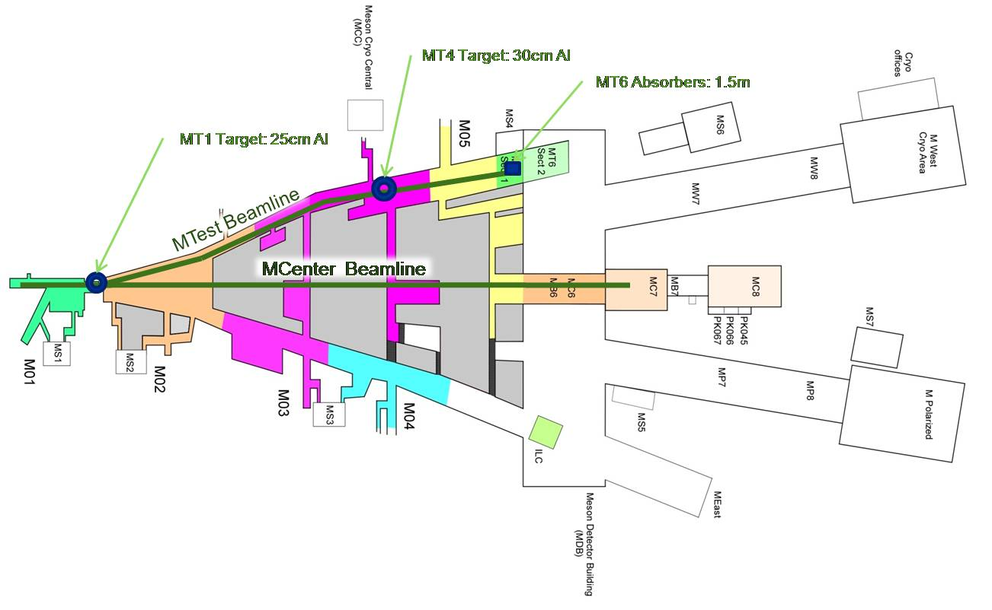
Fixed Target Area

Slide 8
Fixed Target Area – NM Beamline
Presently used for E906/SeaQuest.
5 x 10^12 protons per spill.

Slide 9
Fixed Target Area – MT Beamline
Presently serves the Meson Test Beam Facility.
All rate are 100’s of kHz.
Primary Beam.
120 GeV protons.
Secondary Beam.
Pion Mode: 1- 66 GeV pions or 200 MeV pions.

Slide 10
Fixed Target Area – MC Beamline
Formerly housed the MIPP experiment
May re-commission beamline in within the year.
May be possible to target up to 2x10^12 protons per spill (once per minute) with shielding upgrade.
Can house ~225’ long beamline withing detector building.

