Slide 1
Polarized Solid Targets for Hadron Beams - Overview
Choosing a target for Drell Yan Experiments

Slide 2
Issues
Type of Refrigerator and Recent Experiments
Polarizable Materials
Beam Heating and Radiation Damage
Adiabatic Fast Passage (FP)

Slide 3
Choosing a Refrigerator and “Recent” Experiments
High Intensity > 10⁹ to < 10¹² particles/sec
Use ⁴He Evaporation Refrigerator and ~ 5 T Magnet
Low Intensity < 10⁹ Particles/sec
Dilution Refrigerator ³He/ ⁴He mixture
Very Low Intensity <10⁷ Paricles/sec
Frozen Spin Refrigerator
Chris Keith’s Talk

Slide 6
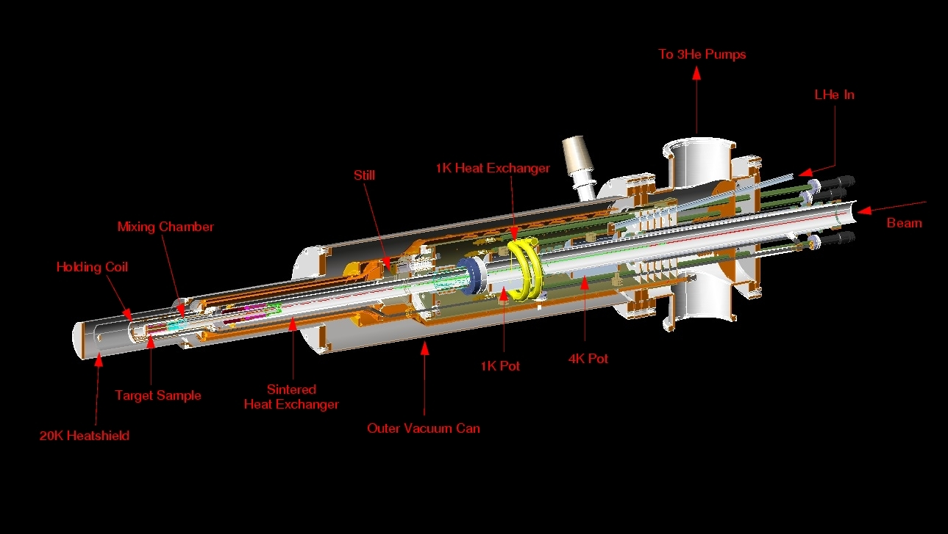

Slide 7
“Recent” Experiments (Since ~ 1990)
SLAC (E143,E155,E155X)
Electrons ~ 9 -50 GeV Duty Factor 10⁻⁴
Average Intensity ~ 100nA (~ 6 10¹¹ e/sec)
BNL (AGS)
Protons 24 GeV, Duty Factor ~30%
Average Intensity ~ 10 ¹¹ protons/sec
JLab (6 experiments, two ⁴He fridges)
Electrons 1 -6 GeV Duty Factor 100%
Average current ~100nA and ~ 5nA

Slide 8
Related Experiments
CERN (EMC, SMC, COMPASS)
muon beams, 100 - 200 GeV
Jlab (FROST)
photon beams 1 – 3 GeV

Slide 9
Target Materials
Properties: High absolute Polarization and
dilution factor
Fast build up
Slow Polarization Decay
(radiation damage resistance)
Talk by James Maxwell
Fast Reversal ? AFP?
Talk by Patrick Hautle

Slide 10
Radiation resistant materials
Ammonia and deuterated ammonia
Proton polarizations > 90%
Deuteron Polarizations ~ 50%
Lithium Hydrides
⁷ LiH ~50% at 5 T and 1 K
⁶LiD ~ 30% at 5 T and 1K for both

Slide 12
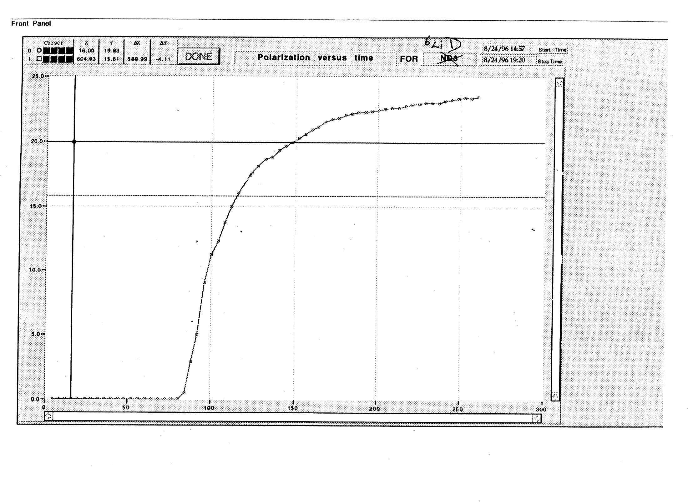

Slide 13
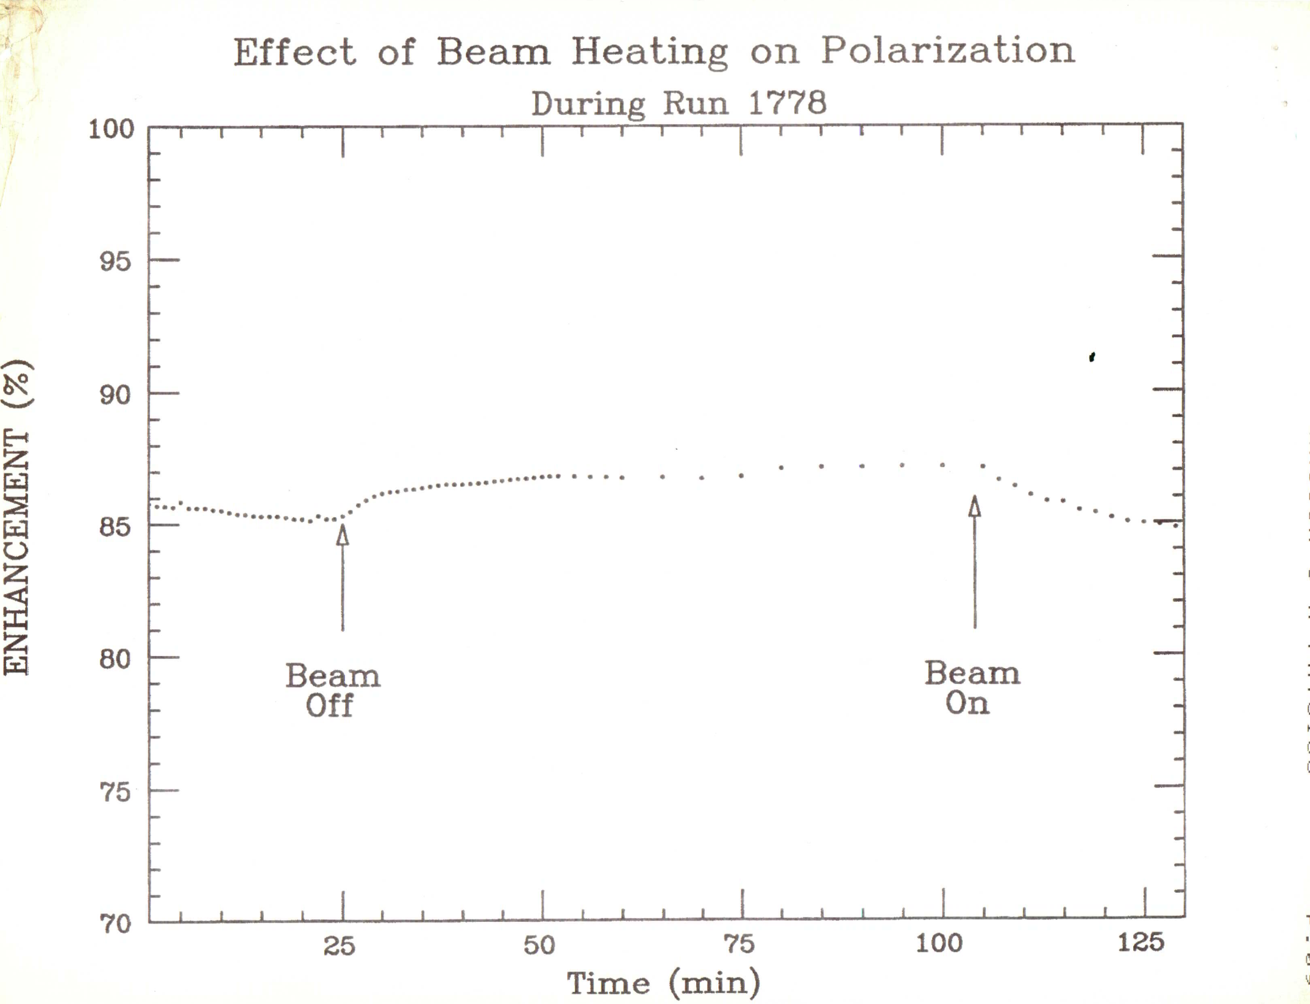

Slide 15
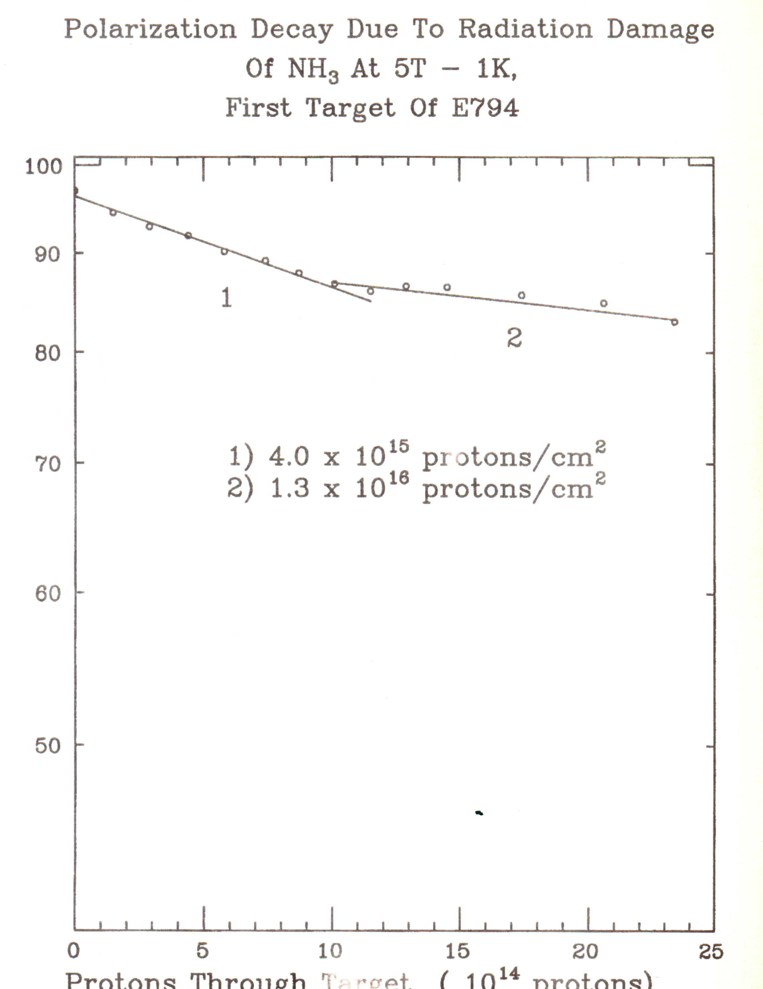

Slide 16
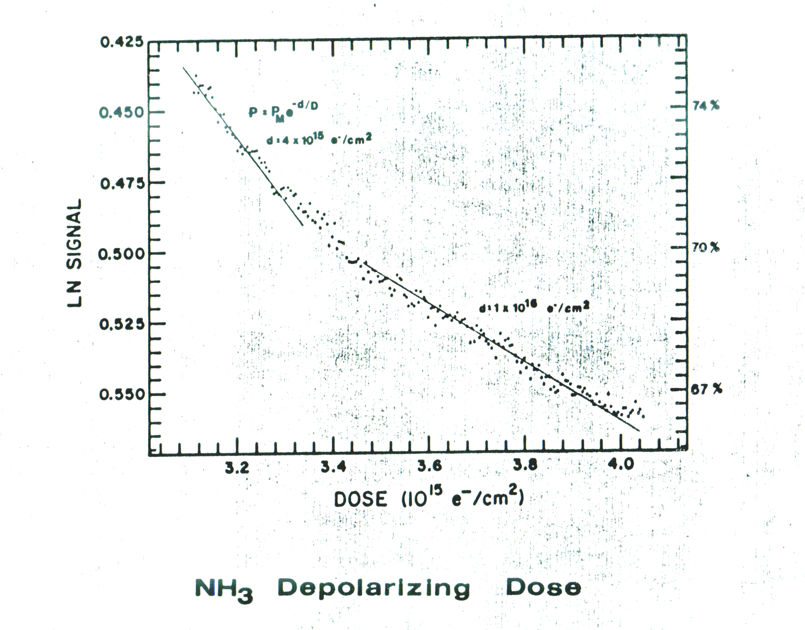

Slide 17
Adiabatic Fast Passage (AFP)
Apply RF pulse to target and if certain conditions are met, the ensemble of spins (or a fraction of them) will flip.
Talk by Patrick Hautle

Slide 18
