Slide 1
RICH Detector for the EIC’s Forward Region Particle Identification
M. Contalbrigo, M. Demarteau, J.M. Durham,
H. Hecke(co-PI), J. Huang, M. Liu, P. Rossi,
Y. Qiang(co-PI), R. Wagner, C. Zorn
an EIC R&D Proposal – Jan 13, 2014
Notes:
Good afternoon
present our plan to develop the RICH detector for …

Slide 2
Overview
Motivation
Detector Concepts and Key Technologies
  Dual radiator RICH
  Modular RICH
  Aerogel
  MCP-based LAPPD
  GEM-based readout
Proposed RICH R&D Project
  Tasks and milestones
  Budget
Summary
Notes:
Talk about movition
Discuss concepts we have in mind and the key tech going to investigate
Finish with a summary

Slide 3
EIC PID Requirements
Very rich physics program:
  Nucleon tomography and spin structure
  Quark hadronization
  Spectroscopy
  Many more …
Dedicated EIC machine and spectrometer
  Hermetic detector system
  Large momentum range
  Multi-particle detection in final states
EM Calorimeter
EM Calorimeter
Barrel EM Calorimeter
RICH Detector
Ion
beam
Cherenkov Counter
Tracking
electron
beam
TOF/DIRC
Magnet
9 m
Notes:
At this point we all know that EIC is a very promising project which covers a lot of important physics topics.
Therefore, dedicated …

Slide 4
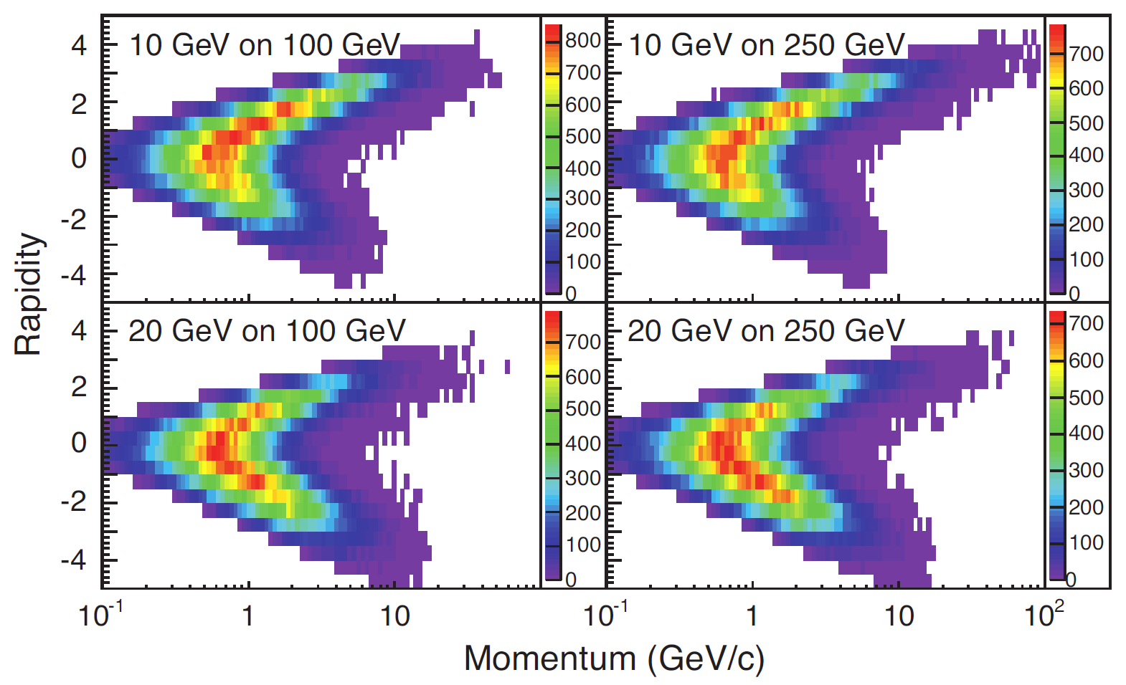
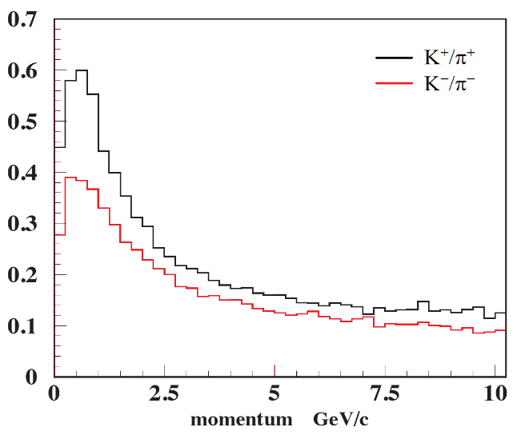
Kaon Identification in SIDIS
Semi-Inclusive Deep-Inelastic Scattering (SIDIS)
  Golden channel to study quark’s orbital motion through transverse momentum-dependent parton distributions (TMDs)
  Kaon identification crucial for sea quark contribution
K/π identification in Forward(Backward) region:
  0 – 15 GeV, 4-σ separation
K/π ratio
Forward
Backward

Slide 5
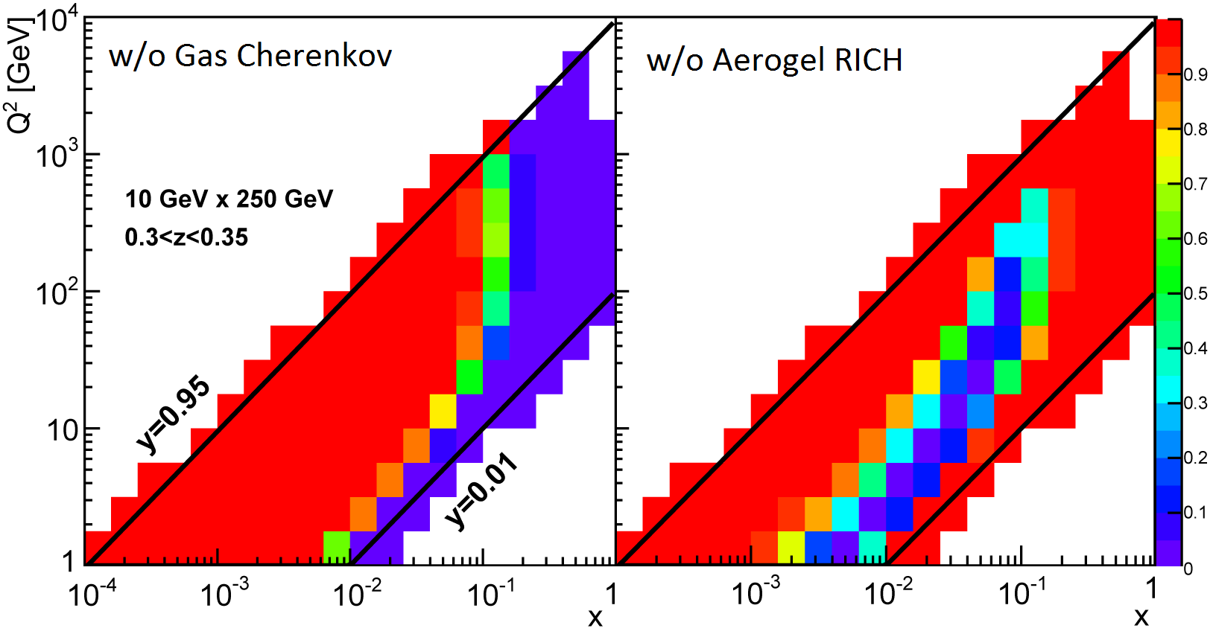
Solution to Forward PID
Multiple radiators are needed to cover the broad kinematic range
  TOF + high-n radiator (aerogel) + low-n radiator (gas)
  Can we combine them into one detector?
SIDIS Event Efficiency
Notes:
The following plots show that what will be the hole in SIDIS kinematics if we miss one of the detector.

Slide 6
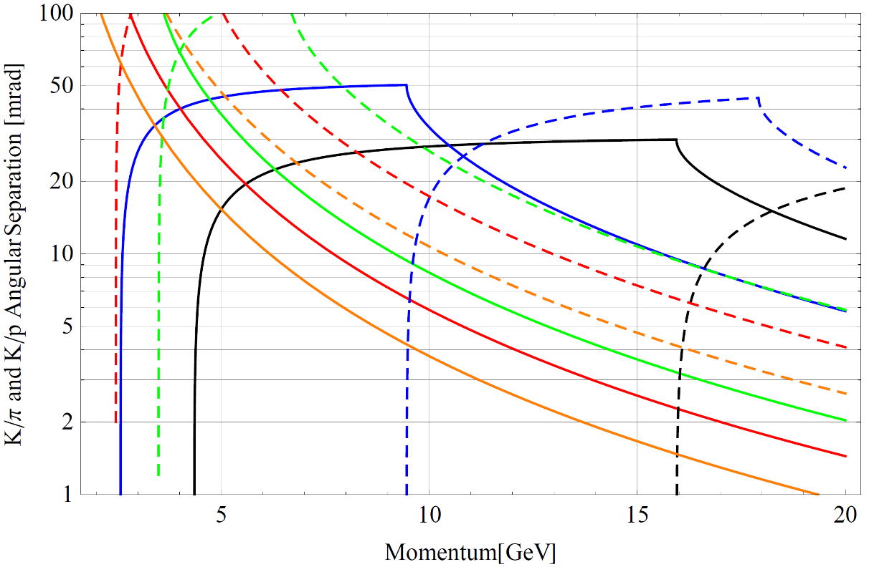
Choice of Radiators
5 – 10 GeV range: Aerogel RICH
  Index ranges 1.01 ~ 1.10
  Used as RICH in HERMES, LHCb, AMS, BELLE …
Single photon resolution (LHCb)
10 – 15 GeV range: heavy gas
  C₄F₁₀/C₄F₈O RICH
    Good light yield
    May need recycling
  CF₄ threshold counter
    Need Aerogel RICH to veto protons
    Can cover much higher range as RICH
−− n = 1.000482 (CF₄)
−− n = 1.00137 (C₄F₁₀)
−− n = 1.01 (Aerogel)
−− n = 1.02 (Aerogel)
−− n = 1.05 (Aerogel)
−−− K/π separation
- - - K/p separation
Notes:
Need recycling due to environmental issues

Slide 7
Dual Radiator Concept
General geometry constraint: ~150 cm length
Focusing RICH
  Aerogel RICH: 3 – 10 GeV
  C₄F₁₀: 10 – 20 GeV
  Focused by a Fresnel lens
  Readout resolution: < 2 mm
Proximity Focusing
  Aerogel RICH: 3 – 10 GeV
  CF₄ threshold counter: 8 – 17 GeV
    Signals from readout window will be mixed with photons from CF₄
  Readout resolution: < 4 mm
Focusing
C₄F₁₀
Lens
Aerogel
Photosensor
Empty or C₄F₁₀
~ 75 cm
~ 75 cm
Source of Cherenkov lights
Aerogel Gas Glass window
Proximity Focusing
CF₄
Aerogel
Photosensor
~ 10 cm
~ 5 mm
~ 150 cm
Notes:
SUVT acrylic, > 280 nm
Two concentric rings will be formed on the readout plane

Slide 8
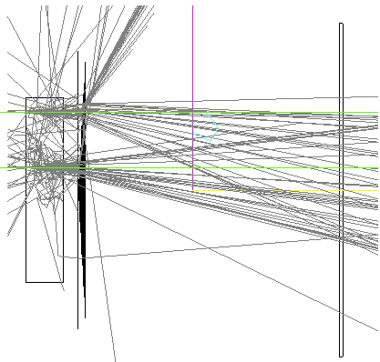
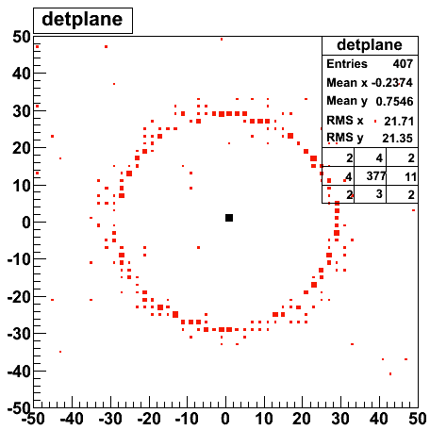
Modular Concept
Single aerogel radiator
  Covers 3 – 10 GeV
  Needs to be paired with additional gas RICH detector for higher momentum range
Modular design for maximum flexibility
  Very compact design, size of a shoe box
  Can be tiled to cover different geometry, used in various experiments
  Fresnel lens for focusing
  Concentric rings for parallel tracks
  Readout resolution: < 0.5 mm
Aerogel
Lens
Photosensor
10 ~ 20 cm

Slide 9
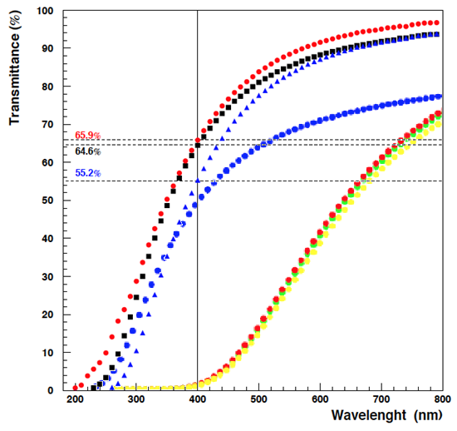
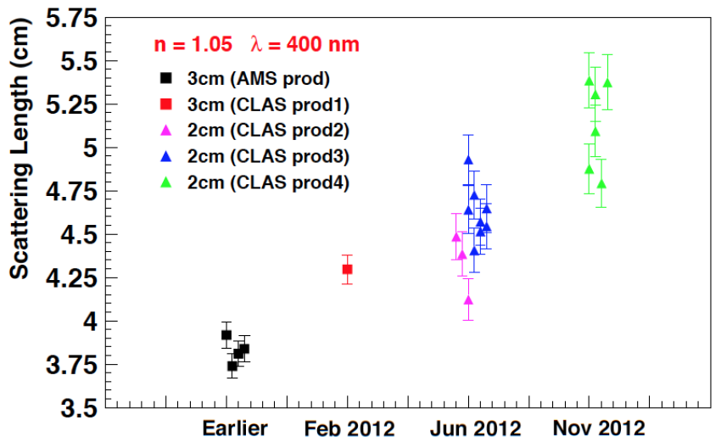
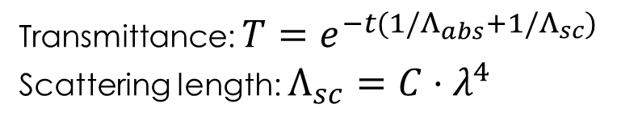
Status of Aerogel
Transmittance: $T=e^{−t(1/Λ_{abs}+1/Λ_{sc})}$
Scattering length: $Λ_{sc}={C⋅λ}^{4}$
Aerogel strongly scatters UV lights
Slowly being improved
Major manufactures
  Novosibirsk, Russia
  Matsushita-Panasonic, Japan
  Aspen, US
Some comparisons available (CLAS12 etc.)
Matsushita, n = 1.05, 1 cm
Novosibirsk, n = 1.05, 2 cm
Novosibirsk, n = 1.05, 3 cm
Aspen, n = 1.01, 2 cm
Aspen, n = 1.05, 2 cm
Notes:
Hunt equation
Cherenkov light yield proportional to the inverse of the wavelength square
Scattering length proportional to the 4-th order of wavelength
Russian aerogel: hydrophilic
Japanese aerogel: hydrophobic

Slide 10
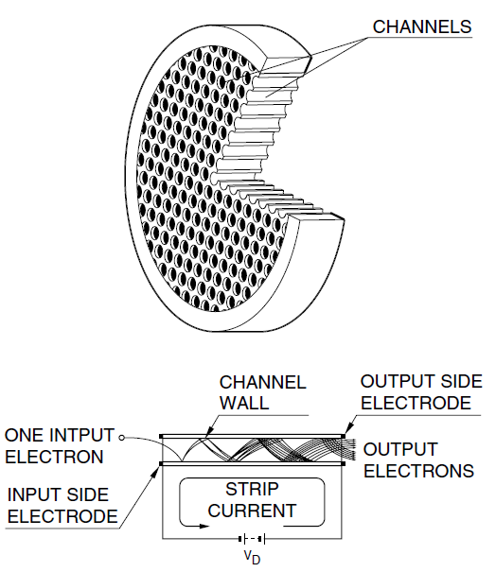
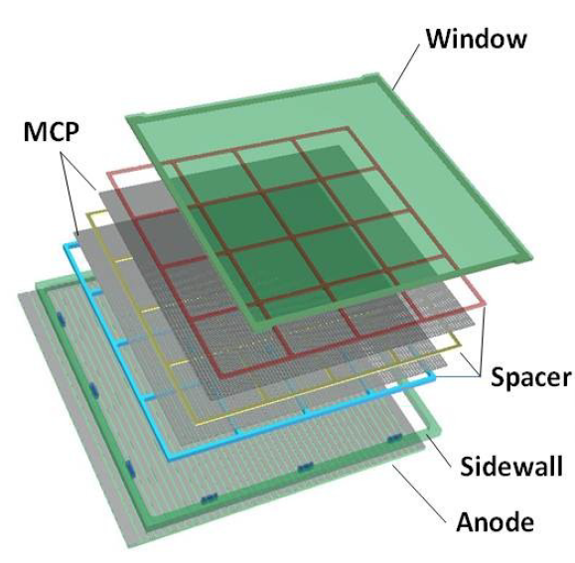
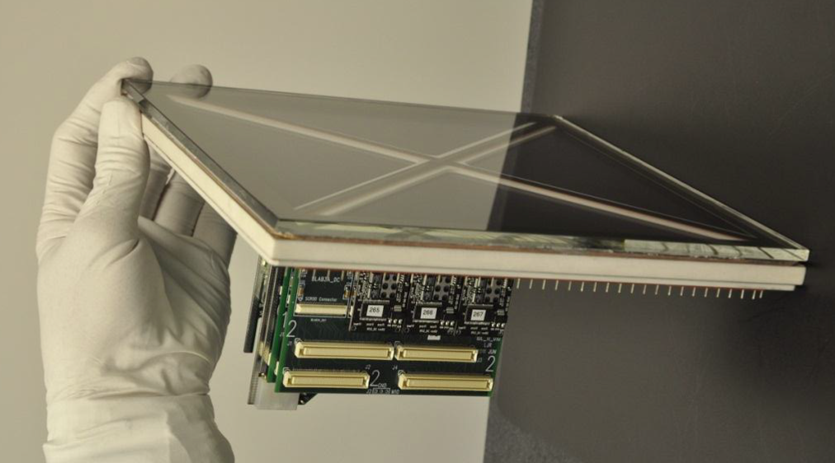
Micro-Channel Plate-based LAPPD
LAPPD: Large Area Picosecond Photo-Detector
γ
Glass window
e
Photocathode
Micro-Channel
Plates (MCPs)
Anode Strips
Glass window
20 × 20 cm²
Front-End Elec.
Compact size, good time resolution, expect good tolerance to magnetic field
Ceramic body prototype
Notes:
Avalanche of secondary electrons, avalanche builds …

Slide 11
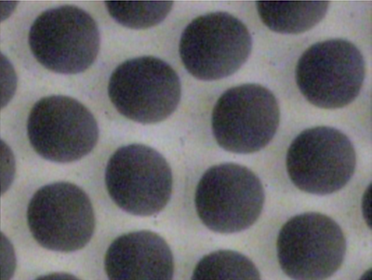
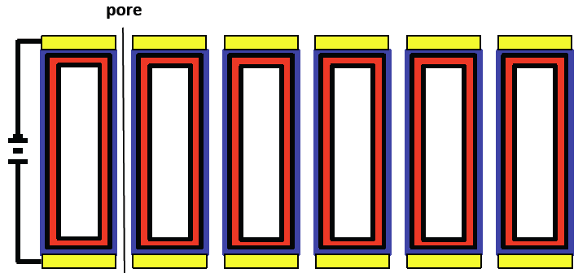
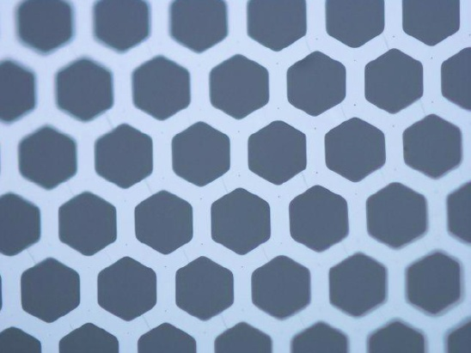
ALD Micro-Channel Plate
Conventional Pb-glass MCP
  Single material, three functions: pore, Pb-glass resistive layer, Pb-Oxide emissive layer
  Higher cost
  Space charge: rate limitation
Conventional Pb-glass MCP
Conductive
Layer
Emissive
Layer
Resistive
Layer
MCP produced with Atomic Layer Deposition (ALD): Separate three functions, more freedom for optimization
  Glass substrate with pores
  Tuned resistive layer provides current for electric field
  Specific emissive layer (Al₂O₃) provides secondary electron emission
Good performance with lower cost
  Gain > 10⁷ for pair MCPs
  Longer lifetime >> 5 C/cm²
Glass Substrate by INCOM
Borosilicate, 20 um pores
1 mm thick
Notes:
Started from 70s
LAPPD revived the technology by introducing ALD.

Slide 12
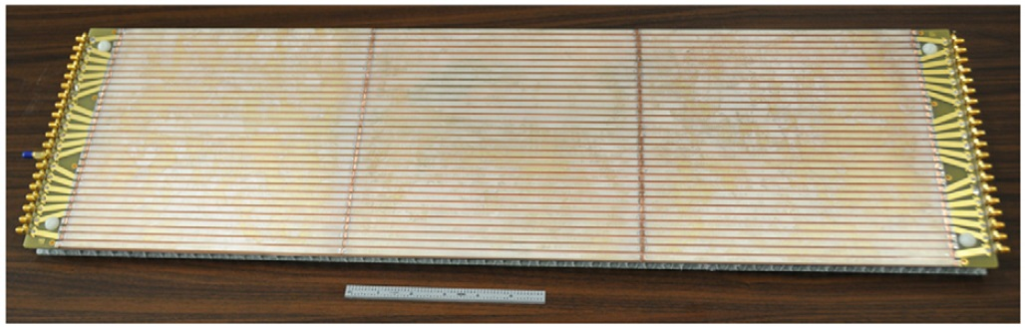
LAPPD Readout and Status
Transmission line readout
  5 mm silver strips
  Waveform sampled on both ends at 10 GS/s
  Lower channel count
  Can be chained
  < 5 mm spatial resolution
Three 20×20 cm² readout board chained
Status of the LAPPD development
  Funded by DOE since 2009
  Individual components proved working
  A working demountable prototype using Al photocathode sealed by O-ring
  First ceramic prototype assembled with bi-alkali photocathode
  Small glass body samples available this year

Slide 13
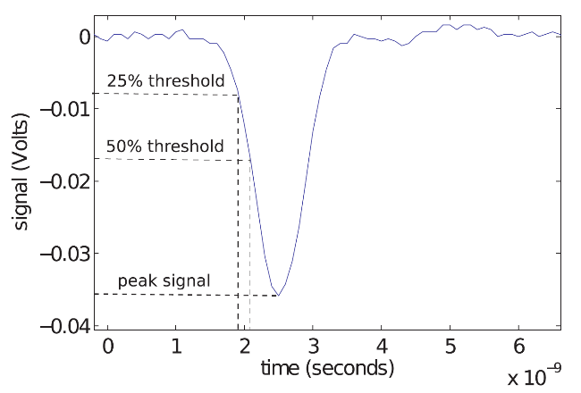
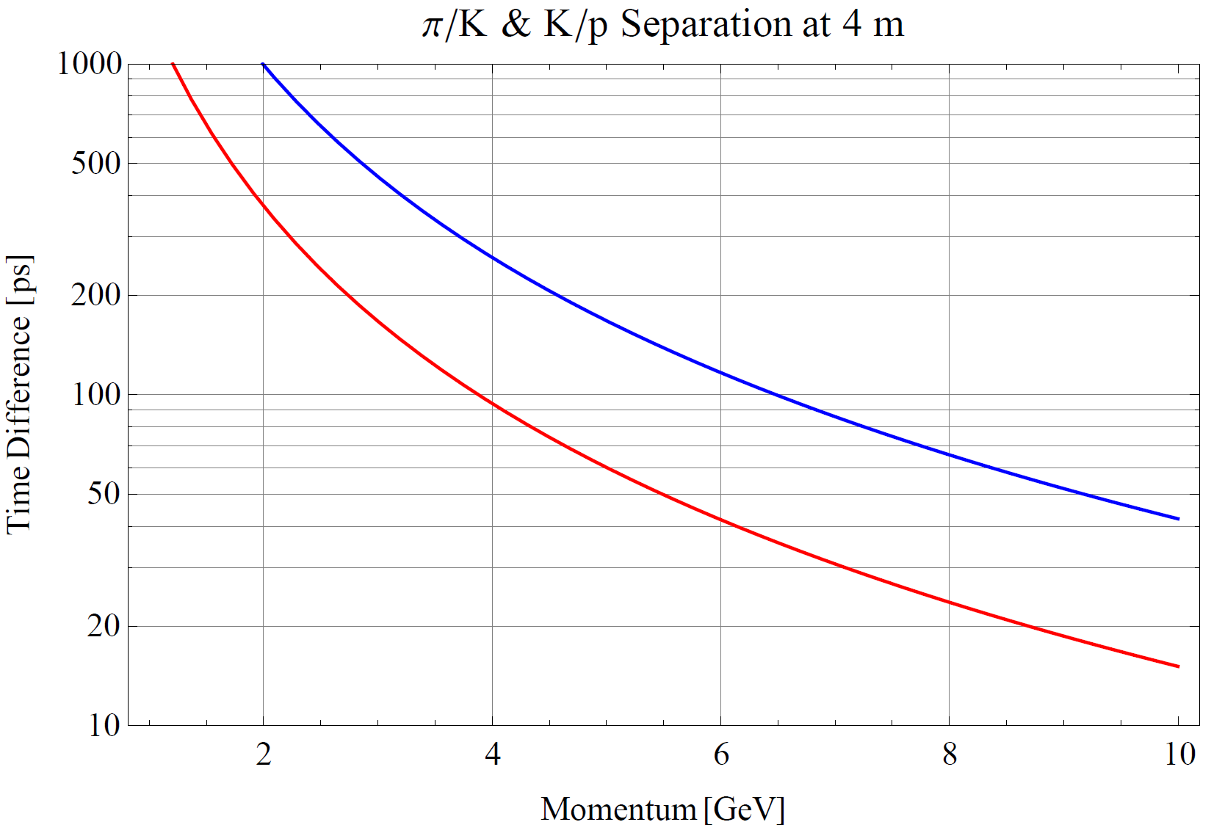
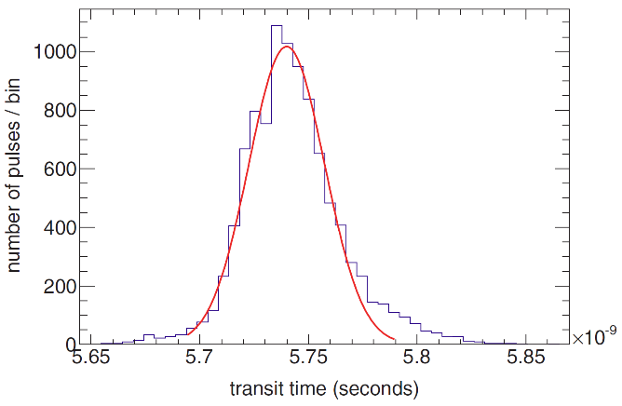
Bonus TOF feature
Excellent time resolution of LAPPD provide additional PID power through time-of-flight
  Use Cherenkov light generated in the entrance window
  Single photon time resolution < 44 ps
−−− K/π
−−− K/p
4-σ separation up to 5 GeV
Expected TOF resolution ~ 15 ps

Slide 14
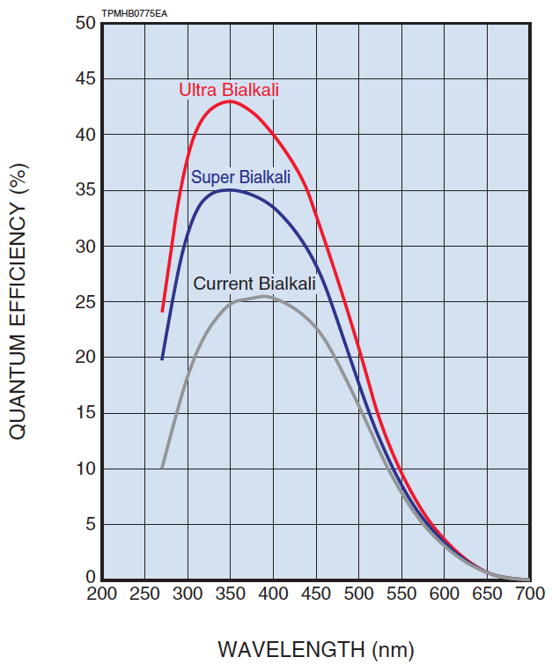
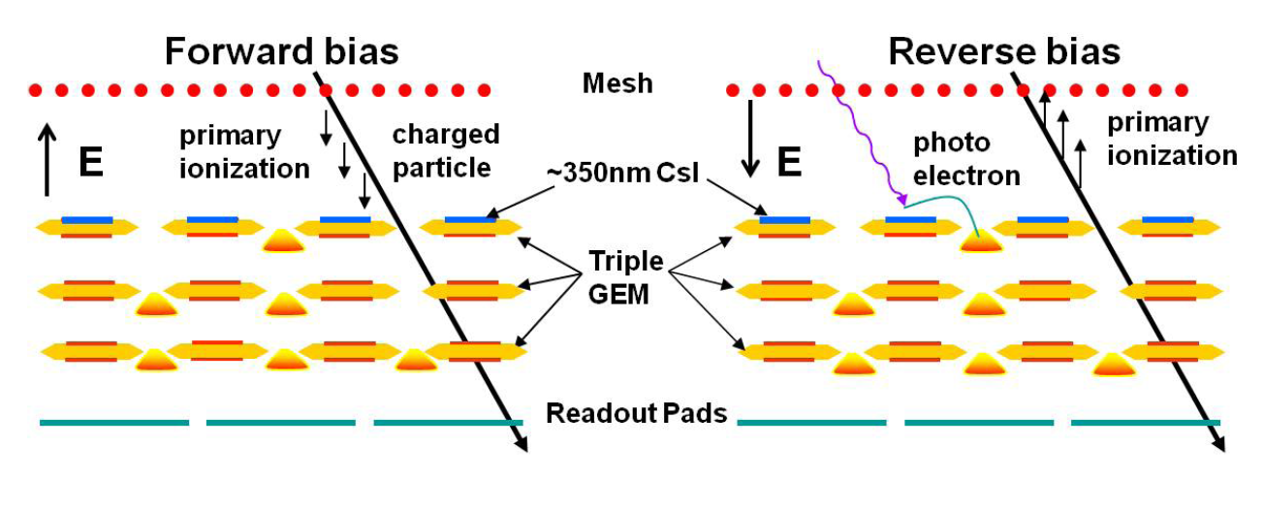
GEM-based Readout
CsI-coated GEM detector successfully used in PHENIX’s hadron blinded-detector (HBD)
  CsI only sensitive to UV light, not suitable for aerogel
  Bi-alkali coating possible (Breskin et al.), however very sensitive to operating gas
  Development needed for optimal combination of bi-alkali and gas mixture
Notes:
Sb-Cs-K, Breskin

Slide 15
Goal of the Proposed Project
Final goal of the three-year project
  Determine the optimal detector technology and finish the conceptual design of the RICH detector
Five parallel tasks
  Detector simulation and conceptual design
  Characterizing LAPPDs
  Improvement of LAPPD
  Study of GEM-based readout
  Characterizing aerogel radiators
Further work is anticipated given the success of the project

Slide 16
Detector Simulation and Design
Goals
  Simulation of detector performance in the EIC environment
  Provide requirements on detector components, e.g. readout performance, aerogel quality etc.
  Optimize optics and detector design
Approaches
  Extended from existing EIC simulation codes/event generators
  Model the optical elements: aerogel, lens, readout
  Model the strip or pixel readout and embed in the EIC environment. Determine maximum pixel/strip size, multiplicity, background rate etc.
  Develop reconstruction software

Slide 17
Characterizing LAPPDs
Goal
  Characterize the MCP-based LAPPD with the needs of the EIC
Properties to be tested
  Single photon detection efficiency at different wavelengths, particularly between UV and green
  Gain with different voltages and input pulse rates
  Time and position resolution
  Background noise level
  Neutron and EM radiation hardness
  Sensitivity to magnetic field
  Lifetime

Slide 18
Improvement of LAPPD
Goal
  Improve and balance the performance of LAPPDs towards the needs of the EIC
List of possible items
  High rate capability: resistance, gain …
  Tolerance to magnetic field: pore orientation, shielding …
  Thinner glass window (now 2.75 mm) to reduce background hits from primary tracks
  Optimize existing readout for high multiplicity: narrower strips, deconvolution in FPGA …
  Alternative readout option if needed: pixel readout, induced signal readout …

Slide 19
Study of GEM-Based Readout
Goals
  Find out proper combinations of photocathode coating and gas mixture of a GEM detector to allow detection of photons with wavelength > 300 nm
  Develop a suitable readout pattern
Approaches
  Existing Cs-I coated GEMs for UV photons
  Triple-GEM detector kits from CERN
  Small vacuum chamber for bialkali photocathode deposition
  LED sources for quantum-efficiency measurements
  Simulation to optimize readout resolution and channel count

Slide 20
Characterization of Aerogel Radiator
Goal
  Working closely with different vendors, Novosibirsk, Matsushita-Panasonic, Aspen etc. to choose the optimal aerogel tiles for the EIC RICH detector
List of measurements
  Measurement of transmittance, absorption length and scattering length for different aerogel tiles
  Measurements of refractive index and chromatic dispersion using the prism method and a monochromator coupled to a Xe-UV lamp or monochromatic lasers.
  Refractive index mapping with gradient method
  High precision mapping of the tiles thickness

Slide 21
Responsibilities and Resources
Jefferson Lab
  Responsibilities
    Testing LAPPDs
    Assist development of LAPPDs
    Detector simulation and design
    Provide space and manpower testing aerogels
  Resources
    Expertise in photosensors, aerogel RICH detector, fast electronics, , EIC simulation
    Existing testing facilities for photodetectors: dark boxes, picosecond pulsed laser source, electronics etc.
    Existing EM and neutron irradiation facilities
    Existing spare 5-Tesla magnet
    Parasitic beam test will be available
    Will hire a postdoctoral researcher for the project
Notes:
EM: Cesium
Neutron: Americium-Beryllium

Slide 22
Responsibilities and Resources
Los Alamos National Lab
  Responsibilities
    Study GEM-based readout
    Detector simulation and design
    Assist testing aerogel samples
  Resources
    Expertise in CsI-coated GEM detector, aerogel Cherenkov detectors, readout electronics, EIC detector simulation
    Existing neutron and proton irradiation facilities
    Will hire a postdoctoral researcher for the project

Slide 23
Responsibilities and Resources
Argonne National Lab
  Responsibilities
    Fabricate LAPPD samples
    R&D of LAPPDs
  Resources
    Expertise in photocathode, micro-channel plate and fast readout electronics
    Existing facilities for fabricating and testing LAPPDs
    Will hire a postdoctoral researcher for the project
INFN
  Responsibility
    Characterization and selection of aerogel samples
  Resources
    Expertise in various RICH detector including aerogel based RICH

Slide 24
Budget
Item | Cost
 | Year 1 | Year 2 | Year 3
Jefferson Lab
M&S – LAPPD testing | $10,000 | $10,000 | $10,000
Equipment – LAPPD testing | $20,000 | $0 | $0
Labor – Postdoc (0.7 FTE) | $70,000 | $70,000 | $70,000
Travel | $10,000 | $10,000 | $10,000
Subtotal | $110,000 | $90,000 | $90,000
Los Alamos National Lab
GEM detector kits (5×$3200) | $16,000 | $0 | $0
CERN RD51 SRS Readout System | $3,000 | $0 | $0
Components for deposition chamber | $30,000 | $20,000 | $20,000
Labor – Post doc (0.4 – 0.5 FTE) | $60,000 | $80,000 | $80,000
M&S and Travel | $20,000 | $20,000 | $20,000
Subtotal | $129,000 | $120,000 | $120,000
Argonne National Lab
M&S – LAPPD fabrication | $15,000 | $15,000 | $15,000
Labor – LAPPD fabrication and R&D | $50,000 | $50,000 | $50,000
Travel | $5,000 | $5,000 | $5,000
Subtotal | $70,000 | $70,000 | $70,000
INFN
M&S – Aerogel Testing | $10,000 | $10,000 | $10,000
Equipment – Aerogel Testing | $30,000 | $0 | $0
Travel | $10,000 | $10,000 | $10,000
Subtotal | $50,000 | $20,000 | $20,000
Grand Total | $359,000 | $300,000 | $300,000
Notes:
Jlab equipment: LEDs (including UV), Oscilloscope, Instrumentation for more precise timing measurements
ANL: deposition chamber
INFN: optics components, spectrophotometer

Slide 25
Summary
An aerogel-based RICH detector is proposed for the EIC’s forward region particle identification
A dual-radiator option or a combination with an additional gas Cherenkov detector is necessary to cover important momentum range of SIDIS processes
A three-year joint effort is planned to investigate different options, find optimal solution and provide a conceptual design at the end
  Two design options will be evaluated: dual-radiator and modular
  Two economical novel readout options will be studied: MCP-based LAPPD and GEM-based readout
The success of the project will become the base of the second phase: development of a prototype

Slide 26
Backup Slides

Slide 27
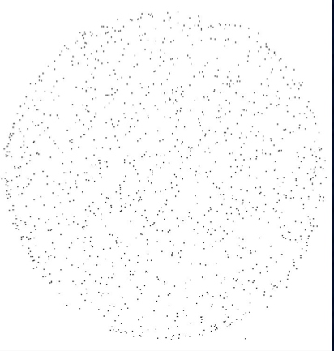
Background rate in ALD-MCP
Background rate of a 33 mm ALD-MCP with 20 μm pores and 1.2 mm thickness measured at 7×10⁶ gain
  33 mm diameter
  20 μm pores, 1.2 mm thickness
  0.84 counts/cm²/s, comparable with comic ray
More test needed for full assembly with photocathode
33 mm
Background hits over 3000 s

Slide 28
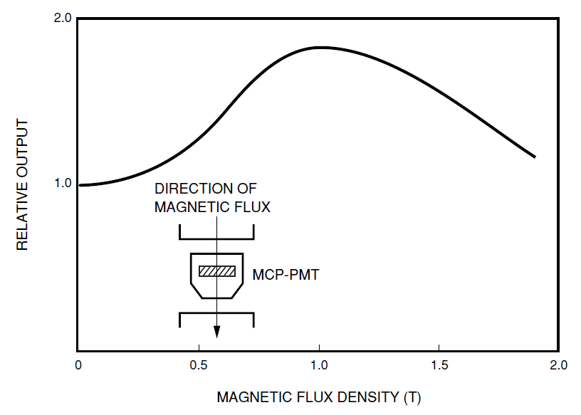
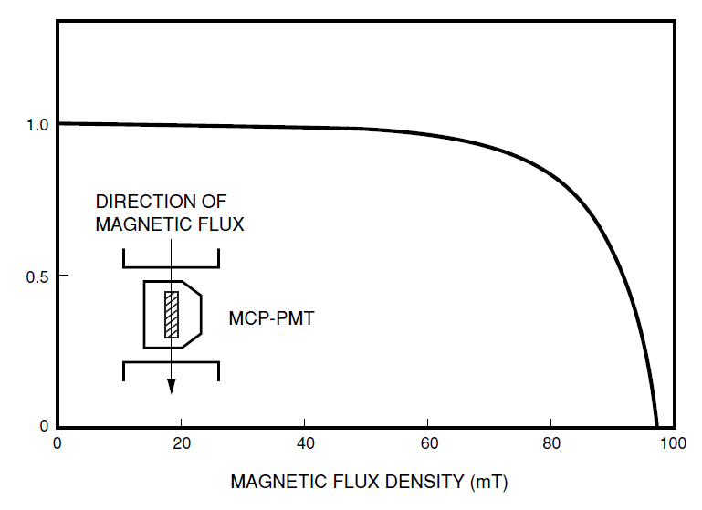
Magnetic Field Tolerance of MCPs
Typical field response of commercial MCPs

Slide 29
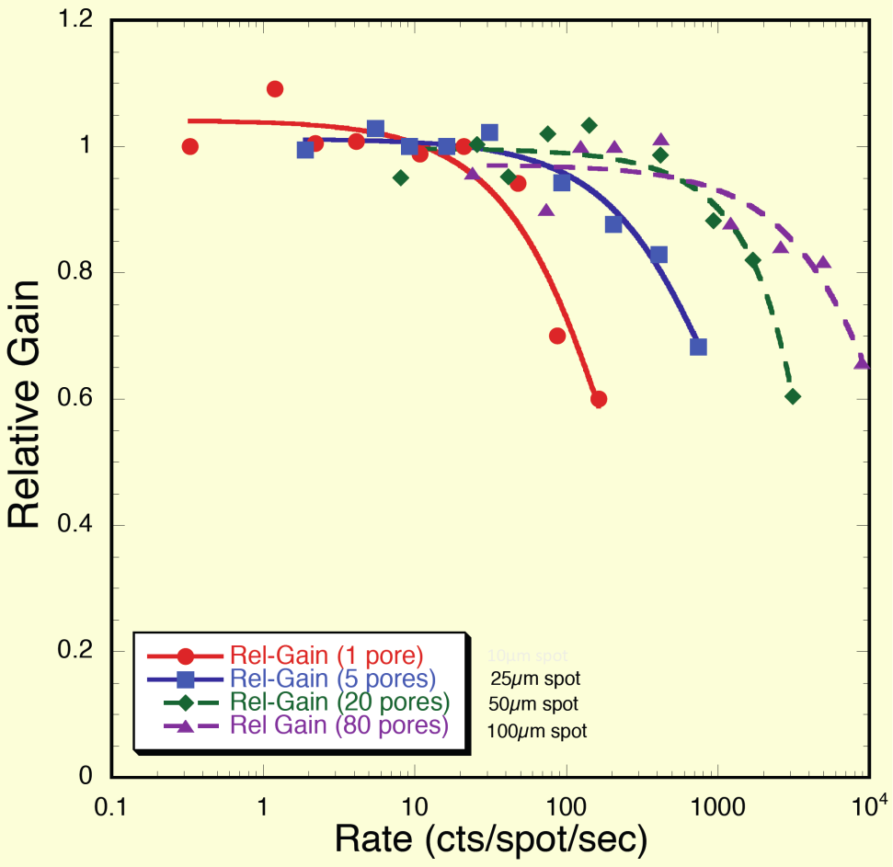
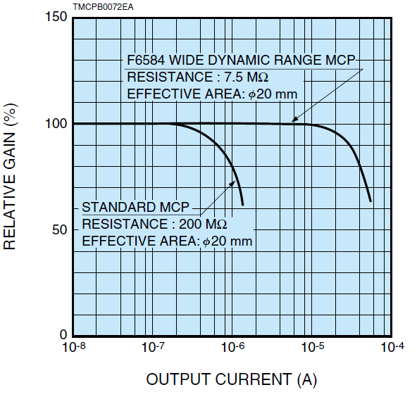
Gain of MCP with different rates
Measurement of an older 10 μm pore ALD-MCP with MgO emission layer
Performance of Hamamatsu MCP-PMTs
10⁶ gain → 300 kHz/cm²

Slide 30
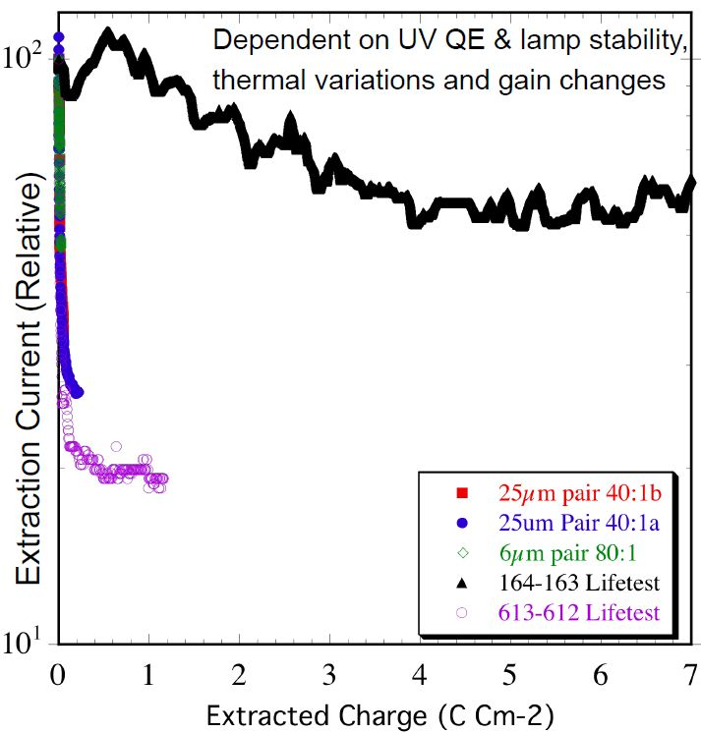
Lifetime of ALD-MCPs
Significant improvement with preconditioning over traditional MCPs
  Possibility due to cleaner glass substrate with much less contamination to create ion backflow
Lifetime of an older ALD-MCP pair (20 μm pore, MgO emission layer, 60:1 L/d, 8○ bias) compared with conventional MCPs
ALD-MCP
Conventional MCPs

Slide 31
Estimated Final Detector Cost
Total Coverage ~ 10 m²
Dual-radiator RICH using LAPPD ~ $5M
  Aerogel ~ $1M
  Gas system ~ $1M
  LAPPD readout ~ $2M (MaPMT ~ $10M)
  Electronics ~ $2M (MaPMT ~ $3.5M)
  MISC ~ $1M

Slide 32
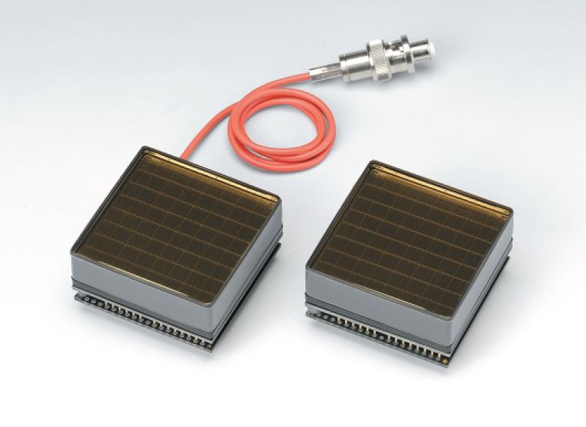
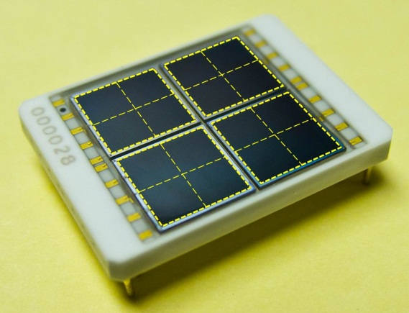
Other Readout Options
Multi-anode MPTs
  Well known technology, will be used in CLAS12 RICH and LHCb
  As small as 3 mm pixel sizes
  Sensitive to visible light
  Low noise
  Moderate resistance to magnetic field
  Expensive (~$1M for 1 m² sensor only)
Silicon Photo-Multipliers
  Relative new technology
  3 mm pixels available
  Sensitive to visible light
  Resistant to strong magnetic field
  Large dark noise, needs to be cooled
  Low neutron radiation tolerance
  Expensive (~$3 M for 1 m² sensor only)

Slide 33
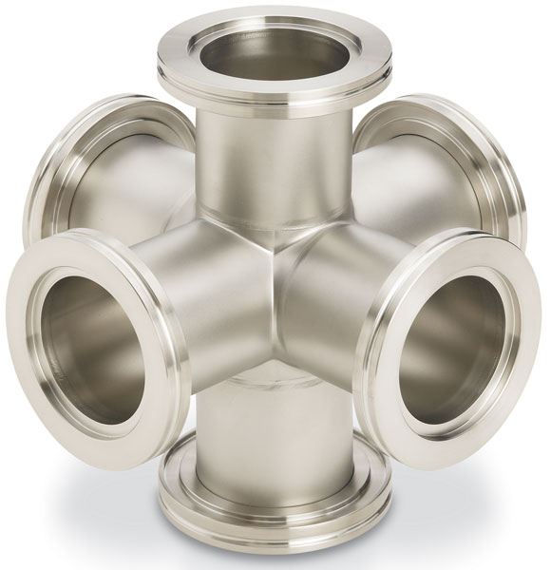
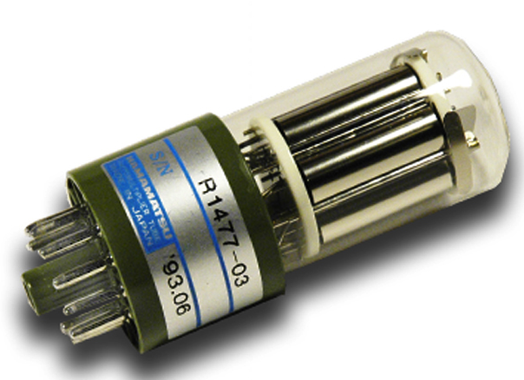
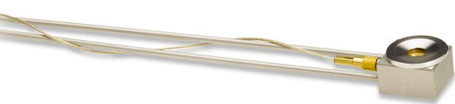
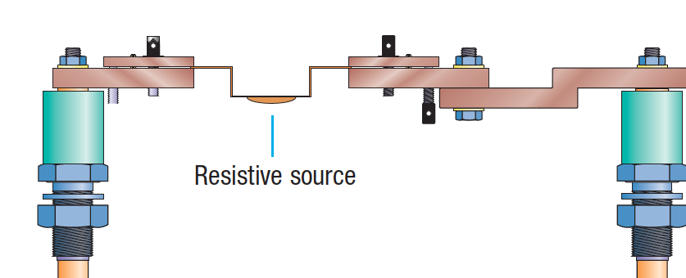
Deposition Chamber/QE measurement
PMT with shutter
GEM foil
Quartz thickness monitor
Collimated LED
Resistive source

Slide 34
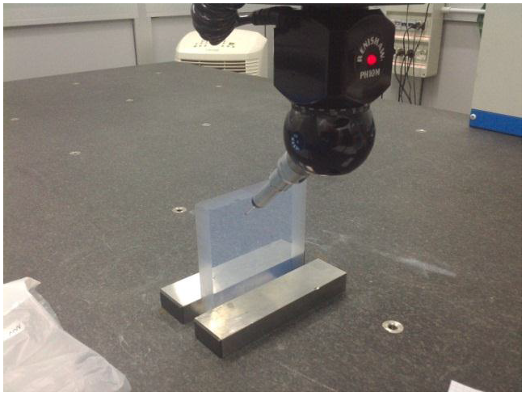
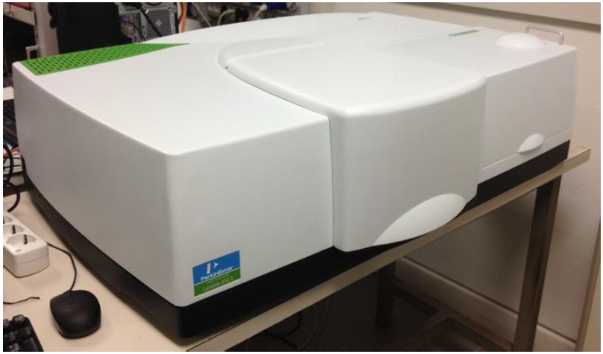
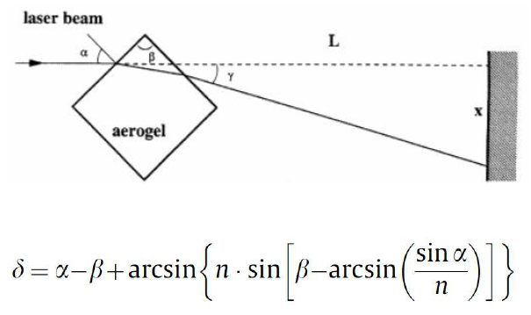
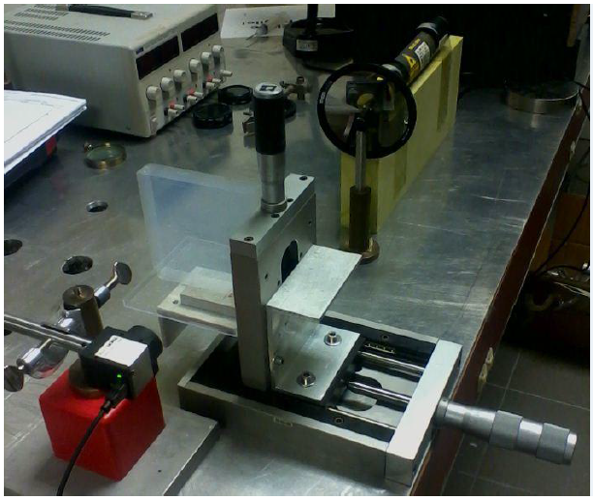
Characterizating Aerogel Tiles
Thickness mapping
Spectrophotometer as light source
Prism method for chromatic dispersion
Gradient method for uniformity

Slide 35
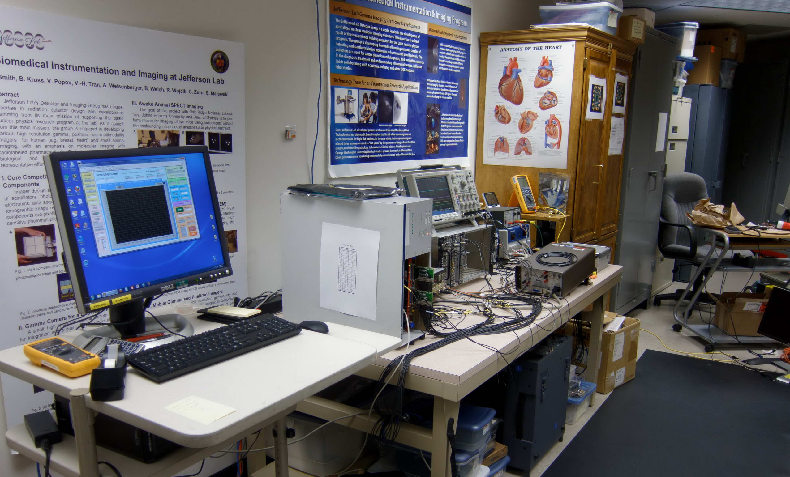
SiPM Test Setup
PC
Electronics & Dark Cabinet for SiPM
DAQ

Slide 36
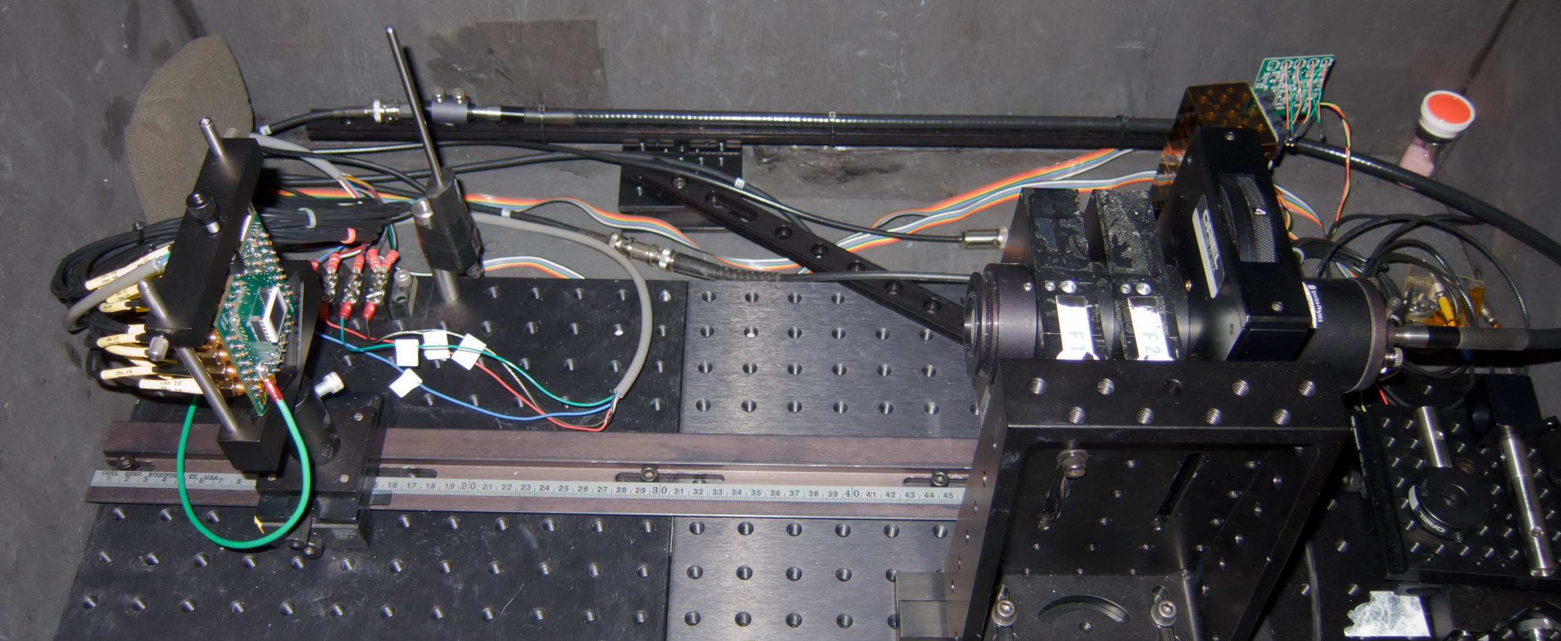
SiPM Test Setup
Temperature Sensor
Blue LED
Liquid Light Guide
SiPM and
Preamplifier
Adjustable Neutral Filter:
Dark, 1%, 2%, 4% and 6%
Collimating Lens and
470±10 nm Filter

Slide 37
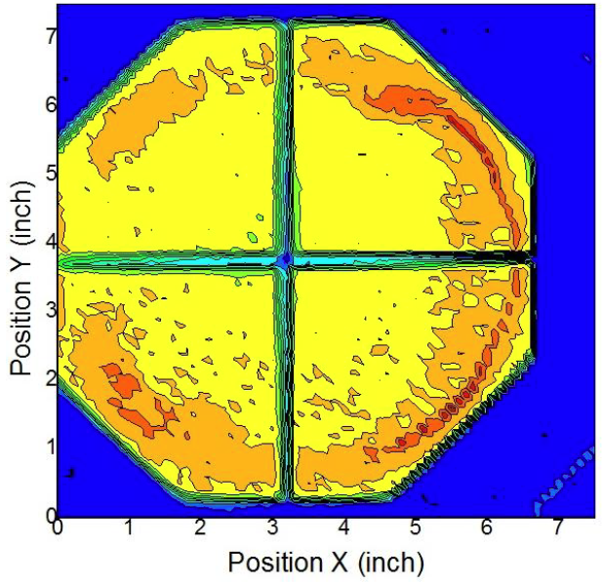

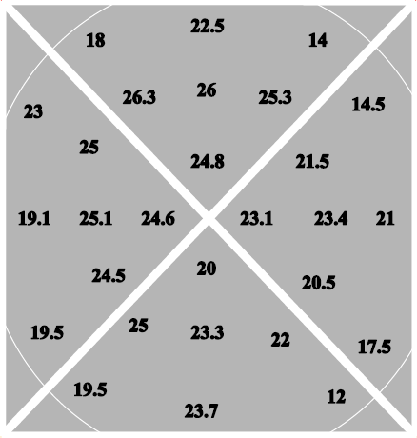
LAPPD’s 8” Photocathode
Argonne National Lab
  Using Burle PMT processing station with home-made photocathode deposition chamber
  7”×7” flat K₂CsSb photocathode was produced
  Max QE: 22% (350 nm, average: 16%)
UC Berkeley
  Deposited Na₂KSb photocathode on 8” windows
  25% QE (350nm) with good uniformity (15%) and stability
Notes:
Na: Sodium
K: Potassium
Cs: Cesium
Sb: Antimony

Slide 38
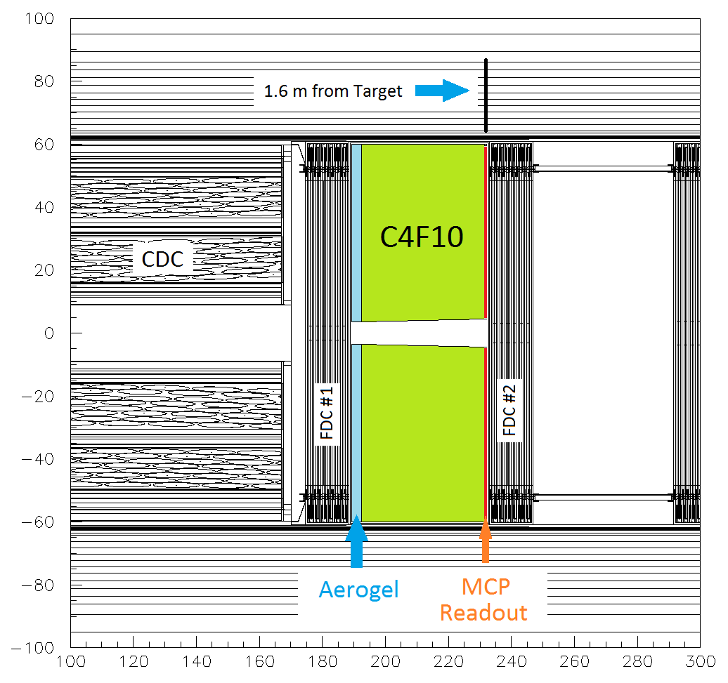
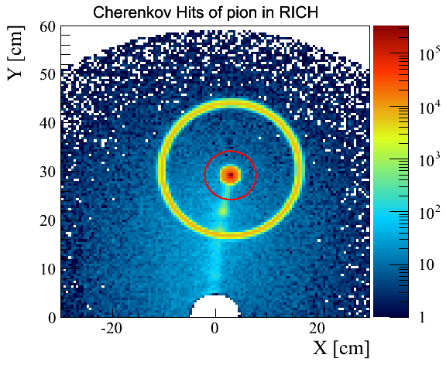
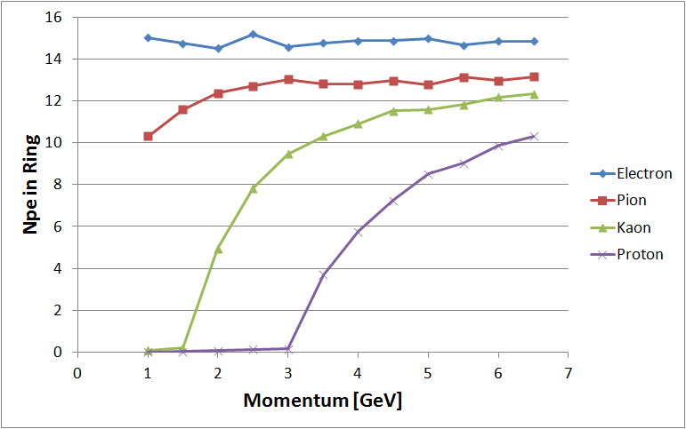
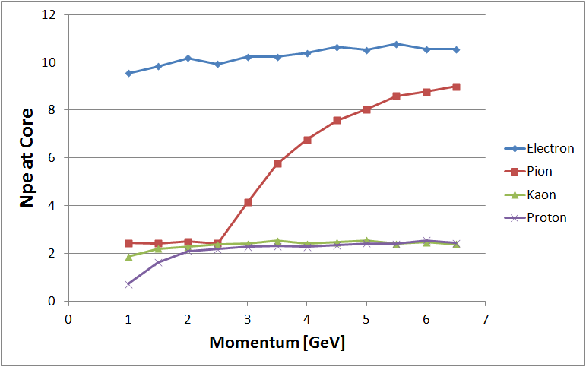
Dual-Radiator RICH Simulation
Simulation in GlueX Environment
5 GeV pions
Cherenkov hits from 3 cm aerogel
Cherenkov hits from 40 cm C₄F₁₀ and 0.5 mm glass

