Slide 1
Proton interrogation of passenger and cargo vehicles at near-background dose levels to identify shielded nuclear threats
Seth Van Liew
Passport Systems, Inc.
North Billerica, MA
5/24/17

Slide 2
Outline
Cargo scanning technologies
Low-dose protons
Material ID with protons
Nuclear detection
Proton sources
Conclusions and next steps

Slide 3
Motivation
A solicitation a few years back called for detection of nuclear materials at human safe radiation levels
A senior scientist at the company said it was “impossible”
I wasn’t so sure, and suggested protons
Low dose if Bragg peak is outside of the human body
Accurate imaging possible at low doses from monitoring the range
Proton current can be adjusted to make scanning as fast as possible
Straightforward to get grayscale images based on range of protons in the detector
Analog for areal density
Not a perfect relationship as stopping power is material-dependent
But can we use that?

Slide 4
Cargo screening at ports and borders
Mandated 100% screening
It’s more like a few percent in practice
Dangerous materials: explosives, nuclear materials, guns
Contraband: drugs, cigarettes, people, other cargo
Most scanners use x-ray technology
Most identification of threats done by operators using “context”
Desire a “red light green light” system
Want to minimize secondary scans
Identification of threats can be done automatically using atomic number, density, neutron energy, nuclear / x-ray fluorescence, shape

Slide 5
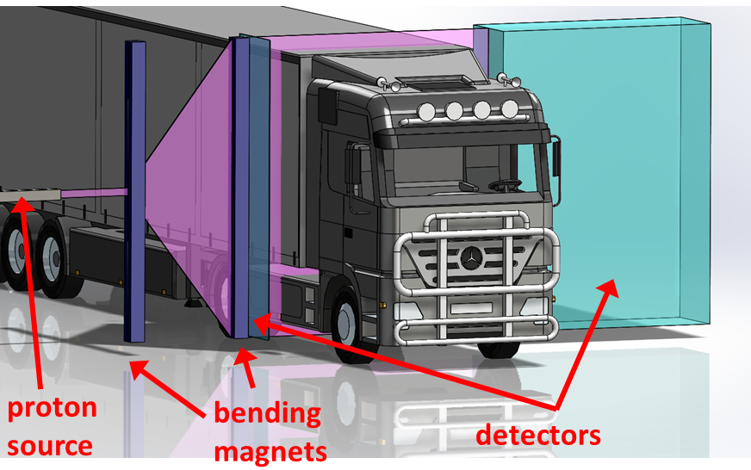
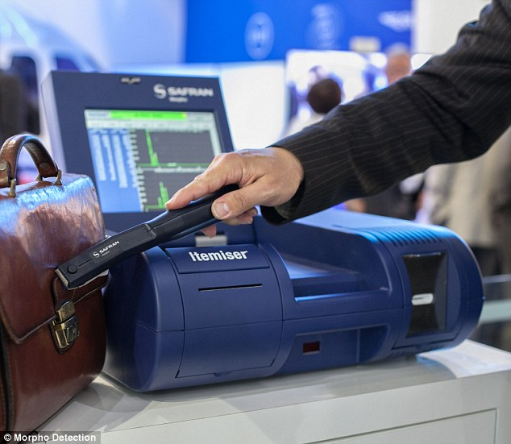
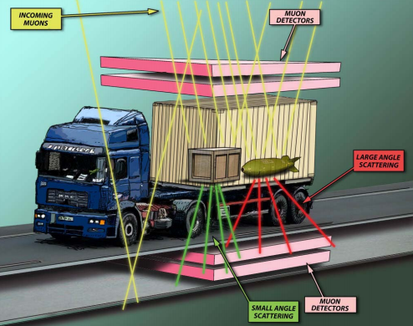
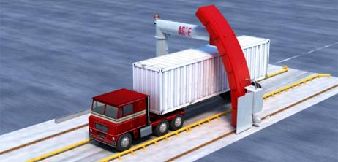
Cargo scanning technology
Protons
Sniffers
X-rays
Muons

Slide 6
 | X-rays | Sniffers | Muons | Protons
Radiograph | X |  | X** | X
Material discrimination | X | X | X | X
Nuclear detection | X* |  | X | X
Fast scanning | X | X |  | X
Low dose |  | X | X | X
Cheap | X* | X | ??
* Cannot achieve nuclear detection and have a cheap x-ray cargo system
** Muons can only create a realistic radiograph after a LONG time

Slide 7
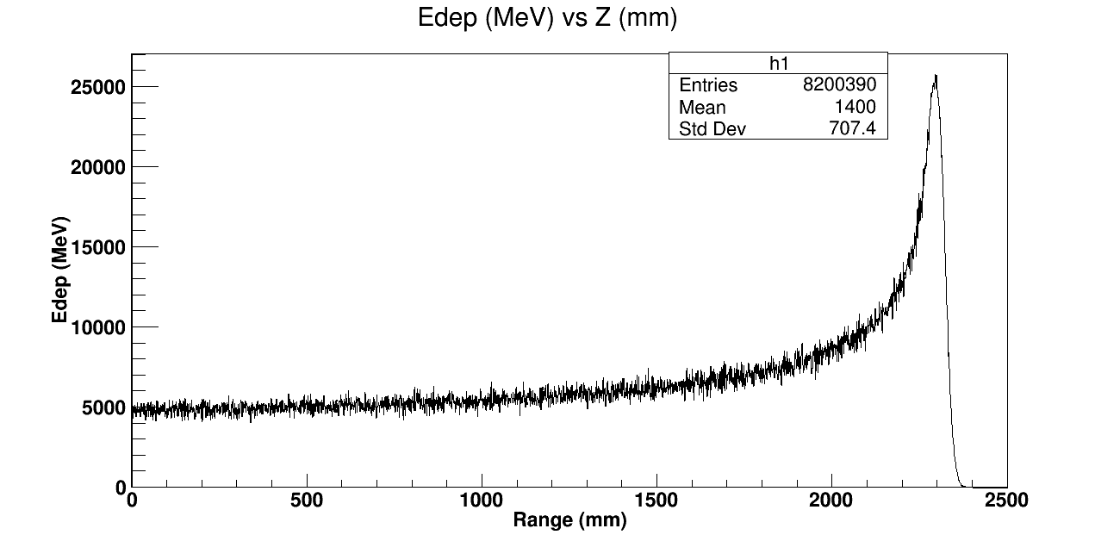
Why are protons lower dose?
X-rays are stochastic, depositing dose in a statistical distribution that is a decaying exponential
Protons are deterministic and have a well-defined range
60% of proton dose occurs in the last meter of travel (for this system)
This Bragg peak becomes sharper with heavier ions

Slide 8
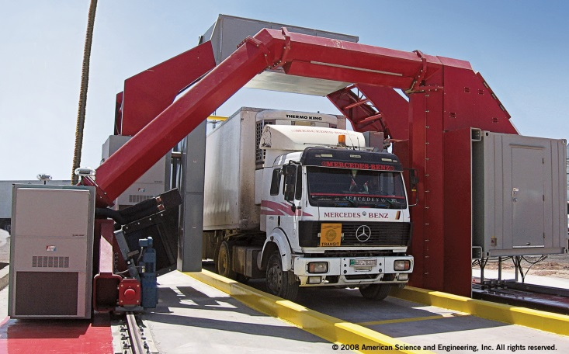
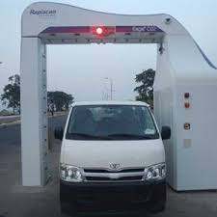
Initial system parameters
Wanted to mimic a cargo x-ray system for comparison
Most x-ray systems have steel penetration of between 300 and 400 mm
At 800 MeV, protons have a range of about 420 mm in steel
At 500 MeV, range in steel is 210 mm
Maximum proton current in the hundreds of pA
For human scanning, a 20 m long cargo container at 60 kph will be scanned in 1.2 s with a proton current of 0.89 pA and dose of 0.23 µSv
Detector concept still uncertain
Used water at an early stage to establish baseline
Standard cargo truck is a little over 3 m high, so chose a 4 m high detector
Chose parallel beam of protons so image wouldn’t be distorted
This can be accomplished with bending magnets

Slide 10
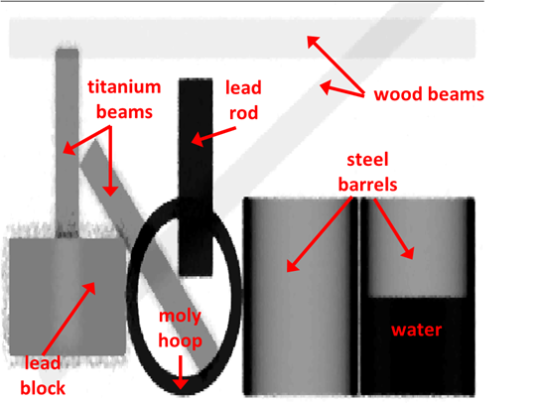
Grayscale image with protons

Slide 11
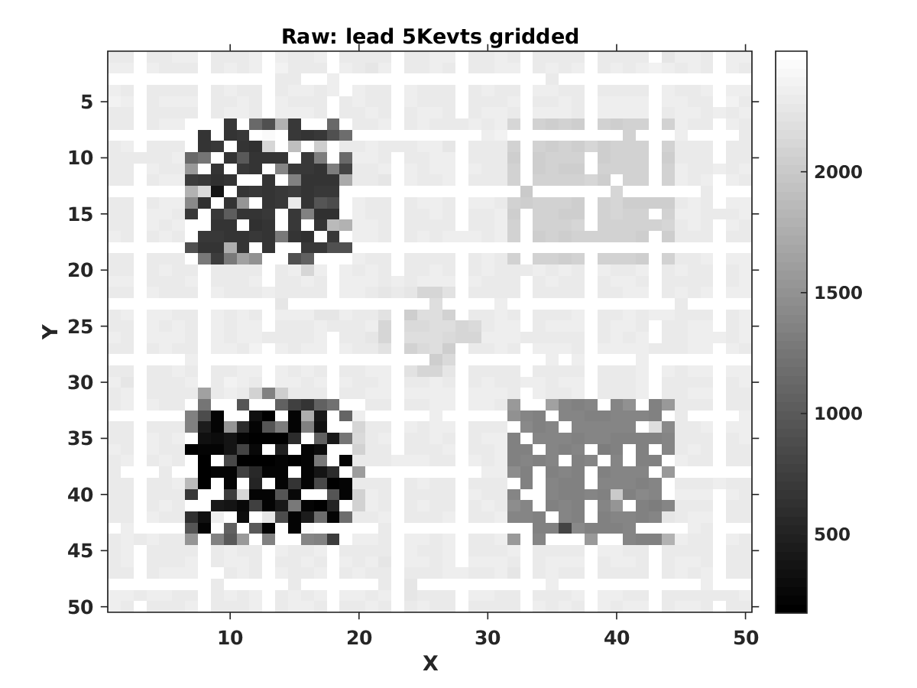
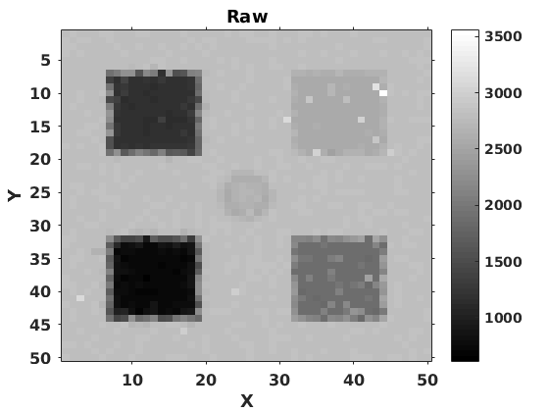
To raster or not to raster
Rastering refers to having a set distance between protons and a sequential scanning pattern
Rastering creates image artifacts
It limits spatial resolution
It restricts proton current if linear raster used
Random distribution far better
Arbitrarily high resolution
Higher proton current
Fewer image artifacts

Slide 12
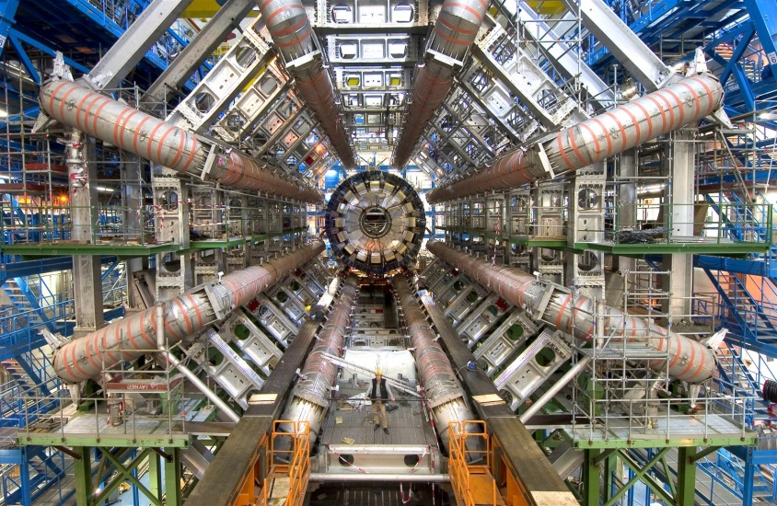
Detector concept
Need to reliably find range
Want to establish position and angle of protons entering and exiting the cargo
This turned from a nice-to-have to a necessary requirement
Due to environment dose considerations, did not want protons scattering out of the detector or passing beyond the end

Slide 13
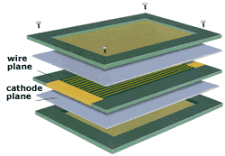
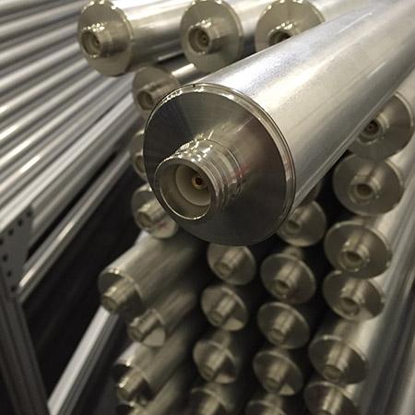
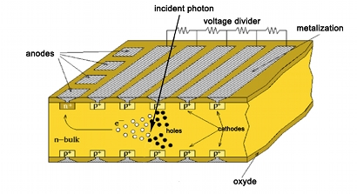
Detector hardware
MWPC’s
Similar to Geiger counter, use ionization of gas as proton passes through
Can read out position information
Cheap (or rather, “cheap”)
Gas handling system, high voltage required
Aluminum drift tubes
Similar to MWPCs
Minimize proton interactions with detector
No way to reliably establish range
Silicon
Excellent spatial resolution
No gas handling or vacuum
No high voltage
Way too expensive
Plastic scintillator
Heavy but cheap
Strongly deflects protons but also stops ‘em
No gas handling or vacuum
No high voltage

Slide 14
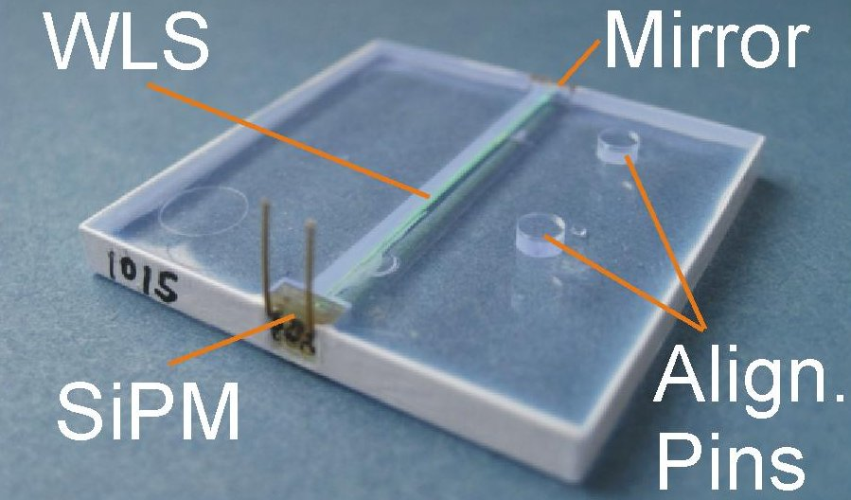
Plastic scintillator detector
Protons create visible light in PVT
This light can be read out directly via PMT
It can also be transmitted via wavelength-shifting fiber embedded within the scintillant
Read out using SiPMs
Biased to about 70 V
Each tile 50 cm wide x 200 cm tall x 10 mm deep
Can limit range resolution
Each tile coated with optical reflector
Entire detector a few hundred thousand in material costs
Segmentation maximizes proton current and keeps tile size manageable

Slide 15
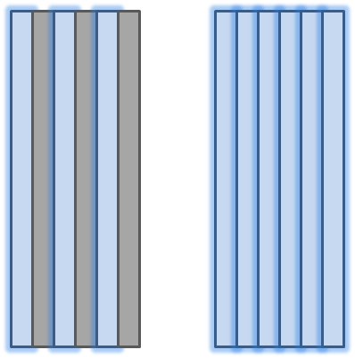
Is there a way to make the detectors more compact?
Can interleave scintillant with steel
Lose some spatial resolution
Can make a detector less than 1 m deep and narrower
PVT
steel

Slide 16
Material identification with protons
Proton attenuation through matter is dependent on Z and A
Although we don’t know a priori how much material the proton passes through, this relationship governs the statistical distribution of the final range
Higher atomic number materials have a larger standard deviation in the final range
This effect is called range straggling

Slide 17
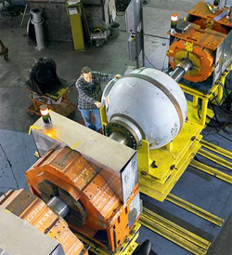
LANL proton material ID
Reconstructs different image planes
Does not need proton range to generate image and establish material ID
Minimal interaction of proton with detector
Excellent contrast and separation of MCS and nuclear scattering
Uses bending magnets on detector side
Limited field of view

Slide 18
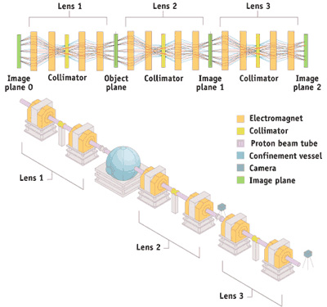
LANSCE pRad concept

Slide 19
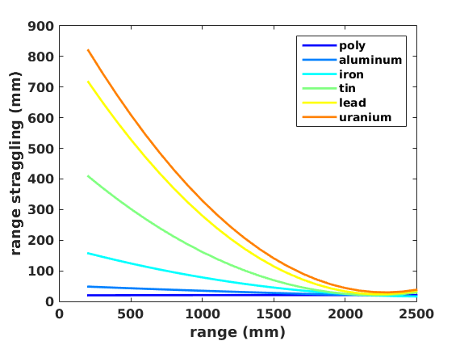
Material ID through range straggling
Irradiated 10 cm x 10 cm squares of different materials and different thicknesses
Can easily distinguish different materials based on range straggling alone
Not great for thin materials
Requires a full distribution of protons
Can we do material ID with a single proton to keep the dose low?

Slide 20
Material identification with single protons
Electron scattering proportional to Z/A from Bethe-Bloch equation
Moliere scattering governs nuclear scattering events, which can be large angle
Unfortunately, there are many variables that govern scattering angle in addition to material
Atomic screening
Interaction length
In addition, accurate track reconstruction is necessary to establish the point of interaction and thus the scattering angle
Proton can interact much more in a detector than in the actual target, complicating matters further

Slide 21
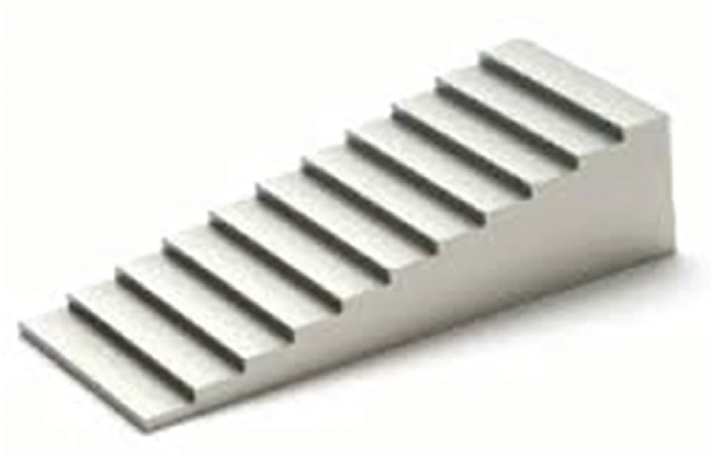
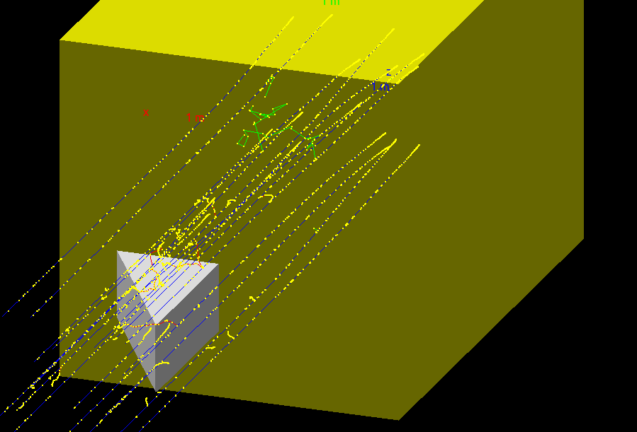
Different approach: just look at distribution
In x-ray inspection systems, wedges of different materials are scanned to establish relationship between signal levels and materials
The plotted results are calibration curves and can be used to fit unknown materials
Would this approach work for protons?

Slide 22
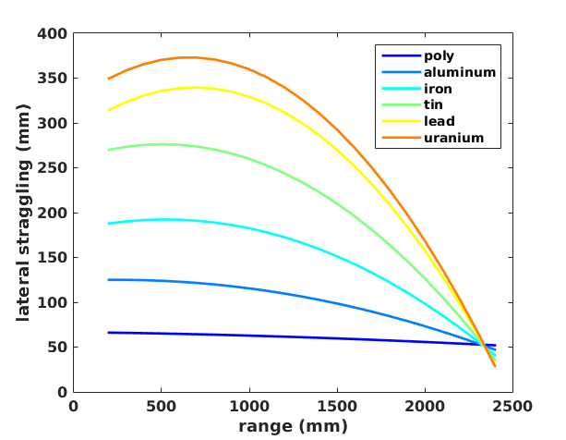
Material ID through lateral straggling
A proton’s lateral deflection is more deterministic
Can reliably get material ID with few protons
Good for both thin and thick materials
Good material separation at all atomic number values

Slide 23
System properties
Pixel sorting
Done by incident proton position only
Proton current - pA
Variable resolution
Can be set differently within same scan
Secondary inspection of region of interest at higher dose
Auto segmentation to establish material ID
We use all protons for an entire object
PINTO (Proton Imaging and Nuclear Threat Optimization) algorithm
Determines material ID through lateral deflection
Determines material density through large angle scattering

Slide 24
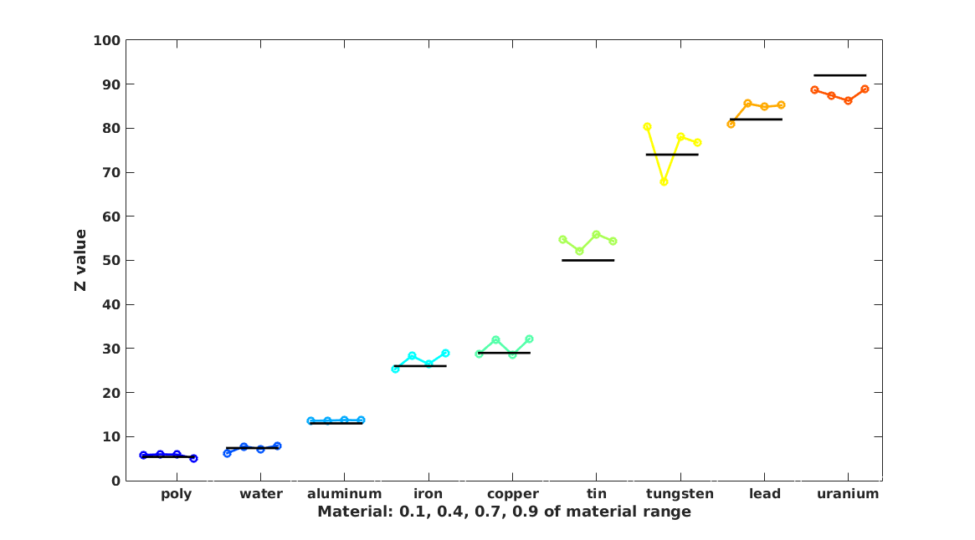
Material ID results
Based on 10 cm x 10 cm squares of material
Dose is 2 µSv

Slide 25
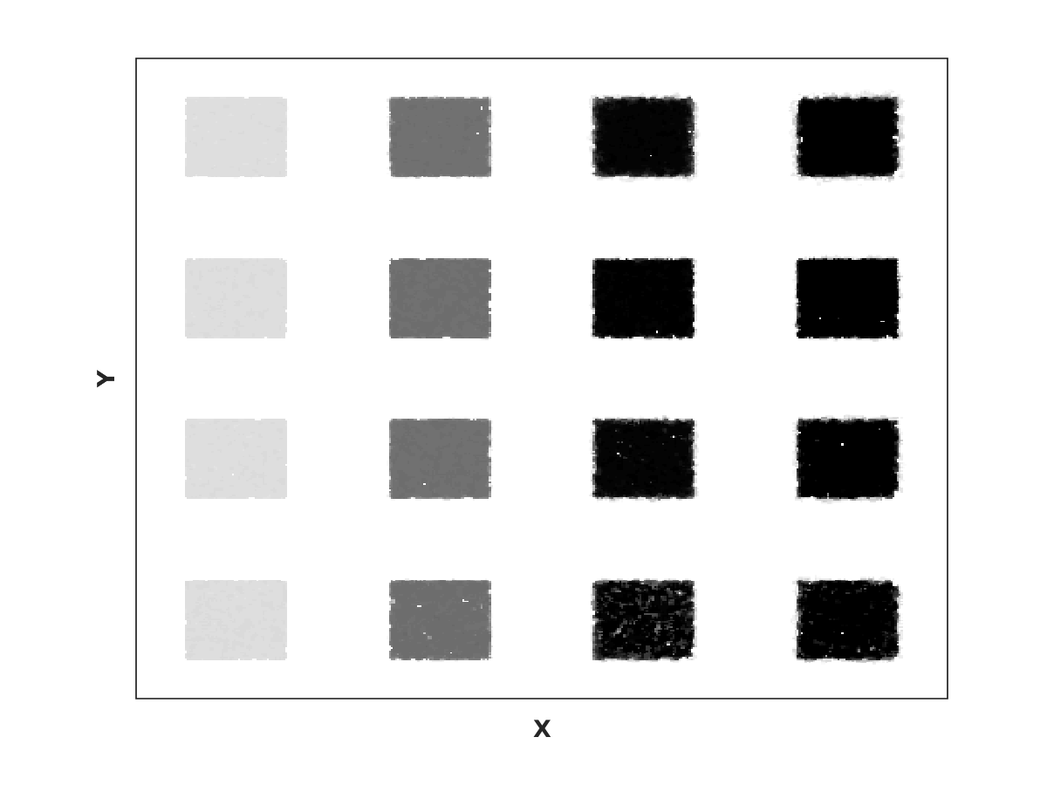
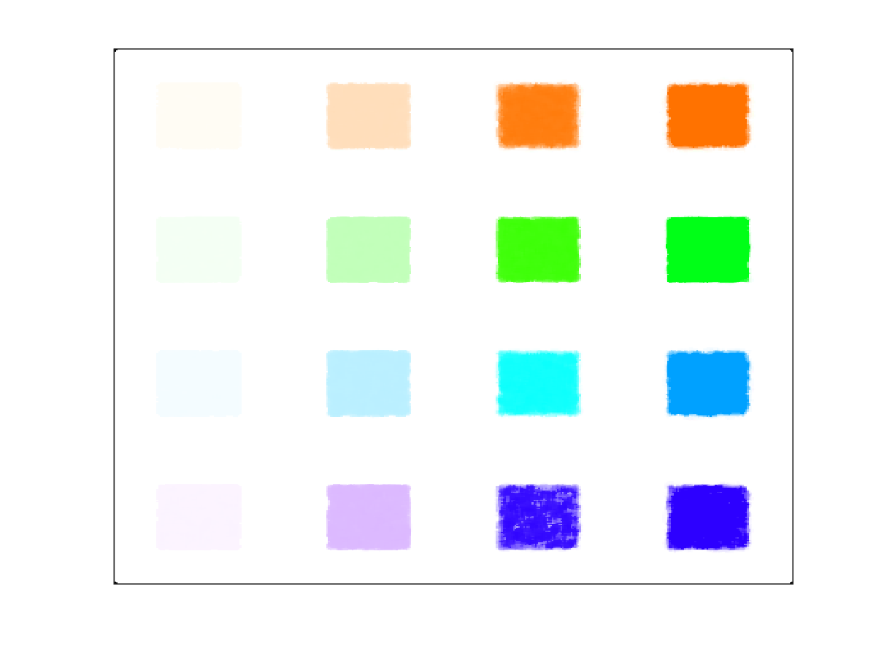
Different materials, different attenuations
Range
fraction
0.1
0.4
0.7
0.9
0.1
0.4
0.7
0.9
HDPE
Iron
Tin
Lead

Slide 26
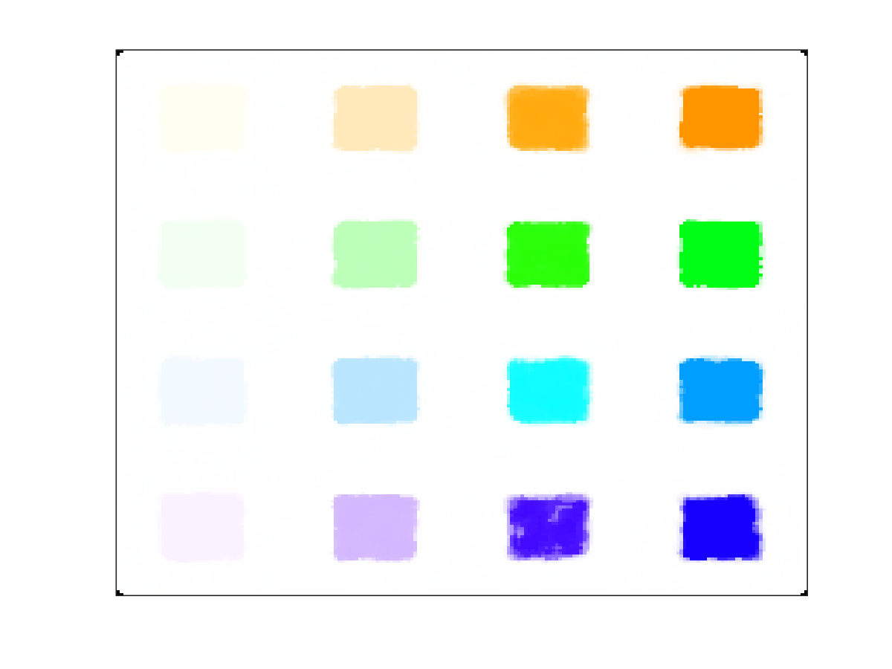
Different doses
Range
fraction
0.1
0.4
0.7
0.9
0.1
0.4
0.7
0.9
HDPE
Iron
Tin
Lead
0.2 µSv
2 µSv

Slide 27
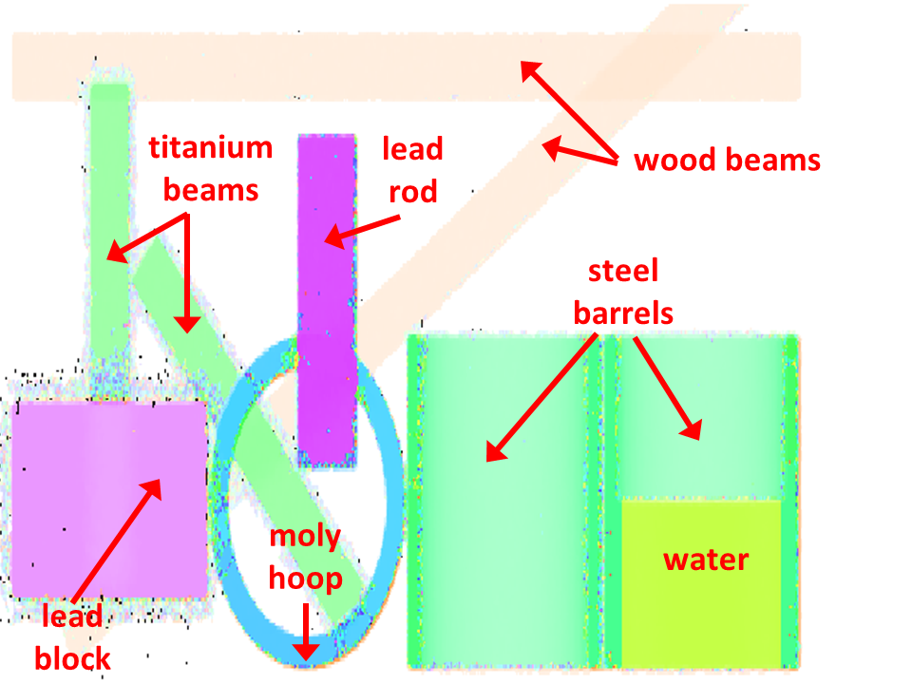
Imaging cluttered cargo

Slide 28
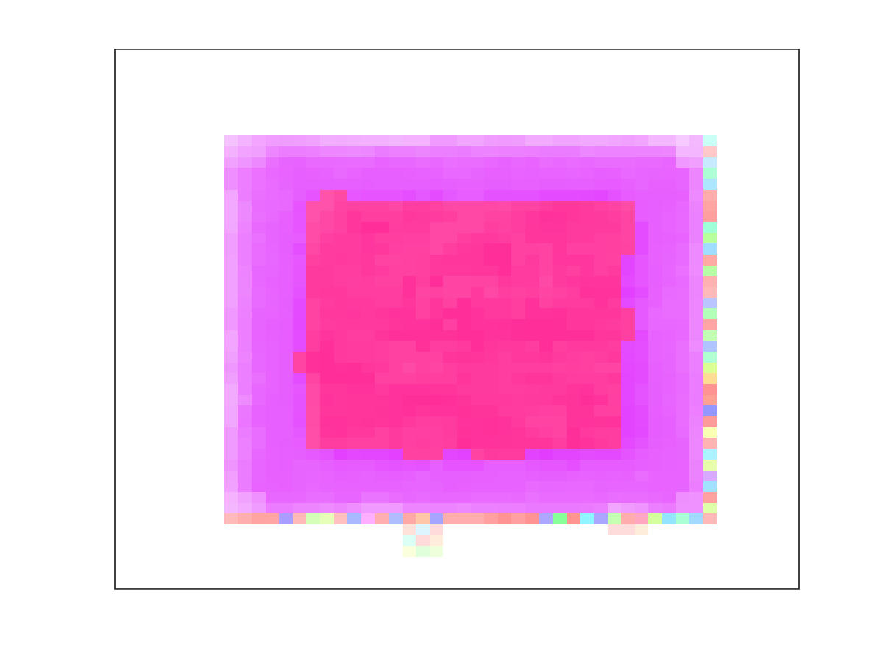
Nuclear detection
The difference between uranium and lead is only about 10% in Z
Although the system can distinguish this, it’s not definitive
There is, however, a big difference in density
Fissile materials (U, Pu, Th) are both high Z and high density
Considered nuclear material “identified” if I could reliably establish Z and density
For experiments, I used 15 cm cubes of uranium shielded by 2.5 cm of lead
Above critical mass of U 235?

Slide 29
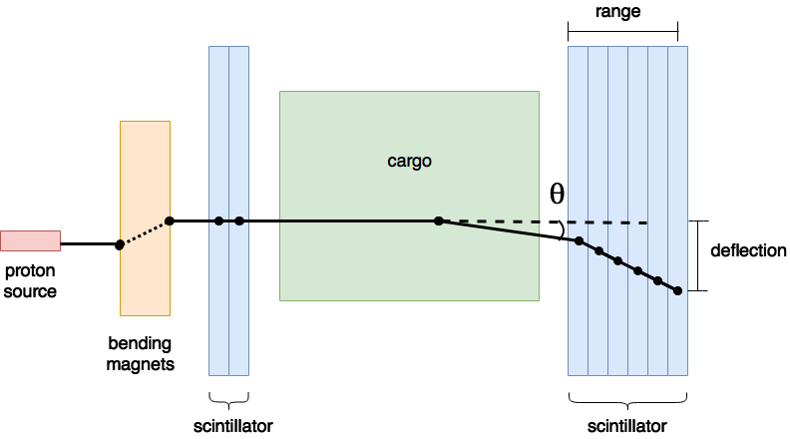
Density determination
Incoming and exiting angle determined by detectors
Large angle measured and averaged over a given threshold
Ratio of large angle deflections to total number of protons calculated
Density determined based on this ratio
Probable interaction point established to enable 2D localization
Similar to POCA
Rudimentary 3D localization also possible

Slide 30
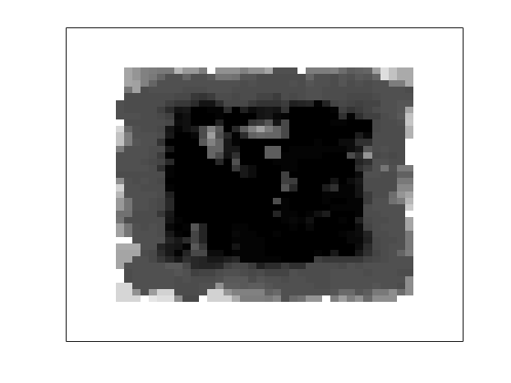
Can we distinguish lead from uranium?
Lead only
There is enough contrast in grayscale to see that something is different
(Each image is normalized)
Image dose is 1.2 µSv
However need material ID
Contrast is visible at low doses
Lead shielded uranium
0.2 µSv

Slide 31
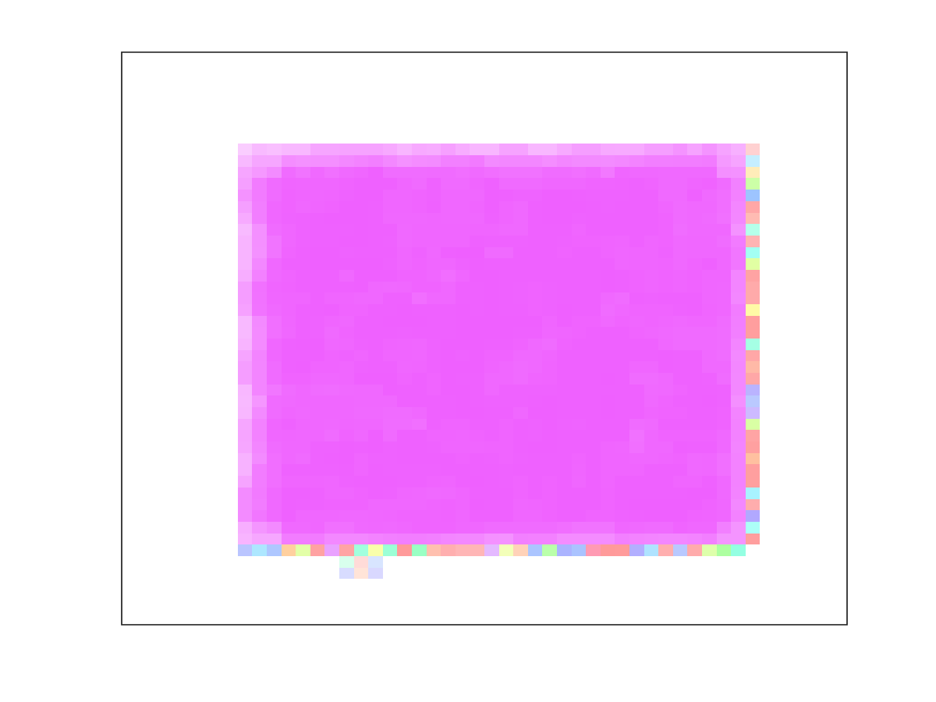
Can we distinguish lead from uranium?
Lead only
With the material discrimination from PINTO, we can see further contrast, but still not much
Lead and Uranium are only 10% different in atomic number or so, 82 vs. 92.
Lead shielded uranium

Slide 32
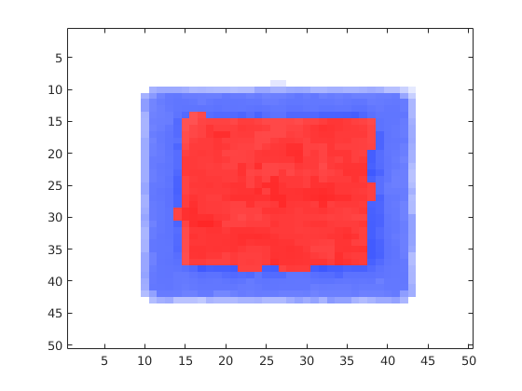
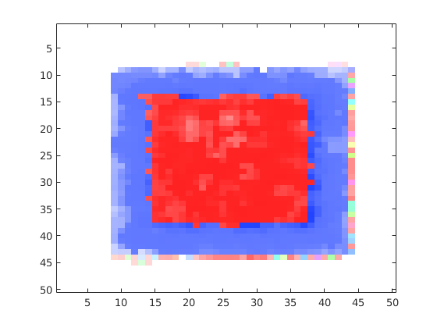
Adding in density enhancement
1.2 µSv
By applying the density difference to the color scheme, a marked difference in material properties can be seen
This difference is still seen even at low doses in the bottom image
0.2 µSv

Slide 33
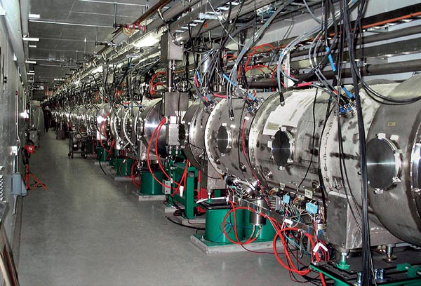
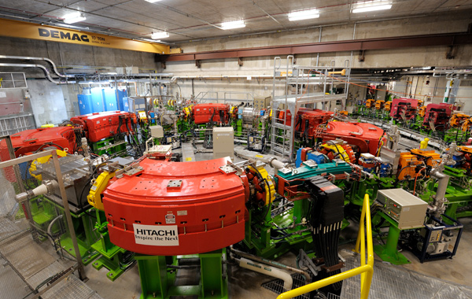
Proton sources – is that all we need?
Accelerating protons is not a cheap business
Linear accelerator
Quite long for 800 MeV protons
High extraction yield
Straightforward technology
Cyclotron
Well-established technology
More compact, but still large
Low extraction efficiency
Sychrotron, synchro-cyclotron
Require super-conducting magnets and sophisticated electronics
Compact
Expensive

Slide 34
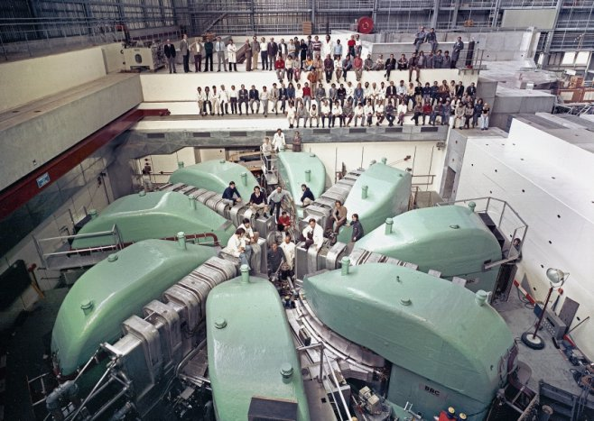
590 MeV cyclotron, PSI, Switzerland

Slide 35
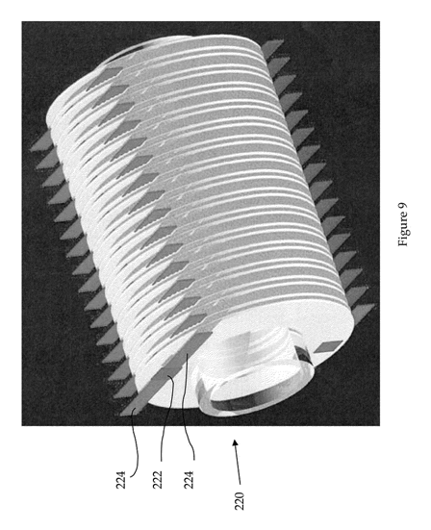
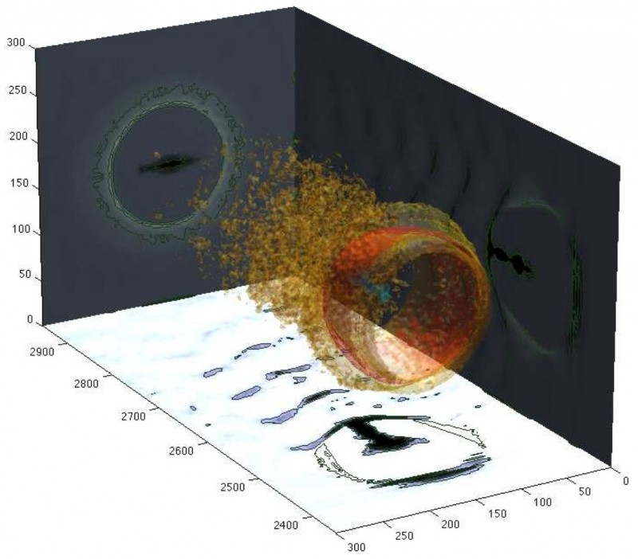
Emerging proton technologies
Dielectric wall accelerator
Similar to linac: uses travelling wave to induce acceleration
Main difference with linac is it uses high-gradient insulators
Can achieve 100 MV/m accelerations
Laser / plasma accelerated protons
Uses wakefield or induced electric field to accelerate charged particles
Highest yield current come from shining a laser through a gas
Still not achieving high energies, but rapidly improving
Both technologies offer potentially cheap and compact way to generate protons

Slide 36
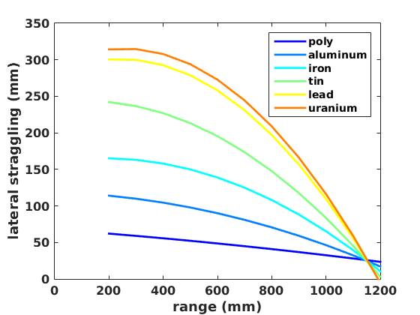
Can we use a lower proton energy?
Short answer: yes!
Longer answer: eh…
Material ID still good at lower energies
Penetration goes down rapidly with decreasing energy
Only 220 mm steel penetration at 500 MeV
500 MeV calibration

Slide 37
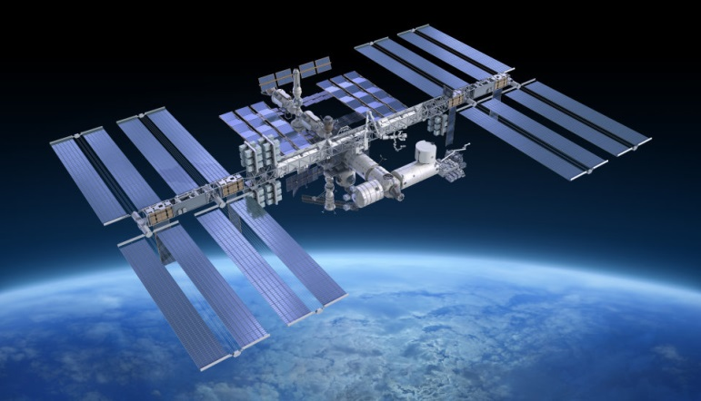
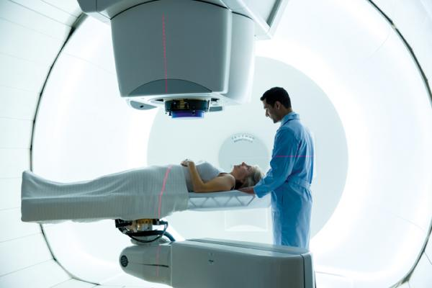
What’s next?
Experimental validation and prototype
Low-dose 3D techniques
The built-in density determination has 3D already encoded
Other applications:
Medical
Space
Specialized

Slide 38
Conclusions
Protons offer superior scan speed and detection while giving low dose
Large-scale radiography of vehicles with compact detector designs possible
Material identification at the full range of densities and atomic numbers demonstrated
Shielded special nuclear materials can be identified at doses of 0.2 µSv, suitable for members of the public
Protons are still expensive to generate, but emerging technologies may change that
3D imaging possible
Other opportunities for this technology outside of security

Slide 39
Thank you!

Slide 40
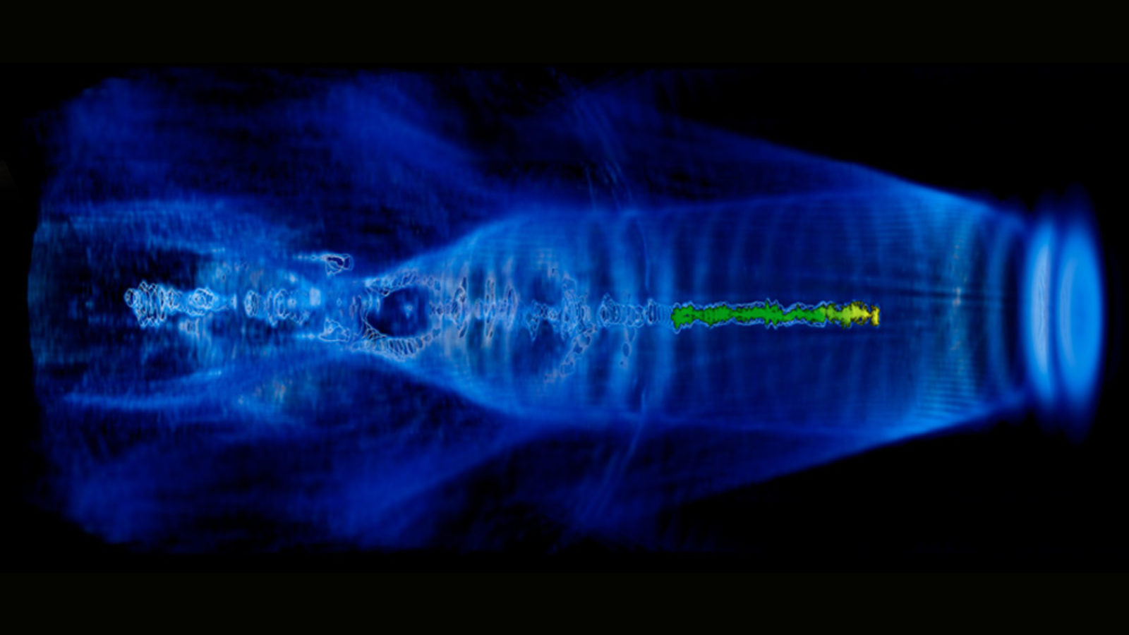
Plasma acceleration

Slide 41
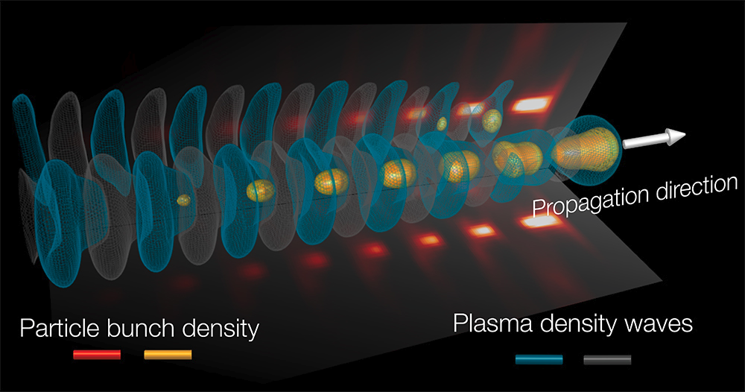
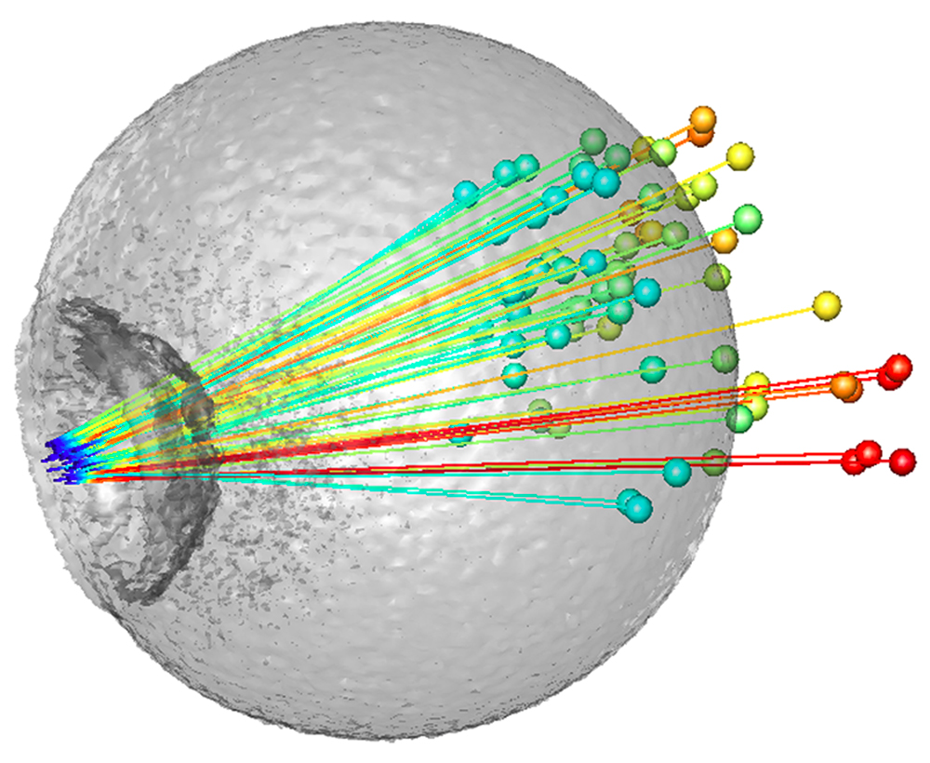
Proton plasma acceleration

