Slide 1
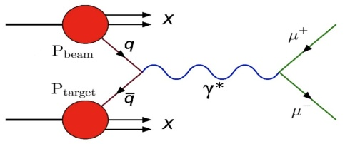

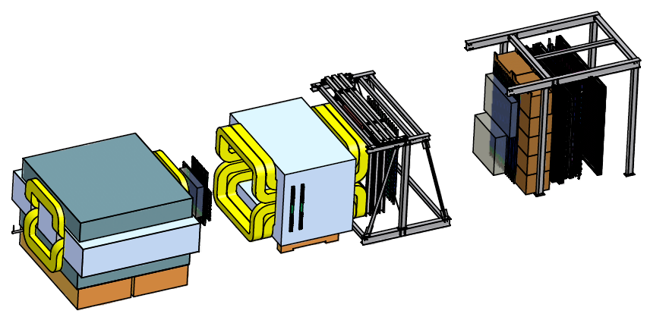


Polarized Drell-Yan at Fermilab
Wolfgang Lorenzon
(18-February-2014)
Los Alamos
Single Spin Asymmetries and Sivers Function
Sivers Function in Polarized Drell-Yan
  fundamental QCD prediction:
Polarized Drell-Yan at Fermilab
  polarized Beam (E1027) or Target (E1039)
Main Injector Polarization Scheme
  present status & plans
SeaQuest Spectrometer
This work is supported by
Notes:
Polarized Drell-Yan scattering has become a major milestone in the hadronic physics community, motivated by a fundamental prediction of QCD that postulates that a time-reversal-odd distribution function (e.g. the Sivers function) measured in Drell-Yan must have the opposite sign when measured with semi-inclusive deep inelastic scattering (DIS).
I want to start with a discussion of the Sivers function and how it is accessed thorugh SSA in DIS, and then discuss the tremendous opportunity at Fermilab, for a relatively modest cost to set up the arguably best polarized Drell-Yan experiment to perform this fundamental test of the gauge structure of QCD (which could be the beginning of a world-class polarized proton program at Fermilab that is complementary to the spin physics programs at RHIC and Jefferson Lab.)
I will then conclude with a discussion of the work that is needed to polarize the MI and how far we have moved towards that goal.

Slide 2
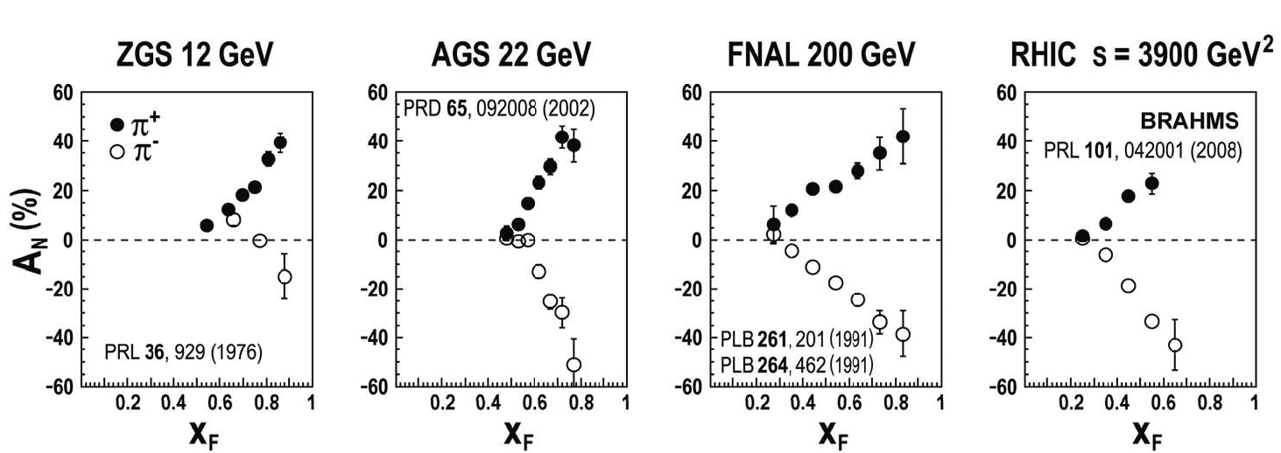
Transverse Single Spin Asymmetries (SSA)
(huge) single spin asymmetries for forward meson production in hadron-hadron interactions have been observed over a wide range of c.m. energies
ANL – 4.9 GeV BNL – 6.6 GeV FNAL – 20 GeV BNL – 62.4 GeV
C. Aidala SPIN 2008 Proceeding and CERN Courier June 2009
“E704 effect”:
  polarized beam at Fermilab (tertiary beam from production & decay of hyperons)
  beam intensity too low for DY
possible explanation for large inclusive asymmetries:
  Sivers distribution function, or Collins fragmentation function
Notes:
The Sivers function was first proposed as a possible explanation of the ``E-704 effect'': the large left-right analyzing power observed in inclusive pion production from a transversely polarized proton beam of 200 GeV incident on a beryllium target. The polarized beam at FNAL-E-704 was a tertiary beam obtained from the production and subsequent decay of hyperons. (Its intensity was however far below that required for Drell-Yan measurements.)
X_f is longitudinal momentum fraction

Slide 3
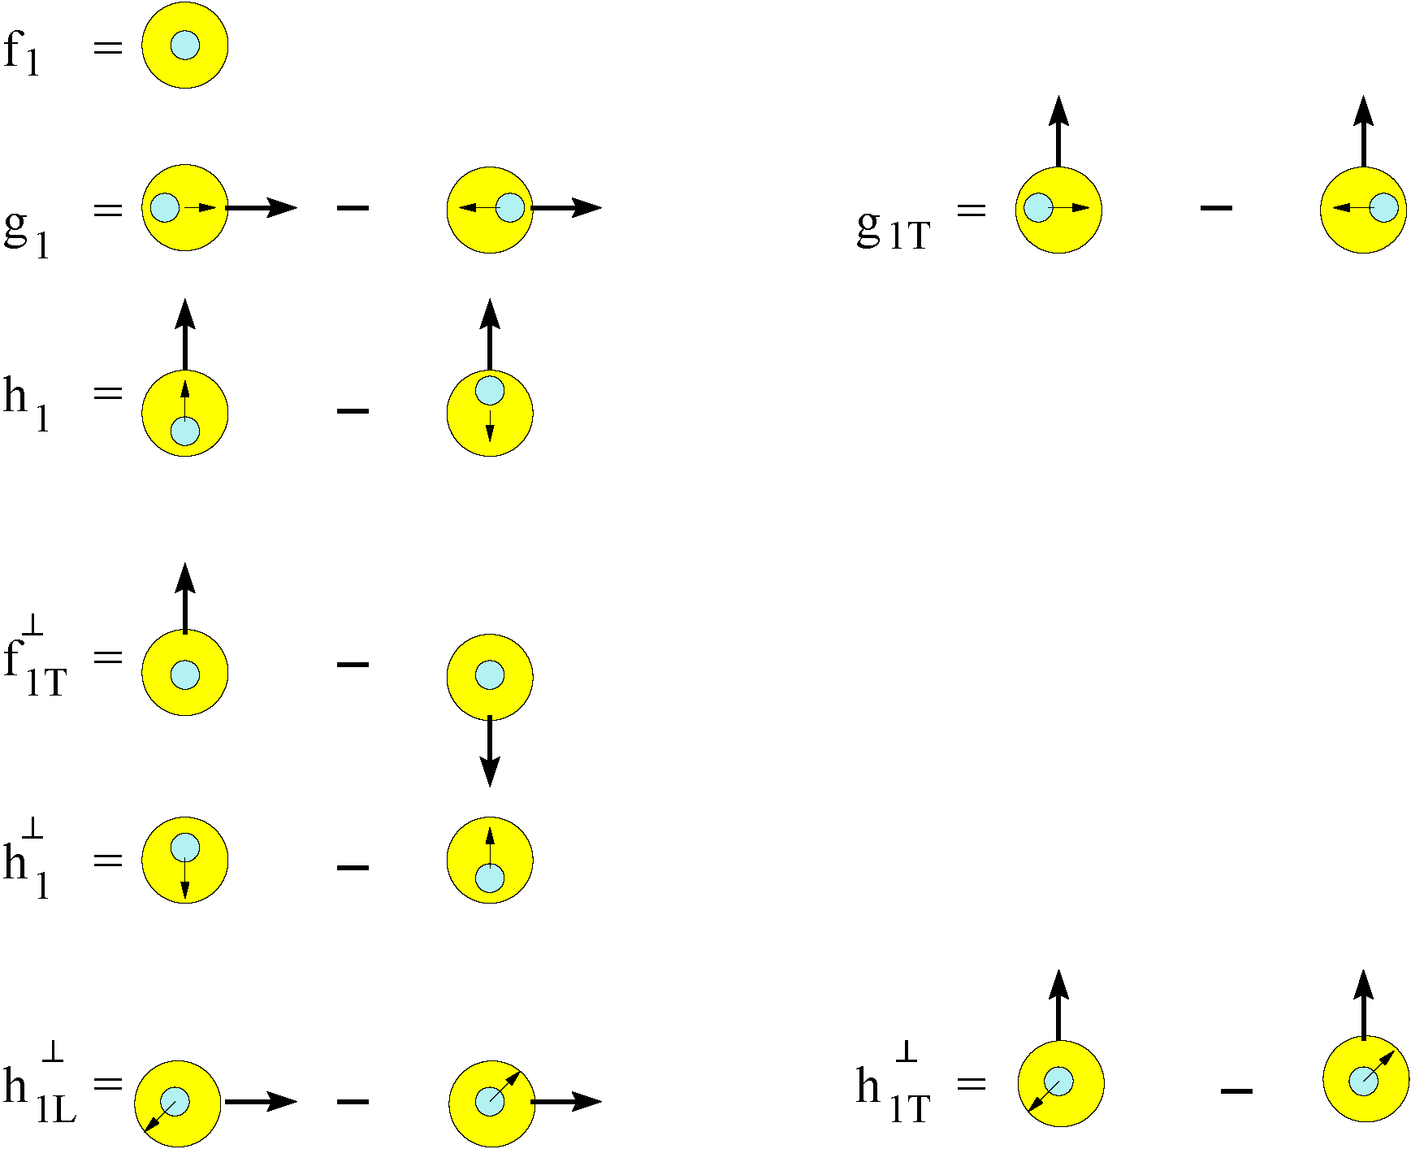
Transverse Momentum Distributions (Introduction)
survive k_{T} integration
Sivers Function
k_{T} - dependent, T-even
k_{T} - dependent,
Naïve T-odd
Boer-Mulders Function
Notes:
Besides the maybe familiar 2 or 3 parton distribution functions there are five additional structure functions, probably less well known, but equally fundamental.
k_T is parton transverse momentum (= momentum transverse to that of s- or t- channel virtual photon)

Slide 4
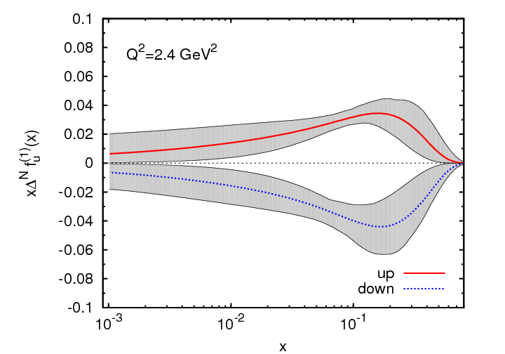
Sivers Function
describes transverse-momentum
distribution of unpolarized quarks inside transversely polarized proton
captures non-perturbative spin-orbit
coupling effects inside a polarized proton
Sivers function is naïve time-reversal odd
leads to
  sin(φ – φ_{S}) asymmetry in SIDIS
  sinφ_{b} asymmetry in Drell-Yan
measured in SIDIS (HERMES, COMPASS)
future measurements at Jlab@12 GeV planned
Anselmino et al. (arXiv:1107.4446 [hep-ph])
x
First moment of Sivers functions:
  u- and d- Sivers have opposite signs, of roughly equal magnitude
Notes:
This single-spin asymmetry is odd under so-called ``naive time-reversal'', the operation that reverses all vectors and pseudo-vectors but does not exchange initial and final states.

Slide 5
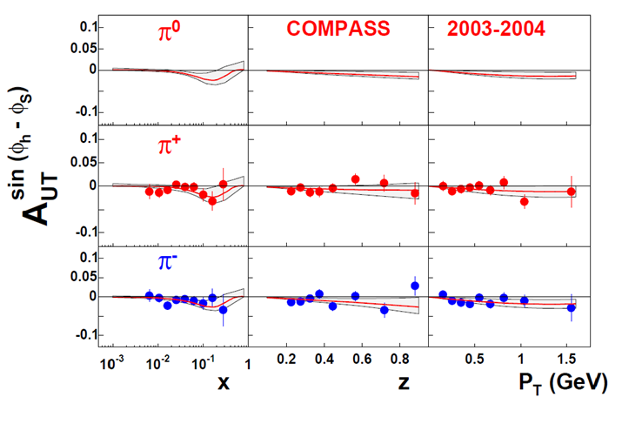
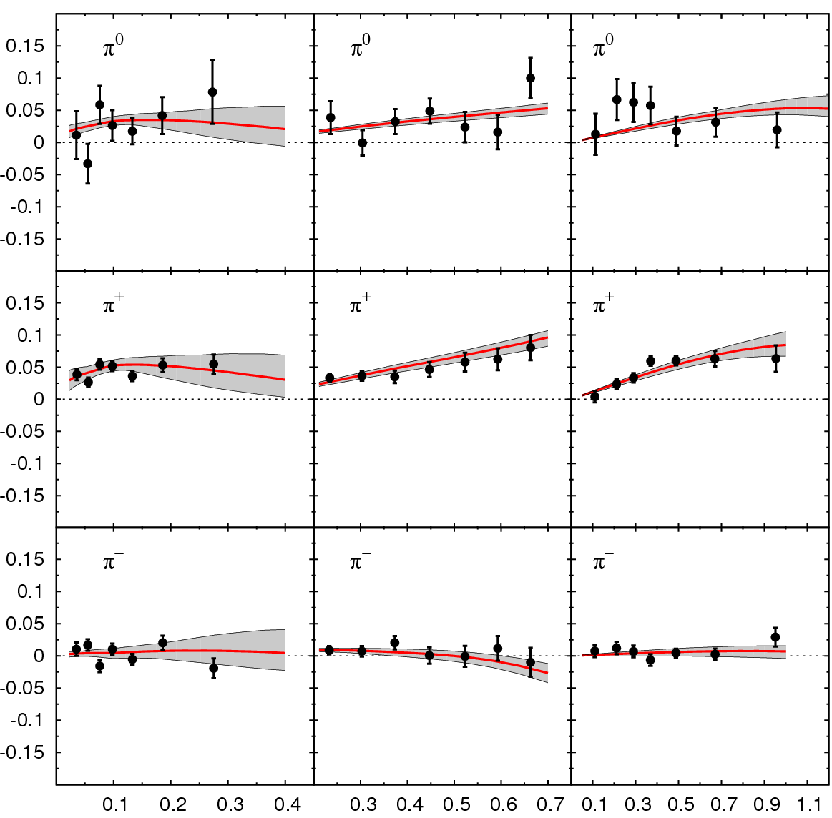
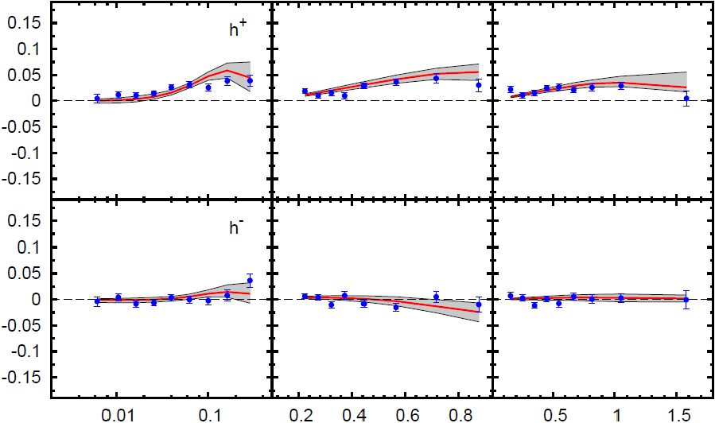
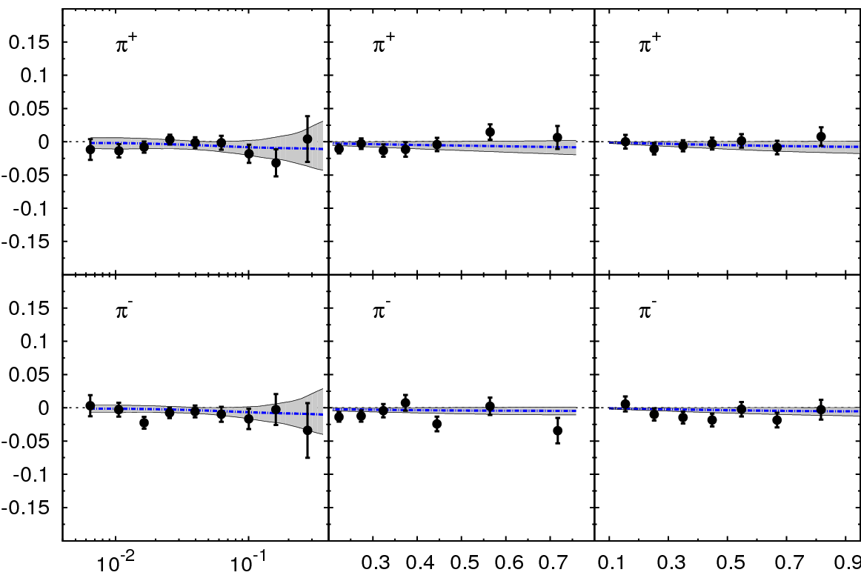
Sivers Asymmetry in SIDIS
HERMES (p)
COMPASS (p)
π⁰
h⁺
π⁺
h⁻
π⁻
x z P_{T} (GeV)
COMPASS (d)
π⁺
Global fit to sin (φ_{h} – φ_{S}) asymmetry in SIDIS (HERMES (p), COMPASS (p), COMPASS (d))
π⁻
x z P_{T} (GeV)
Comparable measurements needed in Drell-Yan process

Slide 6
Polarized Drell-Yan Experiment
NOT Yet Done!
Access to transverse-momentum dependent distribution (TMD) functions
    Sivers, Boer-Mulders, etc
Transversely Polarized Beam or Target
    Sivers function in single-transverse spin asymmetries (sea quarks or valence quarks)
      − valence quarks constrain SIDIS data much more than sea quarks
      − global fits indicate that sea quark Sivers function is small
    transversity Boer-Mulders function
    baryon production, incl. pseudoscalar and vector meson production,
    elastic scattering, two-particle correlations, J/ψ and charm production
Beam and Target Transversely Polarized
    flavor asymmetry of sea-quark polarization
    transversity (quark anti-quark for pp collisions)
      − anti-quark transversity might be very small

Slide 7
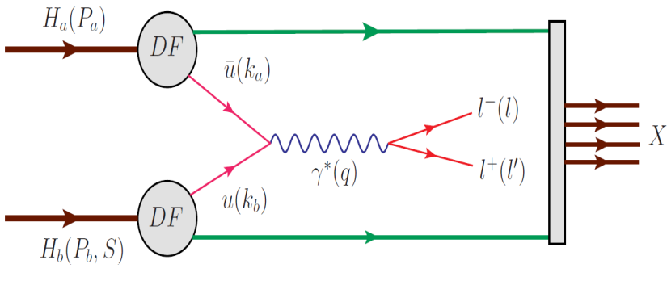
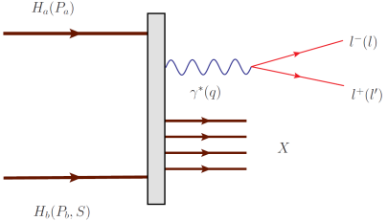
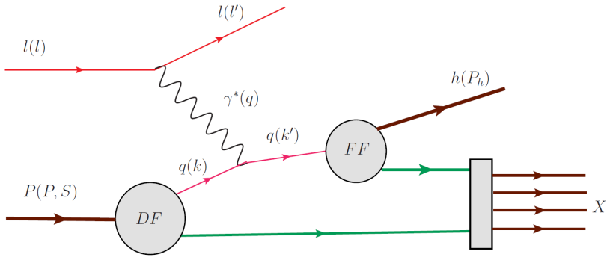
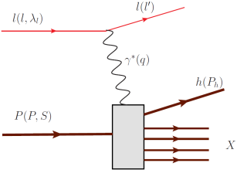
Drell Yan Process
Similar Physics Reach as SIDIS:
  parton level understanding of nucleon
  electromagnetic probe
timelike (Drell-Yan) vs. spacelike (SIDIS) virtual photon
Drell-Yan
SIDIS
A. Kotzinian, DY workshop, CERN, 4/10
Cleanest probe to study hadron structure:
  hadron beam and convolution of parton distributions
  no QCD final state effects
  no fragmentation process
  ability to select sea quark distribution
Assuming factorization valid in QCD: allows direct production of two transverse momentum-dependent distribution (TMD) functions (Sivers, Boer-Mulders, etc)
Assuming universality valid in QCD: DF in DY and SIDIS are identical
Notes:
Assuming factorization is valid in QCD, Drell-Yan can be written as a hard scattering process, and the direct production of two transverse momentum-dependent distribution (TMD) functions (Sivers, Boer-Mulders, etc); and SIDIS allows to measure convolution of DF with FF.
If universality is valid in QCD, DF in D-Y and SIDIS are identical.

Slide 8
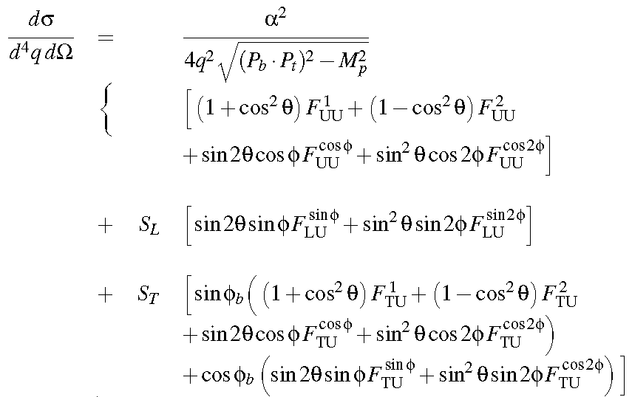
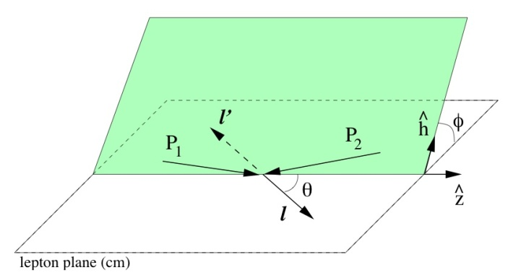
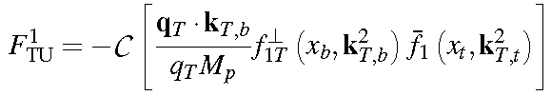

Leading order DY Cross Section
DY cross section at LO:
Sivers Mechanism
Sivers function
  with the asymmetry amplitude:
Notes:
Phi_b = azimuthal angle of transverse spin orientation of beam (in target rest frame)
theta and phi are polar and azimuthal angles of dimuon pair (in dimuon c.m. frame)
Sivers mechanism manifests itself in the sin phi_b(…) modulation of xsec.
Structure function F^1_TU provides signal for Sivers function

Slide 9
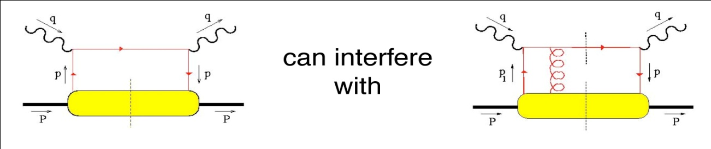
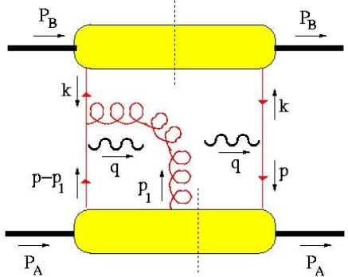
Sivers Function
T-odd observables
  SSA observable ~ odd under naïve Time-Reversal
  since QCD amplitudes are T-even, must arise from interference
  (between spin-flip and non-flip amplitudes with different phases)
Cannot come from perturbative subprocess xsec at high energies:
  q helicity flip suppressed by
  need suppressed loop-diagram to generate necessary phase
  at hard (enough) scales, SSA’s must arise from soft physics
A T-odd function like must arise from interference (How?)
  soft gluons: “gauge links” required for color gauge invariance
  such soft gluon re-interactions with the soft wavefunction are
  final (or initial) state interactions … and maybe process dependent!
  leads to sign change:
Brodsky, Hwang & Smith (2002)
and produce a T-odd effect!
(also need )
e.g. Drell-Yan)
Notes:
To produce a T-odd observable, such as the Sivers function, you must have an interference between spin-flip and non-flip amplitudes, and one of the amplitudes must have an imaginary part.
And all of these should all be completely suppressed in the perturbative hard scattering subprocess xsec.
But a leading twist distribution function is just a forward scattering amplitude, how can it contain an interference?
But because of the data, and the vigorous theoretical effort surrounding these data, Brodksy, Hwang and Smith re-examined the factorization theorem and found that for the case of TMD PDFs, one has to be careful to include these diagrams, where a soft gluon re-interacts between the struck quark and the proton. This looks like higher twist … but no, these are soft gluons, which are the gauge links required for color gauge invariance.
While in DIS this final state interaction is attractive, in D-Y the initial state interaction is repulsive, leading to a sign change

Slide 10
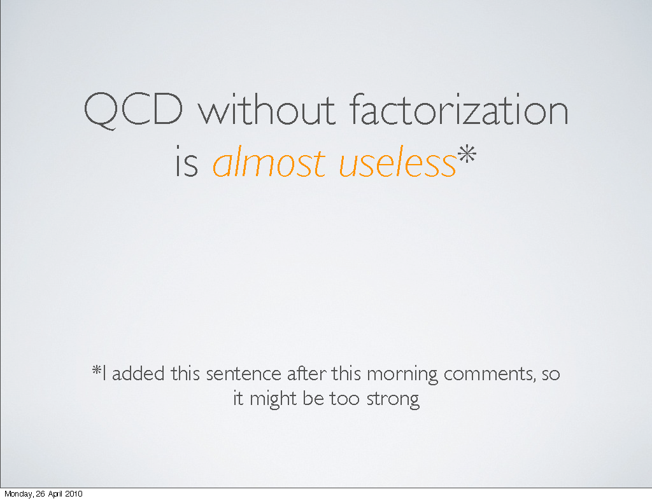
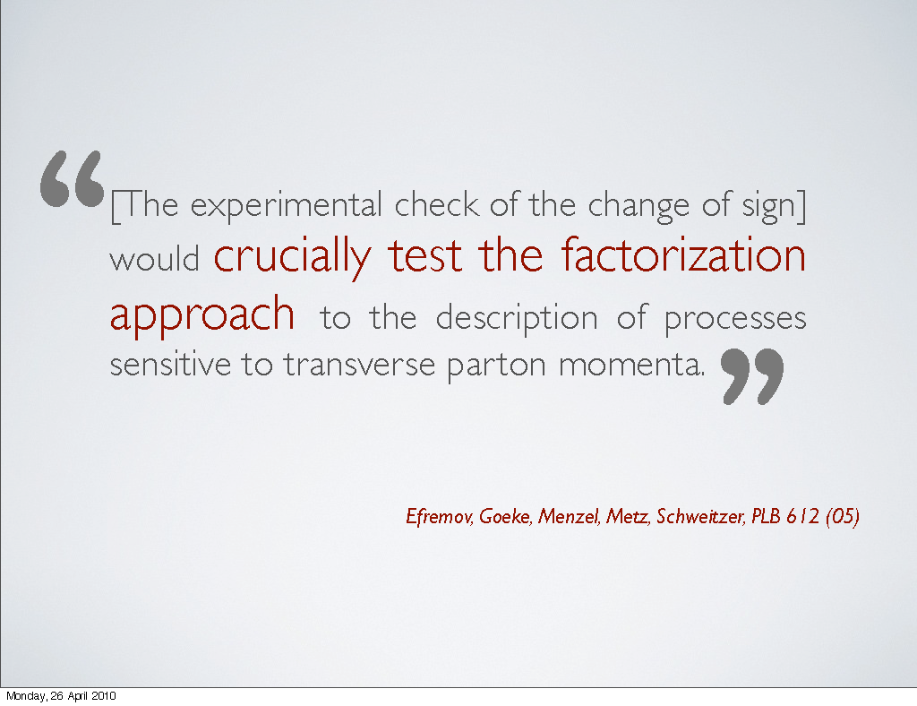
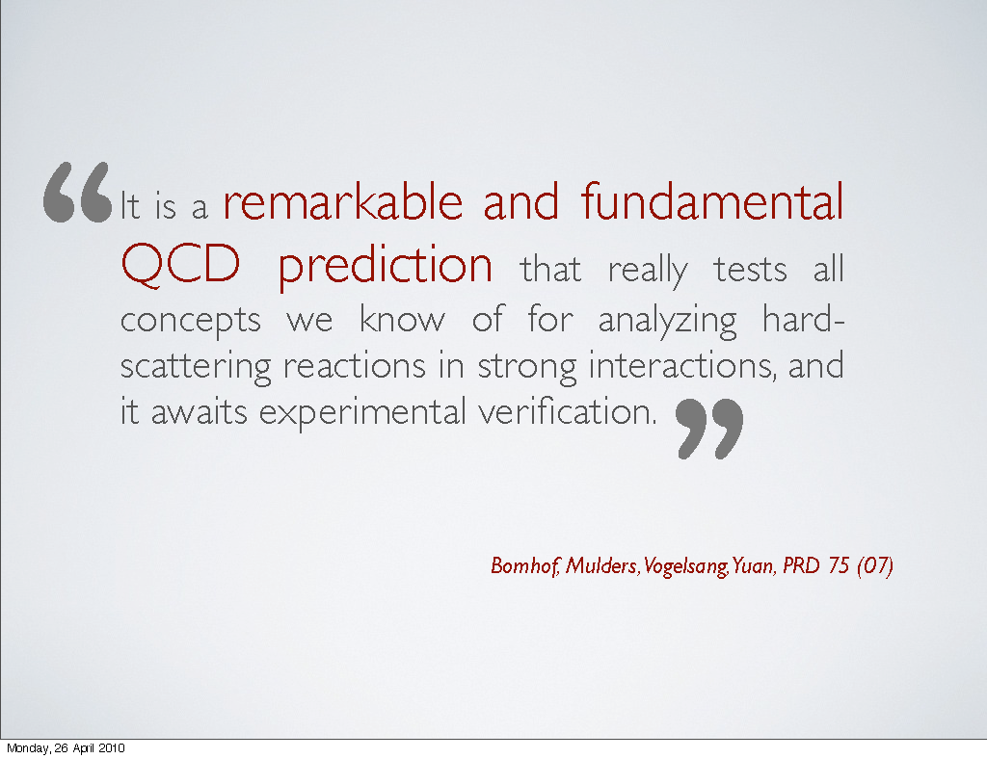
Sivers in Drell-Yan vs SIDIS: The Sign Change
fundamental prediction of QCD (in non-perturbative regime)
  goes to heart of gauge formulation of field theory
Importance of factorization in QCD:
A. Bacchetta , DY workshop, CERN, 4/10

Slide 11
Hadronic Physics Milestone #13
Report to NSAC, 11-Aug-2008 (by subcommittee on performance measures):
  Table 11: New, Updated and Continuing Milestones for Hadronic Physics
New Milestone HP13 reflects the intense activity and theoretical breakthroughs of recent years in understanding the parton distribution functions accessed in spin asymmetries for hard-scattering reactions involving a transversely polarized proton. This leads to new experimental opportunities to test all our concepts for analyzing hard scattering with perturbative QCD.
2015 | HP13 (new) | Test unique QCD predictions for relations between single-transverse spin phenomena in p-p scattering and those observed in deep-inelastic lepton scattering

Slide 12
Planned Polarized Drell-Yan Experiments
experiment | particles | energy | x_{b} or x_{t} | Luminosity | timeline
COMPASS (CERN) | π± + p↑ | 160 GeV √s = 17.4 GeV | x_{t} = 0.2 – 0.3 | 2 x 10³³ cm⁻² s⁻¹ | 2014, 2018
PAX (GSI) | p↑ + p_{bar} | collider √s = 14 GeV | x_{b} = 0.1 – 0.9 | 2 x 10³⁰ cm⁻² s⁻¹ | >2017
PANDA (GSI) | p_{bar} + p↑ | 15 GeV √s = 5.5 GeV | x_{t} = 0.2 – 0.4 | 2 x 10³² cm⁻² s⁻¹ | >2016
NICA (JINR) | p↑ + p | collider √s = 20 GeV | x_{b} = 0.1 – 0.8 | 1 x 10³⁰ cm⁻² s⁻¹ | >2018
PHENIX (RHIC) | p↑ + p | collider √s = 500 GeV | x_{b} = 0.05 – 0.1 | 2 x 10³² cm⁻² s⁻¹ | >2018
RHIC internal target phase-1 | p↑ + p | 250 GeV √s = 22 GeV | x_{b} = 0.25 – 0.4 | 2 x 10³³ cm⁻² s⁻¹ | >2018
RHIC internal target phase-1 | p↑ + p | 250 GeV √s = 22 GeV | x_{b} = 0.25 – 0.4 | 6 x 10³⁴ cm⁻² s⁻¹ | >2018
SeaQuest (unpol.) (FNAL) | p + p | 120 GeV √s = 15 GeV | x_{b} = 0.35 – 0.85 x_{t} = 0.1 – 0.45 | 3.4 x 10³⁵ cm⁻² s⁻¹ | 2012 - 2015
Pol tgt DY‡ (E1039) (FNAL) | p + p↑ | 120 GeV √s = 15 GeV | x_{t} = 0.1 – 0.45 | 3.4 x 10³⁵ cm⁻² s⁻¹ | 2016
Pol beam DY§ (E1027) (FNAL) | p↑ + p | 120 GeV √s = 15 GeV | x_{b} = 0.35 – 0.85 | 2 x 10³⁵ cm⁻² s⁻¹ | 2018
 | ‡ 8 cm NH₃ target § L= 1 x 10³⁶ cm⁻² s⁻¹ (LH₂ tgt limited) / L= 2 x 10³⁵ cm⁻² s⁻¹ (10% of MI beam limited)

Slide 13
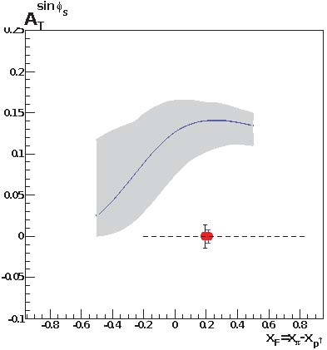
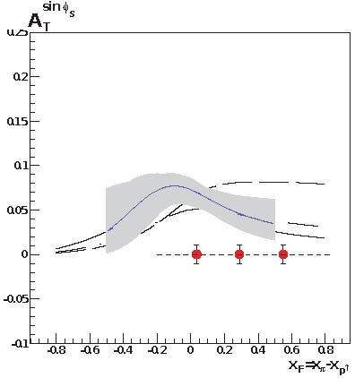
Main Competition: COMPASS
COMPASS statistical significance after two years of running for M_{γ} > M_{J/Ψ}
approved for one year run at LHC restart
  2nd year after 2 years of Primakoff measurements
for comparison of Sivers function need to measure entire function
  must evolve to same Q²
  cannot do QCD evolution on a point
for M_{γ} < M_{J/Ψ} significant contamination from many sources
  charm decays that appear to reconstruct to low mass
  combinatorial background
2.0 GeV < M_{γ} < 2.5 GeV

Slide 14
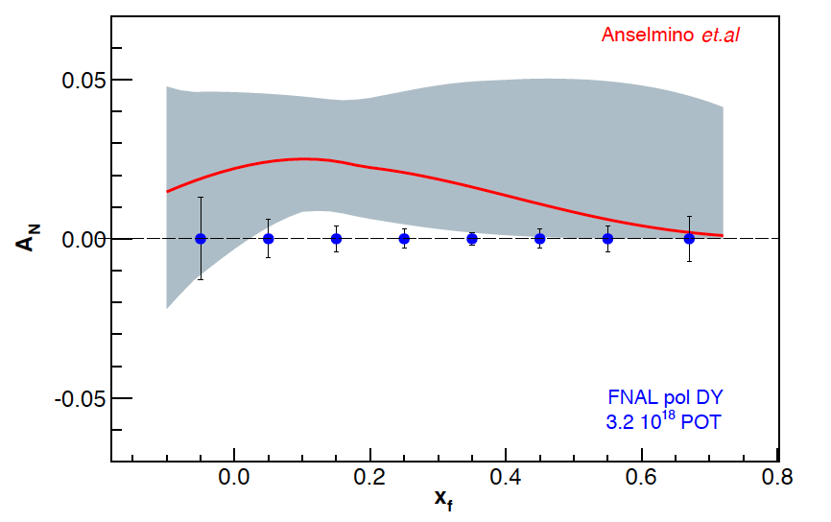
Sivers Asymmetry at Fermilab Main Injector
Experimental Sensitivity
  luminosity: L_{av} = 2 x 10³⁵ (10% of available beam time: I_{av} = 15 nA)
  3.2 x 10¹⁸ total protons for 5 x 10⁵ min: (= 2 yrs at 50% efficiency) with P_{b} = 70%
  Can measure not only sign, but also the size & maybe shape of the Sivers function !
Δχ²=20 error band
Note:
~650k DY events
FNAL pol DY stat errors
3.2 x 10¹⁸ POT
~1,288k DY events
330k DY events
Notes:
Note that SSA A_N^sin(phi-phi_s) is scaled by 2/pi

Slide 15
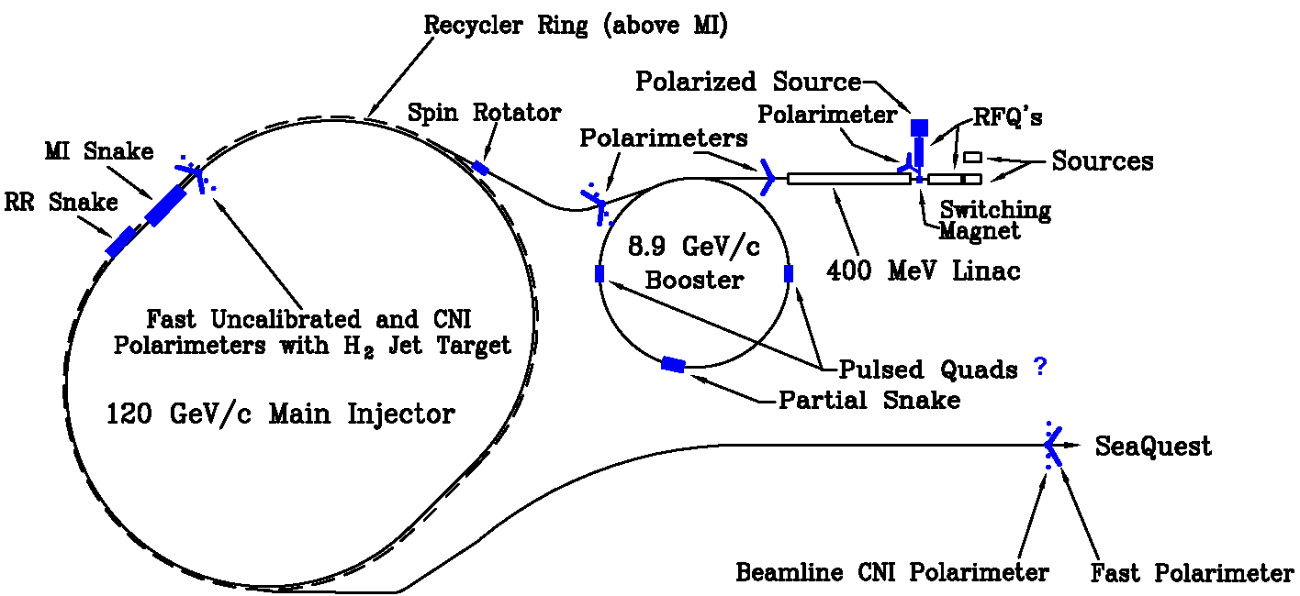
Polarized Drell-Yan at Fermilab Main Injector
Polarize Beam in Main Injector & use SeaQuest di-muon spectrometer
  measure Sivers asymmetry
SeaQuest di-muon Spectrometer
  fixed target experiment, optimized for Drell-Yan
  luminosity: L_{av} = 3.4 x 10³⁵ /cm²/s
    I_{av} = 1.6 x 10¹¹ p/s (=26 nA) / N_{p}= 2.1 x 10²⁴ /cm²
  approved for 2-3 years of running: 3.4 x 10¹⁸ pot
  by 2016: fully understood, ready to take pol. beam

Slide 16
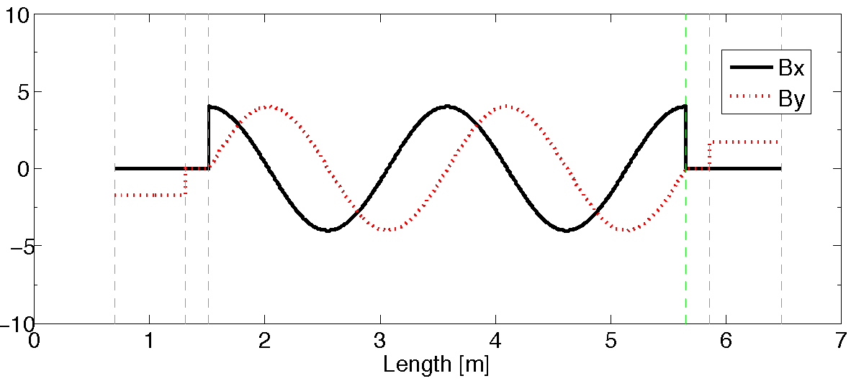
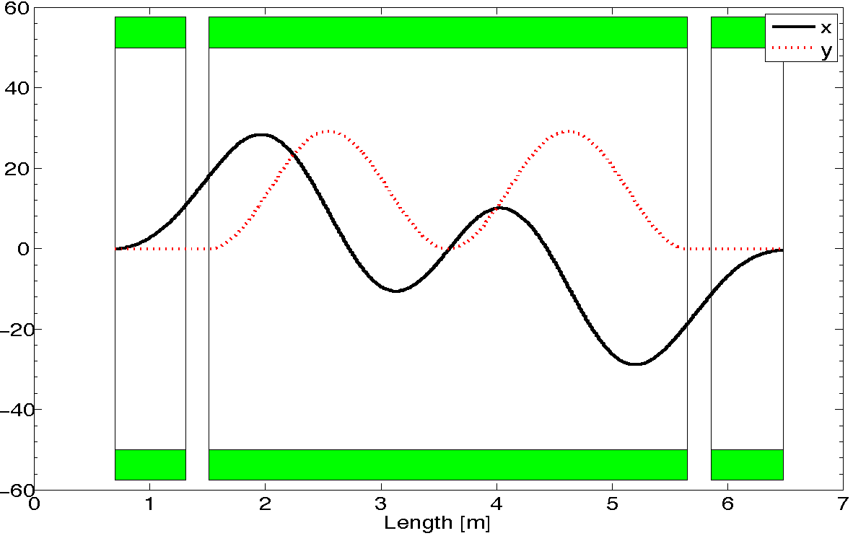
A Novel Siberian Snake for the Main Injector
Single snake design (5.8m long):
1 helical dipole + 2 conv. dipoles
  helix: 4T / 4.2 m / 4” ID
  dipoles: 4T / 0.62 m / 4” ID
use 2-twist magnets
  4π rotation of B field
never done before in a high energy ring
  RHIC uses snake pairs
  single-twist magnets (2π rotation)

Slide 17
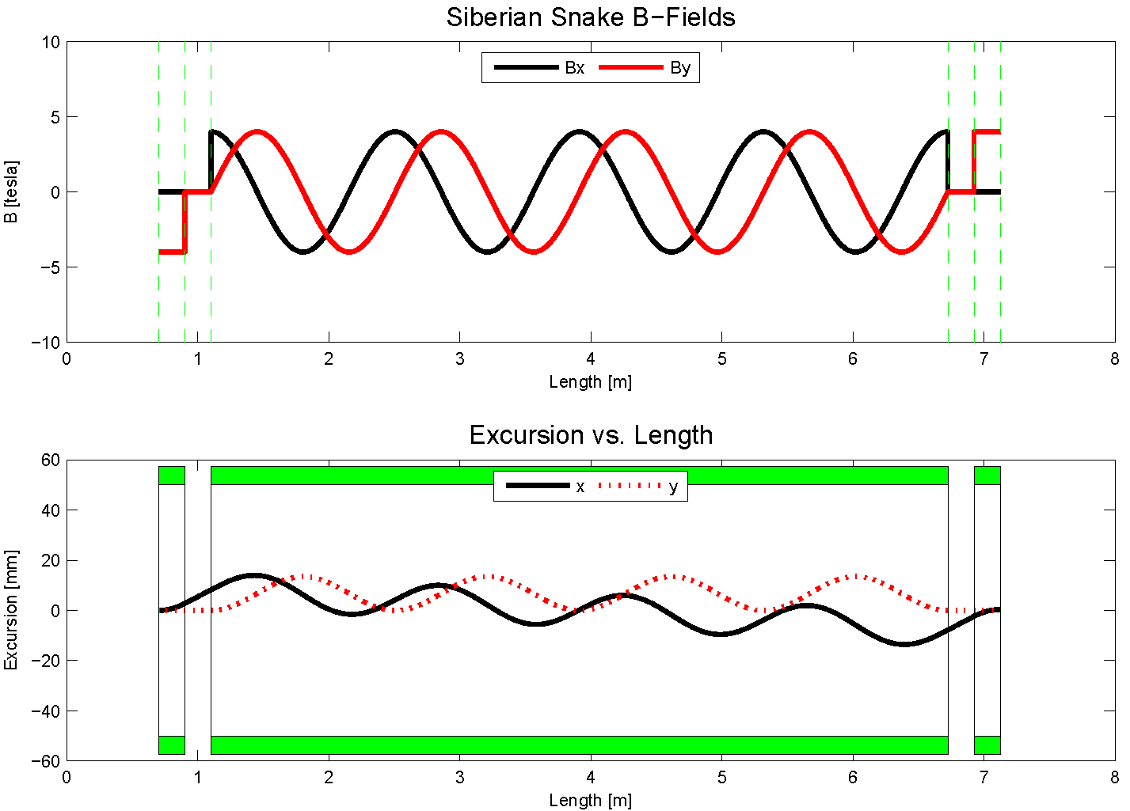
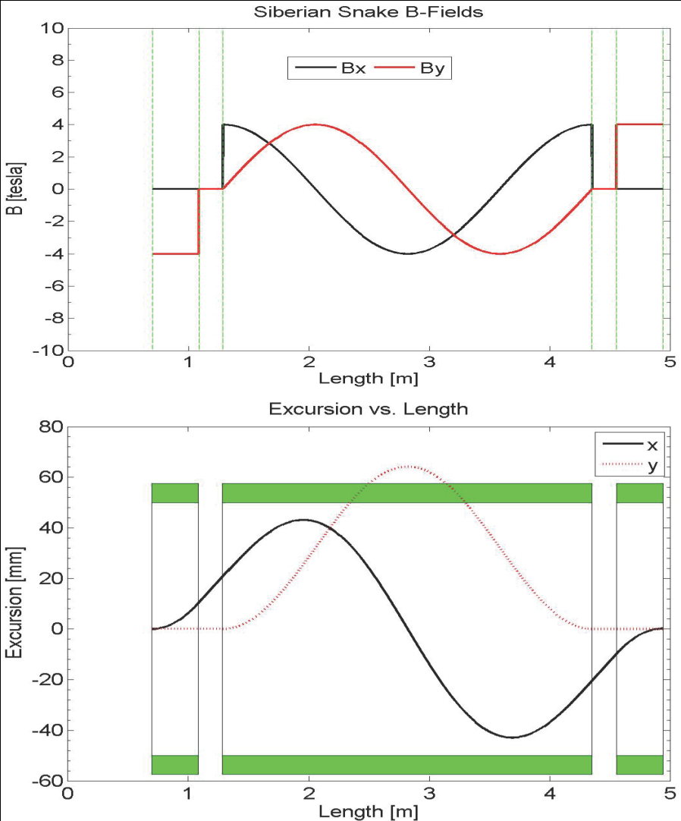
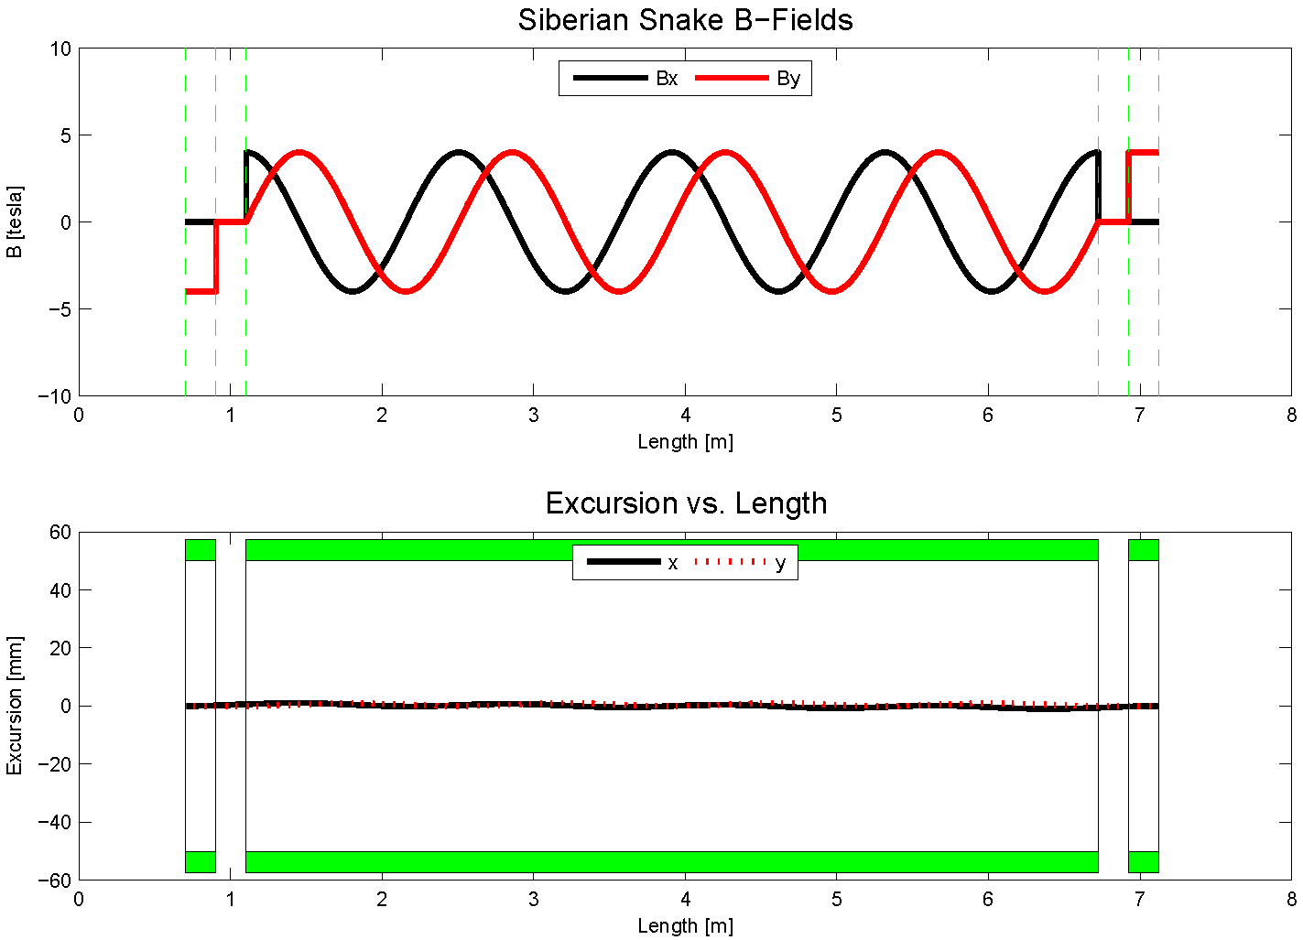
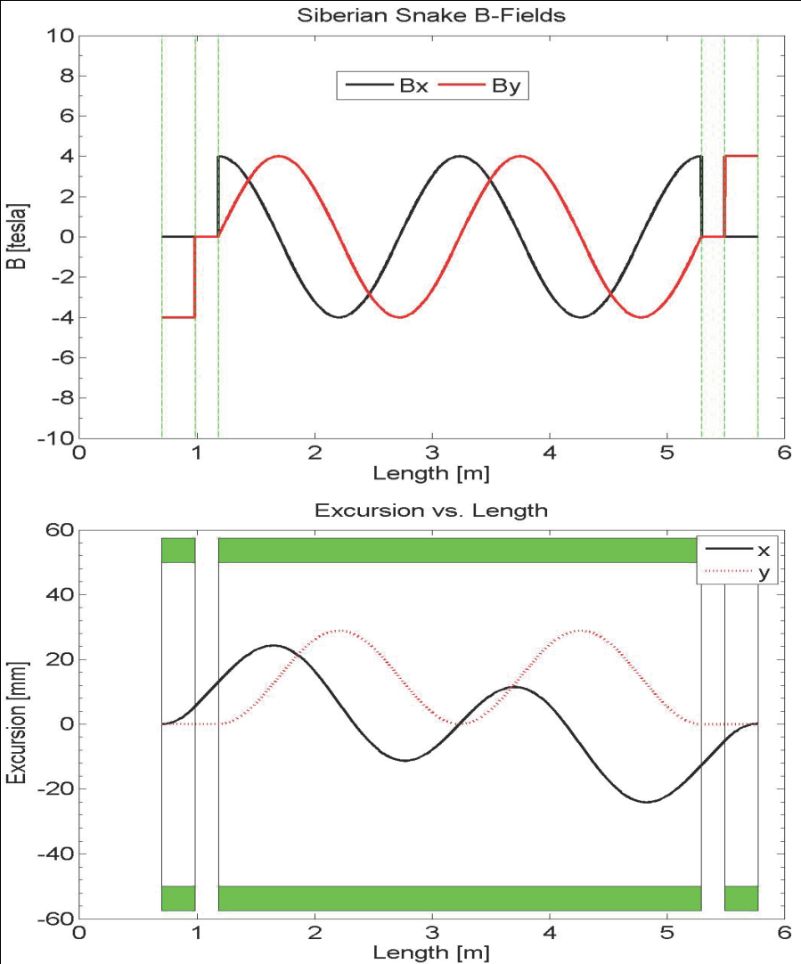
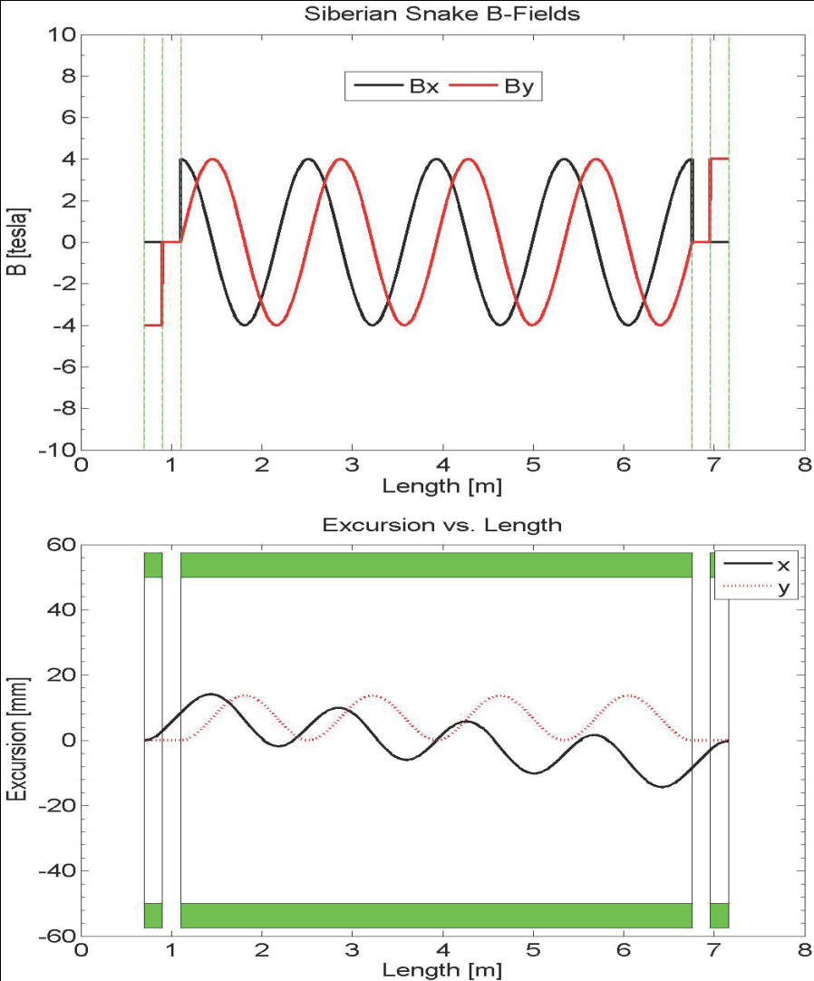
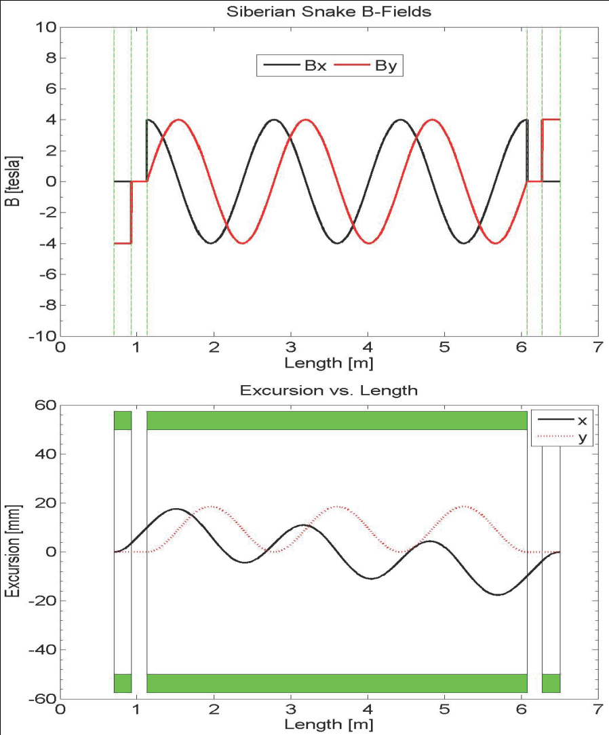
Steady Improvements to 1 Snakes solution
8.9 GeV 4T
4-twist 4T
8.9 GeV
120 GeV
beam excursions shrink w/ number of twists
beam excursions shrink w/ beam energy

Slide 18
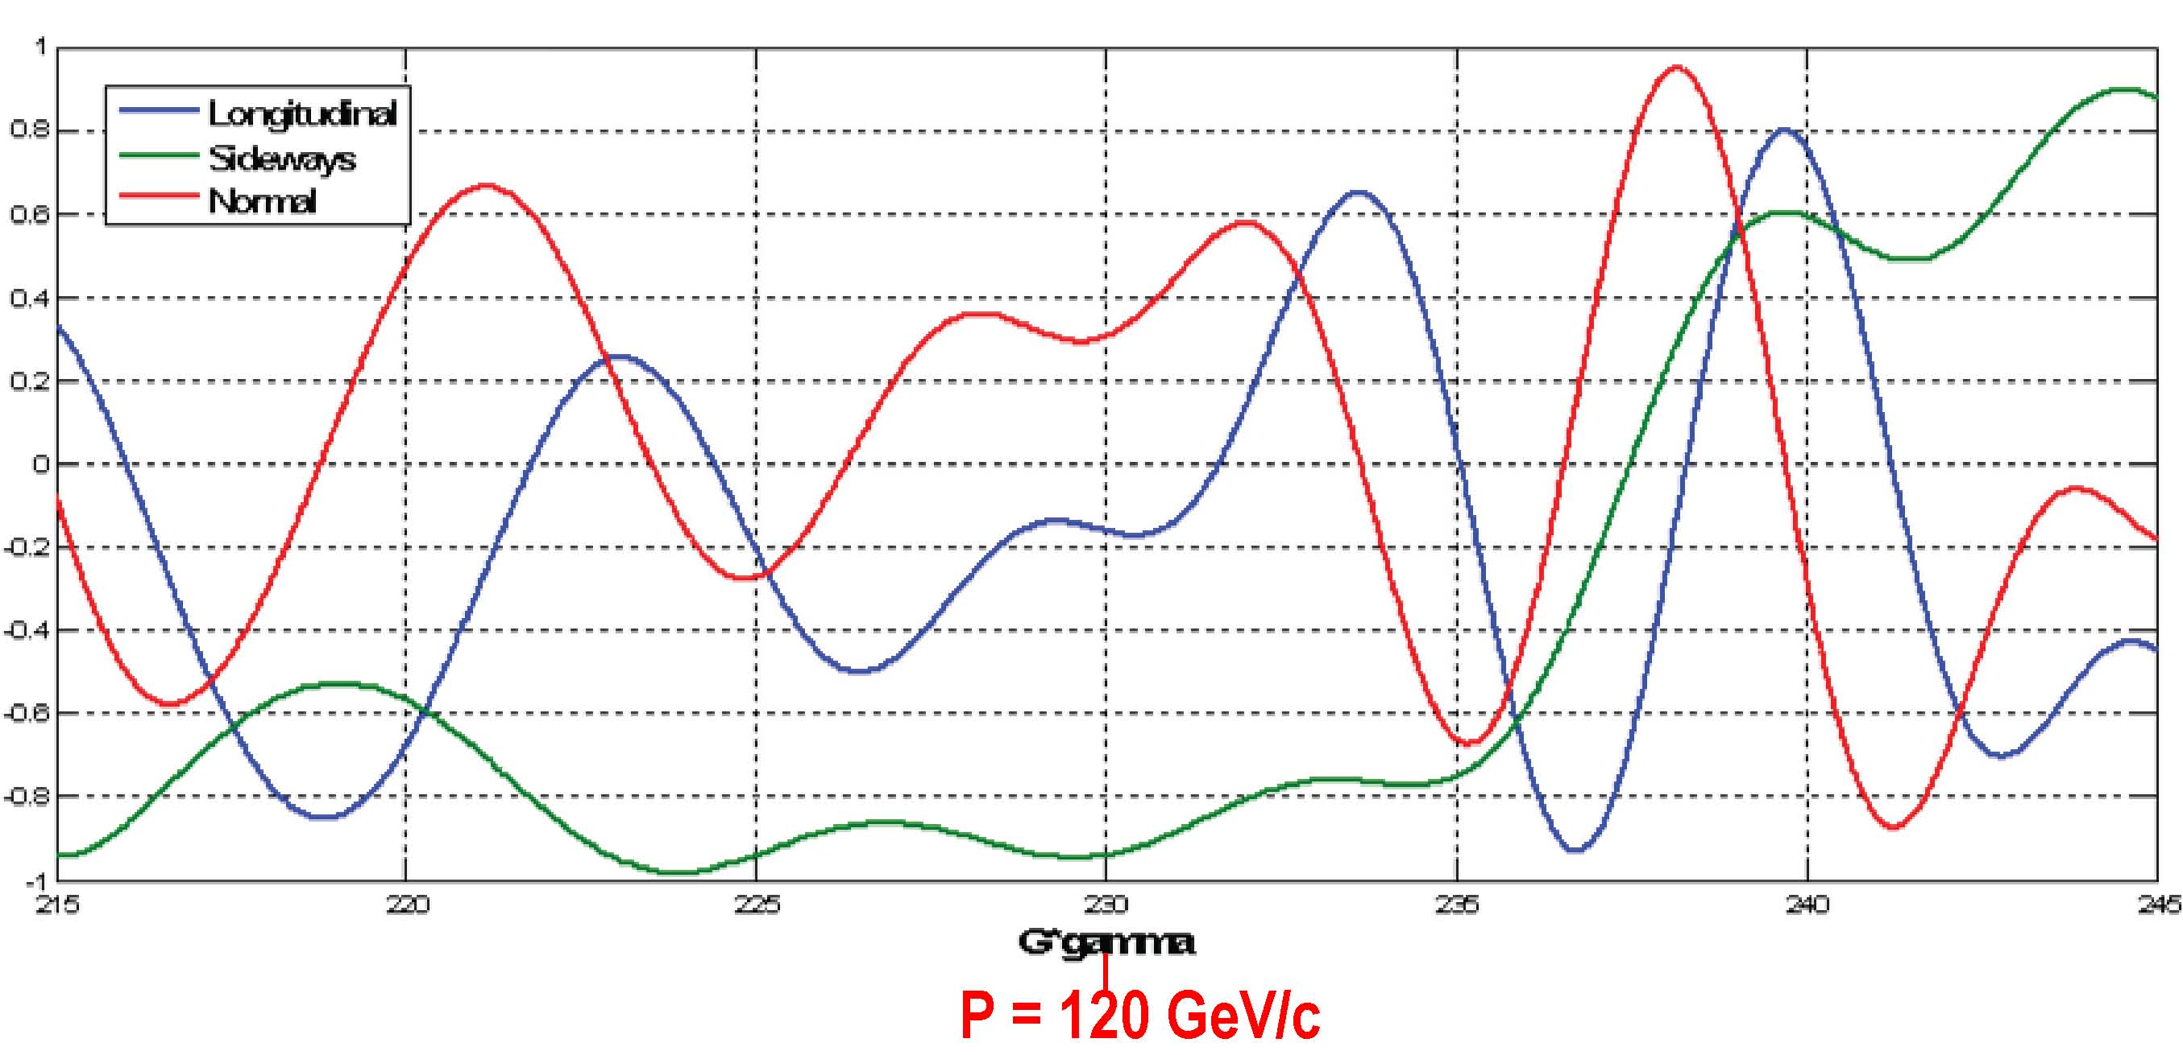
Spin direction control for extracted beam
Spin rotators used to control spin direction at BNL
Spin@Fermi collaboration recent studies (to save $$)
  rotate beam at experiment by changing proton beam energy around nominal 120 GeV
  radial (“sideways”) / vertical (“normal”)
Spin component magnitudes
112 GeV/c
128 GeV/c
124.5 GeV/c
Notes:
Beam direction can be rotated w/in the horizontal plane or into the vertical direction as required by the experiments. This is at the end of a 2.4 km long beam line with 140 bending magnets, some w/ horizontal fields, some w/ vertical and some w/ skew fields.

Slide 19
The Path to a polarized Main Injector
Stage 1 approval from Fermilab: 14-November-2012
Detailed machine design and costing using 1 snake in MI
  Spin@Fermi collaboration provide design
  Fermilab (AD) does verification & costing
Collaboration with A.S. Belov at INR and Dubna to develop polarized source
Develop proposal to DoE NP/HEP to polarize the Main Injector
  Cost to polarize Main Injector $10M
    includes 15% project management & 50% contingency
  secure funding to
    do detailed design: $200k/yr (short-term)
    implement modifications to MI: $10M (longer-term)
    conversations with DoE NP & HEP, NSF NP have started

Slide 20
The Path to a polarized Main Injector
Stage 1 approval from Fermilab: 14-November-2012
Detailed machine design and costing using 1 snake in MI
  E-1027 collaboration provide design
    get latest lattice for NOVA:
      translate “mad8” optics file to spin tracking code (“zgoubi”)
    determine intrinsic resonance strength from depolarization calculations
    do single particle tracking with “zgoubi” with novel single-snake
    set up mechanism for adding errors into the lattice:
      orbit errors, quadrupole mis-alignments/rolls, etc.
    perform systematic spin tracking
      explore tolerances on beam emittance
      explore tolerances on various imperfections: orbit / snake / etc
  Fermilab (AD) does verification & costing

Slide 21
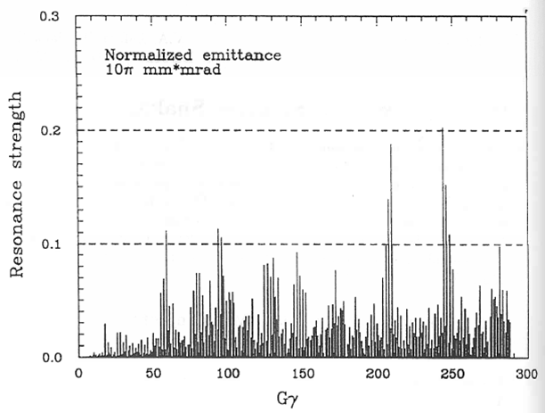
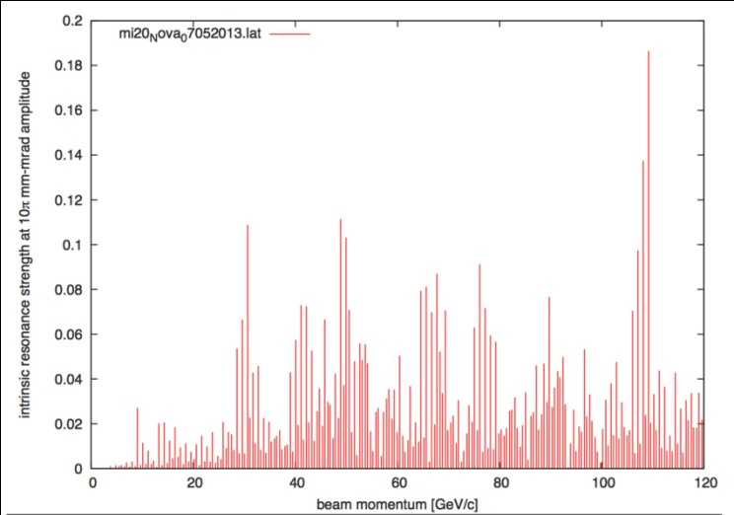
Intrinsic Resonance Strength in Main Injector
Depol calculations: single particle at 10π mm-mrad betatron amplitude
1995 Spin@Fermi report
  before MI was built
using NOVA lattice (July 2013)
very similar: largest resonance strength just below 0.2
  → one snake sufficient (E. Courant rule of thumb)

Slide 22
Drell-Yan Spectrometer for SeaQuest
(25m long)
Station 3
(Hodoscope array, drift chamber track.)
Station 1
(hodoscope array,
MWPC track.)
4.9m
Iron Wall
(Hadron absorber)
Station 4
(hodoscope
array, prop
tube track.)
KTeV Magnet
(Mom. Meas.)
Solid Iron Magnet
(focusing magnet, hadron absorber and beam dump)
Station 2
(hodoscope array, drift chamber track.)
Targets
(liquid H₂, D₂,
and solid targets)

Slide 23
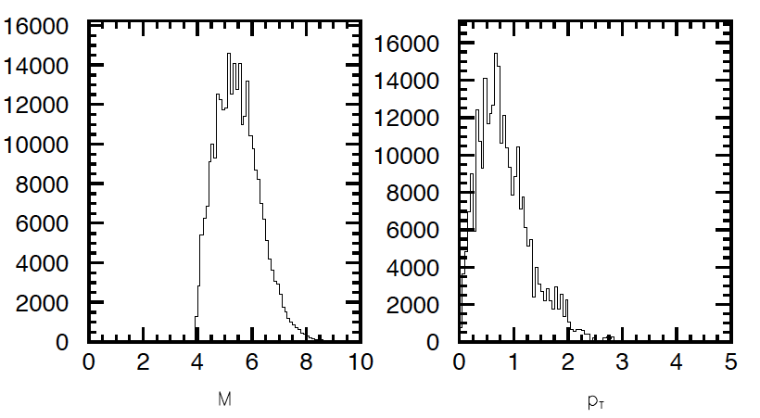
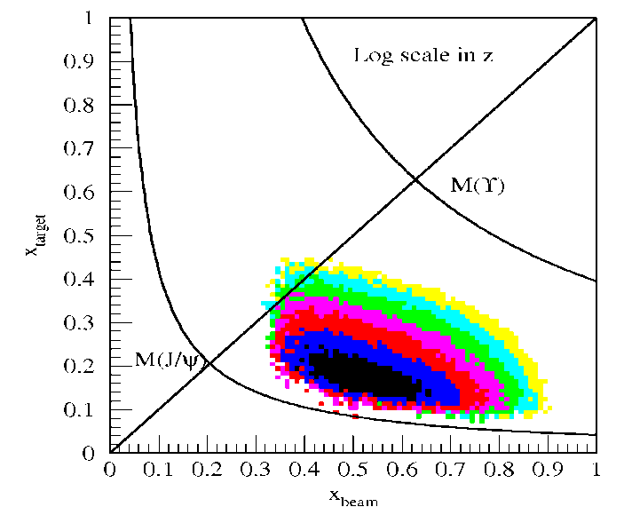
Acceptance for Polarized Drell-Yan
x-range: x_{b} = 0.35 – 0.85 (valence quarks in proton beam)
x_{t} = 0.1 – 0.45 (sea quarks in proton target)
Invariant mass range: M = 4 – 8.5 GeV (avoid J/Ψ contamination)
Transverse momentum: p_{T} = 0 – 3 GeV
E906 Spect.
Monte Carlo

Slide 24
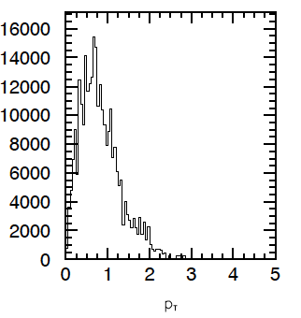
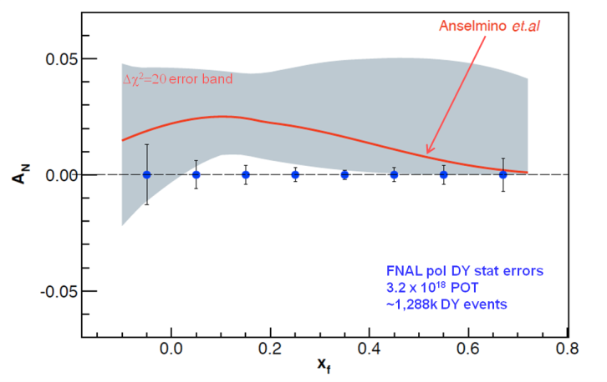
Measurement at Fermilab Main Injector
FMag
Retune 1st spectrometer magnet (FMag):
  focuses high p_{T} muons and
  over focuses low p_{T} muons
    we loose low p_{T} muons when field is high!
    SeaQuest is all about going to the largest x_{t} quarks, requiring high-p_{T} muons
  lowering FMag field
    we get back the low p_{T} muons
    we loose the high p_{T} muons
    we gain 2x in statistics
BUT
p_{T} spectrum peaks at low p_{T}

Slide 25
E-1027 Collaboration (Feb 2014)
Abilene Christian University
Donald Isenhower, Tyler Hague,
Rusty Towell, Shon Watson
Academia Sinica
Wen-Chen Chang, Yen-Chu Chen,
Shiu Shiuan-Hal, Da-Shung Su
Argonne
John Arrington, Don Geesaman
Kawtar Hafidi, Roy Holt, Harold
Jackson, Paul E. Reimer*
University of Basque Country†
Gunar Schnell
University of Colorado
Ed Kinney
Fermilab
Chuck Brown, David Christian,
Jin-Yuan Wu
University of Illinois
Bryan Dannowitz, Markus Diefenthaler,
Bryan Kerns, Naomi C.R
Makins, R. Evan McClellan
KEK
Shinya Sawada
Los Alamos National Laboratory
Ming Liu, Xiang Jiang,
A. Klein, Pat McGaughey, J. Huang
University of Maryland
Betsy Beise, Kaz Nakahara
University of Michigan
Christine Aidala,
Wolfgang Lorenzon*, Joe Osborn, Bryan Ramson, Richard Raymond, Joshua Rubin
National Kaohsiung Normal University
Rurngsheng Guo, Su-Yin Wang
RIKEN
Yuji Goto
Rutgers University
Ron Gilman, Ron Ransome,
A. Tadepalli
Tokyo Institute of Technology
Shou Miyasaka, Ken-ichi Nakano,
Florian Saftl, Toshi-Aki Shibata
University of Virginia‡
Don Crabb, D. Day, Oscar
Rondon, Dustin Keller
Yamagata University
Yoshiyuki Miyachi
*Co-Spokespeople
†new group (Aug’12)
‡new group (Jan ‘13)
Collaboration contains most of the SeaQuest groups and two new groups (total 17 groups as of Feb 2014)
E-1027 collaborates with A. Krisch (SPIN@FERMI), M. Syphers (MSU), M. Bai (BNL)
25

Slide 26
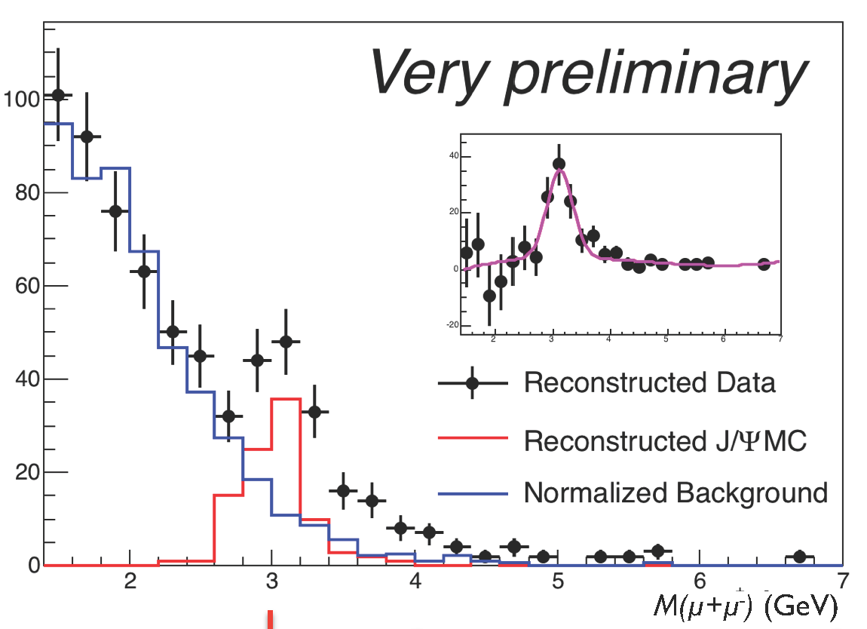
SeaQuest: from Commissioning to Science
Commissioning Run I (late Feb. 2012 – April 30th, 2012)
First beam in E906 on March 8th, 2012
Extensive beam tuning by the Fermilab accelerator group
  1 x10¹² protons/s (5 s spill/min)
  120 GeV/c
All the detector subsystems worked
Main Injector shut down began on May 1st , 2012
Reconstructable dimuon events seen:
M_{J/Ψ} = 3.12 ± 0.05 GeV
σ = 0.23 ± 0.07 GeV
A successful commissioning run
Commissioning Run II (Nov. 2013 – today)
Science Run start: tomorrow(for 2 years)
Notes:
In the background-subtracted insert, the deficit of events just below the J/Πσι is understood as originating from the event mixing process that creates an artificially large background here by mixing a high p_{T} muon from a real J/Πσι with another muon.

Slide 27
Another Way to Add Polarization: E1039
Polarized Target at Fermilab
Probe Sea-quark Sivers Asymmetry
with a polarized proton target at SeaQuest
sea-quark Sivers function poorly known
significant Sivers asymmetry expected
from meson-cloud model
KMAG
FMAG
Polarized Target
use current SeaQuest setup
a polarized proton target, unpolarized beam
Proton Beam 120 GeV/c
Ref: Andi Klein (ANL)

Slide 28
Reliability of predictions for the SSA in Drell-Yan
Workshop: Opportunities of Polarized Physics at Fermilab (20 – 22 May, 2013)
  (J. Collins, U. D’Alesio, J. Qiu, D. Sivers, F. Yuan)
  J. Collins conclusions
    issues with quantitative predictions, especially about dilution of Sivers asymmetry by evolution to higher Q
    A_{N} (DY) reduced substantially compared to HERMES
    predictions by Aybat-Prokudin-Rogers probably too pessimistic
    predictions by Sun-Yuan probably too optimistic (don’t allow for known physics issues)
  substantial theoretical work needed to produce reliable predictions for DY

Slide 29
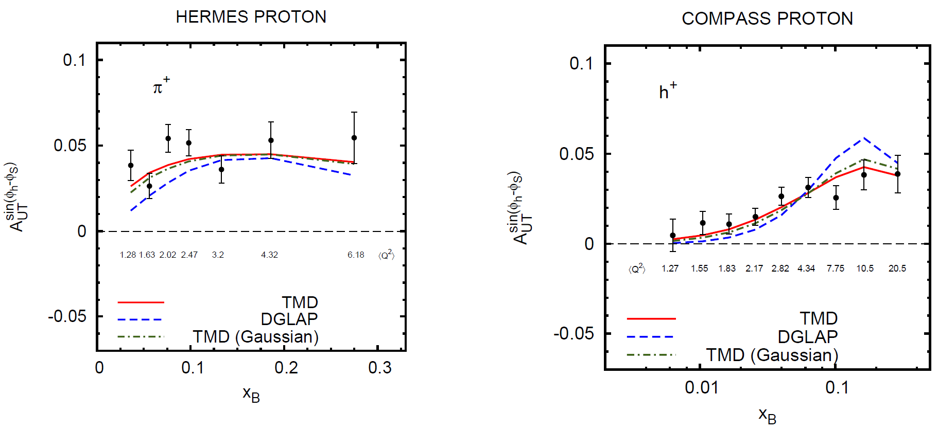
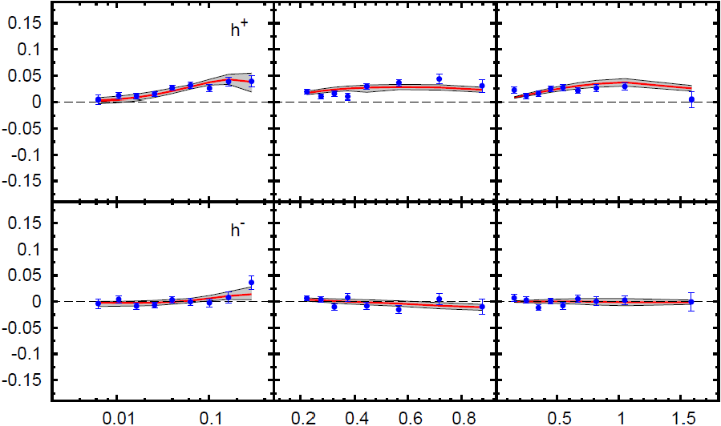
QCD Evolution of Sivers Function
HERMES (p)
COMPASS (p)
π⁻
h⁺
Anselmino et al. (arXiv:1209.1541 [hep-ph])
h⁺
DGLAP
Initial global fits by Anselmino group included DGLAP evolution only in collinear part of TMDs (not entirely correct for TMD-factorization)
Using TMD Q² evolution:
  agreement with data improves
TMD
h⁻
Notes:
Since Q^2 = x y s, s-behavior of asymmetries is intimately connected to their Q^2 evolution
HERMES: <Q^2> 1.28 …… 6.18
COMPASS: <Q^2> 1.27 …… 20.5 -> larger effect if proper TMD evolution equations are used

Slide 30
E1039 Physics Summary
We know almost nothing about sea quarks’ angular momentum.
Quark orbital angular momentum leads to quark Sivers distribution.
Identifying a non-vanishing sea quark Sivers distribution could lead to a major breakthrough in nucleon structure.
Polarized target D-Y at Fermilab’s SeaQuest provides an unique opportunity to pin down sea quark’s angular momentum.
Sea quarks’ orbital angular momentum could be a major part of the “missing spin”.
Does Drell-Yan yield depend on target’s spin direction?
if
Ref: Xiaodong Jiang (ANL)

Slide 31
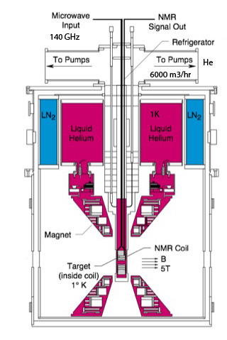
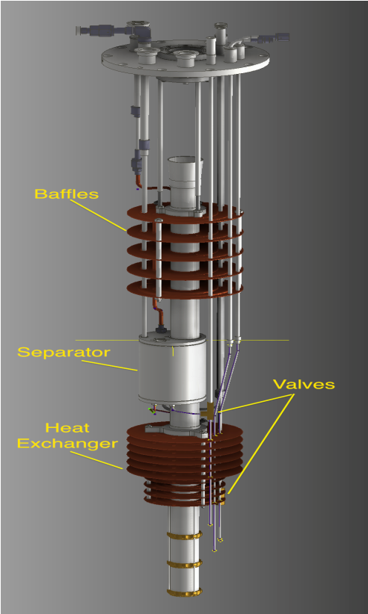
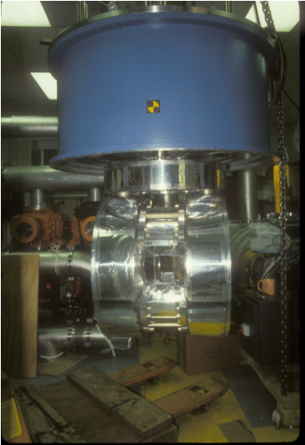
The Polarized Target System
Magnet from LANL
Measure polarization
Microwave: Induces electron spin flips
Tube + Power equip:
Roots pump system used to pump on ⁴He vapor to reach 1K
10,000 m³/hr
Cryostat: UVa
4
Superconducting Coils for Magnet: 5T
Rotation needed
Target material: frozen NH₃
Irradiation @ NIST
Ref: Xiaodong Jiang (ANL)

Slide 32
COMPASS, E-1027 and E-1039 (and Beyond)
 | Beam Pol. | Target Pol. | Favored Quarks | Physics Goal
COMPASS | ✕ | ✔ | Valence quark | Sign change and size of Sivers distribution for valence quark
E-1027 | ✔ | ✕ | Valence quark | Sign change, size and shape of Sivers distribution for valence quark
E-1039 | ✕ | ✔ | Sea quark | Size and sign of Sivers distribution for sea quarks, if DY A_{N}≠ 0.
E-XXXX | ✔ | ✔ | Sea & valence quark | many
Ref: Xiaodong Jiang (ANL)

Slide 33
Summary
π⁰
A non-zero Sivers asymmetry has been measured both at HERMES and COMPASS
QCD (and factorization) require sign change
Fermilab is arguably best place to do this measurement
    high luminosity, large x-coverage,
    high-intensity polarized beam
    spectrometer already setup and running
Run alongside neutrino program (10% of beam needed)
Measure DY with both Beam or/and Target polarized
    broad spin physics program possible
π⁺
π⁻
Fermilab

Slide 34
Thank You

Slide 35
Backup Slides

Slide 36
Project costs - I
June ‘12
Oct ‘12
Preaccelerator |  | $2.0 M |  | $1.9 M
Polarized H− ion source | $0.6 M |  | $0.6 M
35 keV polarimeter | $0.3 M |  | $0.2 M
RFQ and power supply (35 keV to 750 keV) | $0.3 M |  | $0.3 M
Beam lines, switching magnets & vacuum system | $0.5 M |  | $0.5 M
Building Modiﬁcation | $0.1 M |  | $0.1 M
Installation (∼4wks) | $0.2 M |  | $0.2 M
400 MeV LINAC |  | $0.3 M |  | $0.3 M
400 MeV polarimeter | $0.1 M |  | $0.1 M
Installation (∼4wks) | $0.2 M |  | $0.2 M
8.9 GeV/c Booster |  | $3.4 M |  | $1.1 M
Solenoid and Partial Siberian snake (ramped warm) | $2.0 M |  | $0.4 M
Two 3 µsec pulsed quadrupoles with power supplies | $0.1 M |  | $0.1 M
8.9 GeV/c polarimeter | $0.9 M |  | $0.2 M
8.9 GeV/c transfer line spin rotator | $0.1 M |  | $0.1 M
Installation (∼6wks) | $0.3 M |  | $0.3 M
2-snake BNL type design
1-snake new design

Slide 37
Project costs - II
June ‘12
Oct ‘12
Recycler Ring |  | $0.0 M |  | $0.4 M
one superconducting solenoidal Siberian Snake |  |  | $0.1 M
8.9 GeV/c polarimeter |  |  | $0.2 M
Installation (∼2wks) |  |  | $0.1 M
Main Injector |  | $8.57 M |  | $1.3 M
Two/One superconducting helical Siberian Snake(s) | $4.27 M |  | $0.5 M
Power supply for snake | $0.7 M |  | $0.1 M
120 GeV/c polarimeters (CNI & Inclusive) | $0.6 M |  | $0.4 M
Cryogenics (2 Buildings@1.06M, Equip: 0.3 M) | $2.7 M |  | -------
Installation (∼6wks) | $0.3 M |  | $0.3 M
120-150 GeV/c Transfer Line |  | $2.8 M |  | $0.5 M
120-150 GeV/c polarimeters (CNI & Inclusive) | $0.6 M |  | $0.4 M
120-150 GeV/c transfer line spin rotator | $2.0 M |  | -------
Installation (∼4/2wks) | $0.2 M |  | $0.1 M
Miscellaneous |  | $0.6 M |  | $0.6 M
Computers, control modules, cables, and interface | $0.3 M |  | $0.3 M
Transport, reconﬁguration, technical (guess estimate) | $0.3 M |  | $0.3 M
Subtotals |  | $17.67 M |  | $6.1 M
Project Management estimate (15% of subtotal) | $2.65 M |  | $0.9 M
Contingency (∼50%) | $10.16 M |  | $3.5 M
PROJECT TOTAL |  | ∼$30.485 M |  | ∼$10.5 M

Slide 38
Polarized Drell-Yan at Fermilab Main Injector - II
Polarized Beam in Main Injector
  use SeaQuest target
    liquid H₂ target can take about I_{av} = 5 x 10¹¹ p/s (=80 nA)
  1 mA at polarized source can deliver about I_{av} = 1 x 10¹² p/s (=150 nA)
  for 100% of available beam time (A. Krisch: Spin@Fermi report in (Aug 2011): arXiv:1110.3042 [physics.acc-ph])
    26 μs linac pulses, 15 Hz rep rate, 12 turn injection into booster, 6 booster pulses into Recycler Ring, followed by 6 more pulses using slip stacking in MI
    1 MI pulse = 1.9 x 10¹² p
    using three 2-sec cycles/min (~10% of beam time):
    → 2.8 x 10¹² p/s (=450 nA) instantaneous beam current , and I_{av} = 0.95 x 10¹¹ p/s (=15 nA)
  possible scenarios:
    L_{av} = 2.0 x 10³⁵ /cm²/s (10% of available beam time: I_{av} = 15 nA)
    L_{av} = 1 x 10³⁶ /cm²/s (50% of available beam time: I_{av} = 75 nA)
  Systematic uncertainty in beam polarization measurement (scale uncertainty)
ΔP_{b}/P_{b} <5%

Slide 39
Polarized Drell-Yan Rate Estimates
LH₂ ρ_{H2} I_{av} | 50.8 cm 0.0678 g/cm³ 9.5 x 10¹⁰ p/s (= 15nA)
L_{av} | 2 x 10³⁵ cm⁻² s⁻¹
Ω (acceptance) ε_{t} (trigger) ε_{r} (reconstruction) t_{spill} n_{spill} | 0.02 0.8 0.5 2 sec 3/min
Number of DY events ε_{exp} (experimental) | 3730 /day 0.5
Rate = (DY events/min) X ε_{exp} = 1865/day

Slide 40
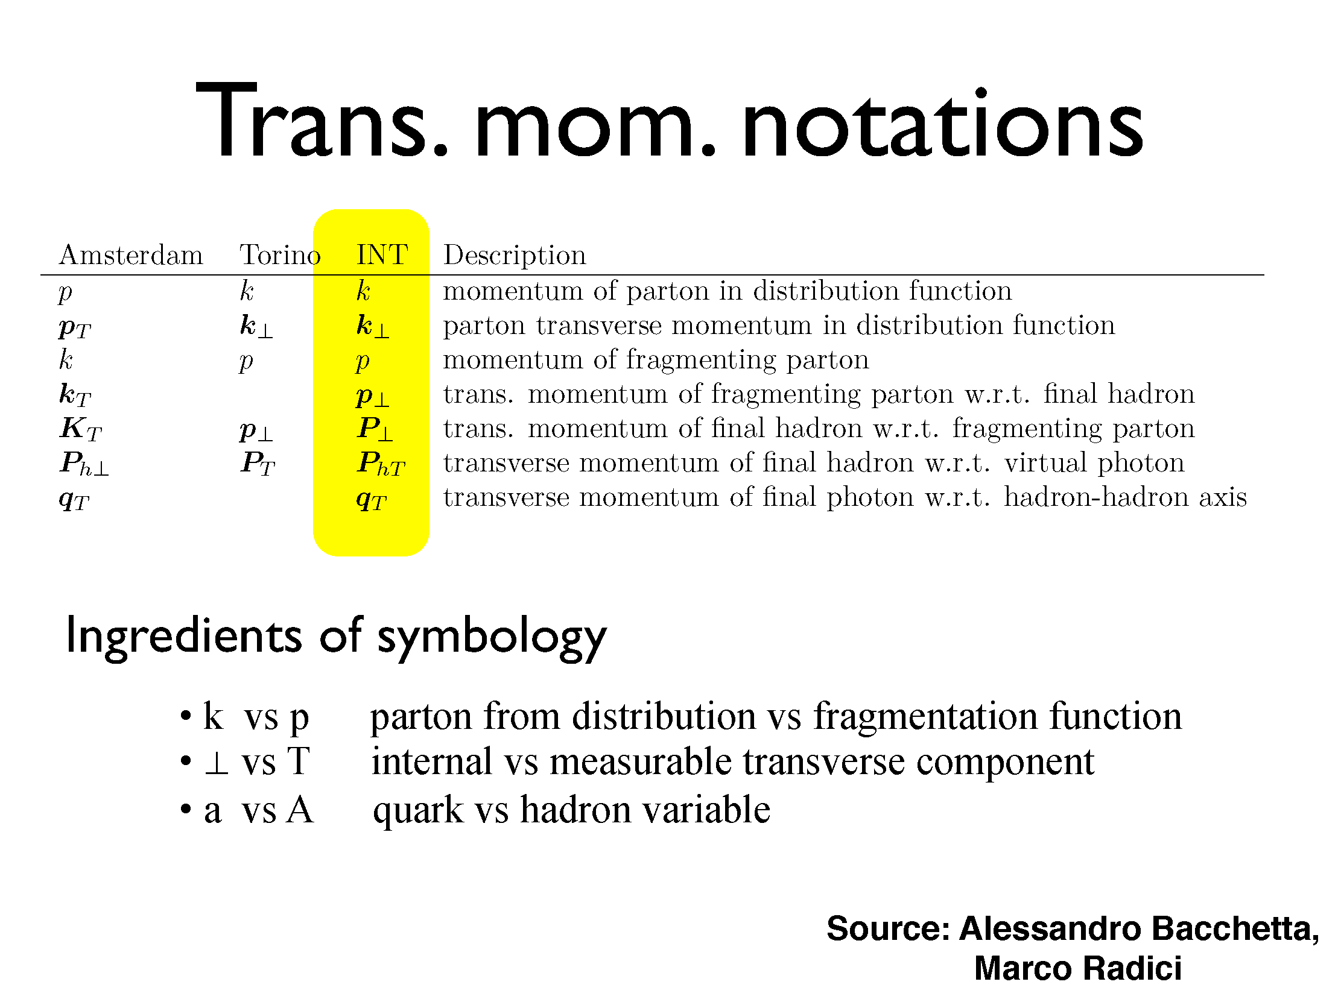
Conclusions

Slide 41
