Slide 1
LANL 20170569ECR
Gluon Saturation Search with Large Hadron Collider Beauty (LHCb) Experiment
Cesar L. da Silva (PI)
Matt Durham, Berenice Garcia, Hubert van Hecke, Gerd Kunde

Slide 2
LANL/ECR has two goals:
publish a first physics result on hints for gluon saturation using LHCb data taken in 2016.
2) produce a small scale prototype for a scintillator-based tracker (called Magnet Station tracker - MS)

Slide 3
Standard Project Evaluation Criteria for an ECR project
Quality: Are the science and technology results of high quality compared to national and international peers? Please help us understand the relative standing of the work presented in the international community.
Performance: Is the project making good progress against the proposed milestones? Is the project plan being re-assessed on a regular basis, in the light of new opportunities and unanticipated difficulties? Please elaborate on any changes of direction to pursue unexpected opportunities or address unanticipated challenges.
Leadership: Are the results and findings of the project leading the technical community and defining R&D directions for the broader community?
Relevance: Is the project continuing to build capability that supports the strategic directions of the Laboratory?

Slide 4
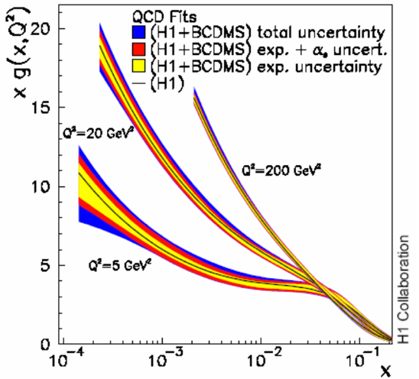
Proton Gluon Distribution
DIS at HERA
Unitarity must be violated at some point at small-x

Slide 5
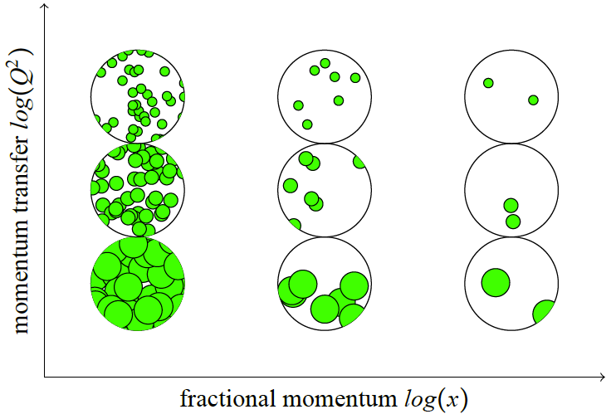
Gluon evolution in the nucleon

Slide 6
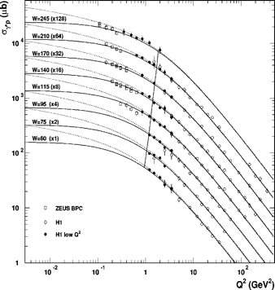
Where Gluon Saturation is Expected
HERA
x<10⁻²
x₀ and λ determined from DIS data fits.

Slide 7
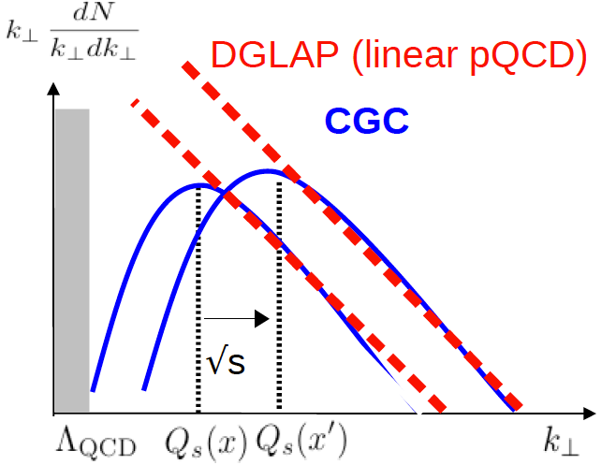
Color Glass Condensate (CGC)
CGC:
effective theory to calculate non-perturbative QCD using the saturation scale
Used in many heavy ion calculations from yield suppressions to early state glasma physics.

Slide 8
Gluon Saturation in p+A Collisions
Gluon density is enhanced by the Lorentz contraction of the nucleus at the probe rest frame.
Saturation scale is amplified.

Slide 9
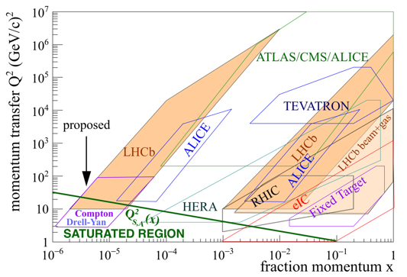

Where to Find Gluon Condensates ?
gluon
LHCb is the best place to find saturated(condensate) gluons today.
The >US$1B eIC may also has a chance in the future.

Slide 10
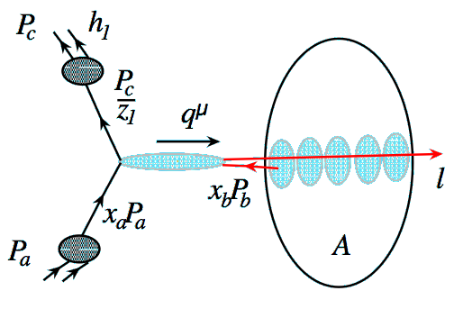
Competing Nuclear Effects
Multiple interactions
Energy Loss
Final-state
energy loss
Initial-state
energy loss
Q²
The probe loses energy before the hard scattering.
The scattering products lose energy in the medium.
Causes yield/nucleon reduction.
The probe is larger than the contracted nucleon in the nucleus.
Causes a yield/nucleon reduction at small-x (shadowing).

Slide 11
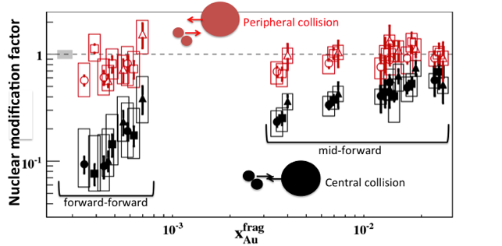
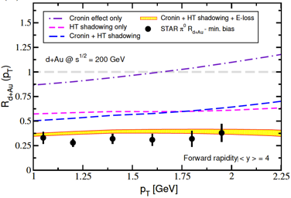
RHIC Measurements in d+Au
Yield/nucleon modification in d+Au collisions relative to p+p.
STAR @ RHIC
PHENIX @ RHIC
Large yield suppressions first claimed as a discovery of gluon saturation and described by CGC
But regular QCD nuclear effects can fully describe the suppressions
No significant suppressions have been observed at LHC (typically high Q² processes)

Slide 12
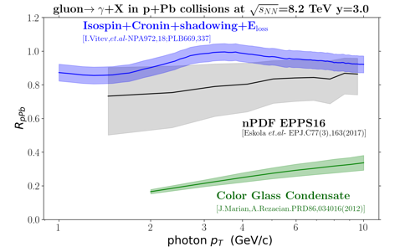
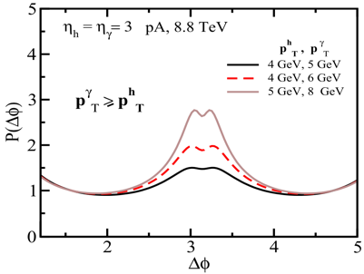
Signatures for Condensate Gluons
PREDICTIONS FOR LHCb
PREDICTIONS FOR LHCb
Gluons start to fuse.
Photons from gluons strongly reduced. Competing effects should be small in LHCb measurements.
Check photons in p+Pb collisions over photons in p+p collisions or peripheral p+Pb collisions.
Gluon wavefunction interference produce double-peak structure in the photon+hadron angular distribution.

Slide 13
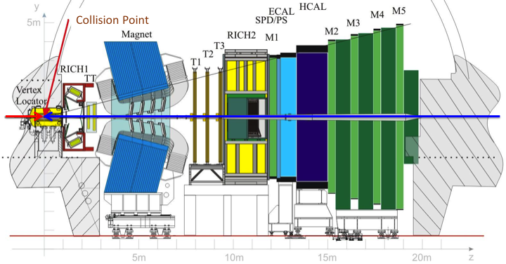
LHCb

Slide 14


Slide 15
Inverse Compton Process
Direct photon is isolated.

Slide 16
Inverse Compton Process
Direct photon is isolated.

Slide 17
Inverse Compton Process
Direct photon is isolated.
Quark fragments in a jet.
Not all particles are measured.
Soft jet reconstruction very challenging.

Slide 18



Inverse Compton Process
Direct photon is isolated.

Slide 19
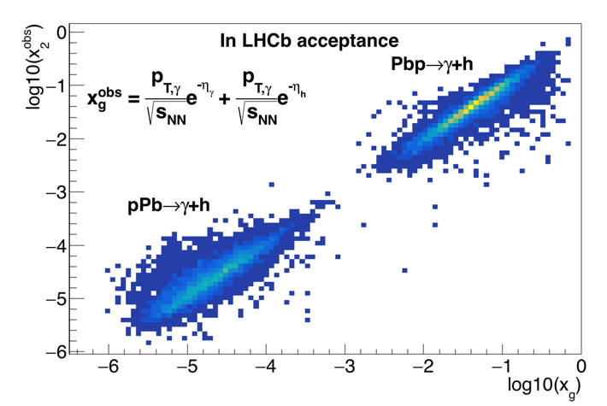
measured
True

Slide 20
Defined a likelihood function for a photon to be isolated.
Accept only the ones with likelihood>0.7

Slide 21
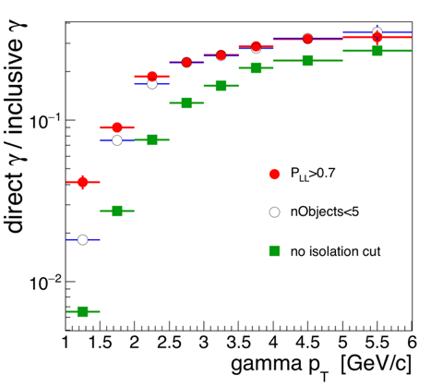

Direct photon Signal / Background
BG from neutral decays
Isolated photon trigger implemented in offline data filtering.
Now it is part of the standard LHCb offline data filtering production.

Slide 22
Measured angular distribution
Measured 𝝲+h angular correlation is affected by the detector acceptance and combinatorial background.
Detector acceptance and combinatorial background accounted for by correlation of photons and hadrons from different events.
Ratio between same and mixed event correlations provides the corrected angular distribution.
Result still includes a large di-jet contribution in the near- (Δ𝛟~0) and away-side peaks.

Slide 23
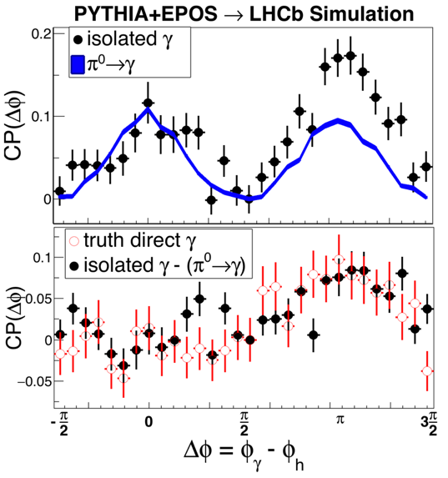
Subtracting di-jet contribution.
Di-jet contribution can be measured with identified π⁰->γ in data.
Near side peak contains only di-jet, so we use it to normalize the di-jet component.
Technique can reproduce the truth Compton angular distribution in simulation.

Slide 24
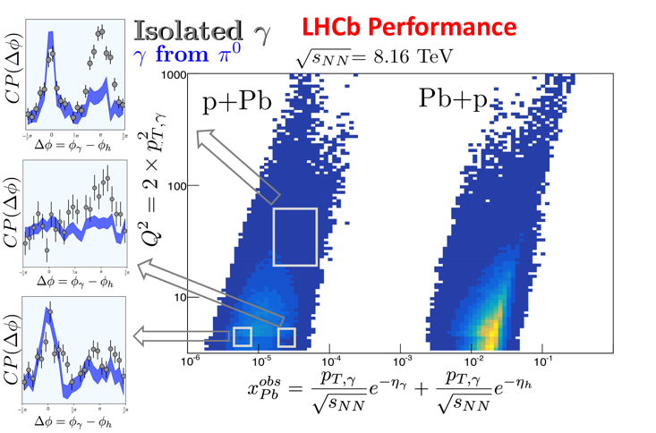
Result in Real Data
First demonstration of direct measurements of gluons in the potential saturate region.
Not all measurements can be shown in public to preserve the integrity of the ongoing analysis.

Slide 25
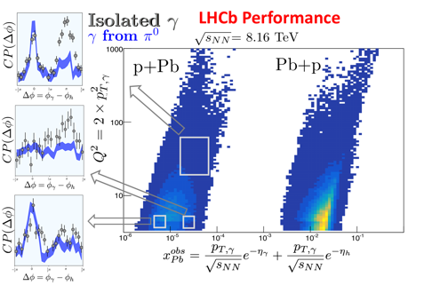
Finalizing this analysis
Obtain any modification of the Compton yields between peripheral and central pPb events, large suppression or modification of the away-side peak shape may indicate the gluon saturated regime
Analyzing simulation to determine if the detector can introduce artificial suppressions in the data or any additional modifications in the shape of the angular distributions
Release preliminary results by the end of the year, a publication may happen in the next winter

Slide 26
Detector Upgrade

Slide 27

Detector Acceptance for Compton’s γ-hadron
At least one hadron coming from the jet is measured.
Poor detection efficiency in the gluon saturated region.
Region mostly composed of soft photon and hadrons.

Slide 28
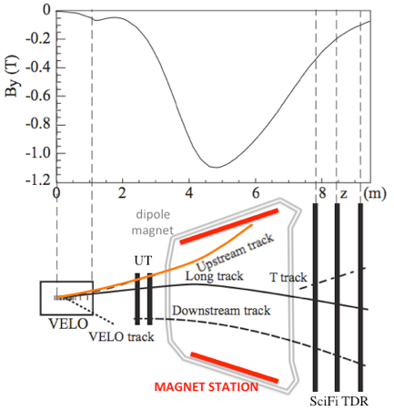
Magnet Station Proposal
Particle tracker to provide momentum measurement for soft particles.
Scintillator tracker inside the LHCb dipole magnet
Increase rec. efficiency for p_{T}<10 GeV/c particles from small Q² processes
Increase det. efficiency for γ->e⁺e⁻

Slide 29
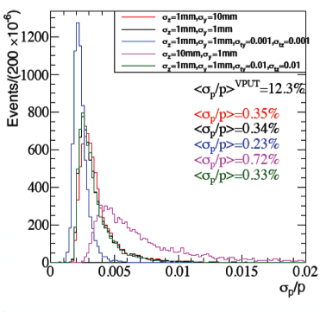
Magnet Station Proposal
σ_{Z}~1mm and σ_{Y}~10cm provides <σ_{p}/p>~0.35%

Slide 30
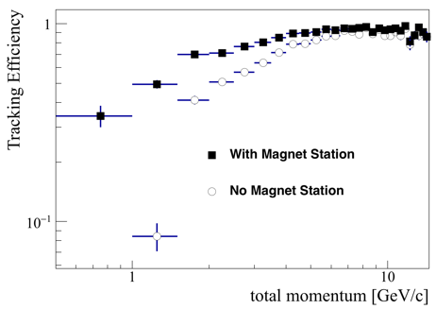
Magnet Station Proposal
Single particle detection improved by a factor of up to 3.
Compton measurement require at least 3 particles: γ->2e + hadron

Slide 31
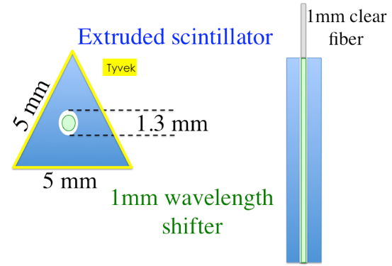

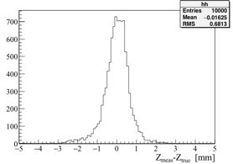
Proposed Implementation
Leverage R&D from Tevatron/D0 preshower
Easy WS-clear fiber coupling
Few number of channels

Slide 32
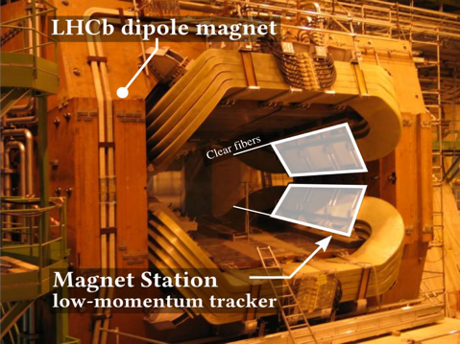
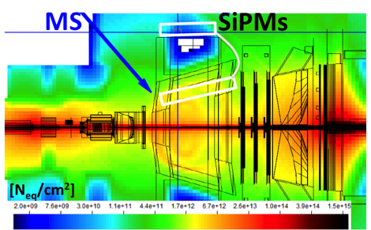
SiPM readout cannot be placed inside the magnet because of the radiation.
Clear fibers should bring the light from bars to readout crates outside the magnet (<6m length light guides)

Slide 33
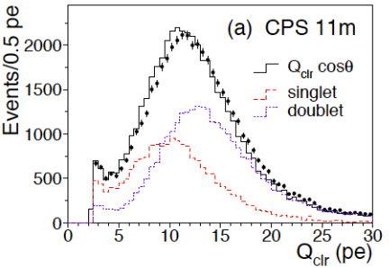
Comparisons btw. D0 and MS
 | D0 | Magnet Station
Triangular bar side | 5.8mm - 5.9mm | 5mm
Bar length | CPS:2.4/2 m, FPS:10-30cm | 30cm-70cm
N planes | CPS: 1, FPS: 2(uv stereo) | 3 xuv
Light guide | 11m - 13m | <6m
photodetection | VLPC (at 9K 80% QE) | SiPM (room T 40% QE)
μ~ 11 pe
= ~ 9 pe

Slide 34
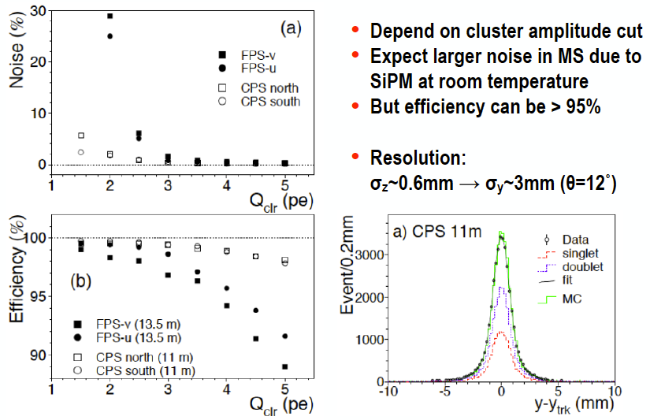
Efficiency, Noise, Resolution from D0
Resolution confirmed with GEANT using 2-bit ADC, like in PACIFIC.

Slide 35
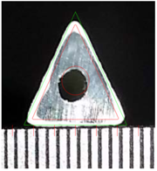
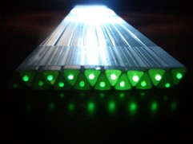
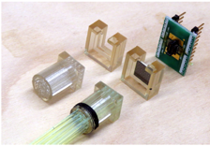
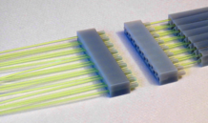
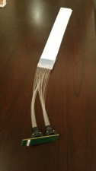
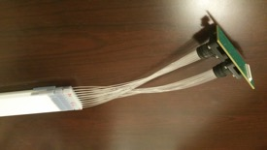
R&D for triangular bars
500 m of triangular bars produced by Fermilab extruded scintillator factory
smallest extruded bar ever produced in that facility, had to develop new tooling for 5mm triangular bars
Wavelength shifter -> clear fiber -> SiPM couplers developed by Hubert van Hecke
First and second version of SiPM array board developed at LANL
Using Hamamatzu 4x4 SiPM arrays (2x2 mm² each channel, but will change to 1.3x1.3 mm²)
Second version with 16 SiPM arrays (256 channels) now available

Slide 36
Tests w/ PACIFIC in Heidelberg
Dark count
Synchronous light
Gerd Kunde visit Heidelberg with sets of our bars for testing with the PACIFIC readout chip used in LHCb scintillator fiber tracker upgrade (SciFi)
All channels worked. Dark count signal shaping and gain same as SciFi
Signal from Sr⁹⁰ close to saturation, but using very short clear fibers
Observed cosmics, but needs a long run and longer bars (ready to take data at LANL)

Slide 37
Magnet Dosimetry
Extruded scintillators + WS have 5% yield reduction after 10 kGy (gamma)
clear fibers may run through top and bottom of the magnet, ~ half of radiation from center

Slide 38
What’s is needed to conclude this ECR
List submitted to LDRD office
Conclude the analysis of p+Pb collisions at 8.2 TeV taken in 2016 to obtain yields and angular distributions of selected direct photon+hadron correlated pairs as a function of Byorken-x and momentum transfered Q² variables.
finish a 1m vs. 20cm area MS prototype, which is designed to have four tracking planes. Each plane is made of triangular extruded scintillating bars with wavelength shifter fiber embed inside each bar. The WS fibers are connected to 6m clear fibers guiding the scintillating light to silicon photomultipliers (siPMs). This prototype will also contain the readout electronics and control boards to send the data to a laptop computer. This prototype will have 512 channels and will take cosmic data for several weeks.

Slide 39
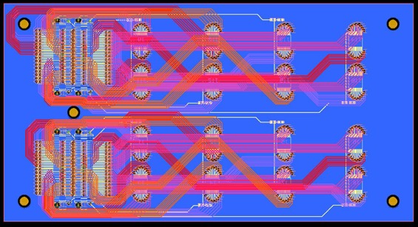
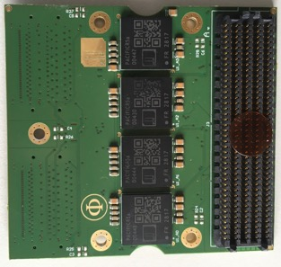
SiPM Board
16 SiPMs per board, will work with production version and current test board (4 SiPM) because of fixed interface.
Gerd. Kunde.

Slide 40
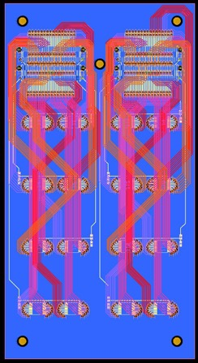
LHCb-SiPM Board
120 mm
10 layer board, layout by ISR
In production, delivery 9/14
64 mm

Slide 41
Readout System
USB to LAPTOP
custom designed test DAQ (PACIFICROB)
FMC connector intermedia board
DC power supply (with output 5V/3A at least)
charge injection board
arbitrary waveform generator
linux PC
PACIFIC5 board available at Heidelberg
Negotiating a production of the PACIFICROB for LANL

Slide 42
SiPM Board Support
Designed by Hubert van Hecke. 3D printed at LANL.

Slide 43
DOE/OS Gets Involved
April: Early Career proposal on gluon saturation submitted
May: LHCb HI program included in the LANL NP strategic plan
Early June: Jim Sowinsky (DOE program manager for Heavy ion physics) asks for new physics we can perform with additional $100K in our baseline budget. We suggested a small-x physics program including gluon saturation search with LHCb. Proposal accepted in record time
Late June: We get the DOE/OS Early Career Award: $2.5M for five years
July: LHCb management reiterate the wish for LANL to lead the LHCb HI program and Magnet Station Construction to be installed in 2025

Slide 44
Invited Talks
Forward Physics And Instrumentation From Colliders To Cosmic Rays
17-19 October 2018
CFNS Stony Brook
Title | The heavy ion and fixed target programs in LHCb
Abstract | The LHCb experiment has coverage of 1.6< η <4.9 including vertex detector, K/pi/p particle identification, tracking, electromagnetic/hadronic calorimetry and muon identification for particles. The ion and fixed target program in LHCb has provided several results on heavy flavor, quarkonia, particle collectivity and ratios, ultra-peripheral collisions and others. LHCb can cover Byorken-x as small as 10^-5, where gluon saturation is expected to exist for Q^2<20 (GeV/c)^2. This presentation will summarize the LHCb program and its implications in understanding forward physics in nucleus.
Heavy Ion Tea in LBNL. Oct 09
Forward physics with the LHCb experiment.
Abstract
The LHCb experiment has coverage of 1.6<eta<4.9 including vertex detector, K/pi/p particle identification, tracking, electromagnetic/hadronic calorimetry and muon identification for particles. The ion and fixed target program in LHCb has provided several results on heavy flavor, quarkonia, particle collectivity and ratios, ultra-peripheral collisions and others. LHCb can cover Byorken-x as small as 10^-5, where gluon saturation is expected to exist for Q^2<20 (GeV/c)^2. This presentation will summarize the LHCb program and its potential implications for small-x physics and the future eIC program.
Also presented in
DNP/APS in Pitsburg 2017
poster in Quark Matter 2018 in Venice.

Slide 45
Paper Publication
42 publications with LANL as associated Institution.
Services to the collaboration:
analysis and paper reviews
Signed Shift Leader
R&D for the Magnet Station, also considered an important service to the collaboration

Slide 46
Conclusions
Gluon saturation search is one of the most appealing topics in QCD which still demands an unambiguous observation. LHCb is the experiment with the highest potential for discovery today and in the foreseen future
Direct photon from gluons are hard to obtain because of the neutral decay background. The analysis technique developed in this ECR was recognized as sound and high impact potential by the DOE referees
Observed direct photons in the potential gluon saturated region, work ongoing to quantify the yield and its possible modification with collision centrality
Future progress in this research depends on detector upgrade. This LDRD identified the technology needed with extruded triangular scintillators, used in Tevatron/DO but now with moderns SiPM, bar coating and readout system. Prototype still under construction
Potential for many applications of this scintillating system at LANL
This R&D was awarded by DOE and provided another source of stable funding for P-division
We should pursue the leadership of the LHCb heavy ion program as one of the best opportunities to expand LANL’s rule in DOE/OS

Slide 47
THANKS FOR THE ECR INDICATION AND
THE LDRD OFFICE FOR ALL SUPPORT !!!

Slide 48
BACKUP SLIDES

Slide 49
The LANL/ECR has two goals:
1) publish a first physics result on hints for gluon saturation using LHCb data taken in 2016.
2) produce a small scale prototype for a scintillator-based tracker (called Magnet Station tracker - MS)
The DOE/ECR has many goals:
1) continue the analysis of the data taken in 2016 using more channels and elaborated techniques
2) introduce regular nuclear effects in particle generator simulations
3) develop a high-level trigger for isolated photons used to probe gluons
3) produce two final-version MS panels and install them inside the LHCb magnet
4) take and analyze high-statistics data in 2022
According to DOE/NP program manager, Jim Sowinsky, DOE funding will start to be sent in August or September. That means, the two funding streams will overlap between August(or September) and December this year. The activities during this period will have the following boundaries:
For LANL/ECR:
1) Conclude the analysis of p+Pb collisions at 8.2 TeV taken in 2016 to obtain yields and angular distributions of selected direct photon+hadron correlated pairs as a function of Byorken-x and momentum transfered Q^2 variables.
2) finish a 1m vs. 20cm area MS prototype, which is designed to have four tracking planes. Each plane is made of triangular extruded scintillating bars with wavelength shifter fiber embed inside each bar. The WS fibers are connected to 6m clear fibers guiding the scintillating light to silicon photomultipliers (siPMs). This prototype will also contain the readout electronics and control boards to send the data to a laptop computer. This prototype will have 512 channels and will take cosmic data for several weeks.
For DOE/ECR:
1) Analyze direct photon+hadron correlated pairs in p+p collisions at 13 TeV obtained in 2016. The measured yields will serve as a reference for the result (1) obtained with the LANL/ECR activity.
2) Produce a first version of a detector simulation for the final 3m x 2m MS detector.
3) prepare the mechanical design of rails and support structure for the future MS to be installed inside the dipole magnet of LHCb.

Slide 50
Small-x program accepted by DOE
The additional 100K, added with our current budget, would allow the development of a long range small-x physics program, regardless if the ECR is granted. This small-x program would include
1 - constraints to nuclear PDFs, especially at small-x and low Q^2 where uncertainties are the largest
2 - systematic experimental study of initial state effect models such as
2a - shadowing
2b - partonic energy loss in nucleus, as a continuation of the study we are performing in E906 but towards lower Byorken-x regions
2c - understanding of the Cronin effect
3 - gluon saturation/condensation
4 - constraints to initial parameters in hydrodynamic models used to describe QGP
The small-x physics can be explored in a combination of
i - current PHENIX data
ii - current E906 data
iii - LHCb data
iv - any possible sPHENIX forward upgrade
v - future EIC.
In this scenario, a small participation in LHCb would be possible. The LANL group would make few analysis towards the item mentioned above, but would not be co-leading the LHCb heavy ion group.
In the scenario where the ECR is granted, the efforts in LHCb would be enhanced, allowing the LANL group to actually co-lead the LHCb heavy ion group. Even though results from the ECR on LHCb can bring a contribution to the EIC physics, the ECR does not cover a long range program/activities towards eIC.

Slide 51
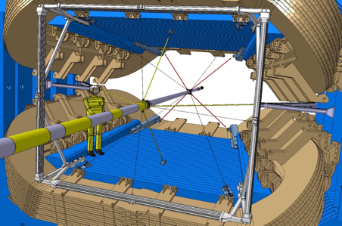
Mechanical Structure
Planning for installation of rails during LS II, when beam pipe and spiderweb will not be present
Discussion with LHCb and LANL engineering teams for implementation using LANL manpower under LHCb engineering team supervision
Still depends on approval
  LHCb upgrade team official approval of safety, design, technical details, schedule
Must have minimal interference with schedule LSII activities

Slide 52
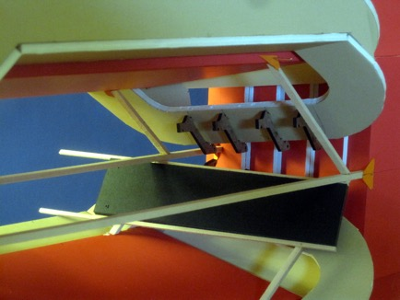
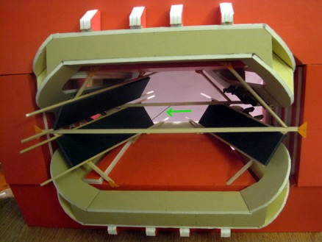
Installation
Installation planning using a realistic 1:21 replica of the magnet in card board (vertical bars are only for the model)
panels installed on rails, rails can fold during installation
So far just just one conflict: one cable from spiderweb (green arrow on right)
Connectors may allow ~1mm freedom for magnet moves when changing polarities

Slide 53
COST for bars
Mechanical Structure: rails and support | ~50 KCHF
Fibers / bars+WS | ~120 KCHF
Clear fibers | ~180 KCHF
SiPM | ~300 KCHF
Electronics(PACIFIC, GBTx, TELL40, etc…) 10CHF/channel | ~400 KCHF
Infrastructure, cooling | 200 KCHF
TOTAL | ~ 1.3 MCHF

Slide 54
SCHEDULE and Effort
LANL is submitting a proposal to DOE in two weeks
  Magnet Station R&D
  Mechanical structure installation during LSII
  2/24 panels and corresponding electronics installed in 2022
Mechanical structure and two panels will allow
  Background studies
  Occupancies
  Aging
  Tracking
  Perhaps, first physics results
Design open for new ideas, as long it fits the rails 😁

Slide 55
May need ~300 optical fibers for data transmission

